Slide 1
Air Force ROTC
Detachment 250
Iowa State University

Slide 2
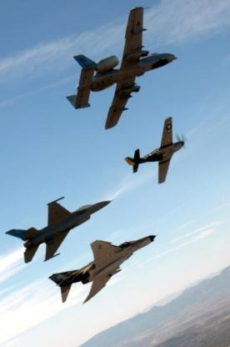
Air Force ROTC Overview
What is Air Force ROTC?
Program Description
Physical Requirements
Commitment to the Air Force
Scholarship Opportunities
Benefits & Compensation
Opportunities
Summary: Key Take-Aways

Slide 3
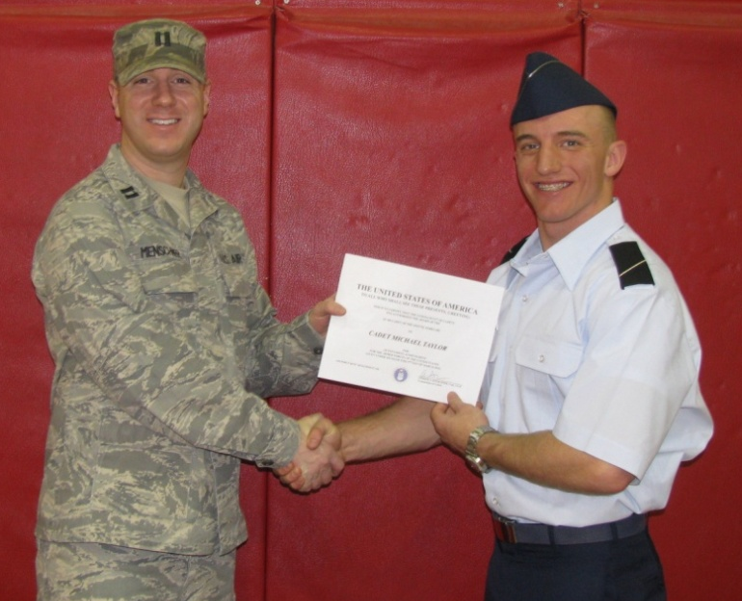
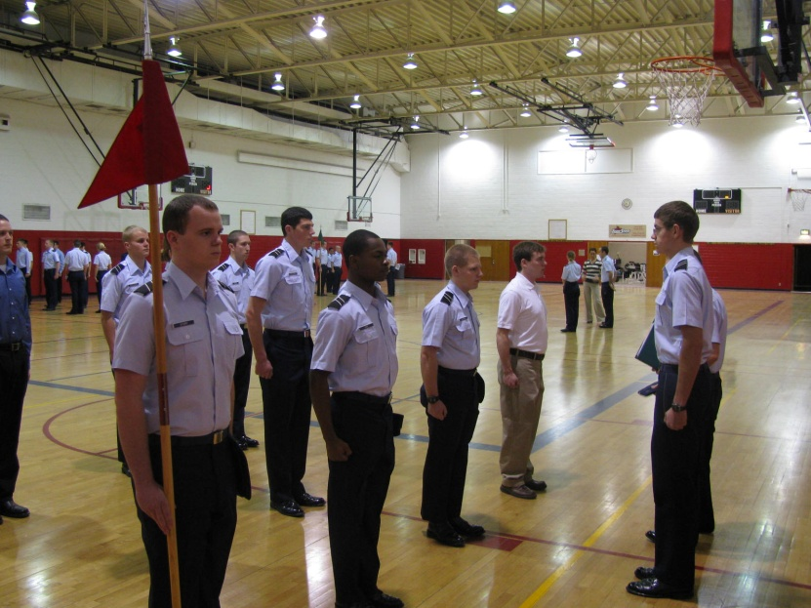
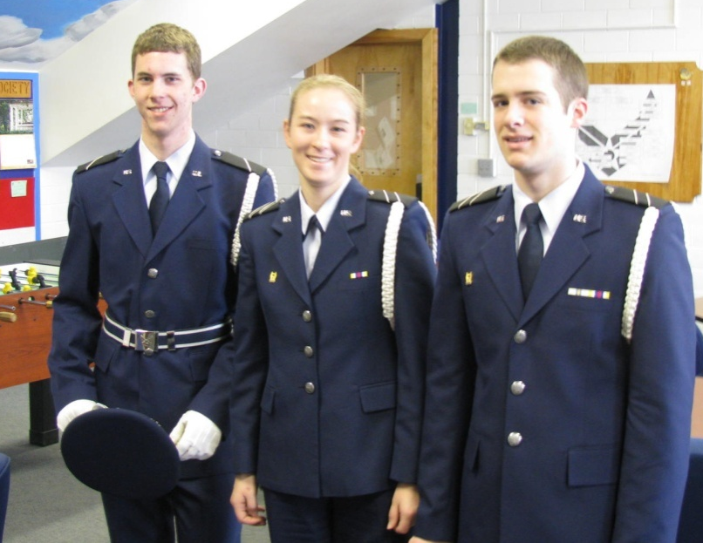
What is Air Force ROTC?
College program offered at over 1000 institutions across the U.S.
  Educate and commission AF Officers
  Provide fully qualified leaders for the AF
Notes:
Engineering and possibly technical degrees will allow ROTC credit to be applied as humanities credit.
To Earn a minor in military studies you must earn 15 credits in any ROTC program.
A 4 year AFROTC program earns you 16 SHs
CAP = $15 per year earns 8 sorties (Ames/Ankeny)
AAS = Community Service Organization within AFROTC
Shadow Program = 12 Days
Base Visits – During year

Slide 4
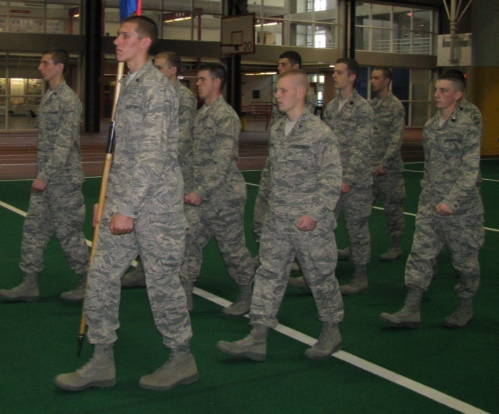
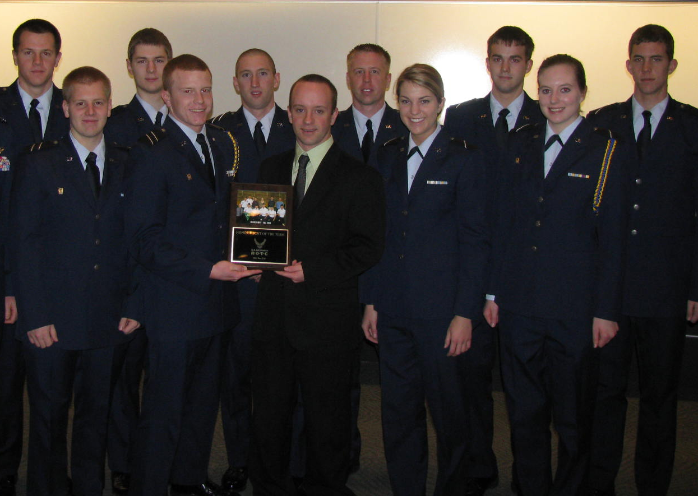
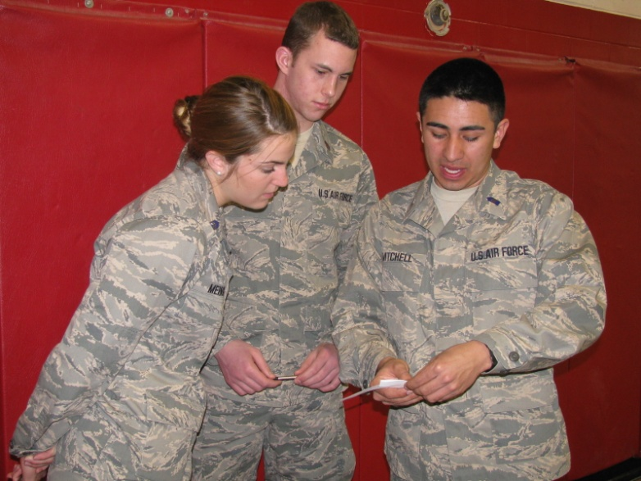
What can Air Force ROTC mean to you?
Chance to earn scholarships
Real leadership training and growth
Guaranteed job after college

Slide 5
4-Year Program Overview
Freshmen/Sophomores (General Military Course or GMC)
  Attend class once/wk, Lead Lab, PT twice/wk
Attend Field Training during summer
  4 weeks in Montgomery, Alabama
    PT, Drill, Leadership, Firearms, Combat Ops
Juniors/Seniors (Professional Officer Course or POC)
  Attend class twice/wk, Lead Lab, PT twice/wk
  Leadership position; run PT & Lead Lab
  Receive AF job Junior year
And finally…
5 – 7 Hrs per week
8 – 12 Hrs per week

Slide 6
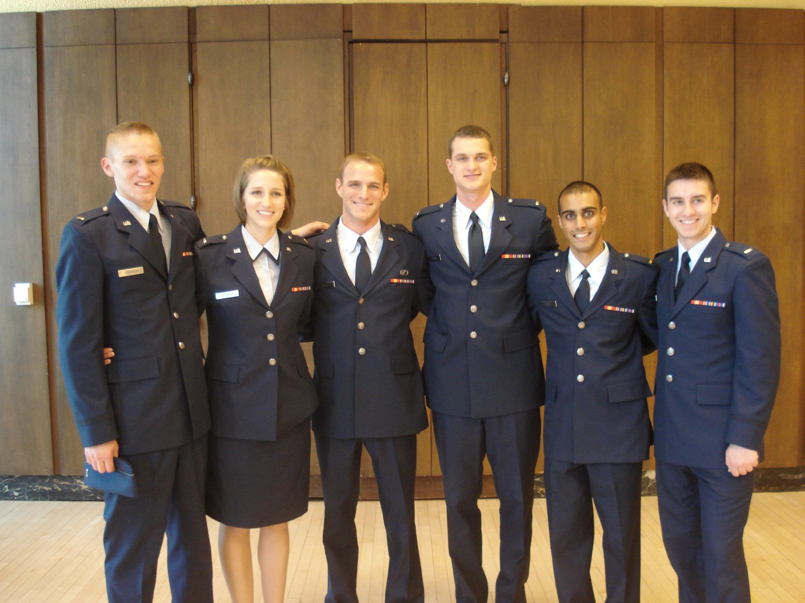

4-Year Program Overview
Graduate and commission as an AF 2nd Lieutenant

Slide 7
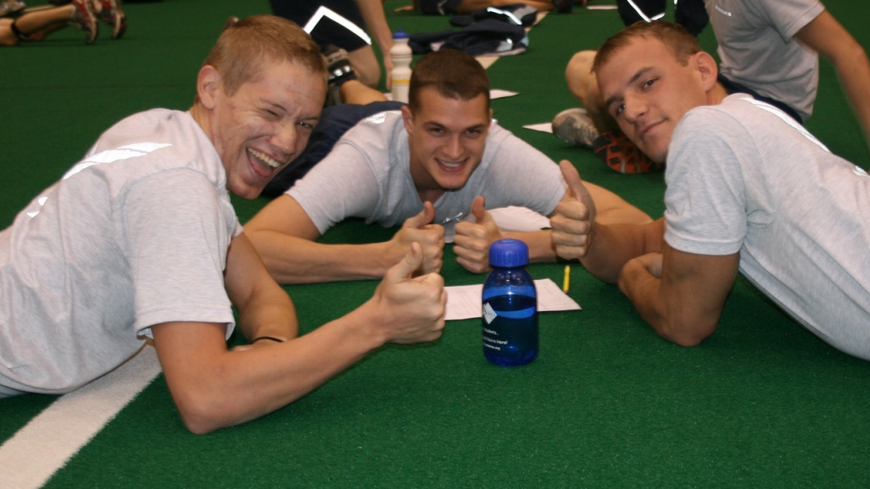
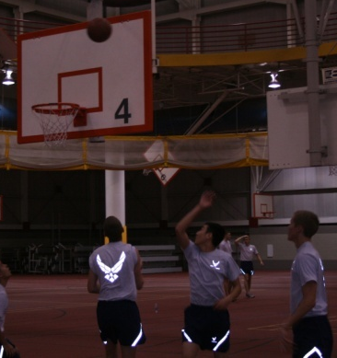
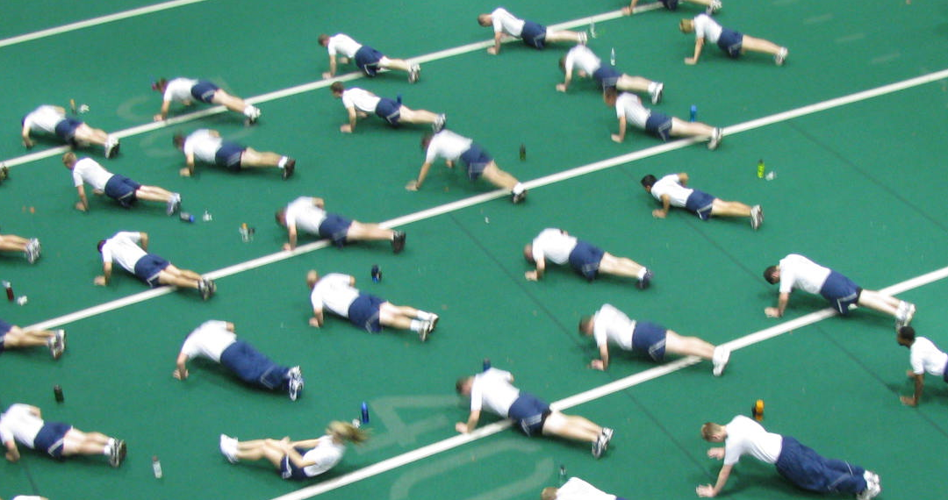
Physical Requirements
Attend Physical Training
  Offered 4 times/wk
    Required 2 times/wk
Physical Fitness Test (once per semester)
  Four Events:
    Max Pushups in 1 minute
    Max Situps in 1 minutes
    Waist measurement/Body Composition
    1.5 Mile Run
Notes:
Up to Age 24:
Max Score / Minimum
Push-ups – Male: 67 (33), Female: 47 (18)
Sit-Ups – Male: 58 (42), Female: 54 (38)
1.5 Mile Run – Male: 9:36 (13:36), Female: 10:24 (16:22)

Slide 8
Commitment to the Air Force
Air Force Commitment Incurred Upon:
  Acceptance of ROTC Scholarship
    Freshmen Option
  Entry Into the POC (Junior Year)
Length of Commitment After Commission
  4 to 12 Yrs Active Duty
    Pilots: 10 Yrs Active Duty After Flight School
    CSOs: 6 Yrs Active Duty After Flight School
    All Other Career Fields: 4 Yrs Active Duty

Slide 9
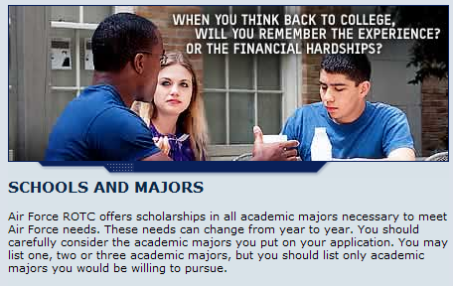
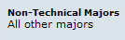
Technical & Critical Foreign Language Majors*
Foreign Language
Majors:
CHINESE (MANDARIN)
DUTCH
FRENCH
GERMAN
JAPANESE
ITALIAN
SPANISH AMERICAN
POLISH
PORT BRAZ (BRAZILIAN)
SPANISH
RUSSIAN
SPANISH/CAS (CASTILLIAN)
TAGALOG
TURKISH
KOREAN
PERSIAN FARSI
VIETNAMESE
SOUTHEAST ASIAN LANGUAGES
SLAVIC LANGUAGES
OTHER FOREIGN LANGUAGE
Technical
Majors:
COMPUTER SCIENCE
OPERATIONS RESEARCH
ARCHITECTURE
BIO,BIOCHEMISTRY
AERONAUTICAL ENGINEERING
AEROSPACE ENGINEERING
ARCHITECTURAL ENGINEERING
ASTRONAUTICAL ENGINEERING
ENVIRONMENTAL ENGINEERING
CIVIL ENGINEERING
ELECTRICAL ENGINEERING
MECHANICAL ENGINEERING
COMPUTER ENGINEERING
MATHEMATICS
CHEMISTRY
METEOROLOGY/ATMOSPHERIC SCIENCES
PHYSICS
Current listing Nov 2010; subject to change

Slide 10
In College Scholarship Process
2 & 3 Year Scholarships: Highly Competitive
  Air Force Pays $9K to $18K per year
    $900 Allowance for Books/Fees
    Stipend - $300 to $500 per month
  Selection Criteria:
    GPA: 2.5 or Greater
    Physical Fitness Test Scores
    Medical Certification Required
    Must Graduate Under Age 35
No application! Qualified GMC cadets are considered automatically!
Notes:
Types
2 = 2 or 3 year scholarship that pays $15K (students can make up diff)
$510 Annual Textbook allowance
$300-$400 Monthly Stipend
3 = 2 or 3 year scholarship that pays up to $9K (students can make up
diff)
$510 Annual Textbook allowance
$300-$400 Monthly Stipend
6 = 2 year scholarship that pays up to $3K (students can make up diff)
$510 Annual Textbook allowance
$300-$400 Monthly Stipend

Slide 11

OFFICER PAY SCALE
Fiscal Year 2011
Day 1….
2nd Lieutenant
Offutt Air Force Base
(Omaha, NE)
Base Pay | $2,784.00
Subsistence Allowance* | $223.84
Housing Allowance* | $870.00
Monthly Total | $3,877.84
Yearly Total | $46,534.08
4 Years Later….
Captain
Offutt Air Force Base
(Omaha, NE)
Base Pay | $4,951.80
Subsistence Allowance* | $223.84
Housing Allowance* | $1,215.00
Monthly Total | $6,390.64
Yearly Total | $76,687.68
100% Free Medical and Dental coverage
100% Tuition Assistance for advanced degrees
Tax Advantages – Allowances* are not taxable income!
Flight Pay
Special Duty/Language Pay
PLUS!
Notes:
31
1Lt pay increase = $1,069 (unmarried)

Slide 12
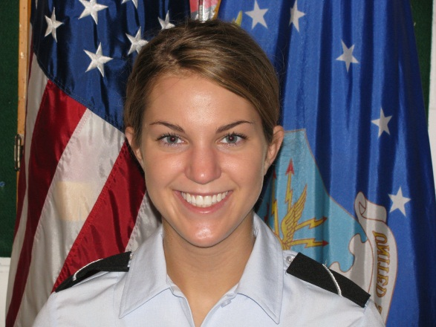
The Payoff: USAF Officer
30 Days Vacation with Pay Every Year
Fly Space-Available On Military Aircraft
Travel and See the World
  68 active bases in 35 states + D.C.
  Assignments in Europe and Asia
Retire at 50% of base pay after 20 years
Other Benefits Include:
  Medical/Dental Benefits
  GI Bill
  All Base Privileges (commissary, exchange, etc)

Slide 13
USAF Officer
Job Opportunities
Acquisition Management
Air Battle Management
Aircraft Maintenance
Biomedicine
Combat Systems
Contracting
Communications/Cyber Ops
Engineering
Finance
Intelligence
Law
Logistics
Manpower
Munitions/Missile Maintenance
Pilot
Personnel
Public Affairs
Research & Development
Security Forces
Scientist
Space & Missile Ops
Special Investigations
Unmanned Aerial Vehicle Ops
Weather
AND MORE!

Slide 14
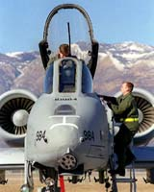
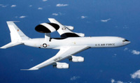
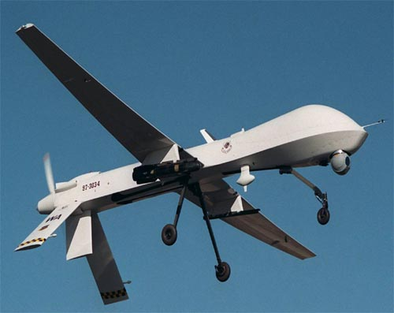
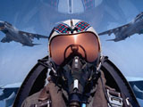
Rated Positions
(flight crew jobs)
2011 Air Force Categorization
FY 11 | Total on Board | Number Selected | Percent Selected | Average GPA | Average PFT
Pilot | 750 | 502 | 66.9% | 3.30 | 96.92
CSO | 191 | 176 | 92.1% | 2.97 | 94.69
ABM | 96 | 67 | 69.8% | 3.13 | 95.59
RPA | 394 | 40 | 10.1% | 3.16 | 95.45

Slide 15
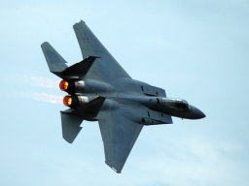
Rated Selection Criteria
Occurs around 1.5 years before commissioning
A composite of:
  AFOQT Scores
  TBAS Flight Simulator Score
  Cumulative GPA
  Field Training Ranking
  Commanders Commissioning Class Ranking
Compete with other cadets nationwide
If not selected, go into other job selection

Slide 16
Program Options
  3-Year Option:
  Complete the GMC in 1 year
  Attend Field Training
  Complete 2 years in POC
  2-Year Option:
  Only for Technical Majors
  Officer Training School:
  Application and Selection Process
  Air Force Recruiter
Notes:
Currently only technical degrees are considered for 2 year program

Slide 17
Miscellaneous
Uniforms issued at no cost; worn once a week
Summer Opportunities
  Intensive Language Programs
  Overseas Immersion
  Lawrence Livermore Labs
  Computer Offense/Defense Camp
  Soaring/Parachuting/Jumping

Slide 18
Summary:
Key “Take-Aways”
Try AFROTC with no initial obligation
Scholarships exist within AFROTC
Scholarship awards are merit based, not need based
No obligation to AFROTC/Commission with scholarship
Complete AFROTC = Commission
Commission = Great start to a rewarding career!

Slide 19
Need More Information?
Contact Me!
kmeinig@iastate.edu
913.731.6293

Slide 20


