Slide 1
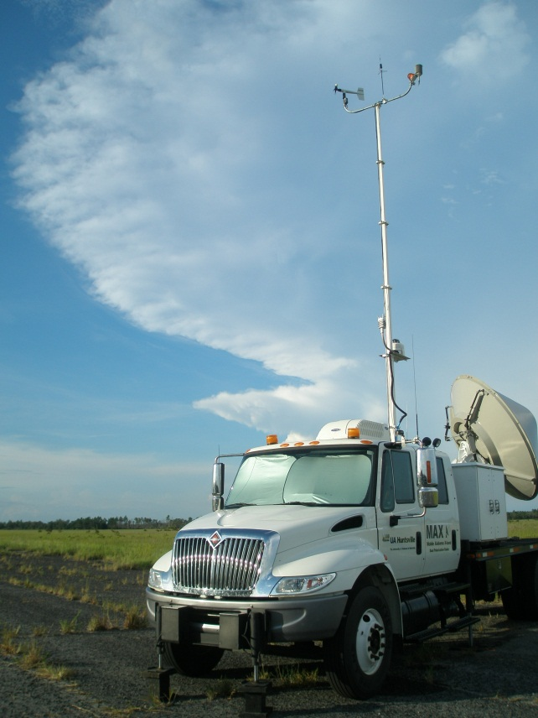
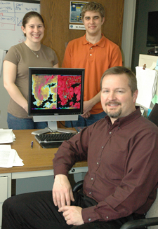
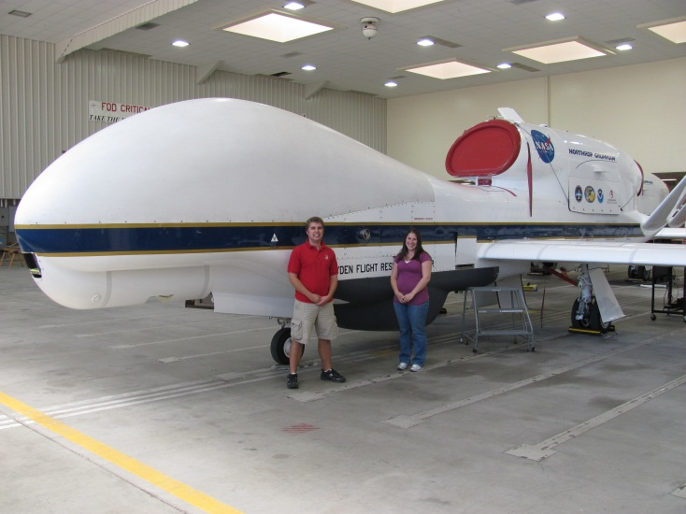
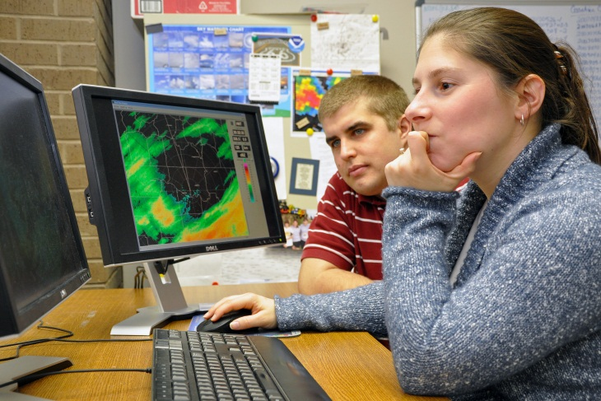
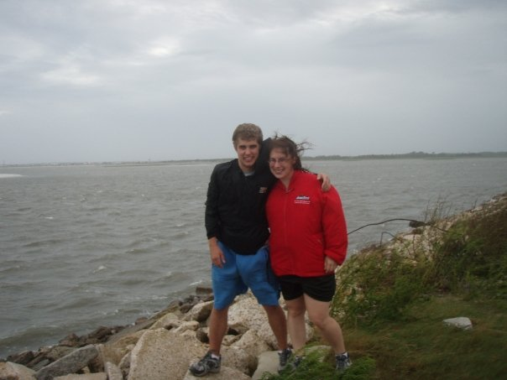
Life is a Journey
Prepare yourself and enjoy the ride!
Notes:
Include a variety of pictures of experiences I have had related to weather.

Slide 2
About Us
Elise (Johnson) Schultz
Chris Schultz
Grew up in Rush City, MN
Weather since age 4
Graduated HS in 2002
B.S. 2006 – Iowa State
M. S. 2009 - Univ. of Alabama in Huntsville (UAH)
PhD. Expected 2012 - UAH
Grew up in Tinley Park, IL
Weather since age 6
Graduated HS in 2002
B.S. 2006 - Univ. of Missouri
M. S. 2008 - Univ. of Alabama in Huntsville (UAH)
PhD. Expected 2012 - UAH

Slide 3
Cast a vision
Develop a deliberate and focused vision
for graduate school and beyond
Career Paths
Ph.D.
Ph.D.
M.S.
M.S.
Career Paths
B.S.
B.S.

Slide 4
Overview
Establishing your vision
Effective Communication
Outside your comfort zone
Persistent
Thinking outside the box
Networking/Involvement

Slide 5
Establishing your vision
What do you want to do?
Where do you want to be?
Complete a SWOT Analysis

Slide 6
SWOT
Knowing your
Strengths
Weakness
Opportunities (available for progress)
Threats (perceived and real to achieve goals) are important in graduate school
(Maintaining a journal helps this process)

Slide 7
Effective Communication
Written, verbal, non-verbal
LISTENING
Facebook, Twitter, LinkedIn
Resume, CV, journal articles
  keywords

Slide 8
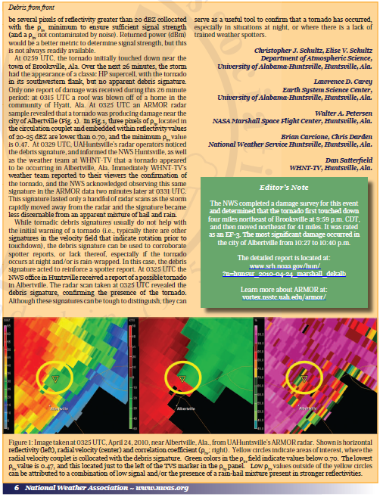
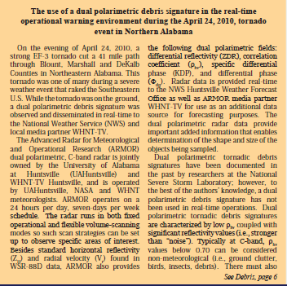
Example

Slide 9
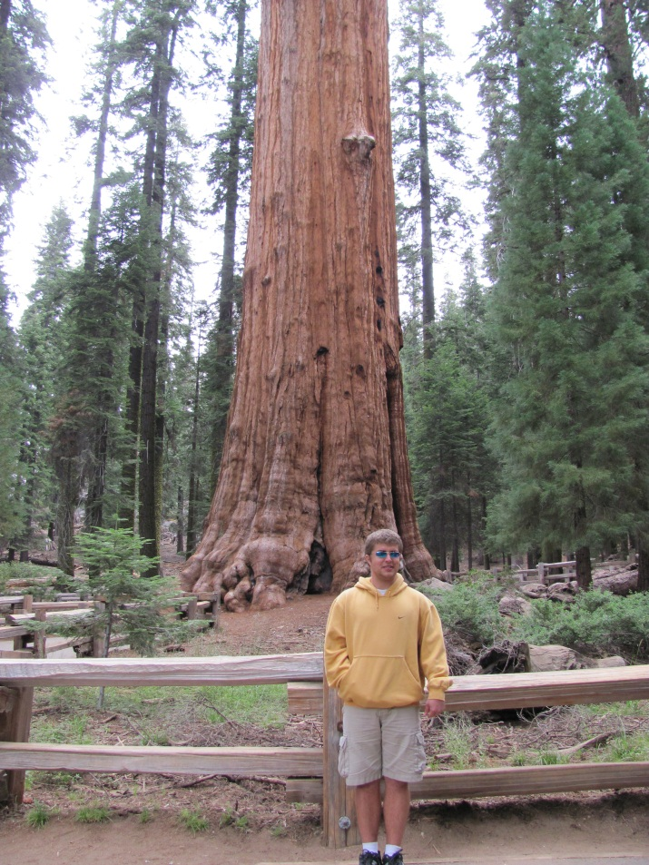
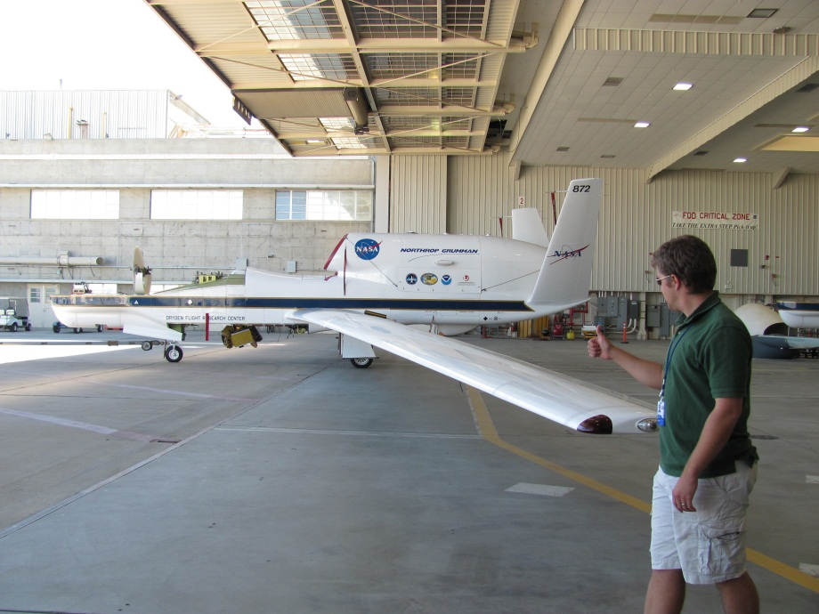
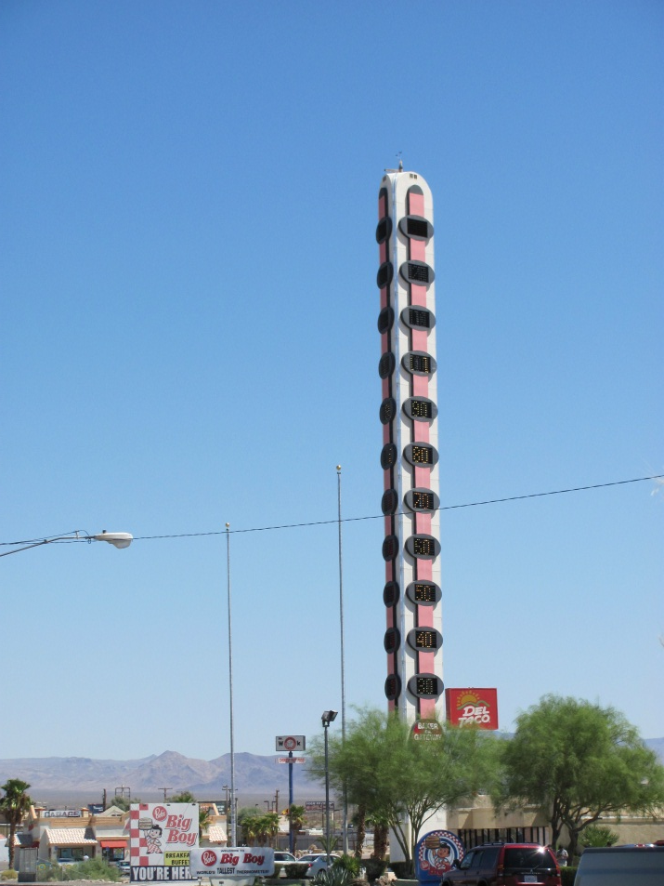
Stepping outside your comfort zone
Don’t be afraid to volunteer or say yes to random projects

Slide 10
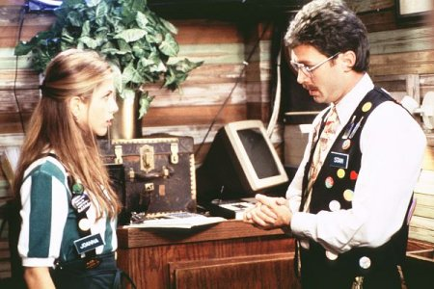
Persistence
Don’t be satisfied with the bare minimum.
Continually pursue ALL options.
Negative results can be positive.
“Office Space” (1999)

Slide 11
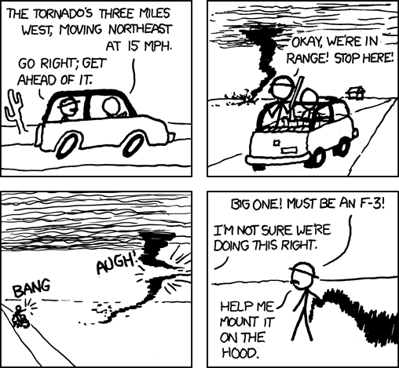
Thinking outside the box
www.xkcd.com

Slide 12
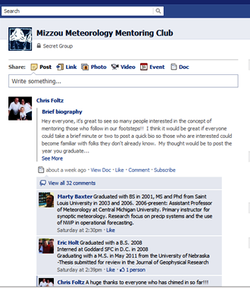
Networking Effectively
Get to conferences whenever you can.
  e.g., Des Moines radar conference.
  AMS student assistantship program.
  NWA annual meeting.
Keep contacts with local professionals/alumni.
  tv/radio mets, NOAA employees, private sector.

Slide 13
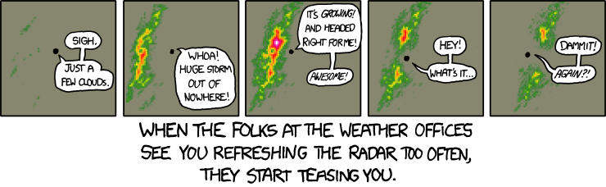
Graduate school – What we’ve learned
www.xkcd.com
It can be frustrating
You need to manage your advisor
Finding a mentor is key
Balance between research and classwork and still have a life!

Slide 14
Graduate School Process
Investigate Schools – Do your research
  Research topic, Advisor, school, funding
Apply to School – By January
  Also email Dept chair
Graduate Research Assistantships (GRAs) start to go out February – March
  Stipends differ
  Check what is included: tuition, fees, health insurance, etc

Slide 15
Other paths – What we’ve observed
NWS/NOAA/NASA
  Contacts are vital
  Possess a unique skill set that separates you from the field
Television/radio
  Teaching science in an understandable manner
  Utilizing social media effectively
Private sector
  Programming skills are very important
  Understand your customers and their needs

Slide 16
Questions?
Elise: johnson@nsstc.uah.edu
Chris: schultz@nsstc.uah.edu

