Slide 1

Image courtesy of NASA/GSFC

Slide 2
Current Efforts in Climate
Forecasting and Modeling
Eugene S. Takle
Director, Climate Science Initiative
Professor of Atmospheric Science
Department of Geological and Atmospheric Sciences
Professor of Agricultural Meteorology
Department of Agronomy
Iowa State University
Ames, Iowa 50011
gstakle@iastate.edu
Greenhouse Gases, Carbon Taxes and Trading, and Carbon Sequestration
CHE 670 – Sustainability Seminar
Kansas State University
Manhattan, KS
6-8 Jan 2010

Slide 3
Outline
Changes in atmospheric carbon dioxide
Causes of climate change
Changes in future climate around the globe
Emission reductions to reach stabilization
Climate change for the US Midwest

Slide 4
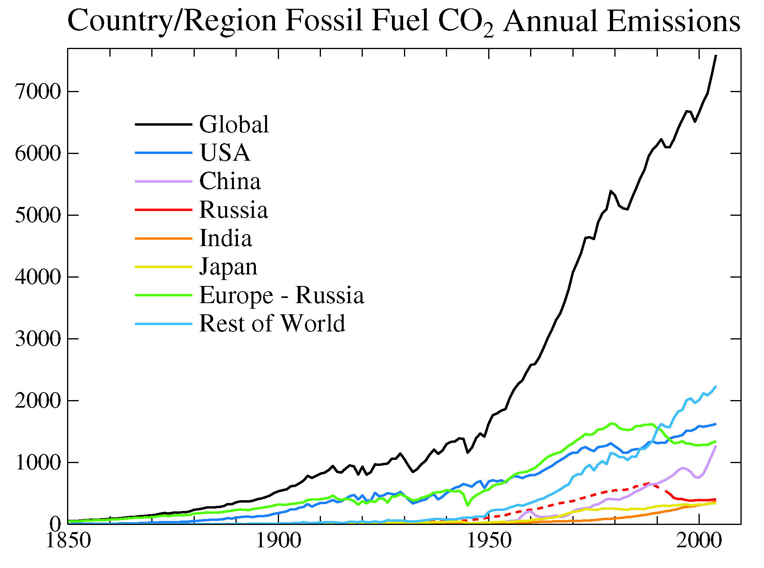
MTons Carbon
IPCC Third Assessment Report

Slide 5
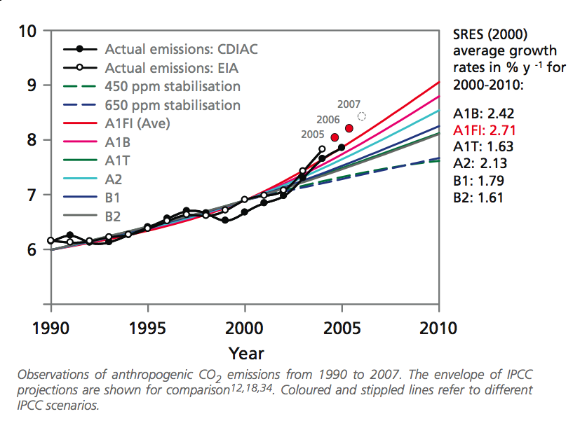

Slide 6
Global Carbon Emissions (Gt)
Actual emissions are exceeding worst case scenarios projected in 1990

Slide 7
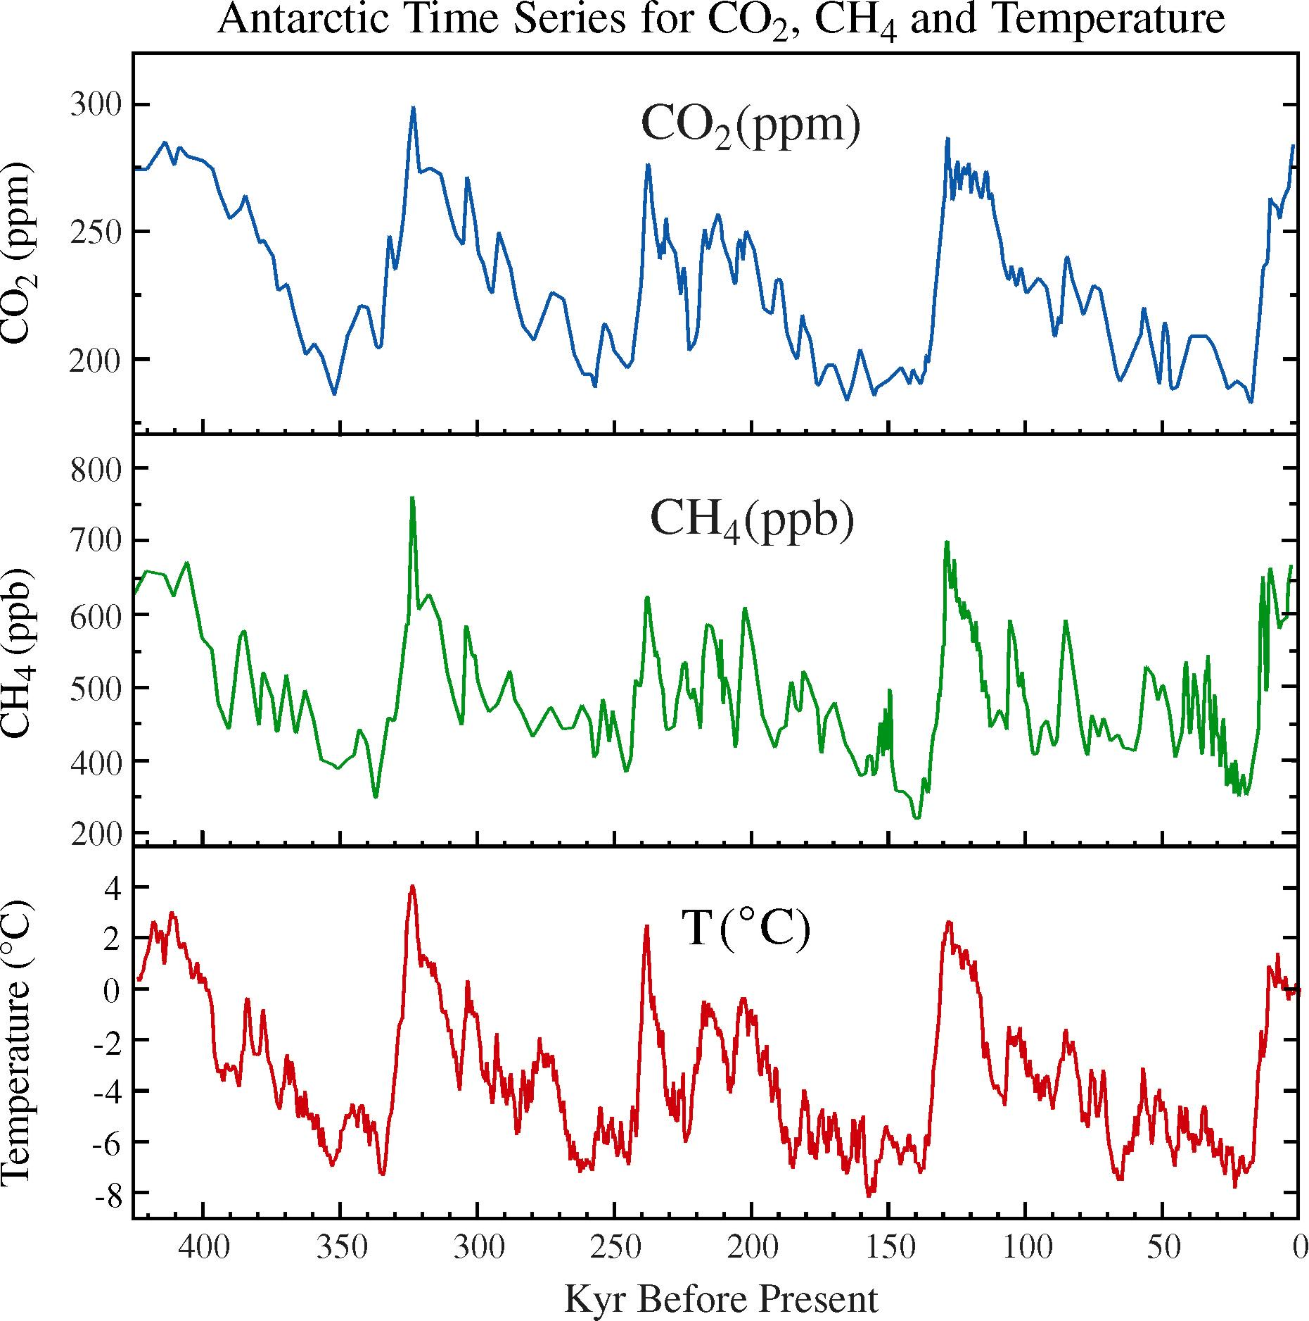
Carbon Dioxide and Temperature

Slide 8
Carbon Dioxide and Temperature
2010
384 ppm

Slide 9
Carbon Dioxide and Temperature
“Business as Usual”
950 ppm (2100)

Slide 10
Carbon Dioxide and Temperature
“Business as Usual”
950 ppm (2100)
?

Slide 11
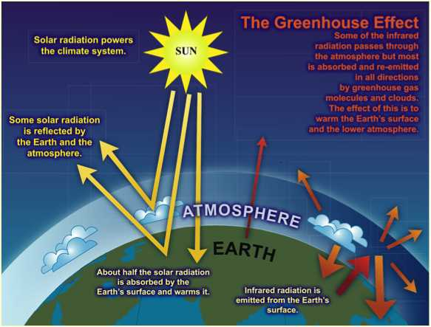
Increased Greenhouse Gases => Global Heating
Increasing greenhouse gases increases heating of the Earth

Slide 12
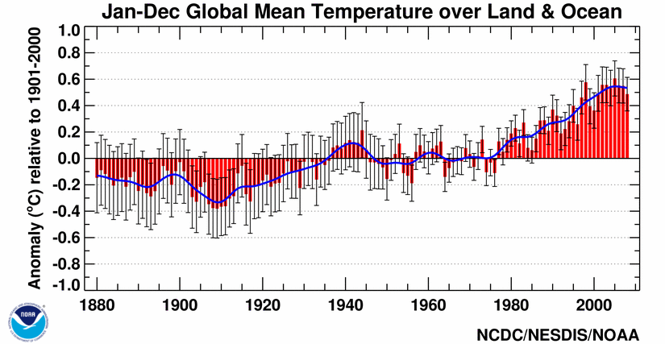
Global Mean Surface Temperature
http://www.ncdc.noaa.gov/img/climate/research/2008/ann/global-jan-dec-error-bar-pg.gif

Slide 13
Global Mean Surface Temperature
I
II
III
IV
http://www.ncdc.noaa.gov/img/climate/research/2008/ann/global-jan-dec-error-bar-pg.gif

Slide 14
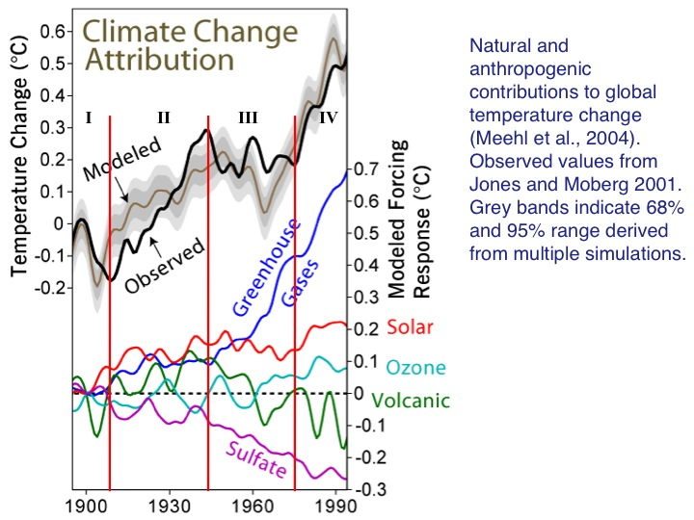

Slide 15
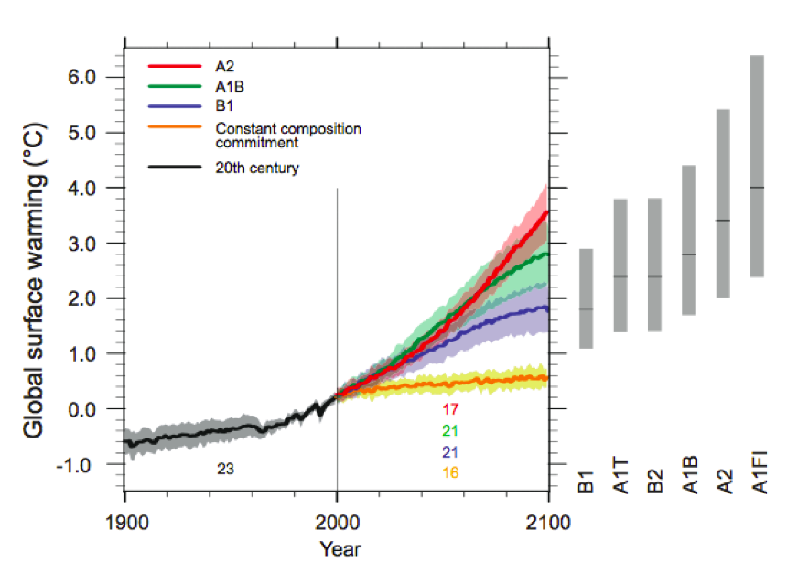
Energy intensive
Balanced fuel sources
More environmentally friendly
If current emission trends continue, global temperature rise will exceed worst case scenarios projected in 2007
FI =fossil intensive
IPCC Fourth Assessment Report Summary for Policy Makers

Slide 16
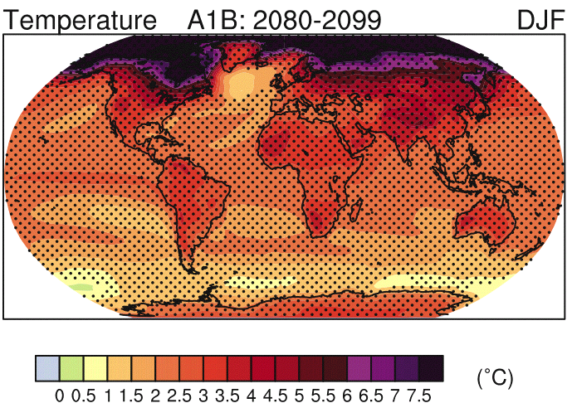

Slide 17
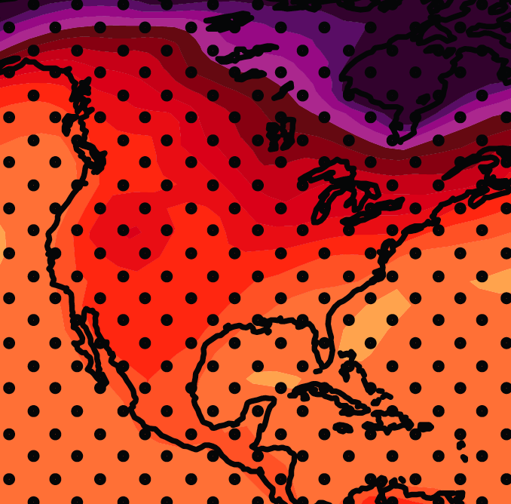
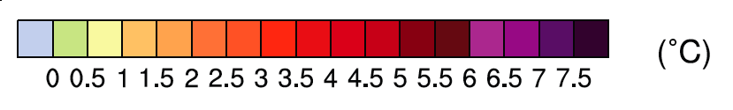
December-January-February Temperature Change
4.0
3.5
A1B Emission Scenario
2080-2099 minus1980-1999

Slide 18
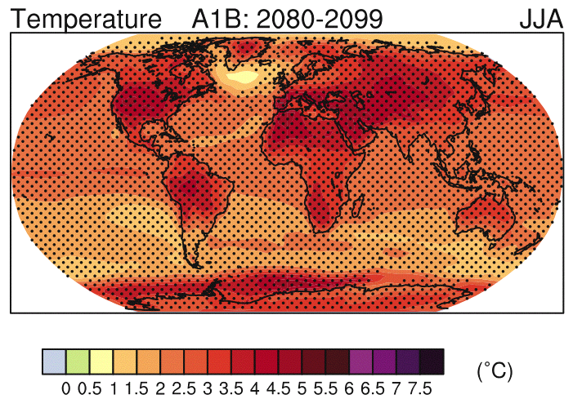

Slide 19
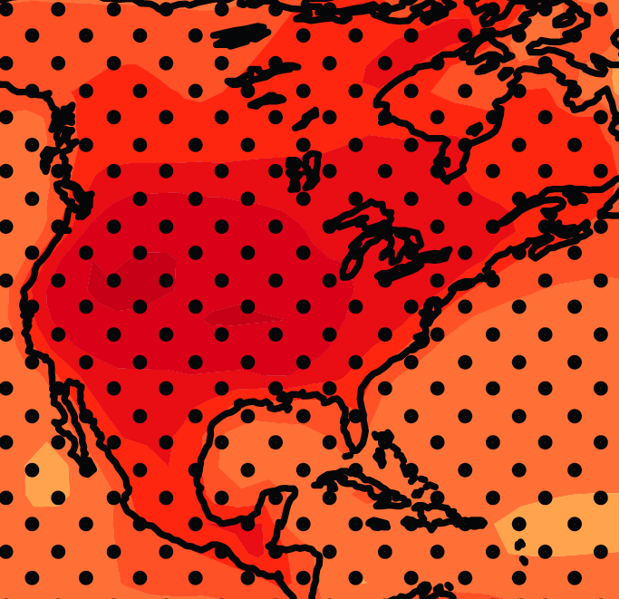
June-July-August Temperature Change
2.5
A1B Emission Scenario
2080-2099 minus1980-1999
3.0

Slide 20
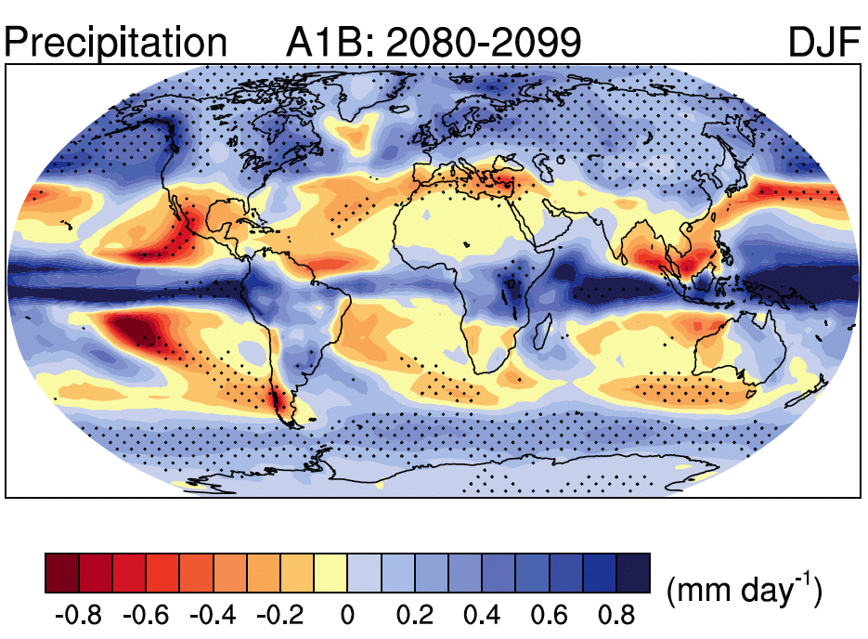
Source: IPCC 4th Assessment Report, 2007

Slide 21
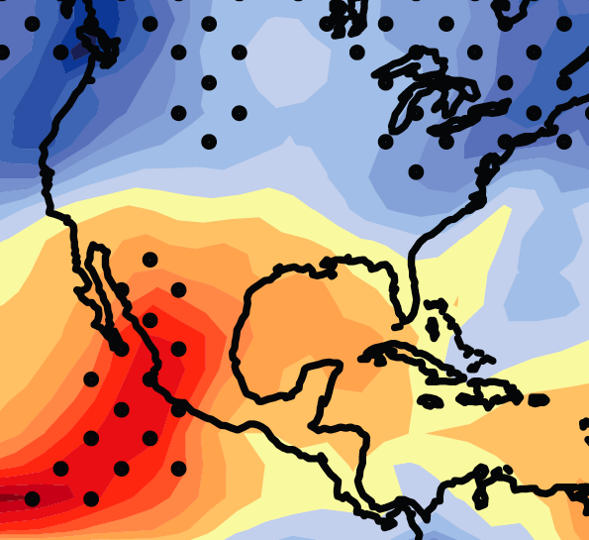

December-January-February Precipitation Change
0.1
0.0
A1B Emission Scenario
2080-2099 minus1980-1999

Slide 22
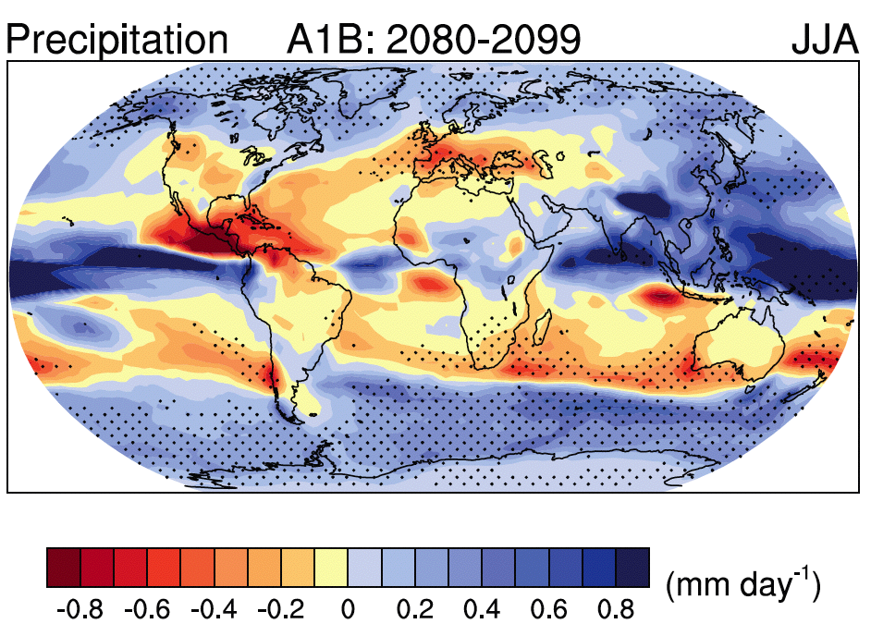
Source: IPCC 4th Assessment Report, 2007

Slide 23
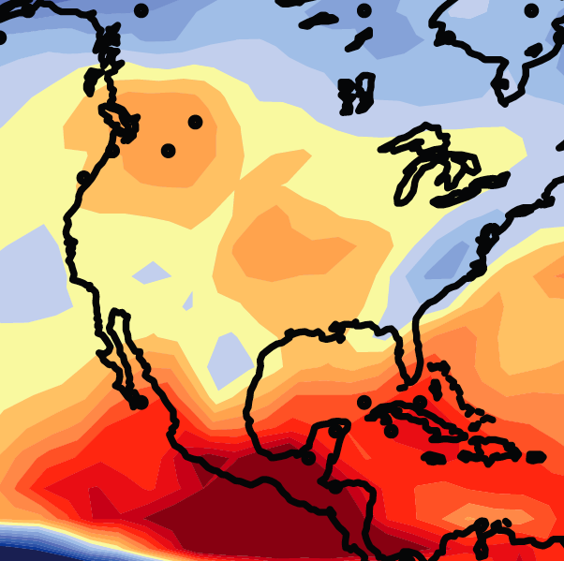
June-July-August Precipitation Change
0.0
-0.1
A1B Emission Scenario
2080-2099 minus1980-1999

Slide 24
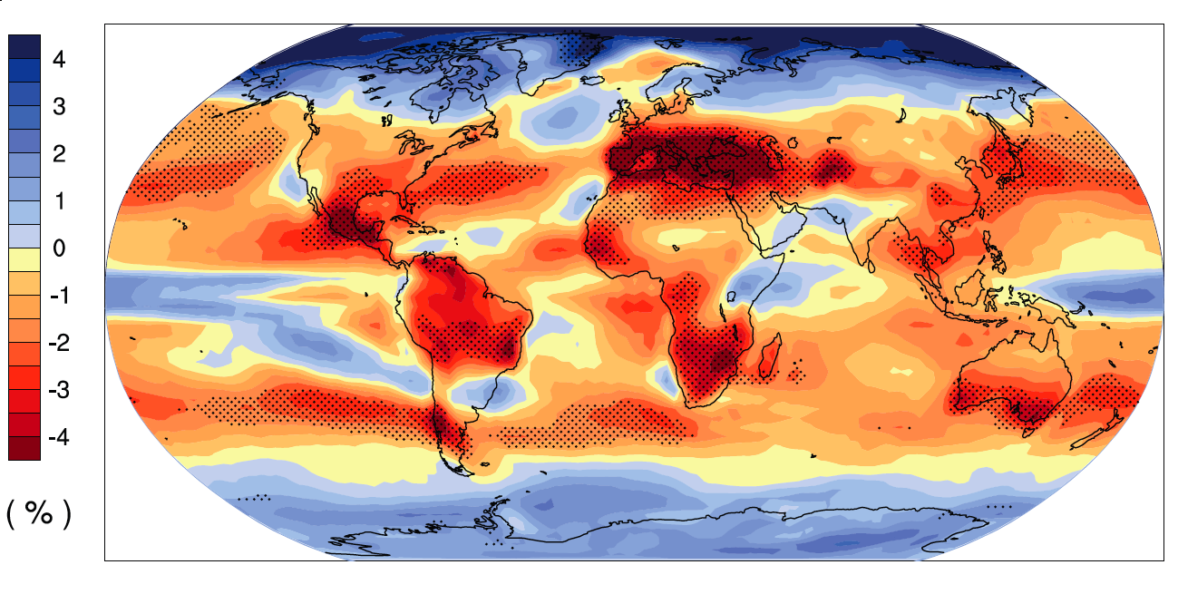
Change in Annual Cloud Cover

Slide 25
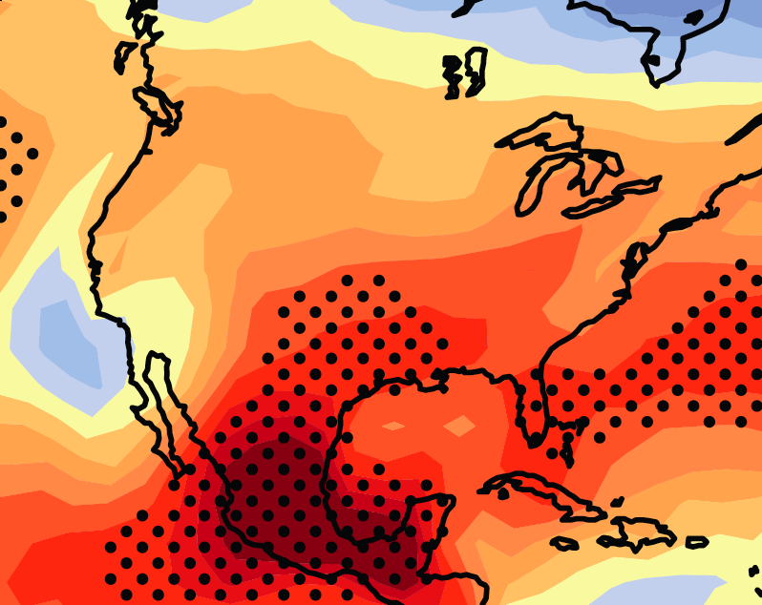

Change in Annual Cloud Cover
A1B Emission Scenario
2080-2099 minus1980-1999
-1.0
-1.5

Slide 26
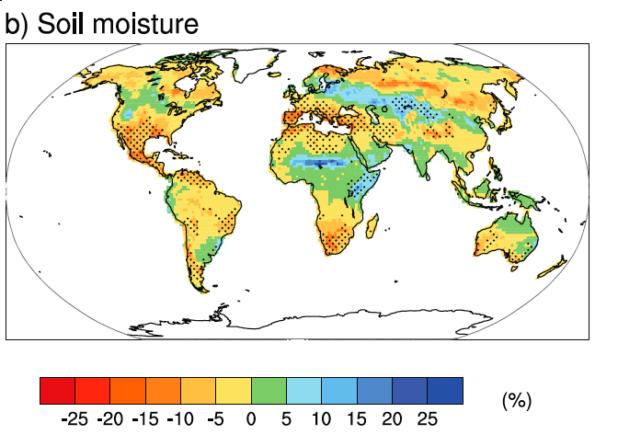
Annual Change in Soil Moisture

Slide 27
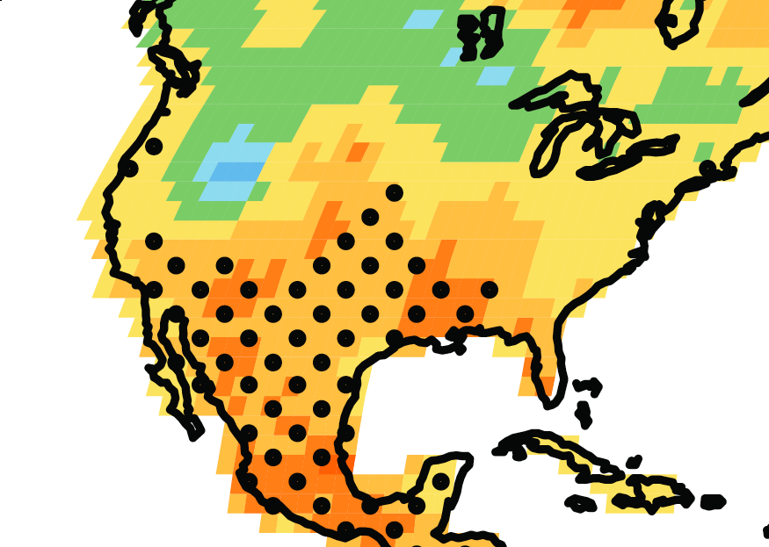
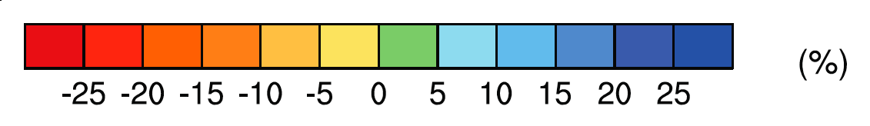
Annual Change in Soil Moisture
A1B Emission Scenario
2080-2099 minus1980-1999
0
-5

Slide 28
Imminent Transition to Arid Climate
Precipitation minus Evaporation for Western US
25N-40N, 95W-125 W
(land areas only)
R. Seager, et al.,2007. Model Projections of an Imminent Transition to a More Arid Climate in Southwestern North America. Science, Vol. 316. no. 5828, pp. 1181 - 1184

Slide 29
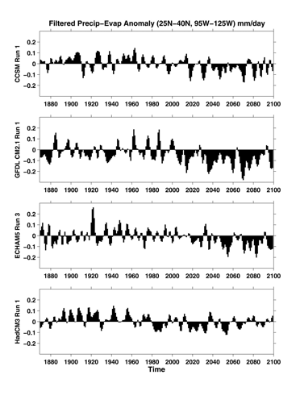
Precipitation minus Evaporation for Western US
(25N-40N, 95W-125 W)
R. Seager, et al.,
2007. Model Projections of an Imminent Transition to a More Arid Climate in Southwestern North America. Science, Vol. 316. no. 5828,
pp. 1181 - 1184

Slide 30
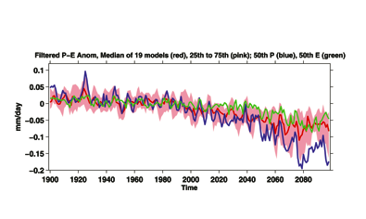
Precipitation minus Evaporation for Western US
(25N-40N, 95W-125 W)
R. Seager, et al.,2007. Model Projections of an Imminent Transition to a More Arid Climate in Southwestern North America. Science, Vol. 316. no. 5828, pp. 1181 - 1184

Slide 31
Precipitation minus Evaporation for Western US
(25N-40N, 95W-125 W)
Colorado River Compact established, 1922
R. Seager, et al.,2007. Model Projections of an Imminent Transition to a More Arid Climate in Southwestern North America. Science, Vol. 316. no. 5828, pp. 1181 - 1184

Slide 32
Cooling Decade in a Century of Warming
Probability of a cooling decade in a century of warming
Probability distribution functions for decadal trends (kelvin/year) in globally averaged surface air temperature
Easterling, D. R., and M. F. Wehner, 2009: Is the climate warming or cooling? Geophys. Res. Lett., 36, L08706, doi:10.1029/2009GL037810, 2009

Slide 33
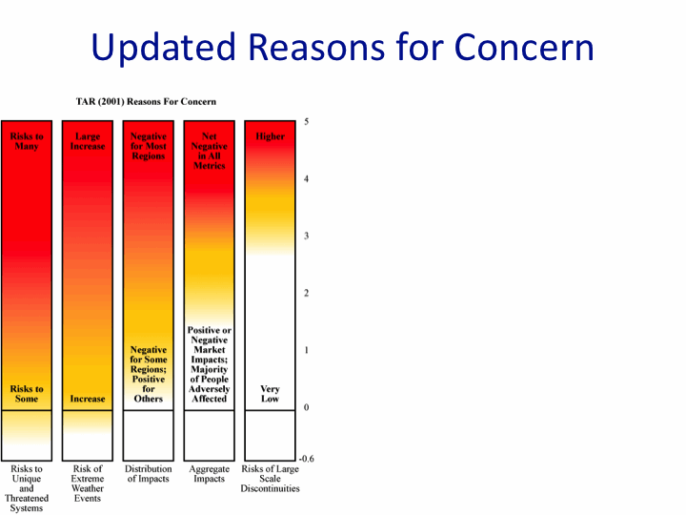
Rise in global mean temperature (ºC)

Slide 34
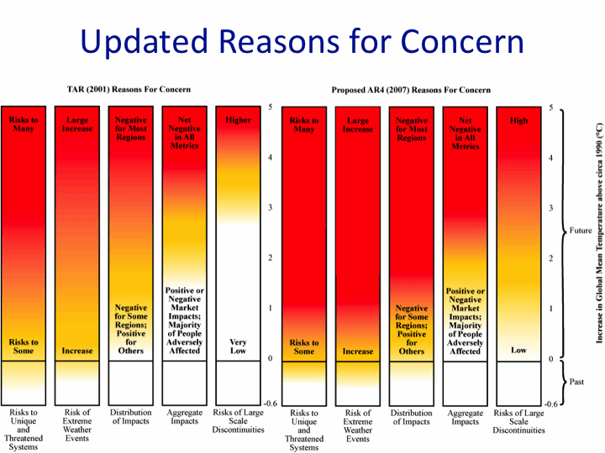
Rise in global mean temperature (ºC)

Slide 35
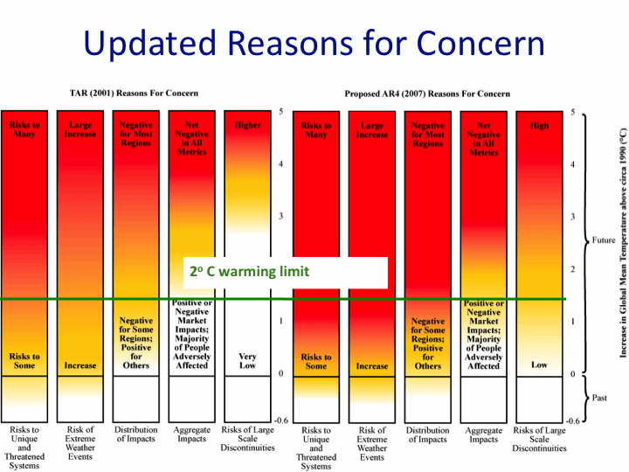
Rise in global mean temperature (ºC)

Slide 36
Energy intensive
Balanced fuel sources
More environmentally friendly
Limit to avoid “dangerous anthropogenic
Interference” with the climate system
2ºC limit
IPCC Fourth Assessment Report Summary for Policy Makers

Slide 37
Energy intensive
Balanced fuel sources
More environmentally friendly
If current emission trends continue, global temperature rise likely will exceed worst case scenarios projected in 2007
2ºC “Guardrail”
2ºC limit to avoid “dangerous anthropogenic
interference” with the climate system
FI =fossil intensive
IPCC Fourth Assessment Report Summary for Policy Makers

Slide 38
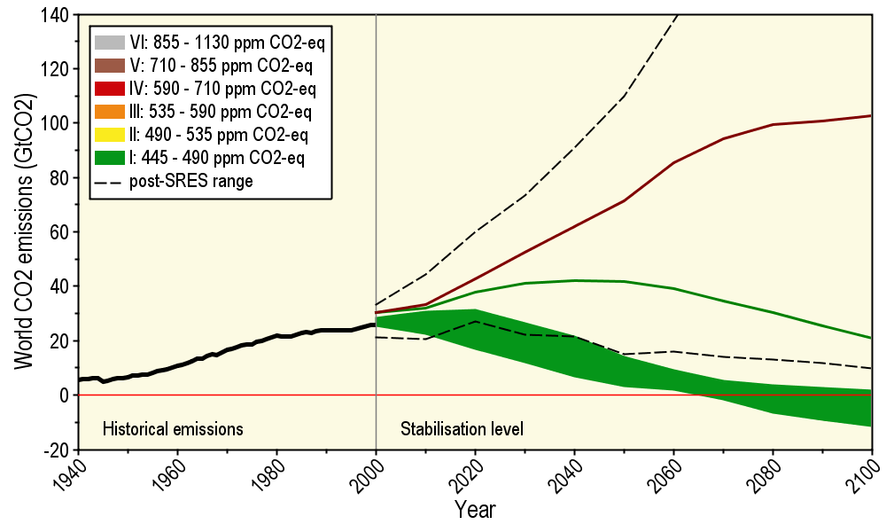
Long-Term Stabilization Profiles
Future trend of
current emissions
A2
Emission scenario needed to
provide 50% probability of not
exceeding the 2ºC guardrail
B1
Nebojša Nakićenović IIASA, Vienna

Slide 39
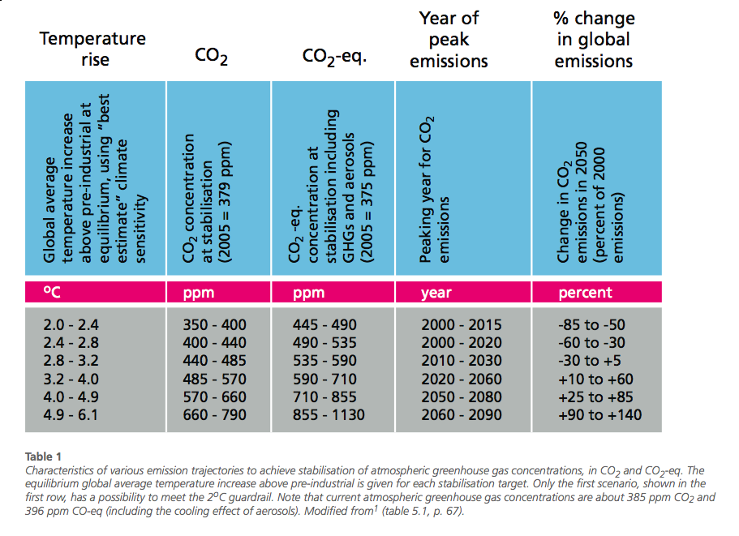
Options for Climate Stabilization

Slide 40
Options for Climate Stabilization

Slide 41
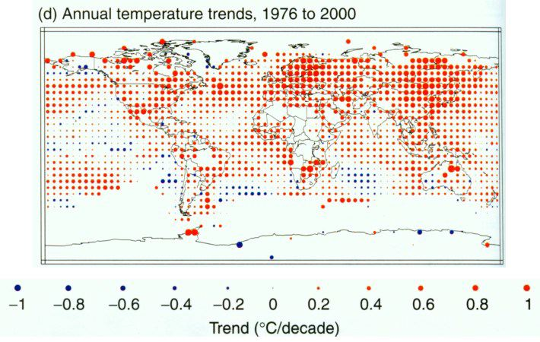
Source: IPCC, 2001: Climate Change 2001: The Scientific Basis

Slide 42
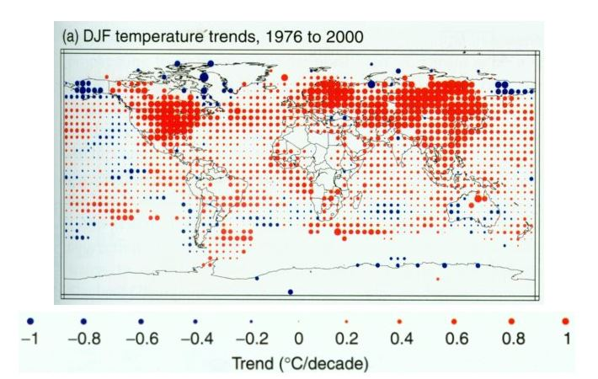
Source: IPCC, 2001: Climate Change 2001: The Scientific Basis

Slide 43
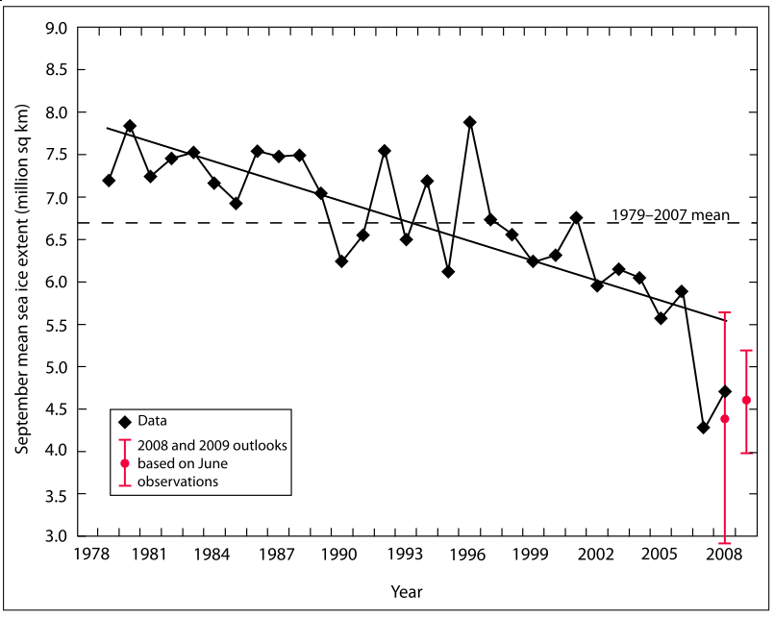
Arctic Sea-Ice Decline

Slide 44
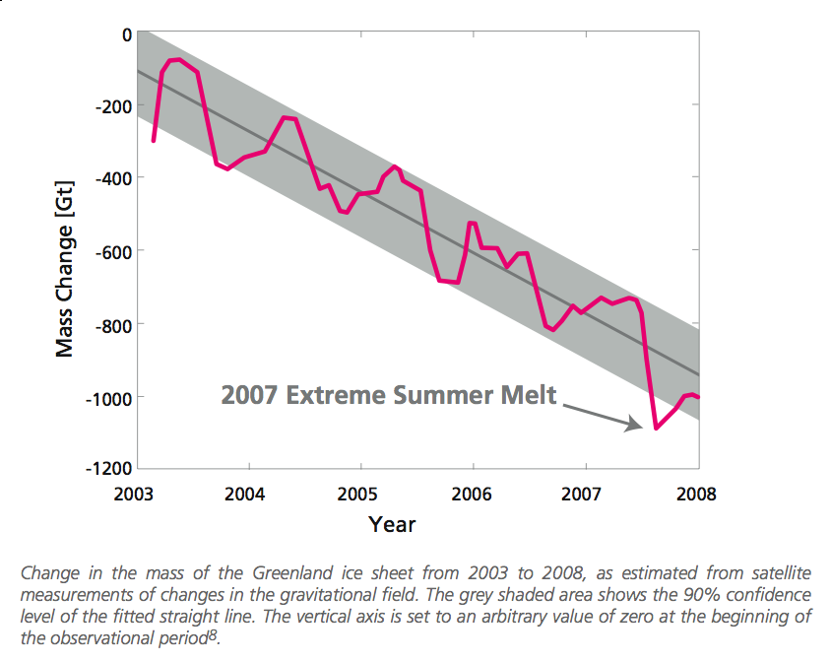
Decline in Greenland Ice Mass

Slide 45
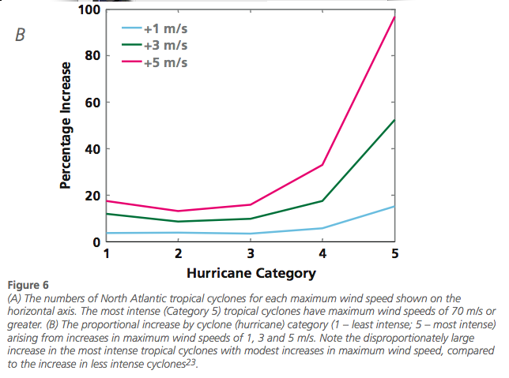
Increase in Hurricane Intensity

Slide 46
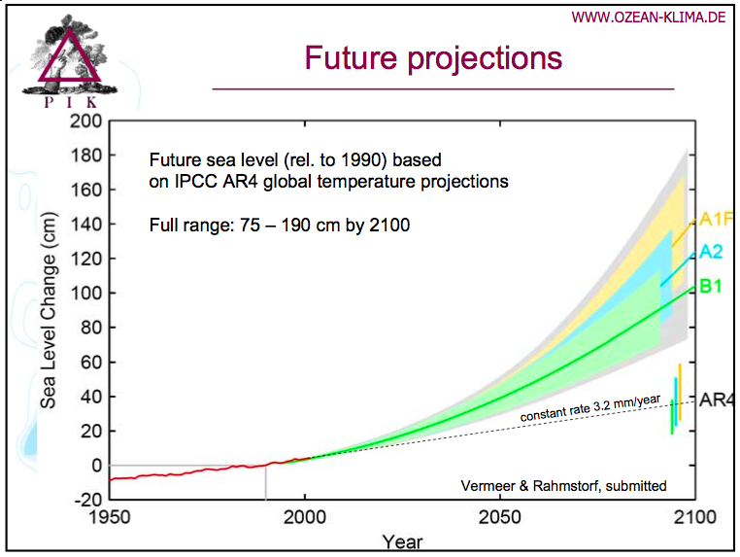

Slide 47
Energy intensive
Balanced fuel sources
More environmentally friendly
The planet is committed to a warming over the next 50 years regardless of political decisions
IPCC Fourth Assessment Report Summary for Policy Makers

Slide 48
Energy intensive
Balanced fuel sources
More environmentally friendly
Mitigation
Possible
Adaptation
Crucial
Adaptation
Necessary
IPCC Fourth Assessment Report Summary for Policy Makers

Slide 49
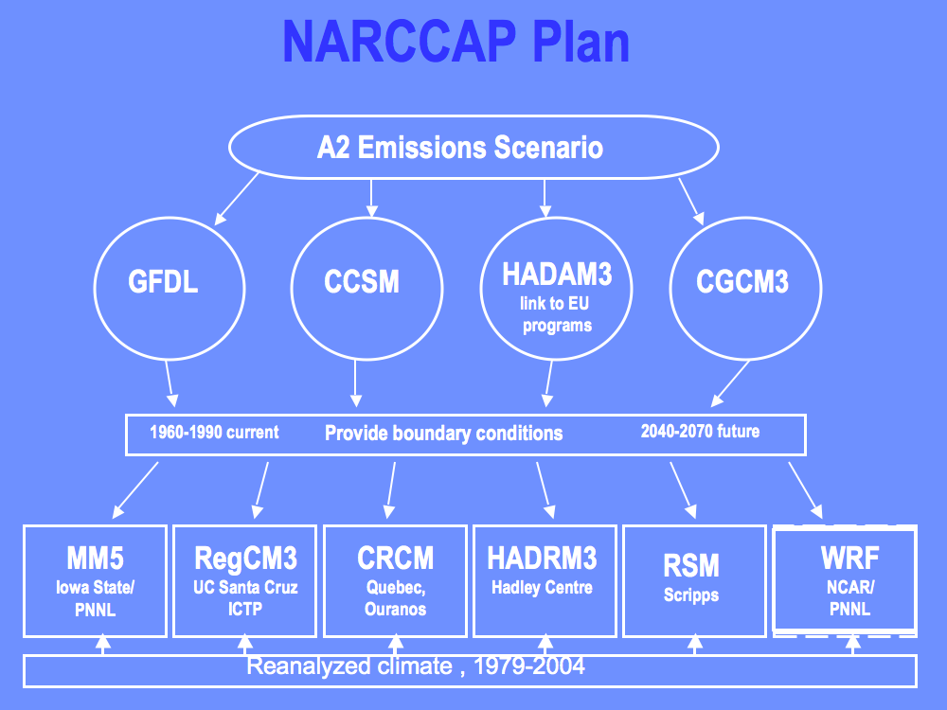

Slide 50
Observed Summer (JJA) Daily Maximum Temperature
Changes (K), 1976-2000
Adapted from Folland et al. [2001]

Slide 51
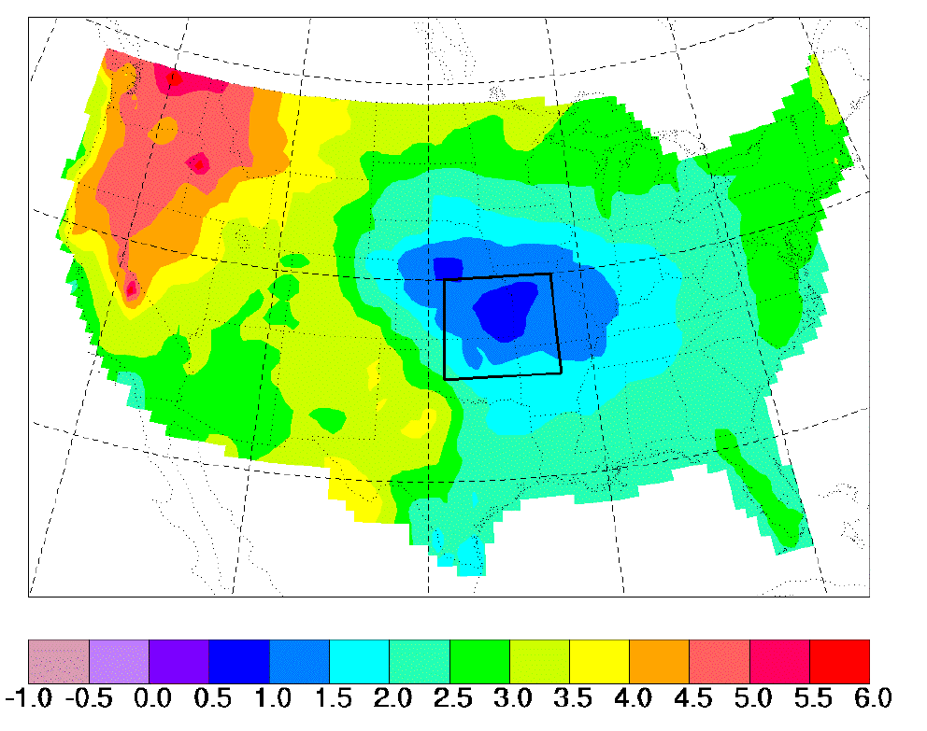
“Warming Hole”:
Simulations of changes in daily maximum summertime temperatures between 1990s and 2040s
ΔT_{max} (JJA)
˚C
    Pan, Z., R. W. Arritt, E. S. Takle, W. J. Gutowski, Jr., C. J. Anderson, and M. Segal,2004: Altered hydrologic feedback in a warming climate introduces a “warming hole”. Geophys. Res. Lett.31, L17109, doi:10.1029/2004GL020528.
Notes:
A feature that corresponds to later 20th century trends. Not seen in GCMs. Linked to mesoscale circulation.

Slide 52
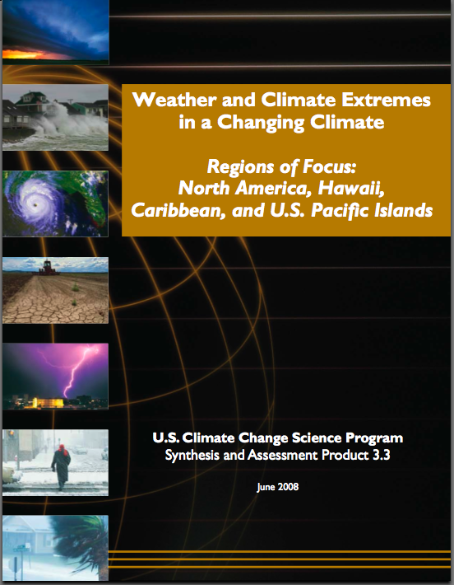
“One of the clearest trends in the United States observational record is an increasing frequency and intensity of heavy precipitation events… Over the last century there was a 50% increase in the frequency of days with precipitation over 101.6 mm (four inches) in the upper midwestern U.S.; this trend is statistically significant “

Slide 53
Projected Changes* for the
Climate of the Midwest
Temperature
Longer frost-free period (high)
Higher average winter temperatures (high)
Fewer extreme cold temperatures in winter (high)
Fewer extreme high temperatures in summer in short term but more in long term (medium)
Higher nighttime temperatures both summer and winter (high)
More freeze-thaw cycles (high)
Increased temperature variability (high)
Follows trend of last 25 years and projected by models
No current trend but model suggestion or current trend but model inconclusive
*Estimated from IPCC reports

Slide 54
Projected Changes* for the
Climate of the Midwest
Precipitation
More (~10%) precipitation annually (medium)
Change in “seasonality”: Most of the increase will come in the first half of the year (wetter springs, drier summers) (high)
More water-logging of soils (medium)
More variability of summer precipitation (high)
  More intense rain events and hence more runoff (high)
  Higher episodic streamflow (medium)
  Longer periods without rain (medium)
Higher absolute humidity (high)
Stronger storm systems (medium)
More winter soil moisture recharge (medium)
Snowfall increases (late winter) in short term but decreases in the long run (medium)
Follows trend of last 25 years and projected by models
No current trend but model suggestion or current trend but model inconclusive
*Estimated from IPCC reports

Slide 55
Projected Changes* for the
Climate of the Midwest
Other
Reduced wind speeds (high)
Reduced solar radiation (medium)
Increased tropospheric ozone (high)
Accelerated loss of soil carbon (high)
Phenological stages are shortened (high)
Weeds grow more rapidly under elevated atmospheric CO2 (high)
Weeds migrate northward and are less sensitive to herbicides (high)
Plants have increased water used efficiency (high)
Follows trend of last 25 years and projected by models
No current trend but model suggestion or current trend but model inconclusive
*Estimated from IPCC and CCSP reports

Slide 56
Summary
Increases in CO2 will create a wide variety of climate changes
Some regions will experience changes favorable for local societal activities, but most will be unfavorable
Stabilization to avoid passing the 2oC guardrail will require major decreases in global emissions
Many, but not all, observed regional climate changes are consistent with global and regional climate model projections

