Slide 1
Welcome to ANR at Noon January 18, 2013
Adapting to Climate Change in Iowa:
Past and Future
Dr. Gene Takle,
Professor of Agronomy,
Dept. of Geological & Atmospheric Sciences

Slide 2
Adapting to Climate Change in Iowa: Past and Future
Eugene S. Takle
Professor of Agricultural Meteorology
Department of Agronomy
Director, Climate Science Program
gstakle@iastate.edu
Agriculture and Natural Resources Extension
Lunch & Learn
18 January 2013

Slide 3
Outline
Trends in Iowa temperature
Recent past
Future projections
Trends in Iowa precipitation
Recent past
Future projections
Planning for Iowa’s future climate
Recent producer adaptation to climate change

Slide 6
Des Moines, Iowa Airport Data
1983: 13
1988: 10
1977: 8
1974: 7

Slide 7
Des Moines, Iowa Airport Data
1983: 13
1988: 10
1977: 8
1974: 7
6 days ≥ 100ºF in 23 years

Slide 8
Des Moines, Iowa Airport Data
1983: 13
11 days in 2012
1988: 10
1977: 8
1974: 7
6 days ≥ 100ºF in 23 years

Slide 9
+2-3ºC
+1-2ºC
+1-2ºC
+4-5ºC
Projected US summer surface temperature changes from a 16-model ensemble

Slide 10
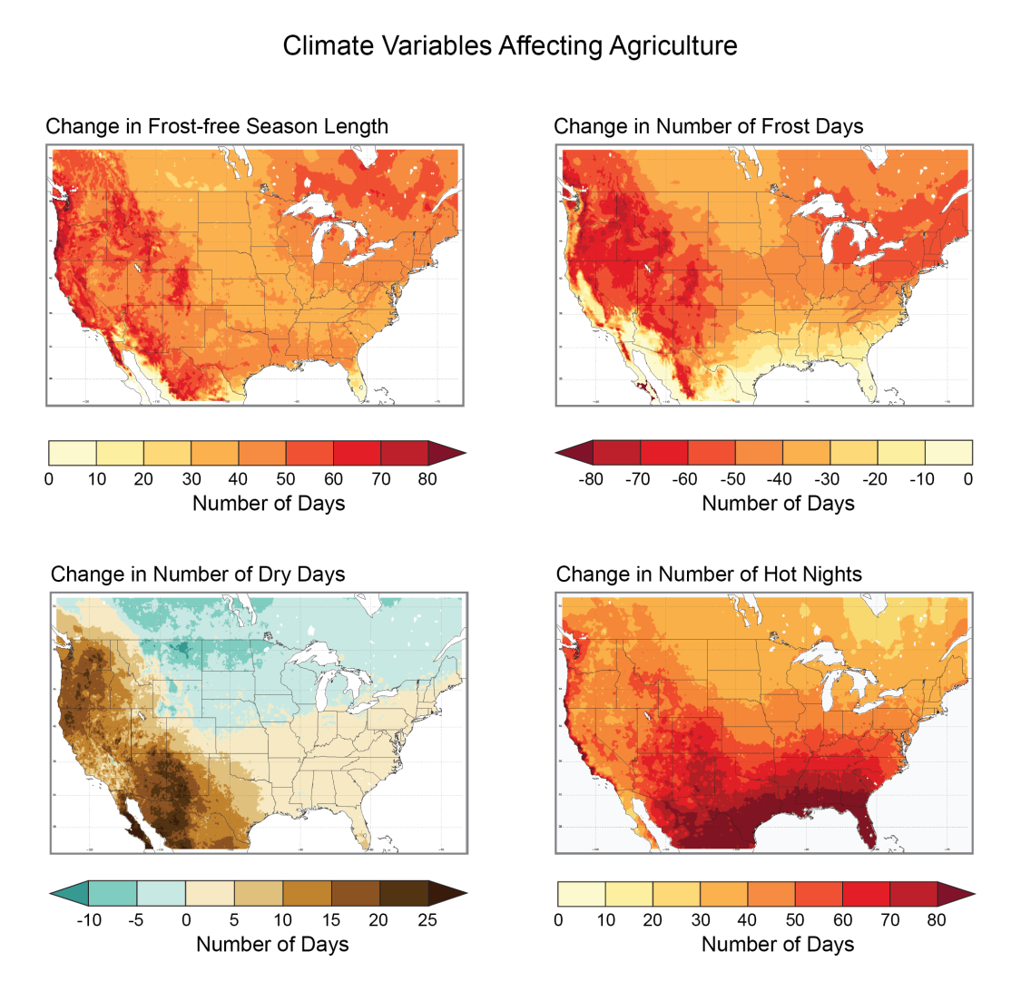
Climate changes are both favorable and unfavorable to agriculture
Lengthening of the growing season
higher yields of commodity crops
Reduction in number of frost days
reduced chilling hours
reduced frost damage to some crops
Number of dry days increases is east, west and south, decreases in north
increased number of field work days
increased moisture stress, pathogens
Increase in number of hot nights
reduced grain weight
reduced weight gain in meat animals

Slide 11
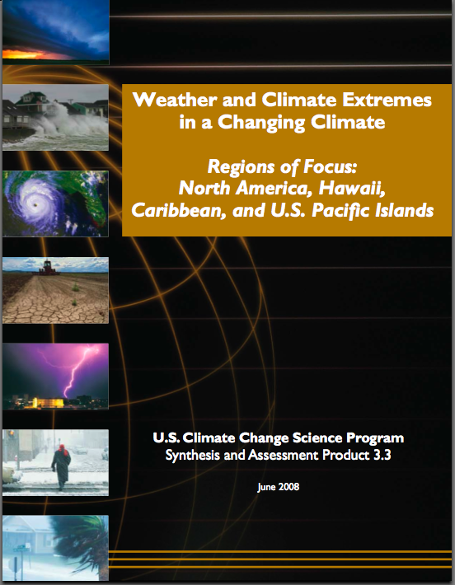
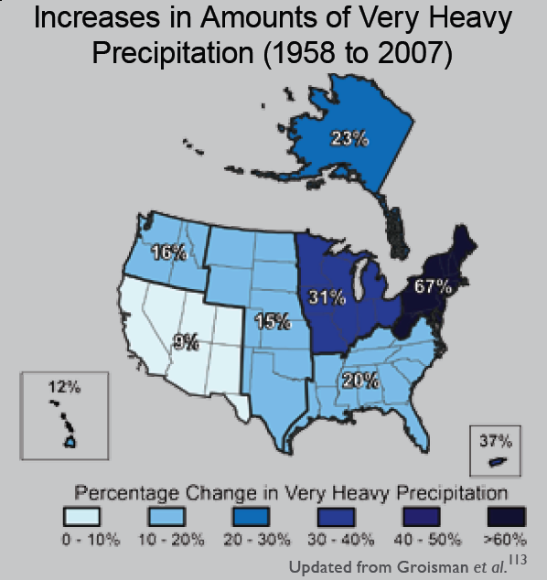
“One of the clearest trends in the United States observational record is an increasing frequency and intensity of heavy precipitation events… Over the last century there was a 50% increase in the frequency of days with precipitation over 101.6 mm (four inches) in the upper midwestern U.S.; this trend is statistically significant “
Karl, T. R., J. M. Melillo, and T. C. Peterson, (eds.), 2009: Global Climate Change Impacts in the United States. Cambridge University Press, 2009, 196pp.

Slide 12
Iowa State-Wide Average Data

Slide 13
Iowa State-Wide Average Data
1990-2011 highly favorable precip for crops

Slide 14
Iowa State-Wide Average Data
Totals above 40”
1 year
5 years
3 years
7 years
2012
Totals below 25”

Slide 15
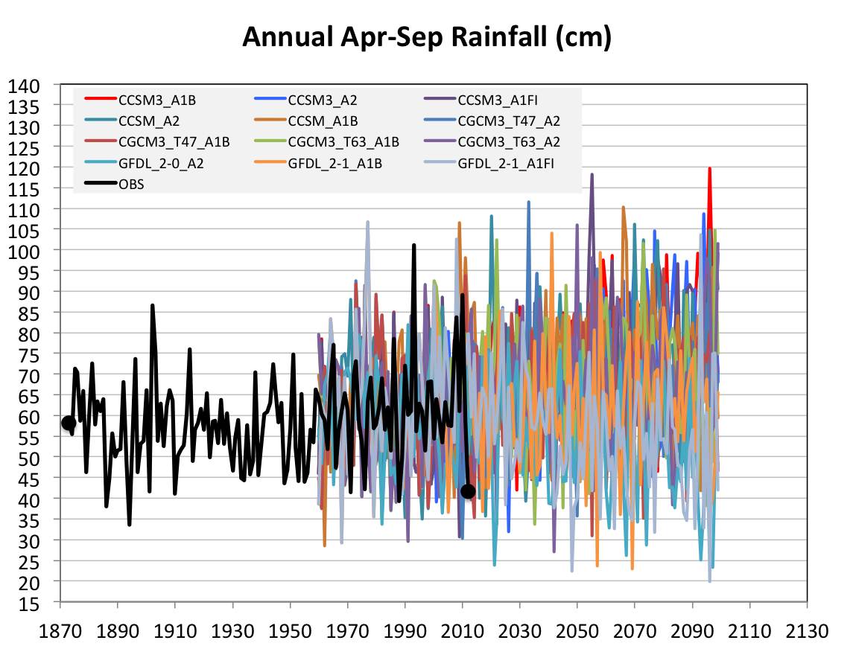
Projected Future Variability in Growing Season Precipitation for Iowa
More extreme high precip years
More extreme low precip years
CJ Anderson, ISU

Slide 16
Future Variability in Growing Season Precipitation for Iowa
More extreme high precip years
Lines drawn by eye
More extreme low precip years
CJ Anderson, ISU

Slide 17
Visioning Future Climate Change for Iowa

Slide 18
Visioning Future Climate Change for Iowa
You are here

Slide 19
Visioning Future Climate Change for Iowa
You are here
Today

Slide 20
Visioning Future Climate Change for Iowa
You are here
Today
Past

Slide 21
Visioning Future Climate Change for Iowa
You are here
Today
Past
Future

Slide 22
Visioning Future Climate Change for Iowa
You are here
?
Today
Past
Future

Slide 23
You be the scientist: For which hypothesis of the future can you find the most evidence?
?
Some Climate Variable (temp, precip, humid)
Today
Past
Future

Slide 24
You be the scientist: For which hypothesis of the future can you find the most evidence?
Some Climate Variable (temp, precip, humid)
Measured past
Today
Past
Future

Slide 25
You be the scientist: For which hypothesis of the future can you find the most evidence?
Some Climate Variable (temp, precip, humid)
Future will return to something in the past
Measured past
Today
Past
Future

Slide 26
You be the scientist: For which hypothesis of the future can you find the most evidence?
Future will be like average of the past
Some Climate Variable (temp, precip, humid)
Future will return to something in the past
Measured past
Today
Past
Future

Slide 27
You be the scientist: For which hypothesis of the future can you find the most evidence?
Future will be like today
Future will be like average of the past
Some Climate Variable (temp, precip, humid)
Future will return to something in the past
Measured past
Today
Past
Future

Slide 28
You be the scientist: For which hypothesis of the future can you find the most evidence?
Current trend will continue
Future will be like today
Future will be like average of the past
Some Climate Variable (temp, precip, humid)
Future will return to something in the past
Measured past
Today
Past
Future

Slide 29
You be the scientist: For which hypothesis of the future can you find the most evidence?
What does the best available science have to say?
Current trend will continue
Future will be like today
Future will be like average of the past
Some Climate Variable (temp, precip, humid)
Future will return to something in the past
Measured past
Today
Past
Future

Slide 30
You be the scientist: For which hypothesis of the future can you find the most evidence?
Based on climate models, climate scientists overwhelmingly agree that the future will be more extreme than today
Current trend will continue
Future will be like today
Future will be like average of the past
Some Climate Variable (temp, precip, humid)
Future will return to something in the past
Measured past
Today
Past
Future

Slide 31
You be the scientist: For which hypothesis of the future can you find the most evidence?
Future will be more extreme than today
Current trend will continue
Future will be like today
Future will be like average of the past
Some Climate Variable (temp, precip, humid)
Future will return to something in the past
Measured past
Today
Past
Future

Slide 32
You be the scientist: For which hypothesis of the future can you find the most evidence?
Some Climate Variable (temp, precip, humid)
Measured past
Today
Past
Future

Slide 33
Best Available Science
A Prudent View of the Future
Some Climate Variable (temp, precip, humid)
Measured past
Today
Past
Future

Slide 34
Current Adaptations Enable Producers to Maintain High Yields (Iowa Example):
Longer growing season: plant earlier, plant longer season hybrids, harvest later
Wetter springs: larger machinery enables planting in smaller weather windows
More summer precipitation: higher planting densities for higher yields
Wetter springs and summers: more subsurface drainage tile is being installed, closer spacing, sloped surfaces
Fewer extreme heat events: higher planting densities, fewer pollination failures
Higher humidity: more spraying for pathogens favored by moist conditions. more problems with fall crop dry-down, wider bean heads for faster harvest due to shorter harvest period during the daytime.
Drier autumns: delay harvest to take advantage of natural dry-down conditions, thereby reducing fuel costs
Future climate change will demand new innovations in both technology and management for successful adaptation

Slide 35
Summary
Recent climate trends, with a few exceptions, have been favorable to agriculture
Iowa’s future climate will likely have more extremes in precipitation, both high and low
Years with low precipitation will be accompanied by more extreme high temperatures
Future adaptation to climate change will require more innovation in technology and management

