Slide 1

Image courtesy of NASA/GSFC

Slide 2
Climate as a Resource:
Does Climate Change Matter??
Eugene S. Takle
Professor
Department of Agronomy
Department of Geological and Atmospheric Science
Director, Climate Science Program
Iowa State University
Ames, IA 50011
Globe 201
Iowa State University
1 February 2011

Slide 3
Outline
Observed global changes in carbon dioxide and temperature
Projected future changes in global and US temperatures and precipitation
Changes in extreme events
Future climate change for Iowa and the US Midwest
Climate at a critical global resource

Slide 4
Climate change is one of the most important issues facing humanity
The scientific evidence clearly indicates that our climate is changing, and that human activities have been identified as a dominant contributing cause
Human actions of the next two decades will have significant impacts on the productivity, natural resiliency, and human habitability of major parts of the Earth at the end of this century
Notes:
No disagreement in peer reviewed literature
Powerful statements from every major professional science society and organization in the world
Powerful statements from the National Academies of Sciences (the leadership in science) for every major country
G8 + 5 other countries, May 2009: “The need for urgent action to address climate change is now indisputable.”

Slide 5
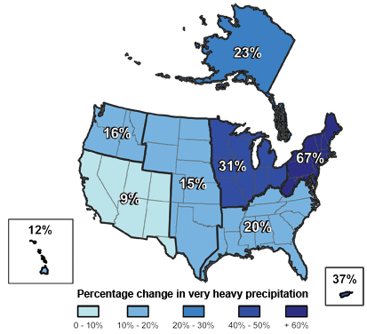
Climate changes are underway in the U.S. and are projected to grow
Temperature rise
Sea-level rise
Increase in heavy downpours
Rapidly retreating glaciers
Thawing permafrost
Lengthening growing
season
Lengthening ice-free season
in the ocean and on lakes
and rivers
Earlier snowmelt
Changes in river flows
Plants blooming earlier; animals, birds and fish moving northward
Don Wuebbles

Slide 6
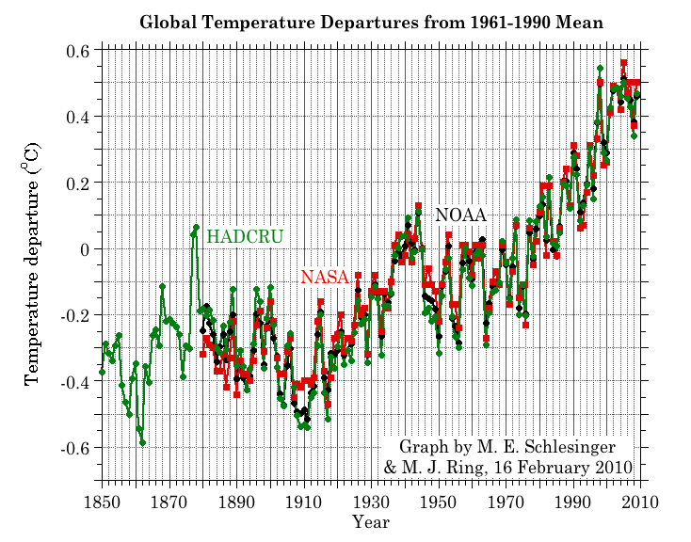
Three separate analyses of the temperature record – Trends are in close agreement
2010 has tied 2005 as the warmest year on record since 1880

Slide 7
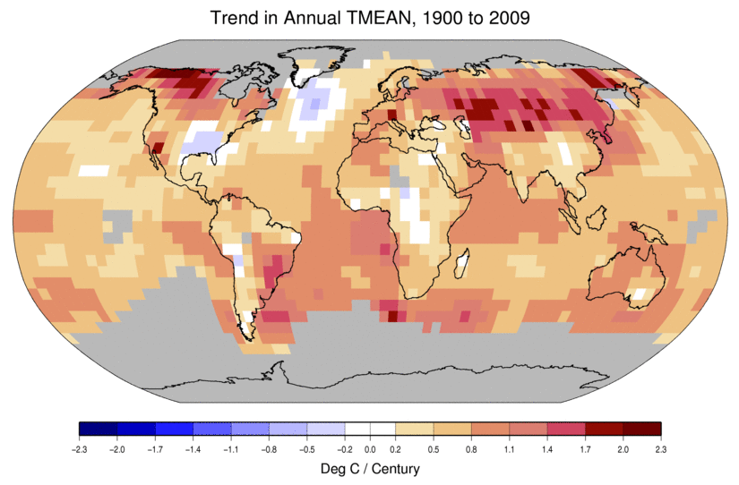
Temperature Changes are Not
Uniform Around the Globe
From Tom Karl, NOAA NCDC

Slide 8
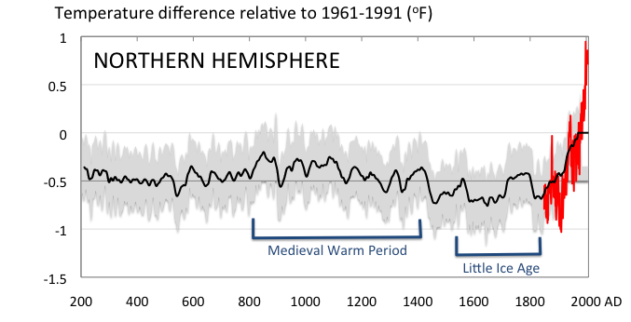
Conditions today are unusual in the context of the last 2,000 years …
Don Wuebbles

Slide 9
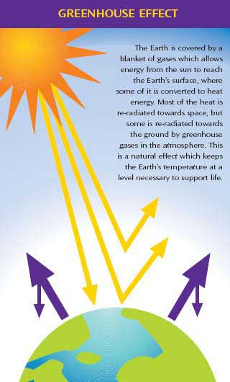
Why does the Earth warm?
1. Natural causes
THE GREENHOUSE EFFECT…
…is 100% natural.
  Heat is trapped in the atmosphere.
…sustains life on Earth.
  Keeps average temperatures at 12.8ºC (55ºF), instead of –29ºC (-20ºF).
Don Wuebbles

Slide 10
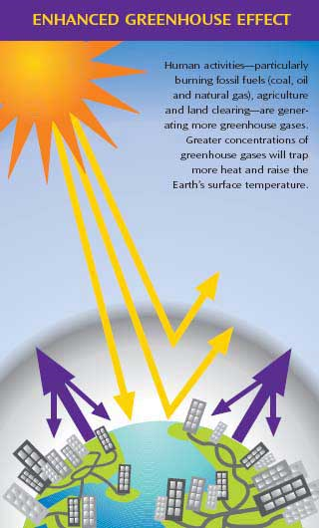
Why does the Earth warm?
2. Human causes
THE ENHANCED GREENHOUSE EFFECT
(or GLOBAL WARMING)
… is primarily human-induced: We’re increasing heat-trapping gases in the atmosphere.
… is like wrapping an extra blanket around the Earth.
Don Wuebbles

Slide 11
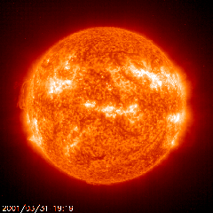
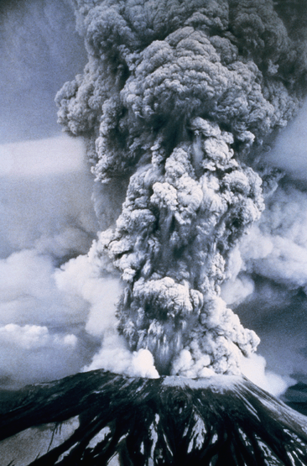
Natural factors affect climate
Variations in the energy
received from the sun
Variations in the Earth's orbit
(Milankovic effect)
Stratospheric
aerosols from
energetic
volcanic eruptions
Chaotic interactions in
the Earth's climate
(for example, El Nino, NAO)
Don Wuebbles

Slide 12
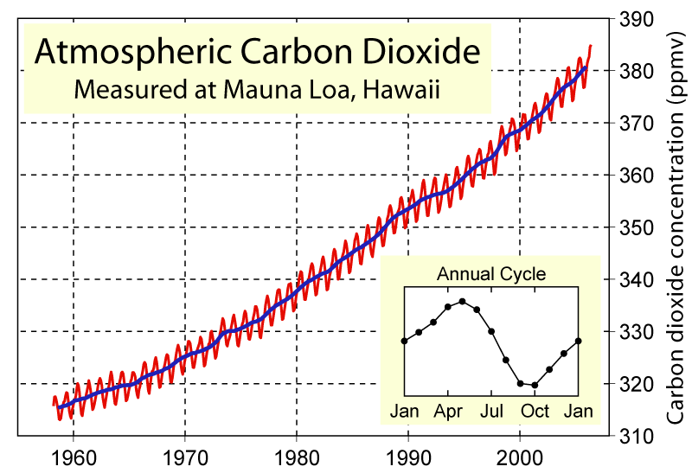
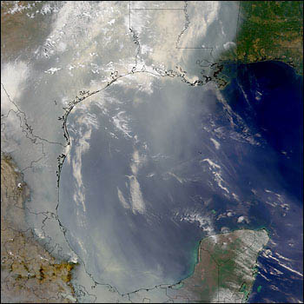
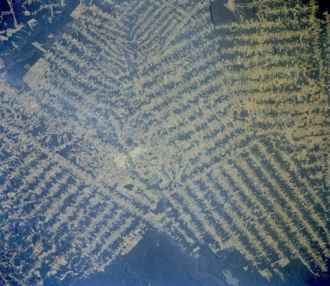
Non-natural mechanisms
Changes in atmospheric concentrations of radiatively important gases
Changes in aerosol particles from burning fossil fuels and biomass
Changes in the reflectivity (albedo) of the Earth’s surface
Don Wuebbles

Slide 13
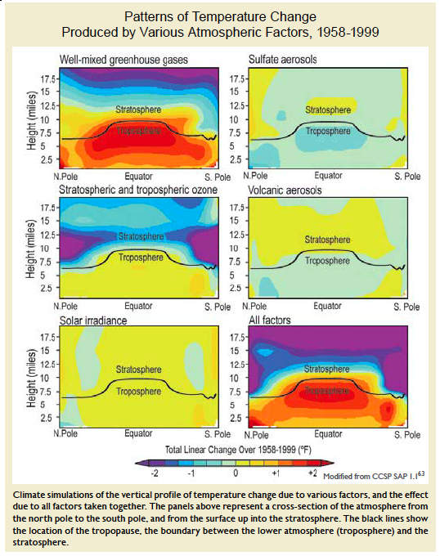
Warming of the Lower and Upper Atmosphere Produced by Natural and Human Causes
Karl, T. R., J. M. Melillo, and T. C. Peterson, (eds.), 2009: Global Climate Change Impacts in the United States. Cambridge University Press, 2009, 196pp.

Slide 14
Warming of the Lower and Upper Atmosphere Produced by Natural and Human Causes
Note that greenhouse gases have a unique temperature signature, with strong warming in the upper troposphere, cooling in the lower stratosphere and strong warming at the surface over the North Pole. No other warming factors have this signature.
Karl, T. R., J. M. Melillo, and T. C. Peterson, (eds.), 2009: Global Climate Change Impacts in the United States. Cambridge University Press, 2009, 196pp.

Slide 15
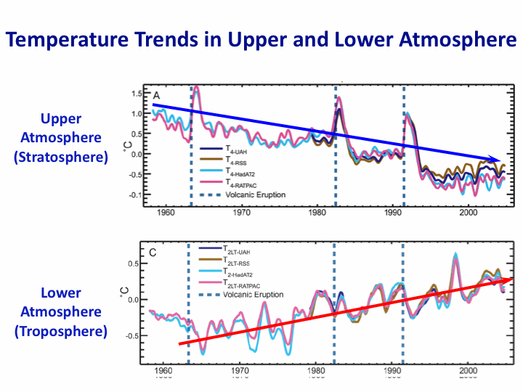
Warming of the Lower and Upper Atmosphere Produced by Natural and Human Causes
Note that greenhouse gases have a unique temperature signature, with strong warming in the upper troposphere, cooling in the lower stratosphere and strong warming at the surface over the North Pole. No other warming factors have this signature.
Karl, T. R., J. M. Melillo, and T. C. Peterson, (eds.), 2009: Global Climate Change Impacts in the United States. Cambridge University Press, 2009, 196pp.

Slide 16
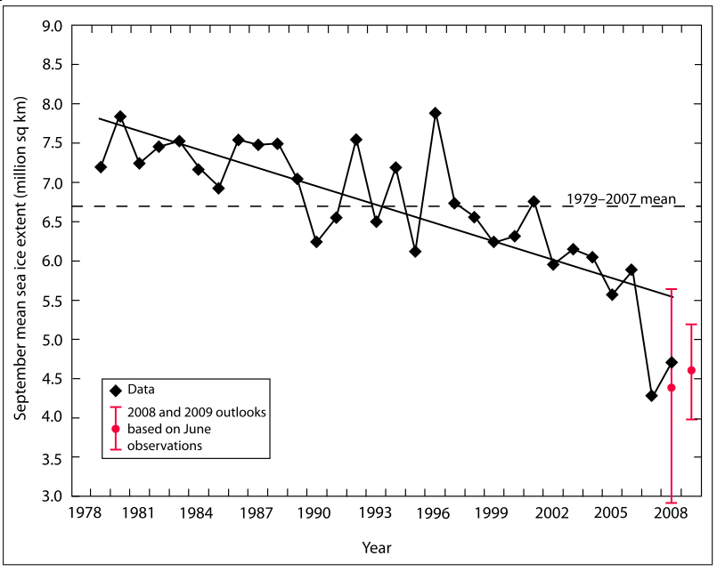
Warming of the Lower and Upper Atmosphere Produced by Natural and Human Causes
Note that greenhouse gases have a unique temperature signature, with strong warming in the upper troposphere, cooling in the lower stratosphere and strong warming at the surface over the North Pole. No other warming factors have this signature.

Slide 17
Many lines of evidence for conclusion of a “discernible human influence”
“Basic physics” evidence
  Physical understanding of the climate system and the heat-trapping properties of greenhouse gases
Qualitative analysis evidence
  Qualitative agreement between observed climate changes and model predictions of human-caused climate changes (warming of oceans, land surface and troposphere, water vapor increases, etc.)
Paleoclimate evidence
  Reconstructions of past climates enable us to place the warming of the 20th century in a longer-term context
Fingerprint evidence
  Rigorous statistical comparisons between modeled and observed patterns of climate change
Don Wuebbles

Slide 18
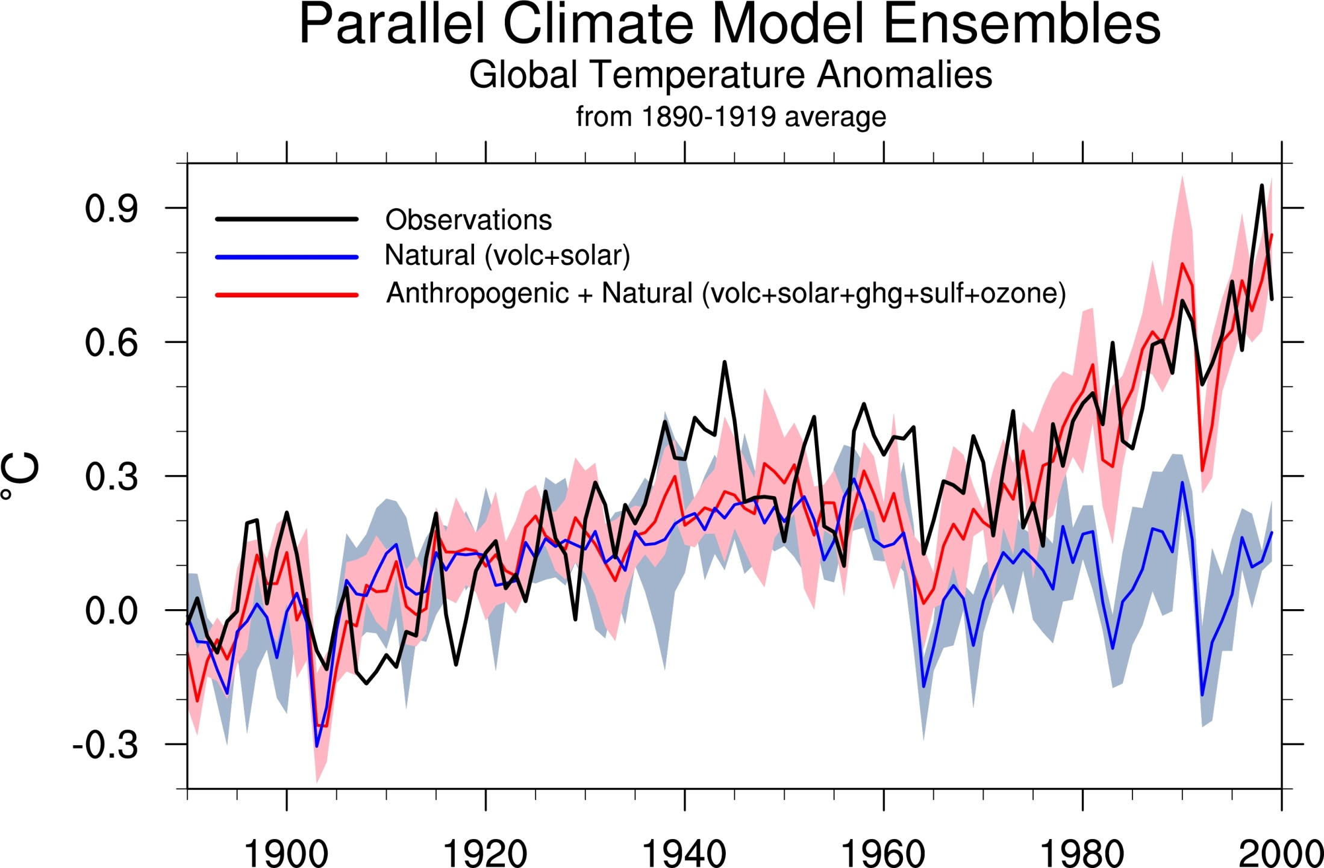
Climate models: Natural processes do not account for
observed 20th century warming after 1965

Slide 19
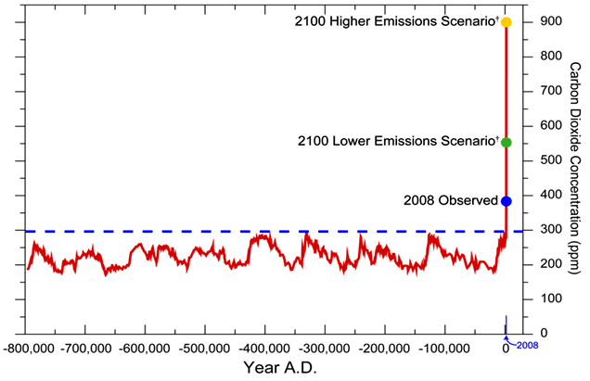
We have Moved Outside the Range of Historical Variation
800,000 Year Record of Carbon Dioxide Concentration
Don Wuebbles

Slide 20
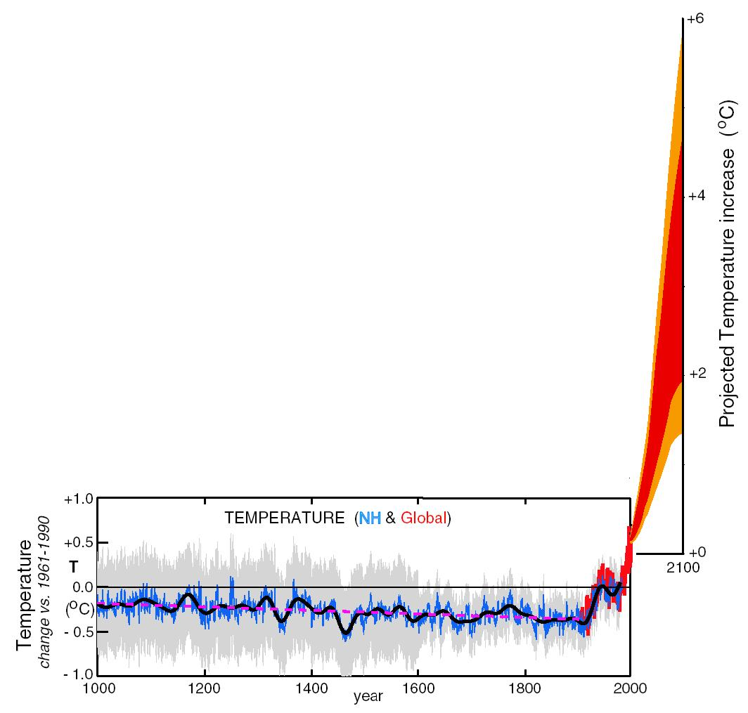
What can we expect in the future?
Don Wuebbles

Slide 21
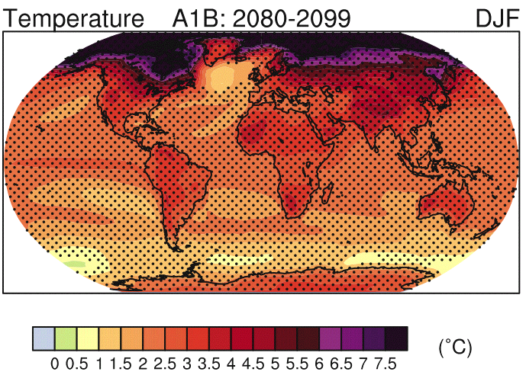
IPCC 2007

Slide 22
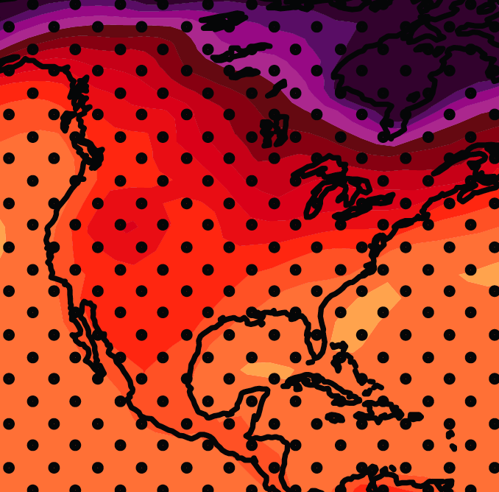
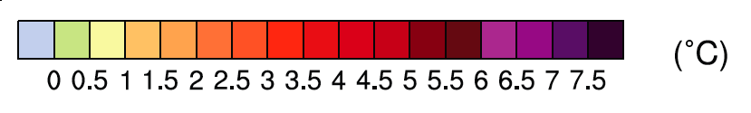
December-January-February Temperature Change
7.2ºF
6.3ºF
A1B Emission Scenario
2080-2099 minus1980-1999

Slide 23
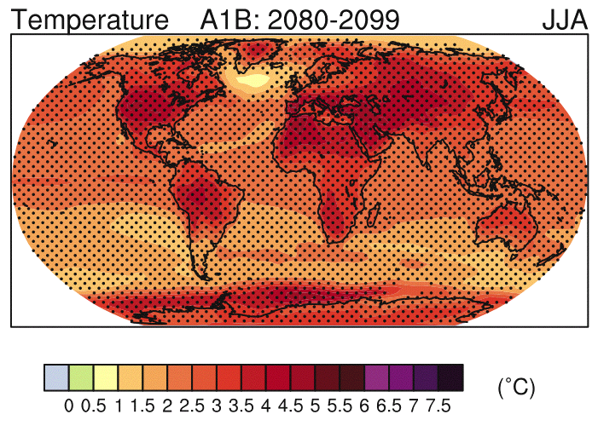
IPCC 2007

Slide 24
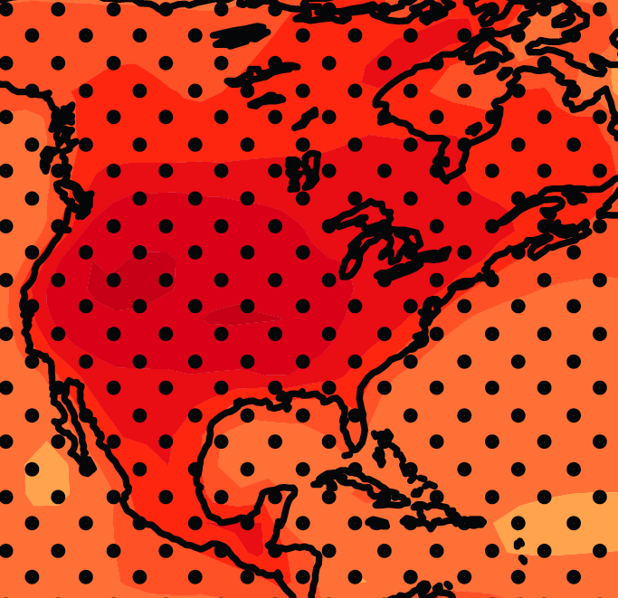
June-July-August Temperature Change
4.5ºF
5.4ºF
A1B Emission Scenario
2080-2099 minus1980-1999

Slide 25
June-July-August Temperature Change
4.5ºF
5.4ºF
A1B Emission Scenario
2080-2099 minus1980-1999
Not the direction of current trends

Slide 26
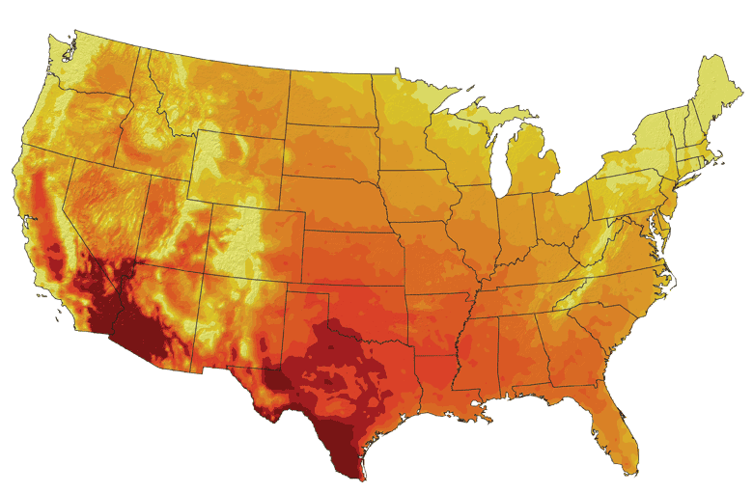
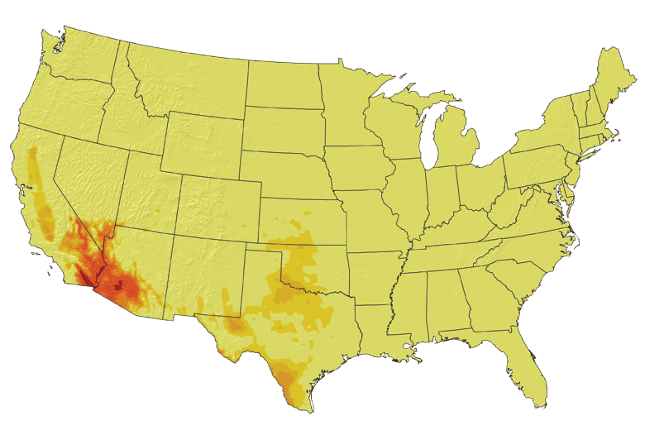
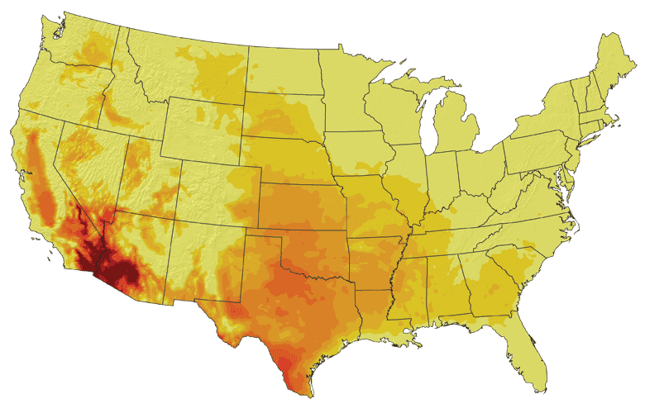
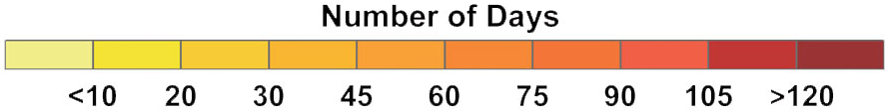
Increases in very high temperatures will have
wide-ranging effects
Higher Emissions Scenario, 2080-2099
Number of Days Over 100ºF
Recent Past, 1961-1979
Average:
30-60 days
Lower Emissions Scenario, 2080-2099
Average:
10-20 days
Don Wuebbles

Slide 27
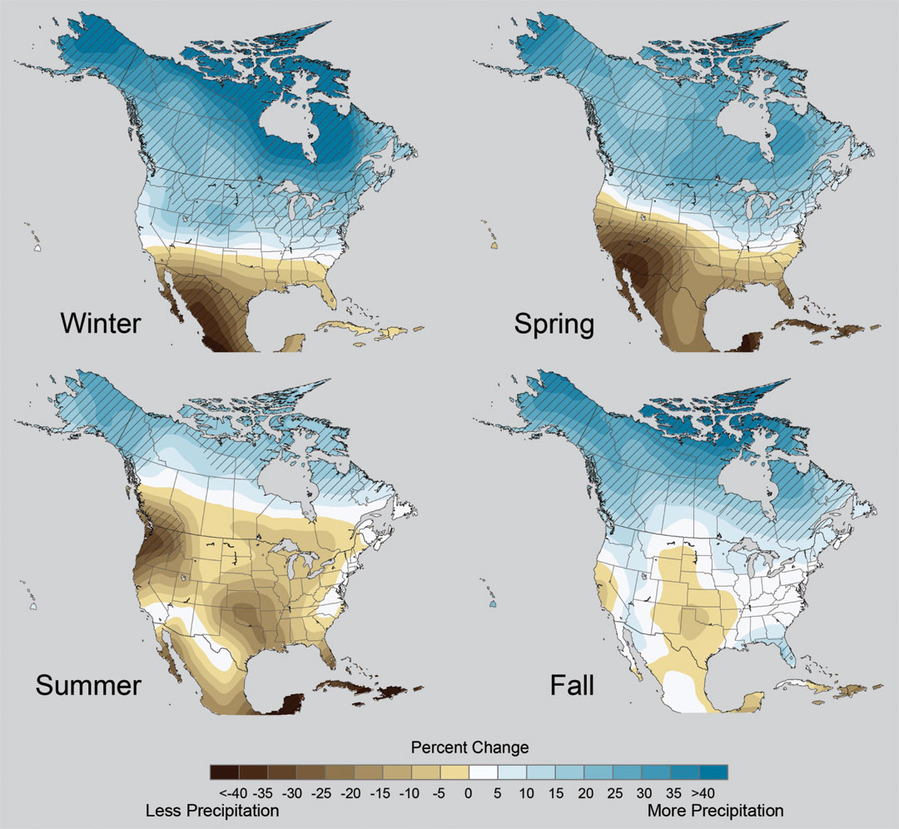
Projected Change in Precipitation: 2081-2099
Midwest: Increasing winter and spring precipitation, with drier summers
More frequent and intense periods of heavy rainfall
Unstippled regions indicate reduced confidence
Relative to 1960-1990
NOTE: Scale Reversed
Don Wuebbles

Slide 28
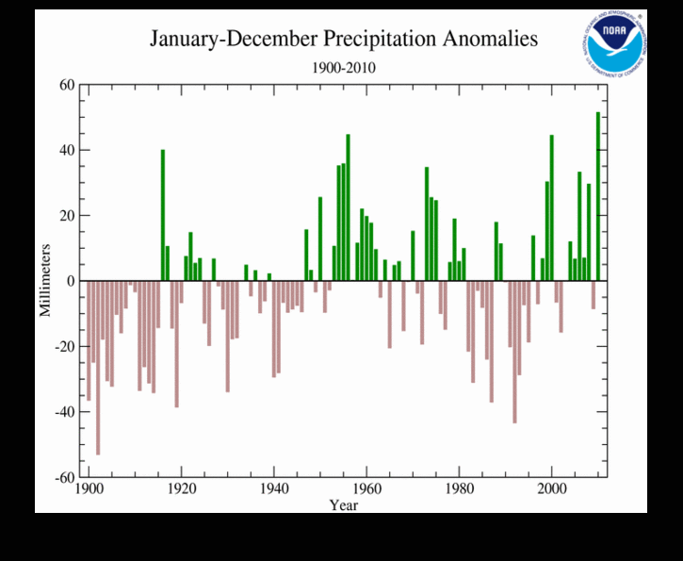
2010 had the highest global total precipitation in the 111 year record

Slide 29
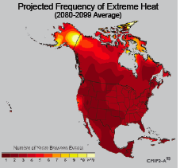
Extreme weather events become more common
Events now considered rare will become commonplace.
Heat waves will likely become longer and more severe
Droughts are likely to become more frequent and severe in some regions
Likely increase in severe thunderstorms (and perhaps in tornadoes).
Winter storm tracks are shifting
northward and the strongest storms are
likely to become stronger and more
frequent.
Don Wuebbles
Notes:
Shown here is the frequency at the end of the century of what we consider now to be a 20 year heat wave. Instead of once every 20 years, these temperatures would be experienced every other year or so over most of the continental US in this business as usual scenario.

Slide 30
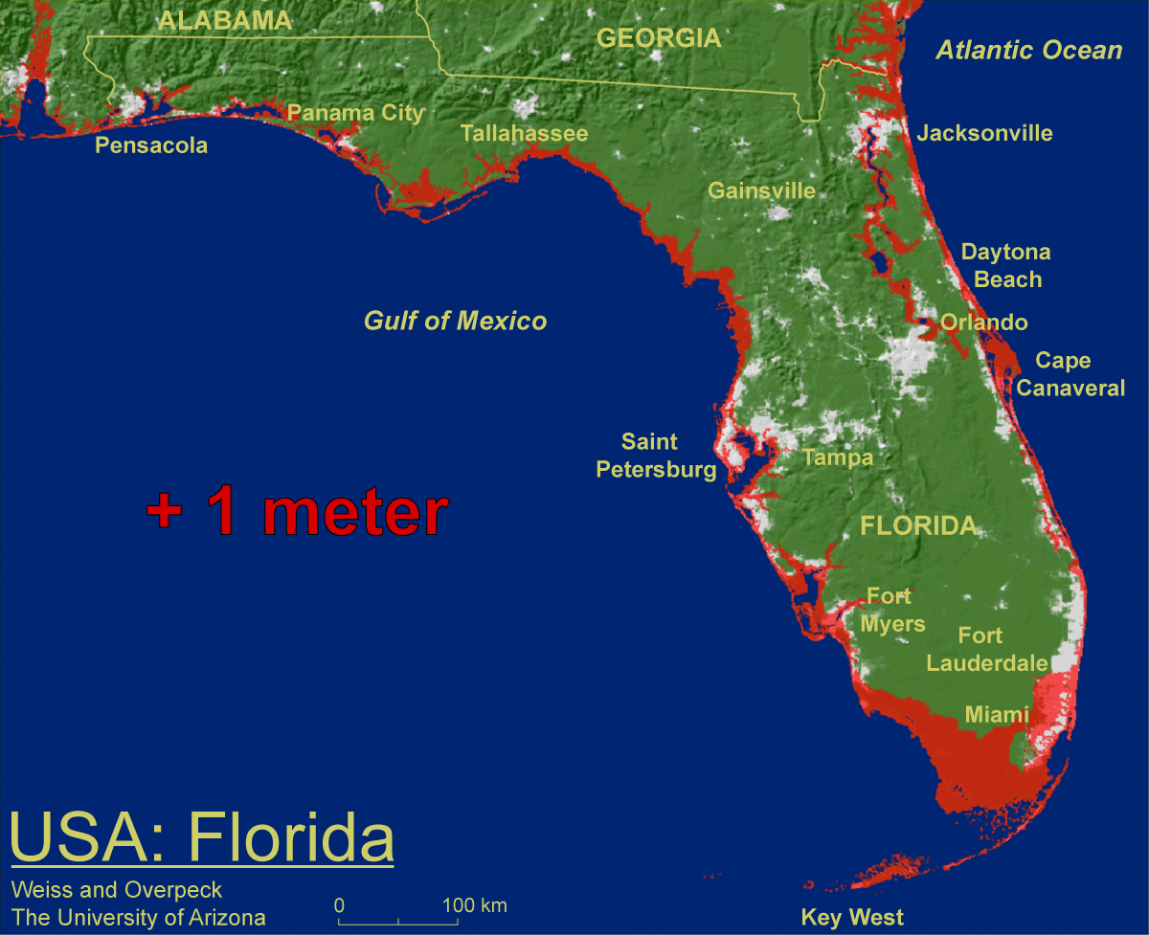
1 meter will be hard to avoid, possibly within this century, just from thermal expansion and small glacier melt.
Don Wuebbles

Slide 31

Widespread climate-related impacts are occurring now and are expected to increase
Water Resources
Energy Supply & Use
Transportation
Agriculture
Don Wuebbles
Ecosystems
Human Health
Society

Slide 32
But Abstract Concepts of Global Changes and Models Projecting Future Conditions Do Not Inspire Urgency and Action
It takes nearby events in my backyard that are recurring and outside the range of recent memory to raise questions about whether something fundamental is changing.
The Iowa Example…

Slide 33
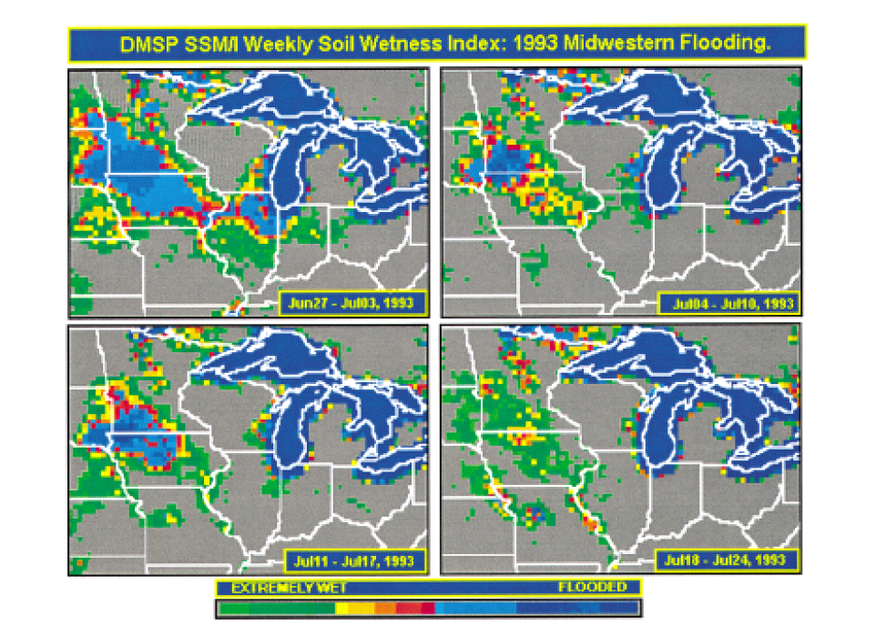
Great Flood of 1993 in the US Midwest:
A New “Great Lake”
1993
Historical Data indicate this should happen about once every 500 years
Lakshmi, V., and K. Schaaf, 2001: Analysis of the 1993 Midwestern flood using satellite and ground data. IEEE Trans. Geosci & Remote Sens., 39, 1736-1743.

Slide 34
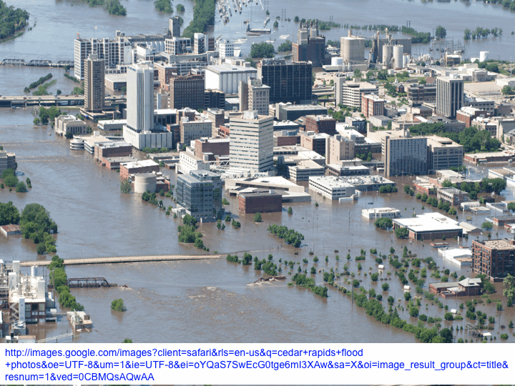
2008

Slide 35
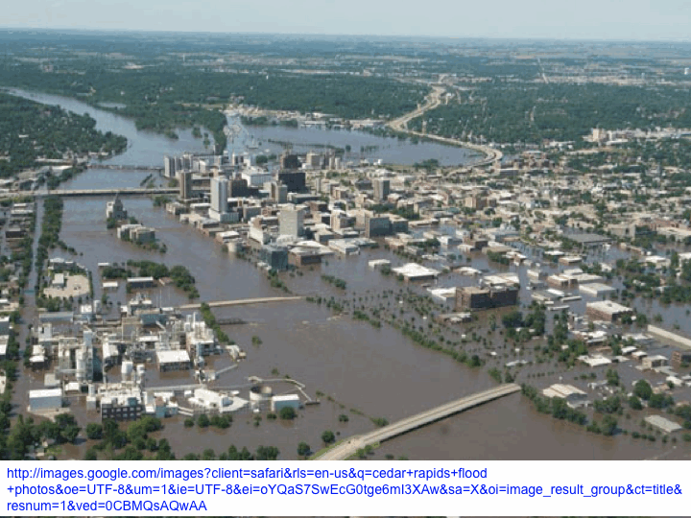

Slide 36
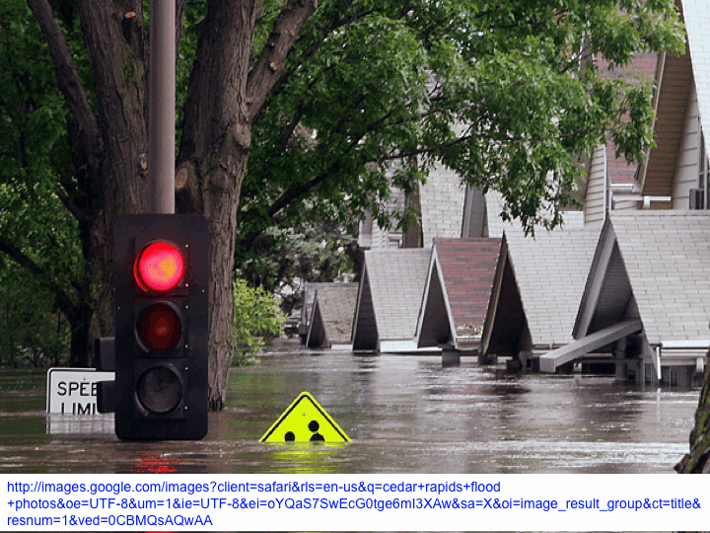

Slide 37
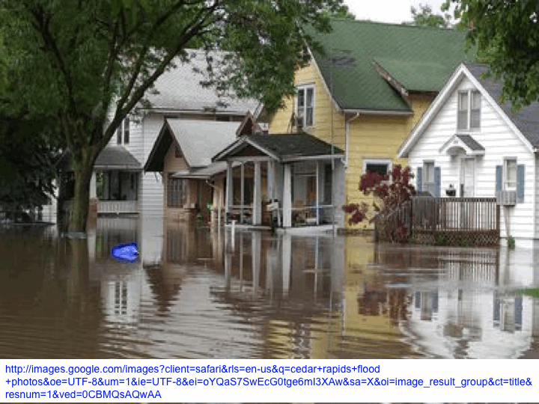

Slide 38
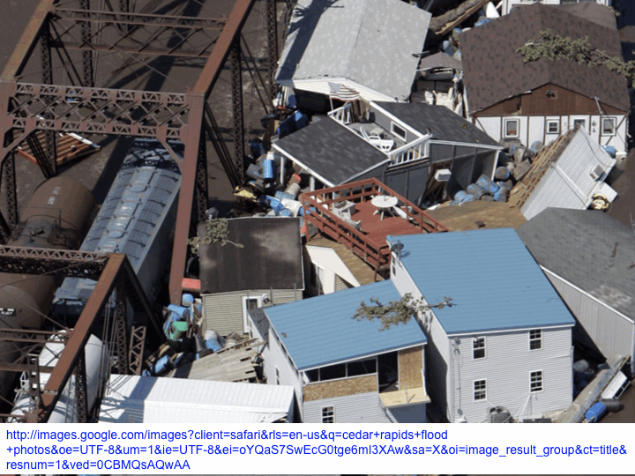

Slide 39
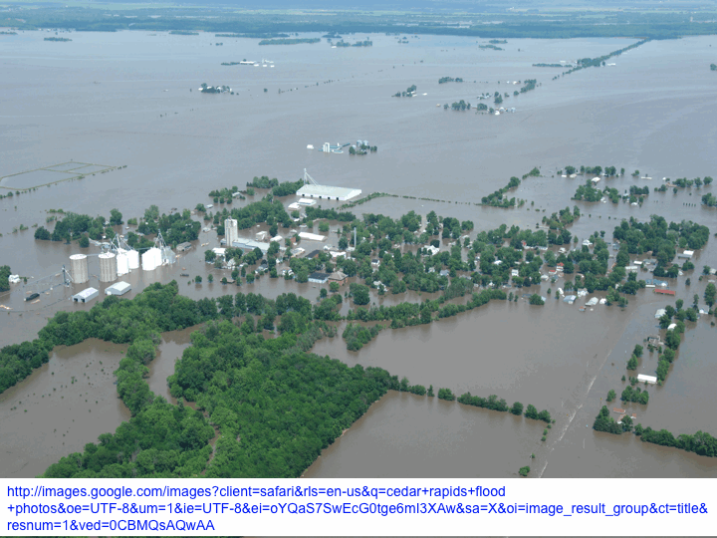

Slide 40
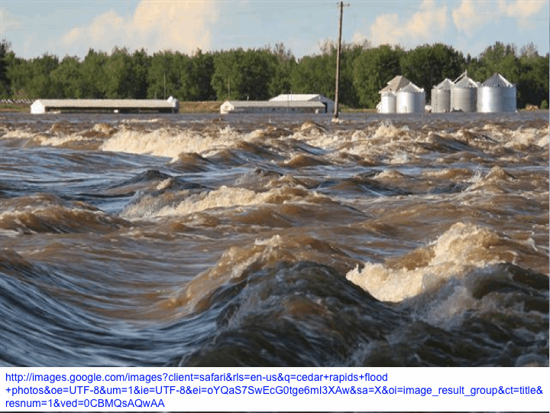

Slide 41
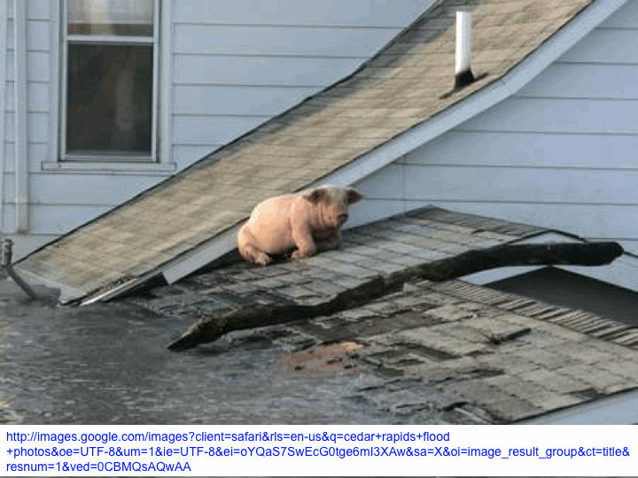
This is not normal weather

Slide 43
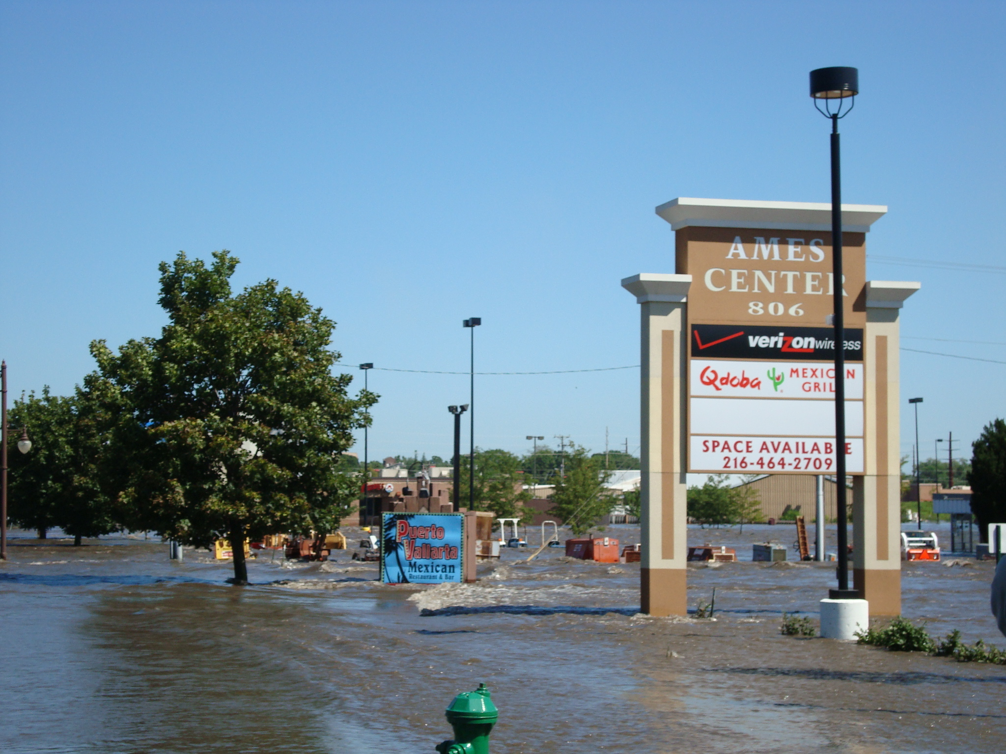
2010

Slide 44
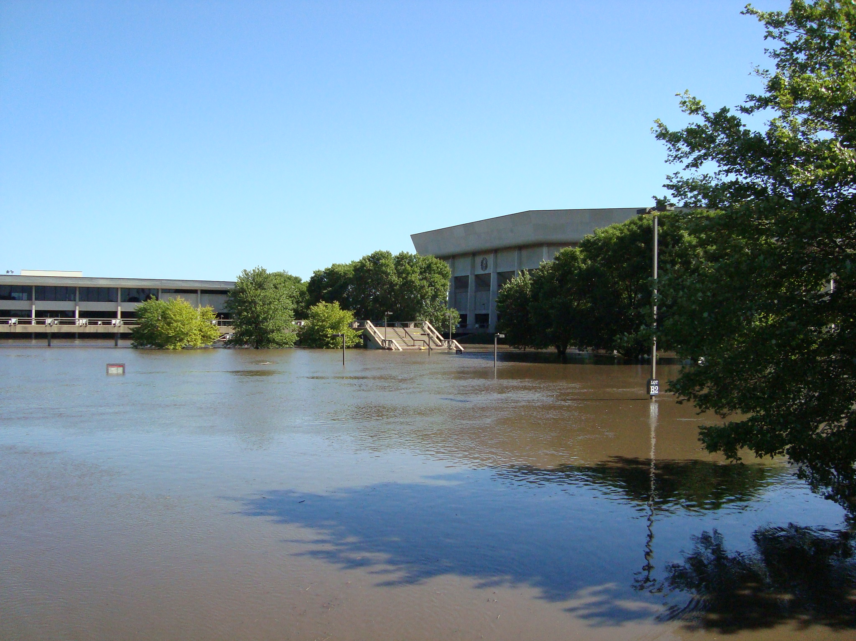

Slide 45
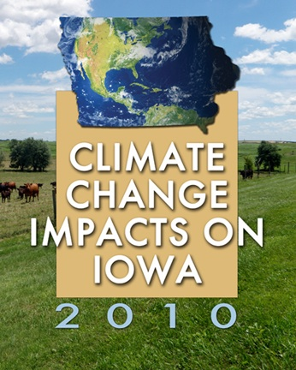
http://climate.engineering.iastate.edu/CSPPublications.html
Image courtesy of NASA/GSFC

Slide 46
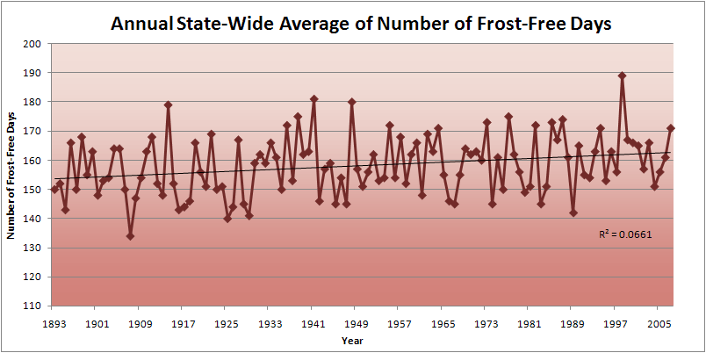
Iowa State-Wide Average Data

Slide 47
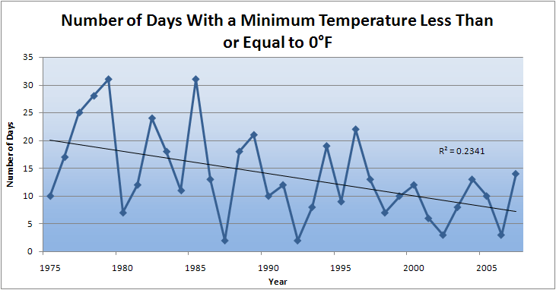
Des Moines Airport Data
Caution: Not corrected for urban heat island effects

Slide 48
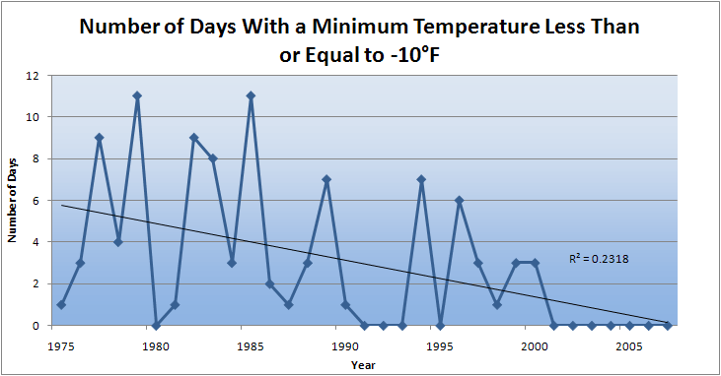
Des Moines Airport Data
Caution: Not corrected for urban heat island effects

Slide 49
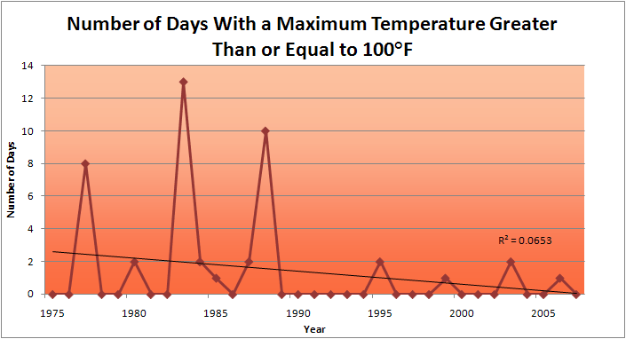
Des Moines Airport Data
1983: 13
1988: 10
1977: 8
2009: 0
2010: 0

Slide 50
Des Moines Airport Data
1983: 13
1988: 10
6 days ≥ 100ºF in the last 22 years
1977: 8
2009: 0
2010: 0

Slide 53
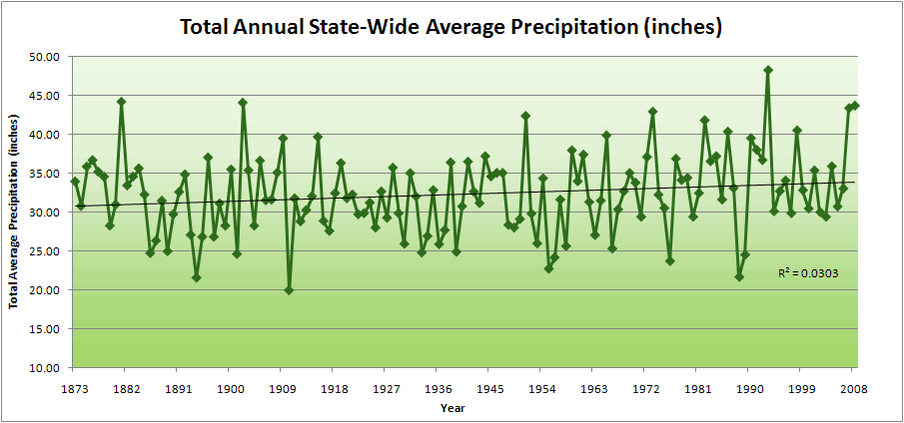
Iowa State-Wide Average Data

Slide 54
Iowa State-Wide Average Data
34.0”
10% increase
30.8”

Slide 55
Iowa State-Wide Average Data
Totals above 40”
2 years

Slide 56
Iowa State-Wide Average Data
Totals above 40”
8 years
2 years

Slide 57
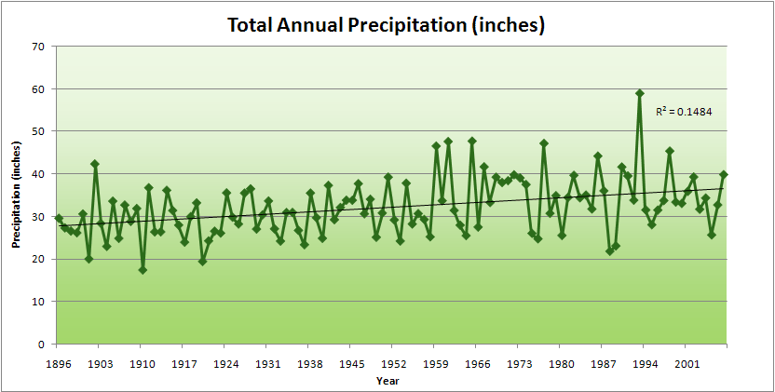
Cedar Rapids Data

Slide 58
Cedar Rapids Data
28.0”
32% increase
37.0”

Slide 59
Cedar Rapids Data
Years with more than 40 inches
11
1
28.0”
32% increase
37.0”

Slide 60
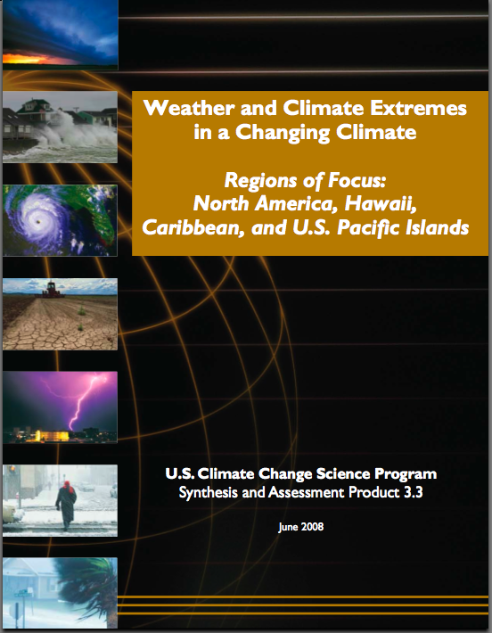
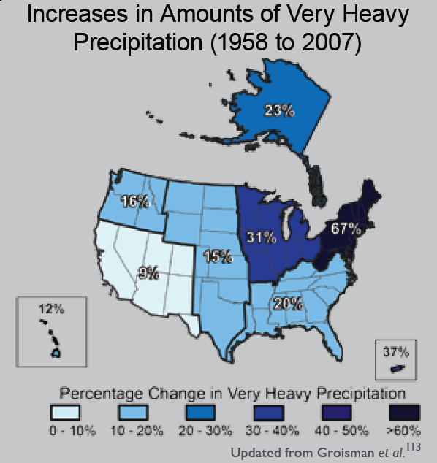
“One of the clearest trends in the United States observational record is an increasing frequency and intensity of heavy precipitation events… Over the last century there was a 50% increase in the frequency of days with precipitation over 101.6 mm (four inches) in the upper midwestern U.S.; this trend is statistically significant “
Karl, T. R., J. M. Melillo, and T. C. Peterson, (eds.), 2009: Global Climate Change Impacts in the United States. Cambridge University Press, 2009, 196pp.

Slide 61

Cedar Rapids Data
1.25 inches
4.2 days
57% increase
6.6 days

Slide 62
Cedar Rapids Data
1.25 inches
Years having more than 8 days
13
2
4.2 days
57% increase
6.6 days

Slide 63
Years with more than 40 inches: 43% Increase
2010 so far

Slide 64
2010 through Sept 27
3.7
41% Increase
5.2

Slide 65
Years having more than 8 days
2010 through Sept 27
7
350% Increase
2
3.7
41% Increase
5.2

Slide 66


Slide 67

Rise in global mean temperature (ºC)

Slide 68

Rise in global mean temperature (ºC)

Slide 69

Energy intensive
Balanced fuel sources
More environmentally friendly
Limit to avoid “dangerous anthropogenic
Interference” with the climate system
2ºC limit
IPCC Fourth Assessment Report Summary for Policy Makers

Slide 70

Long-Term Stabilization Profiles
A2
B1
2008
2009
Nebojša Nakićenović IIASA, Vienna

Slide 71
Long-Term Stabilization Profiles
A2
Achieving this emission reduction scenario will provide a 50% chance of not exceeding the 2ºC guardrail
B1
2008
2009
Nebojša Nakićenović IIASA, Vienna

Slide 72
Long-Term Stabilization Profiles
A2
Achieving this emission reduction scenario will provide a 50% chance of not exceeding the 2ºC guardrail
B1
Carbon reductions needed will be 90 times as large
as the impact of the 2009 recession
2008
2009
Nebojša Nakićenović IIASA, Vienna

Slide 73

Share of Carbon-Free Energy
4.5ºC
4.0ºC
3.0ºC
2.0ºC*
* maximum temperature change over the 21st century assuming 3ºC climate sensitivity
Nebojša Nakićenović IIASA, Vienna
Notes:
Add temperature numbers here as well!!

Slide 74
Summary
Global temperature trends of the 20C cannot be explained on the basis of natural variation alone
Only when the influences of greenhouse gases and sulfate aerosols are included can the trends be explained
Models that explain these trends, when projected into the future, indicate a 1.5-6.5ºC warming over the 21C
Societies around the world are already suffering negative impacts of climate change
Substantial adverse consequences to sea-level rise, food production, fresh-water supplies, severe weather events, environmental degradation and human health will occur for temperature increases above 2ºC
The major challenge to our global society is to figure out how to avoid the unmanageable elements of future global climate change

Slide 75
For More Information
Contact me directly:
gstakle@iastate.edu
Current research on regional climate and climate change is being conducted at Iowa State University under the Regional Climate Modeling Laboratory
http://rcmlab.agron.iastate.edu/
North American Regional Climate Change Assessment Program
http://www.narccap.ucar.edu/
For current activities on the ISU campus, regionally and nationally relating to climate change see the Climate Science Initiative website:
http://climate.engineering.iastate.edu/
Or just Google Eugene Takle

