Slide 1
Image courtesy of NASA/GSFC

Slide 2
Use of Climate Modeling and Analysis of Recent Trends to Develop Adaptive Strategies to Climate Change in the Midwest
Eugene S. Takle
Professor
Department of Agronomy
Department of Geological and Atmospheric Science
Director, Climate Science Program
Iowa State University
Ames, IA 50011
Environmental Challenges and Responses
ENV 120
Grinnell College
1 October 2010

Slide 3
Outline
Observed global changes in carbon dioxide and temperature
Projected future changes in global and US temperatures and precipitation
Adaptation (managing the unavoidable)
Mitigation (avoiding the unmanageable)
Confronting Climate Change: Avoiding the Unmanageable, Managing the Unavoidable,
Rosina Bierbaum, John P. Holdren, Michael MacCracken, Richard Moss, and Peter H. Raven.
http://www.globalproblems-globalsolutions-files.org/unf_website/PDF/climate%20_change_avoid_unmanagable_manage_unavoidable.pdf

Slide 4
Climate change is one of the most important issues facing humanity
The scientific evidence clearly indicates that our climate is changing, and that human activities have been identified as a dominant contributing cause.
Don Wuebbles
Notes:
No disagreement in peer reviewed literature
Powerful statements from every major professional science society and organization in the world
Powerful statements from the National Academies of Sciences (the leadership in science) for every major country
G8 + 5 other countries, May 2009: “The need for urgent action to address climate change is now indisputable.”

Slide 5
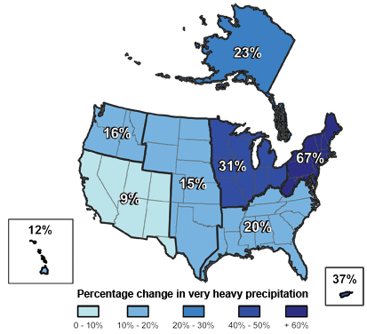
Climate changes are underway in the U.S. and are projected to grow
Temperature rise
Sea-level rise
Increase in heavy downpours
Rapidly retreating glaciers
Thawing permafrost
Lengthening growing season
Lengthening ice-free season in the ocean and on lakes and rivers
Earlier snowmelt
Changes in river flows
Plants blooming earlier; animals, birds and fish moving northward
Don Wuebbles

Slide 6
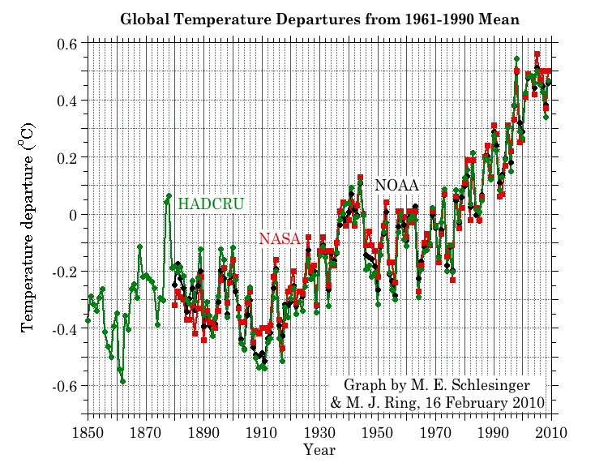
Three separate analyses of the temperature record – Trends are in close agreement
Don Wuebbles

Slide 7
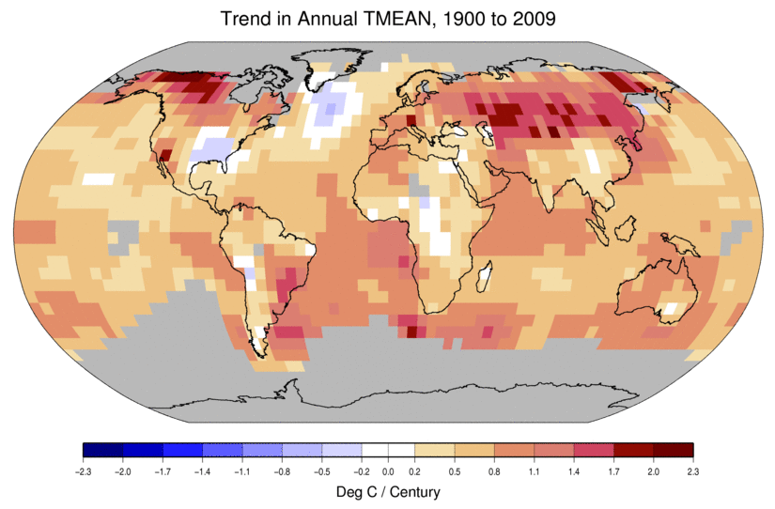
Temperature Changes are Not Uniform Around the Globe
From Tom Karl, NOAA NCDC

Slide 8
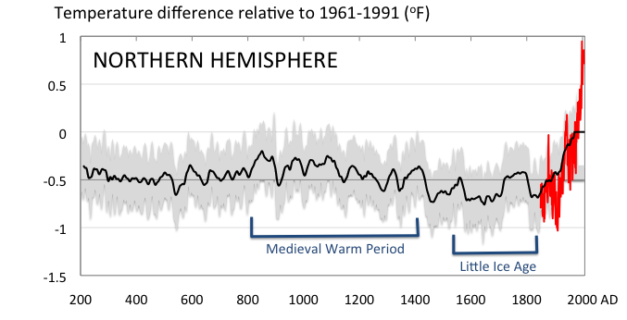
Conditions today are unusual in the context of the last 2,000 years …
Don Wuebbles

Slide 9
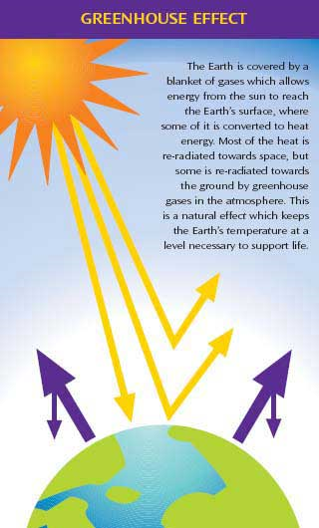
Why does the Earth warm? 1. Natural causes
THE GREENHOUSE EFFECT…
…is 100% natural.
Heat is trapped in the atmosphere.
…sustains life on Earth.
Keeps average temperatures at 12.8ºC (55ºF), instead of –29ºC (-20ºF).
Don Wuebbles

Slide 10
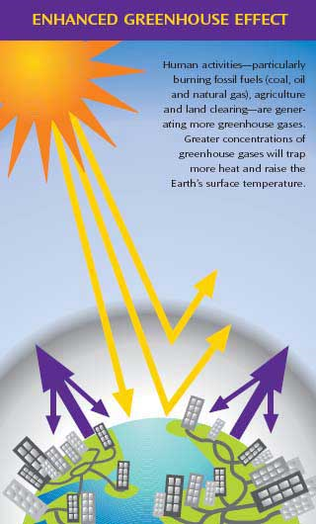
Why does the Earth warm? 2. Human causes
THE ENHANCED GREENHOUSE EFFECT
(or GLOBAL WARMING)
… is primarily human-induced: We’re increasing heat-trapping gases in the atmosphere.
… is like wrapping an extra blanket around the Earth.
Don Wuebbles

Slide 11
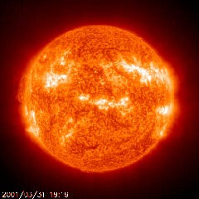
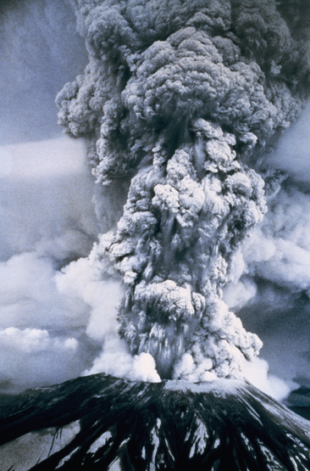
Natural factors affect climate
Variations in the energy
received from the sun
Variations in the Earth's orbit
(Milankovic effect)
Stratospheric
aerosols from
energetic
volcanic eruptions
Chaotic interactions in
the Earth's climate
(for example, El Nino, NAO)
Don Wuebbles

Slide 12
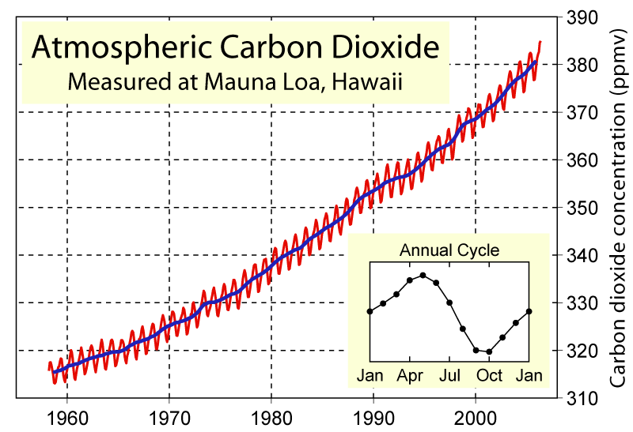
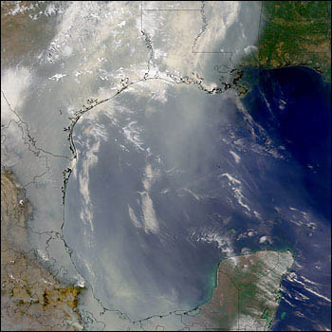
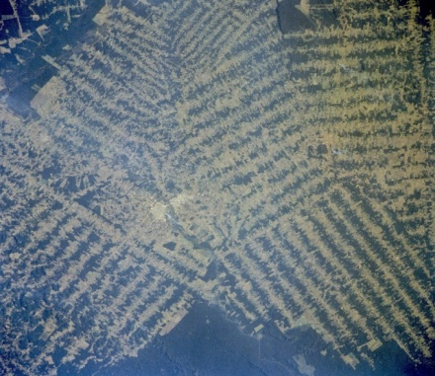
Non-natural mechanisms
Changes in atmospheric concentrations of radiatively important gases
Changes in aerosol particles from burning fossil fuels and biomass
Changes in the reflectivity (albedo) of the Earth’s surface
Don Wuebbles

Slide 13
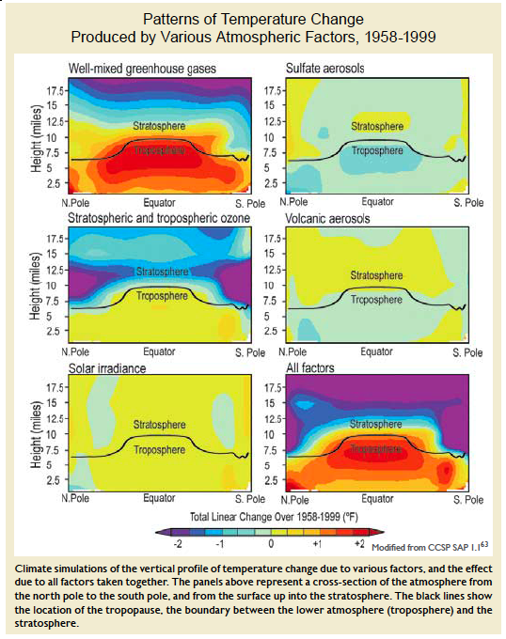
Warming of the Lower and Upper Atmosphere Produced by Natural and Human Causes
Karl, T. R., J. M. Melillo, and T. C. Peterson, (eds.), 2009: Global Climate Change Impacts in the United States. Cambridge University Press, 2009, 196pp.

Slide 14
Warming of the Lower and Upper Atmosphere Produced by Natural and Human Causes
Note that greenhouse gases have a unique temperature signature, with strong warming in the upper troposphere, cooling in the lower stratosphere and strong warming at the surface over the North Pole. No other warming factors have this signature.
Karl, T. R., J. M. Melillo, and T. C. Peterson, (eds.), 2009: Global Climate Change Impacts in the United States. Cambridge University Press, 2009, 196pp.

Slide 15
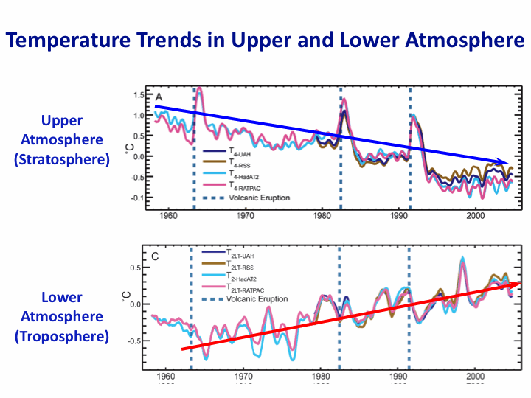
Warming of the Lower and Upper Atmosphere Produced by Natural and Human Causes
Note that greenhouse gases have a unique temperature signature, with strong warming in the upper troposphere, cooling in the lower stratosphere and strong warming at the surface over the North Pole. No other warming factors have this signature.
Karl, T. R., J. M. Melillo, and T. C. Peterson, (eds.), 2009: Global Climate Change Impacts in the United States. Cambridge University Press, 2009, 196pp.

Slide 16
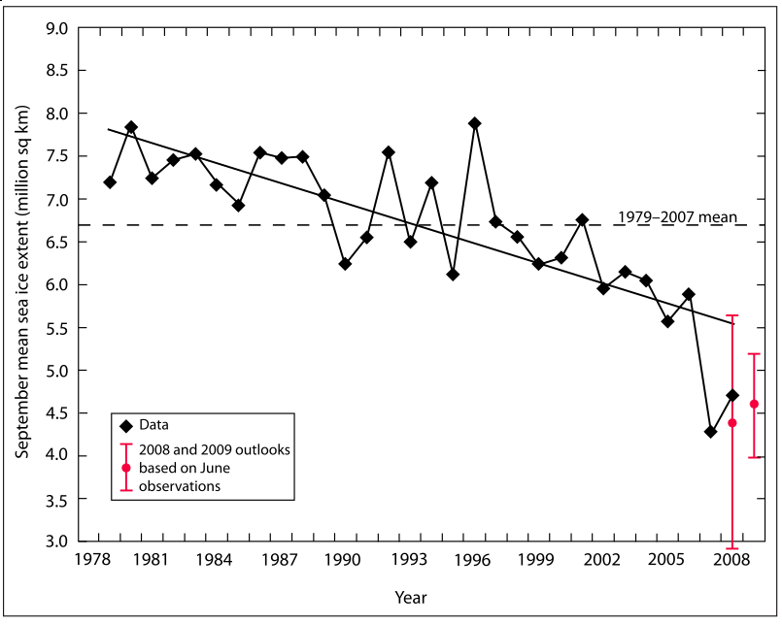
Warming of the Lower and Upper Atmosphere Produced by Natural and Human Causes
Note that greenhouse gases have a unique temperature signature, with strong warming in the upper troposphere, cooling in the lower stratosphere and strong warming at the surface over the North Pole. No other warming factors have this signature.

Slide 17
Many lines of evidence for conclusion of a “discernible human influence”
“Basic physics” evidence
Physical understanding of the climate system and the heat-trapping properties of greenhouse gases
Qualitative analysis evidence
Qualitative agreement between observed climate changes and model predictions of human-caused climate changes (warming of oceans, land surface and troposphere, water vapor increases, etc.)
Paleoclimate evidence
Reconstructions of past climates enable us to place the warming of the 20th century in a longer-term context
Fingerprint evidence
Rigorous statistical comparisons between modeled and observed patterns of climate change
Don Wuebbles

Slide 18
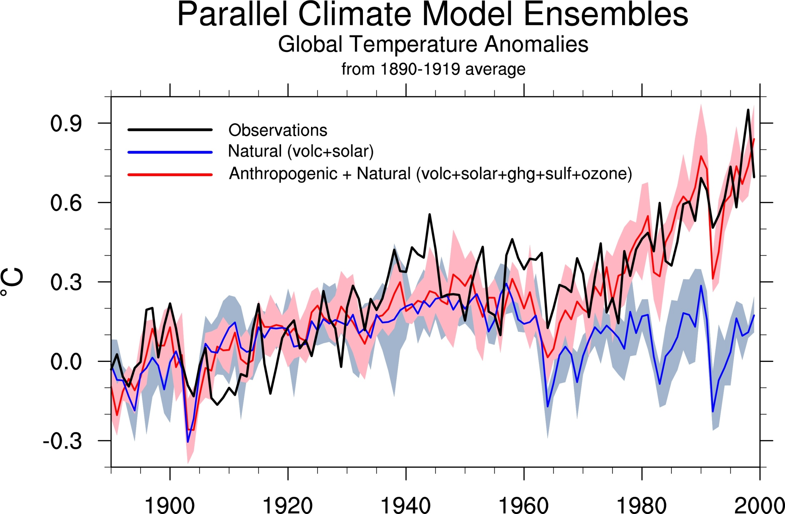
Climate models: Natural processes do not account for
observed 20th century warming after 1965

Slide 19
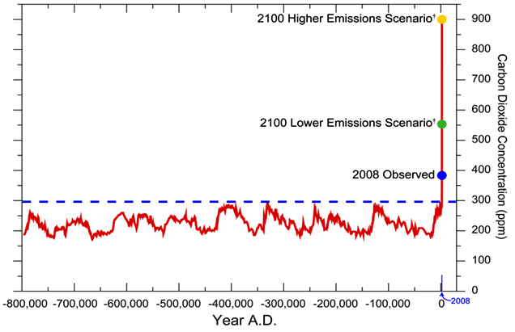
We have Moved Outside the Range of Historical Variation
800,000 Year Record of Carbon Dioxide Concentration
Don Wuebbles

Slide 20
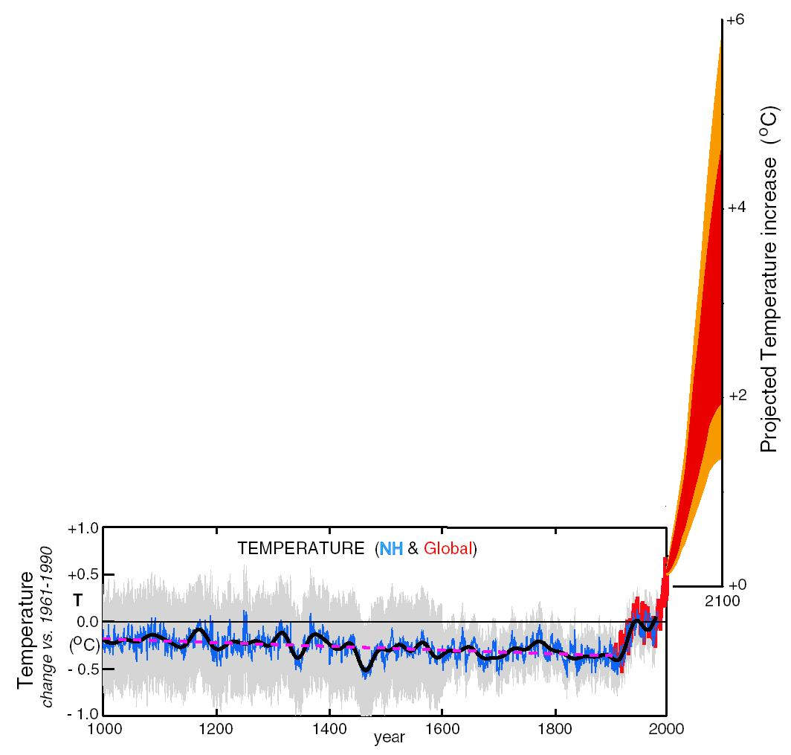
What can we expect in the future?
Don Wuebbles

Slide 21
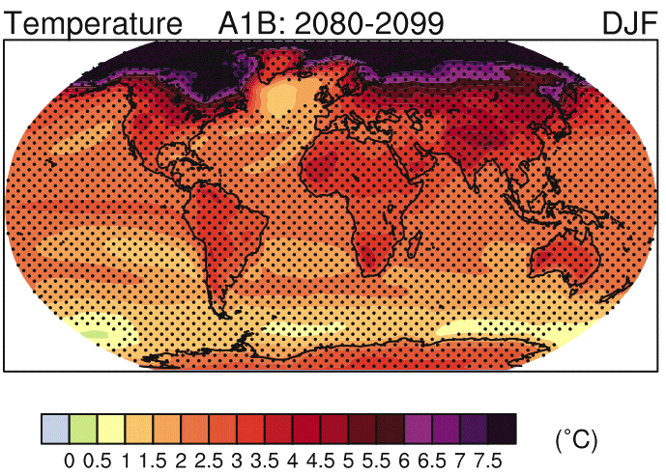
IPCC 2007

Slide 22
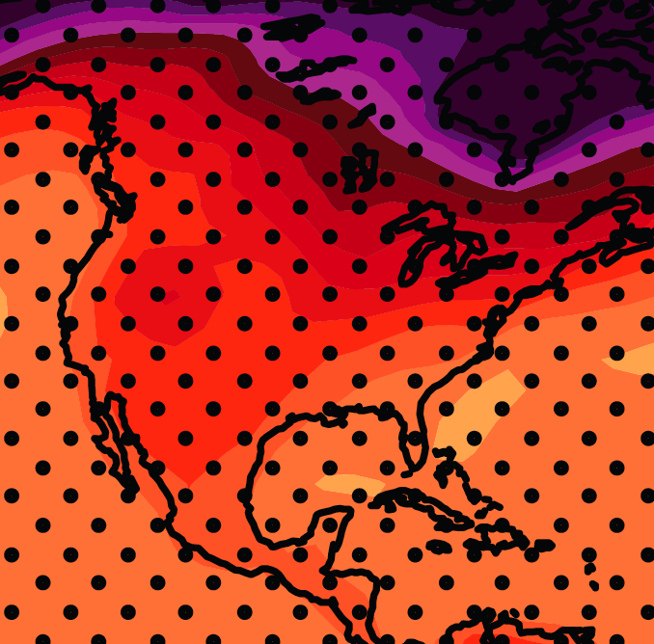
December-January-February Temperature Change
7.2ºF
6.3ºF
A1B Emission Scenario
2080-2099 minus1980-1999

Slide 23
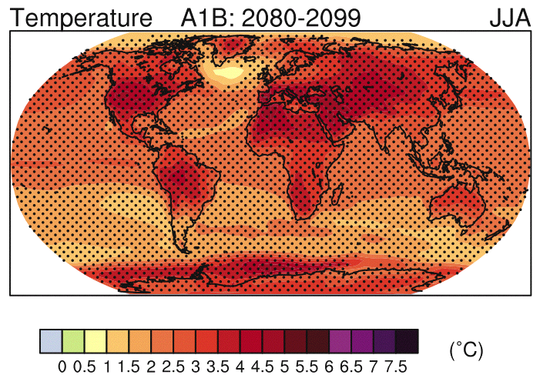
IPCC 2007

Slide 24
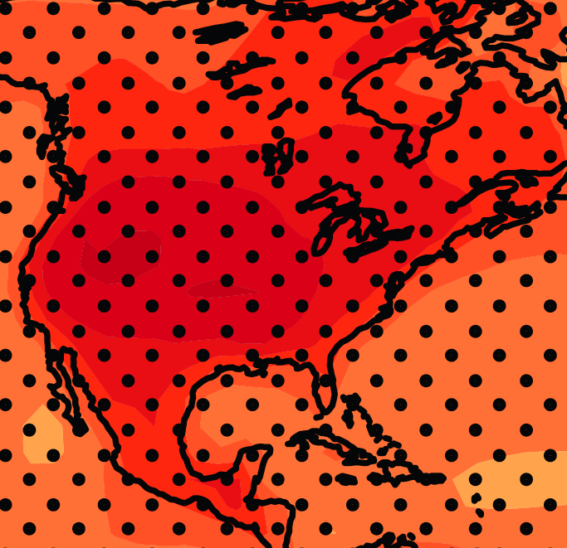
June-July-August Temperature Change
4.5ºF
5.4ºF
A1B Emission Scenario
2080-2099 minus1980-1999

Slide 25
June-July-August Temperature Change
4.5ºF
5.4ºF
A1B Emission Scenario
2080-2099 minus1980-1999
Not the direction of current trends

Slide 26
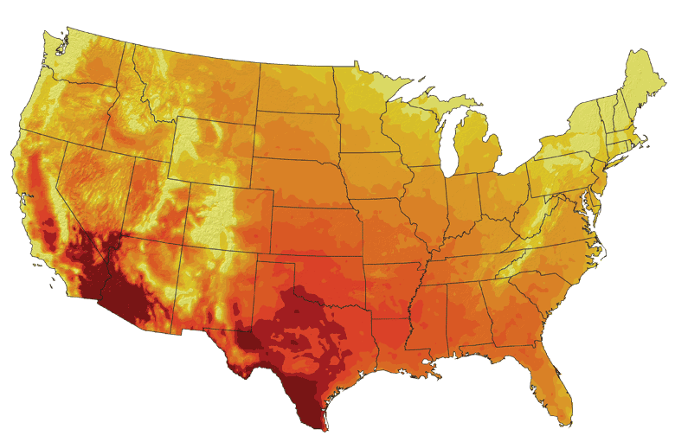
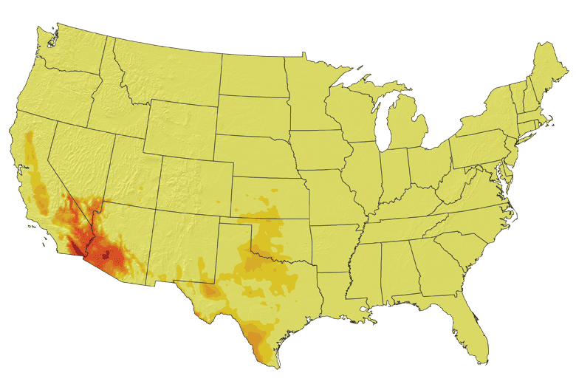
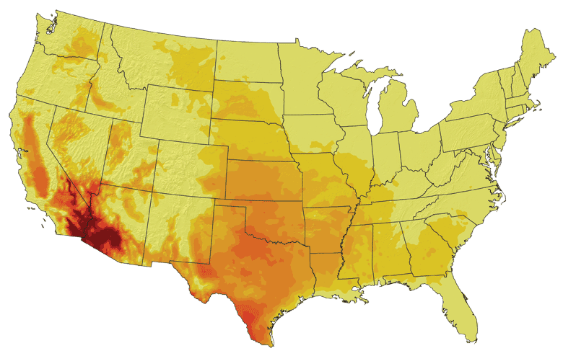
Increases in very high temperatures will have
wide-ranging effects
Higher Emissions Scenario, 2080-2099
Number of Days Over 100ºF
Recent Past, 1961-1979
Average:
30-60 days
Lower Emissions Scenario, 2080-2099
Average:
10-20 days
Don Wuebbles

Slide 27
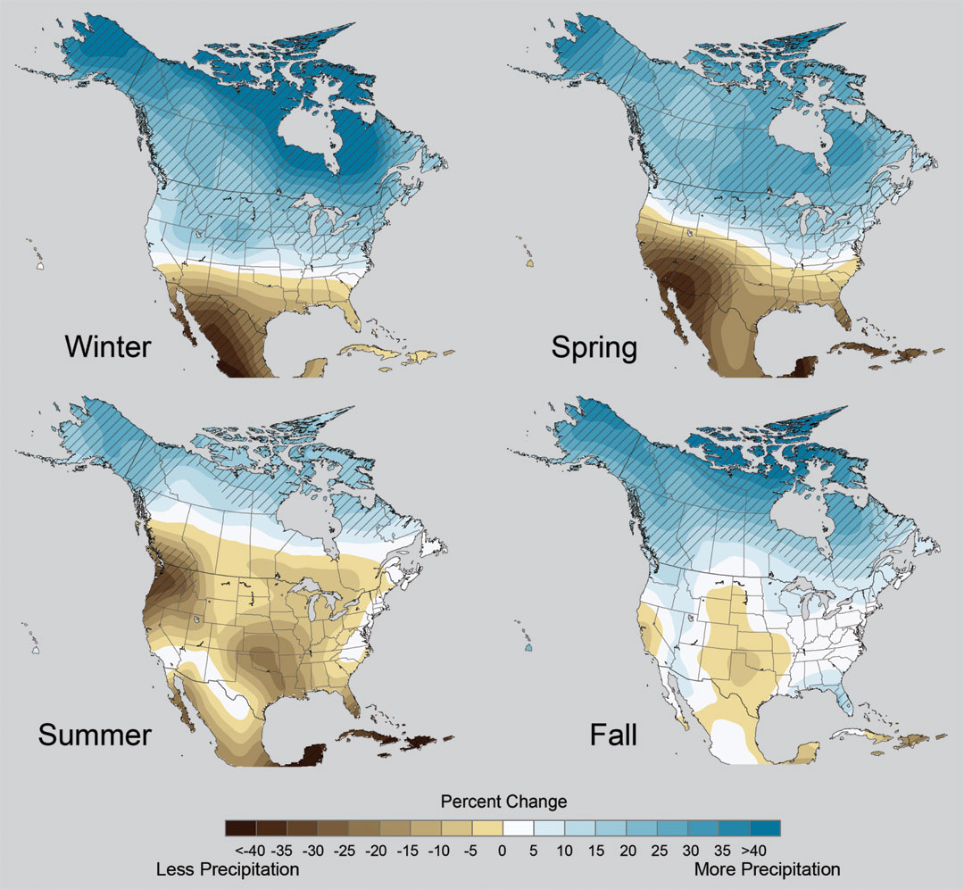
Projected Change in Precipitation: 2081-2099
Midwest: Increasing winter and spring precipitation, with drier summers
More frequent and intense periods of heavy rainfall
Unstippled regions indicate reduced confidence
Relative to 1960-1990
NOTE: Scale Reversed
Don Wuebbles

Slide 28
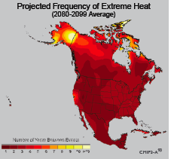
Extreme weather events become more common
Events now considered rare will become commonplace.
Heat waves will likely become longer and more severe
Droughts are likely to become more frequent and severe in some regions
Likely increase in severe thunderstorms (and perhaps in tornadoes).
Winter storm tracks are shifting
northward and the strongest storms are
likely to become stronger and more
frequent.
Don Wuebbles
Notes:
Shown here is the frequency at the end of the century of what we consider now to be a 20 year heat wave. Instead of once every 20 years, these temperatures would be experienced every other year or so over most of the continental US in this business as usual scenario.

Slide 29
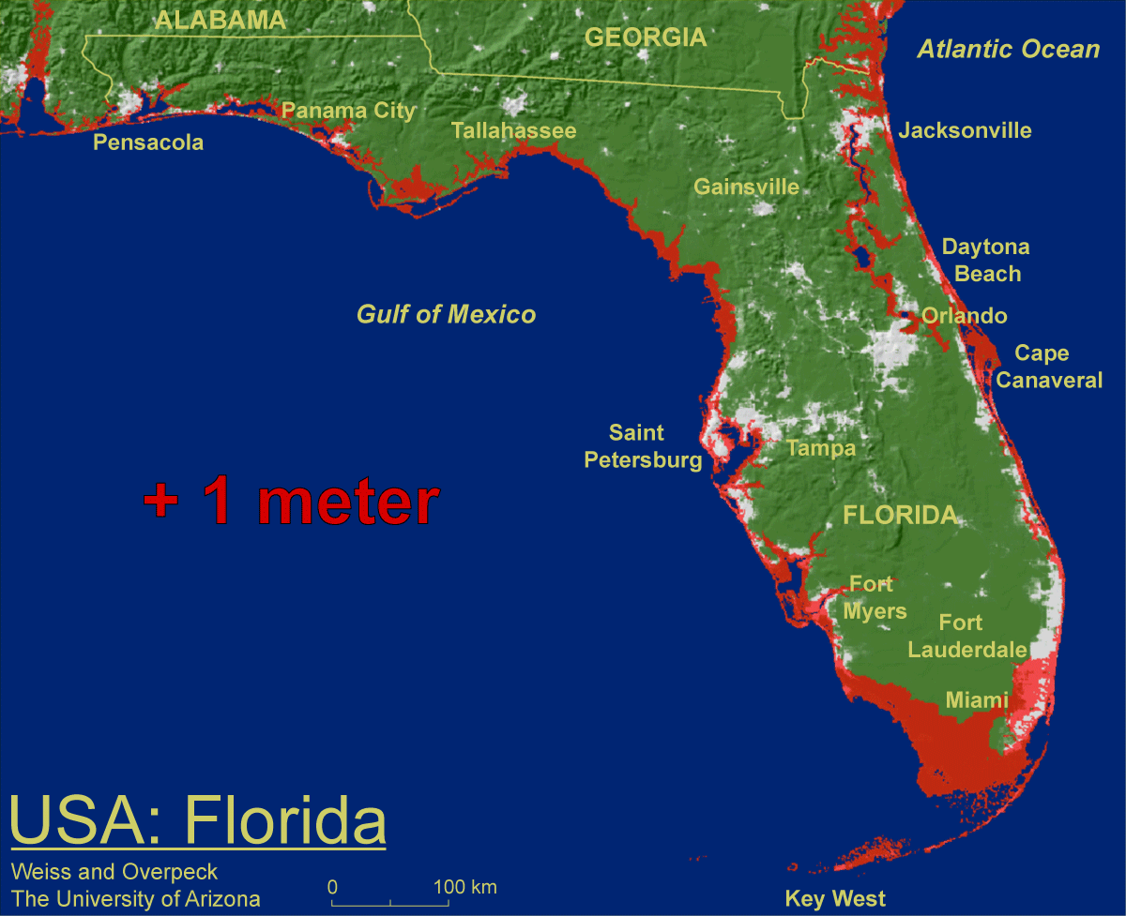
1 meter will be hard to avoid, possibly within this century, just from thermal expansion and small glacier melt.
Don Wuebbles

Slide 30
Widespread climate-related impacts are occurring now and are expected to increase
Water Resources
Energy Supply & Use
Transportation
Agriculture
Don Wuebbles
Ecosystems
Human Health
Society

Slide 31
Managing the Unavoidable:
Adapting to Climate Change

Slide 32
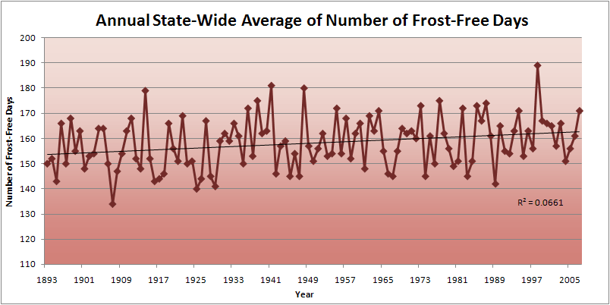
Iowa State-Wide Average Data

Slide 33
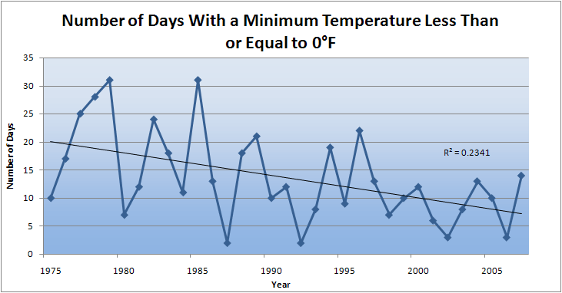
Des Moines Airport Data
Caution: Not corrected for urban heat island effects

Slide 34
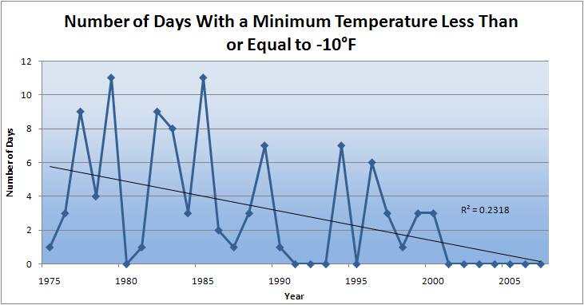
Des Moines Airport Data
Caution: Not corrected for urban heat island effects

Slide 35
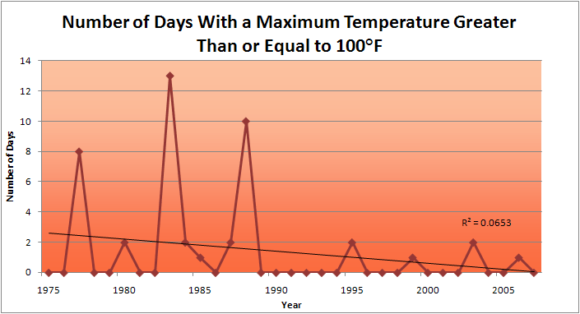
Des Moines Airport Data
1983: 13
1988: 10
1977: 8
2009: 0
2010: 0

Slide 36
Des Moines Airport Data
1983: 13
1988: 10
6 days ≥ 100ºF in the last 22 years
1977: 8
2009: 0
2010: 0

Slide 37
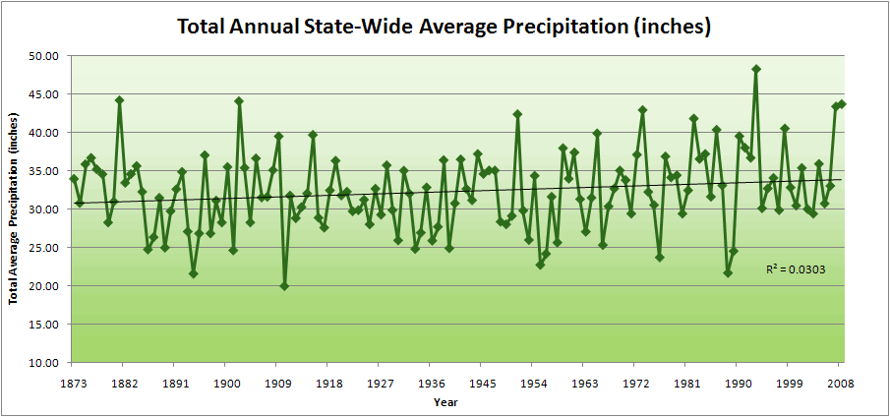
Iowa State-Wide Average Data

Slide 38
Iowa State-Wide Average Data
34.0”
8% increase
31.5”

Slide 39
Iowa State-Wide Average Data
Totals above 40”
2 years

Slide 40
Iowa State-Wide Average Data
Totals above 40”
8 years
2 years

Slide 41
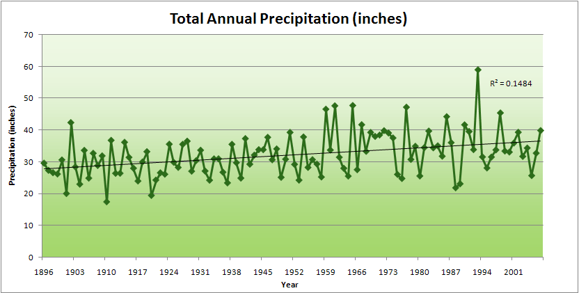
Cedar Rapids Data

Slide 42
Cedar Rapids Data
28.0”
32% increase
37.0”

Slide 43
Cedar Rapids Data
Years with more than 40 inches
11
1
28.0”
32% increase
37.0”

Slide 44
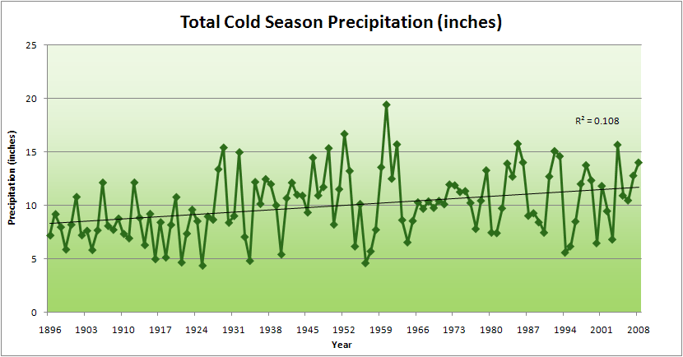
Cedar Rapids Data
51% increase
11.8”
7.8”

Slide 45
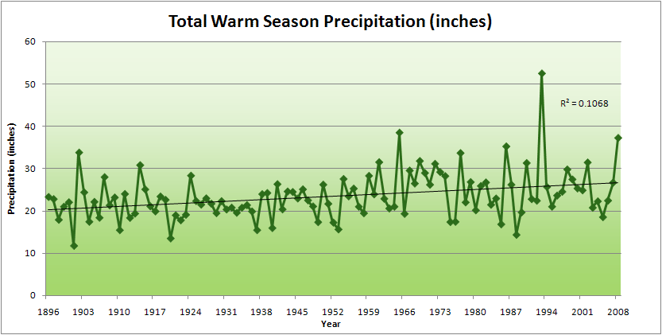
Cedar Rapids Data
34% increase
26.8”
20.2”

Slide 46
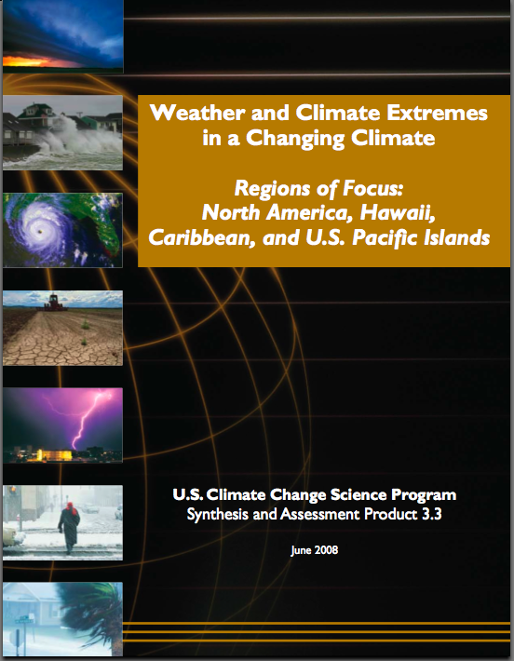
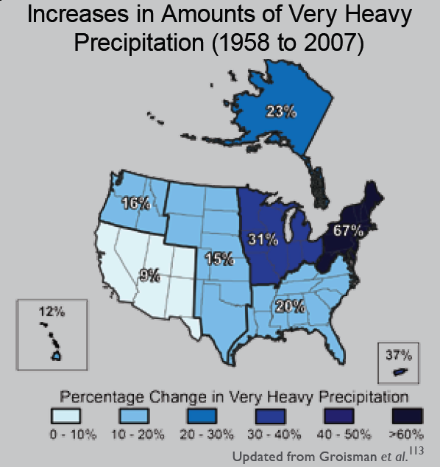
“One of the clearest trends in the United States observational record is an increasing frequency and intensity of heavy precipitation events… Over the last century there was a 50% increase in the frequency of days with precipitation over 101.6 mm (four inches) in the upper midwestern U.S.; this trend is statistically significant “
Karl, T. R., J. M. Melillo, and T. C. Peterson, (eds.), 2009: Global Climate Change Impacts in the United States. Cambridge University Press, 2009, 196pp.

Slide 47
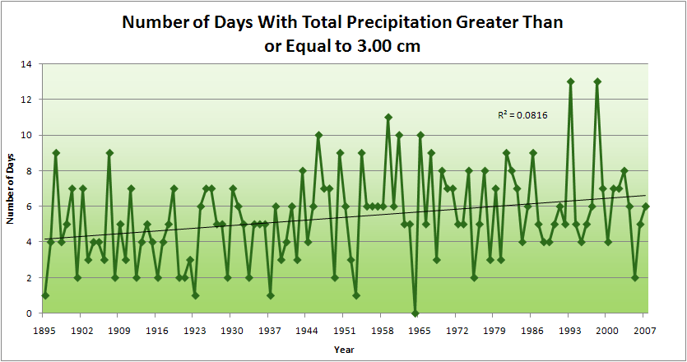
Cedar Rapids Data
4.2 days
57% increase
6.6 days

Slide 48
Cedar Rapids Data
Years having more than 8 days
13
2
4.2 days
57% increase
6.6 days

Slide 49
Years with more than 40 inches: 43% Increase
2010 so far

Slide 50
2010 through Sept 27
3.7
41% Increase
5.2

Slide 51
Years having more than 8 days
2010 through Sept 27
7
350% Increase
2
3.7
41% Increase
5.2

Slide 52
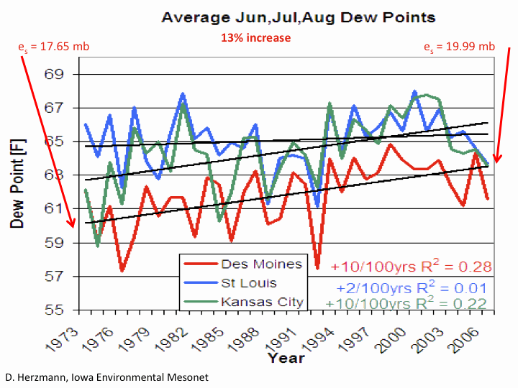

Slide 53
Iowa Agricultural Producers are Managing the Unavoidable:
Longer growing season: plant earlier, plant longer season hybrids, harvest later
Wetter springs: larger machinery enables planting in smaller weather windows
More summer precipitation: higher planting densities for higher yields
Wetter springs and summers: more subsurface drainage tile is being installed, closer spacing, sloped surfaces
Fewer extreme heat events: higher planting densities, fewer pollination failures
Higher humidity: more spraying for pathogens favored by moist conditions. more problems with fall crop dry-down, wider bean heads for faster harvest due to shorter harvest period during the daytime.
Drier autumns: delay harvest to take advantage of natural dry-down conditions
HIGHER YIELDS!!
Is it genetics or climate? Likely some of each.

Slide 54
Avoiding the Unmanageable :
Mitigating Impacts of Global Climate Change

Slide 55
Rise in global mean temperature (ºC)

Slide 56
Rise in global mean temperature (ºC)

Slide 57
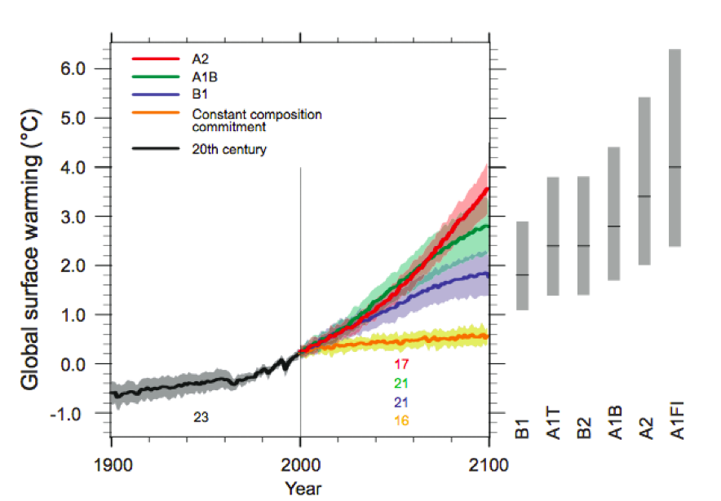
Energy intensive
Balanced fuel sources
More environmentally friendly
Limit to avoid “dangerous anthropogenic
Interference” with the climate system
2ºC limit
IPCC Fourth Assessment Report Summary for Policy Makers

Slide 58
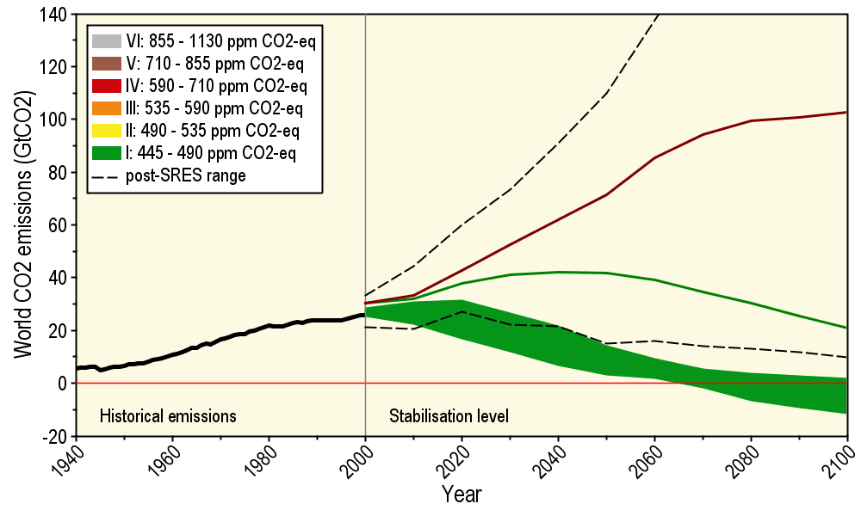
Long-Term Stabilization Profiles
A2
B1
Nebojša Nakićenović IIASA, Vienna

Slide 59
Long-Term Stabilization Profiles
A2
Achieving this emission reduction scenario will provide a 50% chance of not exceeding the 2ºC guardrail
B1
Nebojša Nakićenović IIASA, Vienna

Slide 60
Share of Carbon-Free Energy
4.5ºC
4.0ºC
3.0ºC
2.0ºC*
* maximum temperature change over the 21st century assuming 3ºC climate sensitivity
Nebojša Nakićenović IIASA, Vienna
Notes:
Add temperature numbers here as well!!

Slide 61
Summary
Global temperature trends of the 20C cannot be explained on the basis of natural variation alone
Only when the influences of greenhouse gases and sulfate aerosols are included can the trends be explained
Models that explain these trends, when projected into the future, indicate a 1.5-6.5ºC warming over the 21C
Societies are now engaged in managing the unavoidable
Substantial adverse consequences to sea-level rise, food production, fresh-water supplies, severe weather events, environmental degradation and human health will occur for temperature increases above 2ºC
The major challenge to our global society is to figure out how to avoid the unmanageable

Slide 62
For More Information
Contact me directly:
gstakle@iastate.edu
Current research on regional climate and climate change is being conducted at Iowa State University under the Regional Climate Modeling Laboratory
http://rcmlab.agron.iastate.edu/
North American Regional Climate Change Assessment Program
http://www.narccap.ucar.edu/
For current activities on the ISU campus, regionally and nationally relating to climate change see the Climate Science Initiative website:
http://climate.engineering.iastate.edu/
Or just Google Eugene Takle

