Slide 1

Image courtesy of NASA/GSFC

Slide 2
Sustainability under Global Climate Change:
Avoiding the Unmanageable, Managing the Unavoidable
Eugene S. Takle
Professor
Department of Agronomy
Department of Geological and Atmospheric Science
Director, Climate Science Program
Iowa State University
Ames, IA 50011
NREM 120
Iowa State University
13 April 2011

Slide 3
Outline
Observed global changes in carbon dioxide and temperature
Projected future changes in global and US temperatures and precipitation
Adaptation (managing the unavoidable)
Mitigation (avoiding the unmanageable)
Confronting Climate Change: Avoiding the Unmanageable, Managing the Unavoidable,
Rosina Bierbaum, John P. Holdren, Michael MacCracken, Richard Moss, and Peter H. Raven.
http://www.globalproblems-globalsolutions-files.org/unf_website/PDF/climate%20_change_avoid_unmanagable_manage_unavoidable.pdf

Slide 4
Climate change is one of the most important issues facing humanity
The scientific evidence clearly indicates that our climate is changing, and that human activities have been identified as a dominant contributing cause
Human actions of the next two decades will have significant impacts on the productivity, natural resiliency, and human habitability of major parts of the Earth at the end of this century
Notes:
No disagreement in peer reviewed literature
Powerful statements from every major professional science society and organization in the world
Powerful statements from the National Academies of Sciences (the leadership in science) for every major country
G8 + 5 other countries, May 2009: “The need for urgent action to address climate change is now indisputable.”

Slide 5
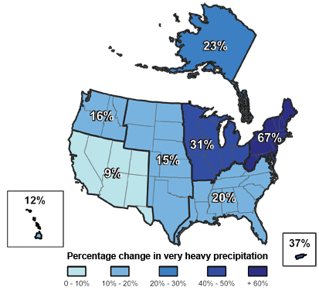
Climate changes are underway in the U.S. and are projected to grow
Temperature rise
Sea-level rise
Increase in heavy downpours
Rapidly retreating glaciers
Thawing permafrost
Lengthening growing
season
Lengthening ice-free season
in the ocean and on lakes
and rivers
Earlier snowmelt
Changes in river flows
Plants blooming earlier; animals, birds and fish moving northward
Don Wuebbles

Slide 6
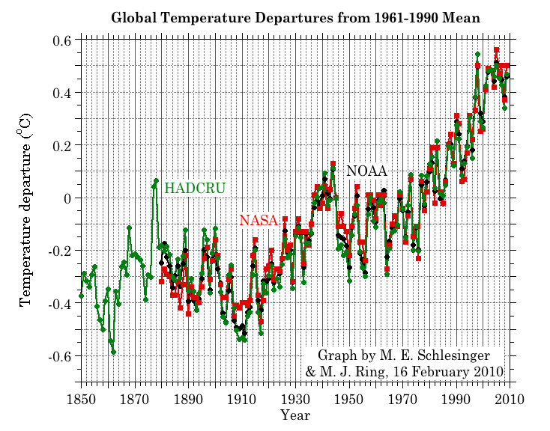
Three separate analyses of the temperature record – Trends are in close agreement
2010 has tied 2005 as the warmest year on record since 1880

Slide 7
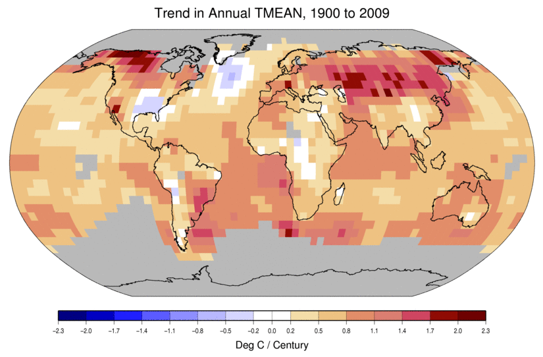
Temperature Changes are Not
Uniform Around the Globe
From Tom Karl, NOAA NCDC

Slide 8
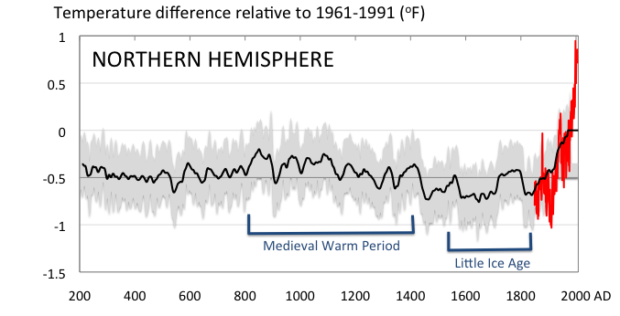
Conditions today are unusual in the context of the last 2,000 years …
Don Wuebbles

Slide 9
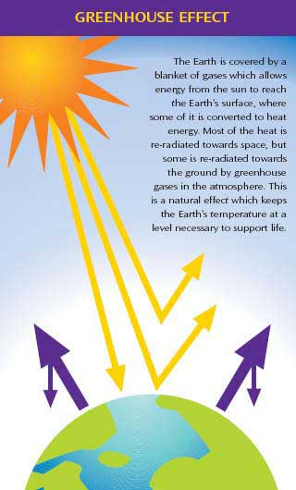
Why does the Earth warm?
1. Natural causes
THE GREENHOUSE EFFECT…
…is 100% natural.
  Heat is trapped in the atmosphere.
…sustains life on Earth.
  Keeps average temperatures at 12.8ºC (55ºF), instead of –29ºC (-20ºF).
Don Wuebbles

Slide 10
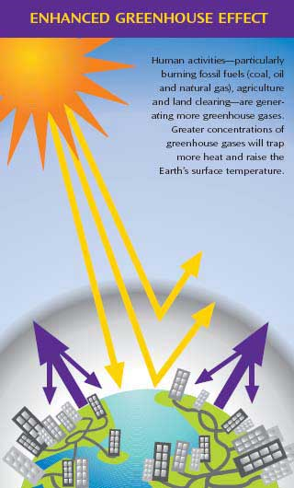
Why does the Earth warm?
2. Human causes
THE ENHANCED GREENHOUSE EFFECT
(or GLOBAL WARMING)
… is primarily human-induced: We’re increasing heat-trapping gases in the atmosphere.
… is like wrapping an extra blanket around the Earth.
Don Wuebbles

Slide 11
Image courtesy of NASA/GSFC

Slide 12
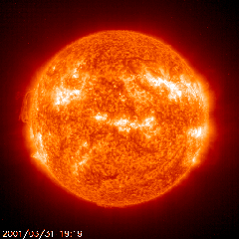
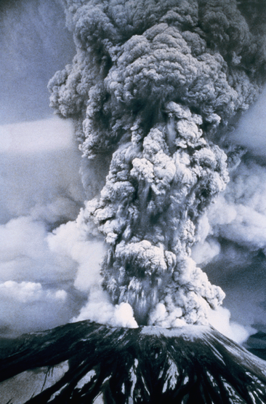
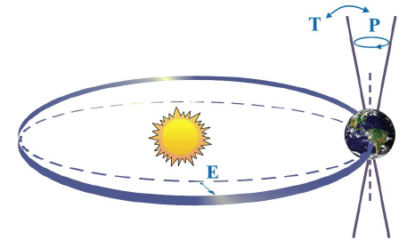

Natural factors affect climate
Variations in the energy
received from the sun
Variations in the Earth's orbit
(Milankovic effect)
Stratospheric
aerosols from
energetic
volcanic eruptions
Chaotic interactions in
the Earth's climate
(for example, El Nino, NAO)
Don Wuebbles

Slide 13
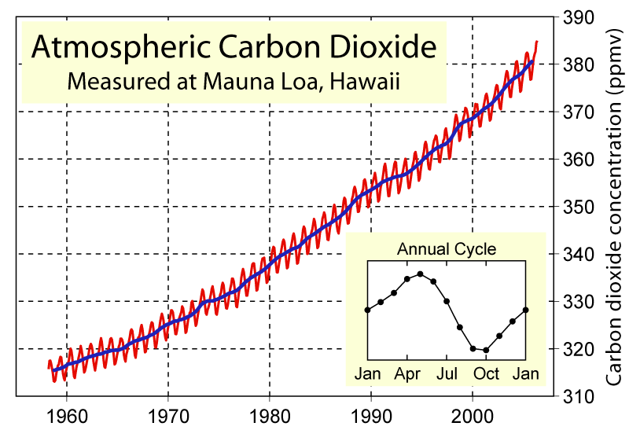
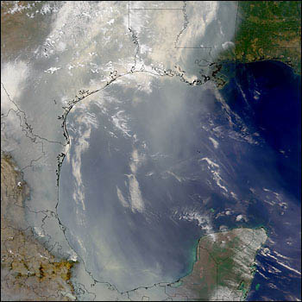
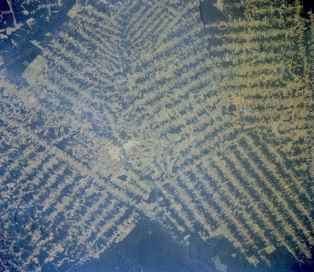
Non-natural mechanisms
Changes in atmospheric concentrations of radiatively important gases
Changes in aerosol particles from burning fossil fuels and biomass
Changes in the reflectivity (albedo) of the Earth’s surface
Don Wuebbles

Slide 14
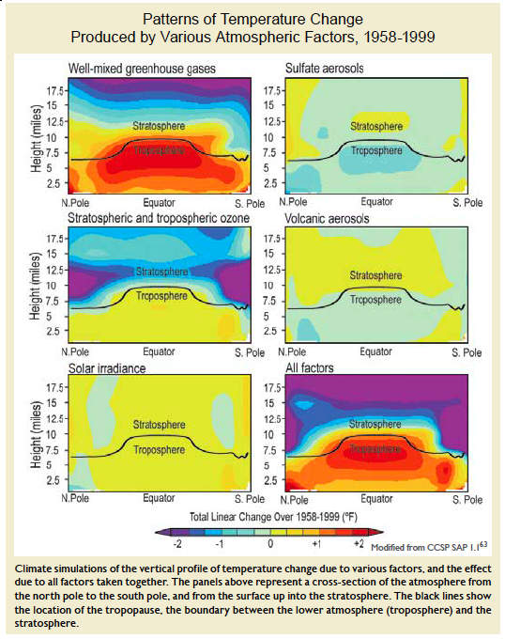
Warming of the Lower and Upper Atmosphere Produced by Natural and Human Causes
Karl, T. R., J. M. Melillo, and T. C. Peterson, (eds.), 2009: Global Climate Change Impacts in the United States. Cambridge University Press, 2009, 196pp.

Slide 15
Warming of the Lower and Upper Atmosphere Produced by Natural and Human Causes
Note that greenhouse gases have a unique temperature signature, with strong warming in the upper troposphere, cooling in the lower stratosphere and strong warming at the surface over the North Pole. No other warming factors have this signature.
Karl, T. R., J. M. Melillo, and T. C. Peterson, (eds.), 2009: Global Climate Change Impacts in the United States. Cambridge University Press, 2009, 196pp.

Slide 16
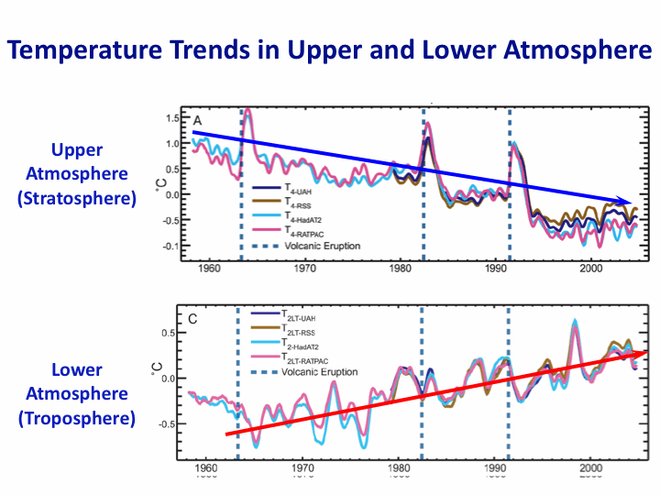
Warming of the Lower and Upper Atmosphere Produced by Natural and Human Causes
Note that greenhouse gases have a unique temperature signature, with strong warming in the upper troposphere, cooling in the lower stratosphere and strong warming at the surface over the North Pole. No other warming factors have this signature.
Karl, T. R., J. M. Melillo, and T. C. Peterson, (eds.), 2009: Global Climate Change Impacts in the United States. Cambridge University Press, 2009, 196pp.

Slide 17
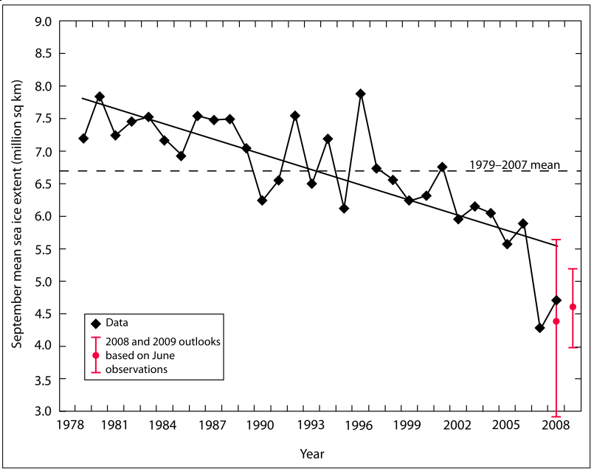
Warming of the Lower and Upper Atmosphere Produced by Natural and Human Causes
Note that greenhouse gases have a unique temperature signature, with strong warming in the upper troposphere, cooling in the lower stratosphere and strong warming at the surface over the North Pole. No other warming factors have this signature.

Slide 18
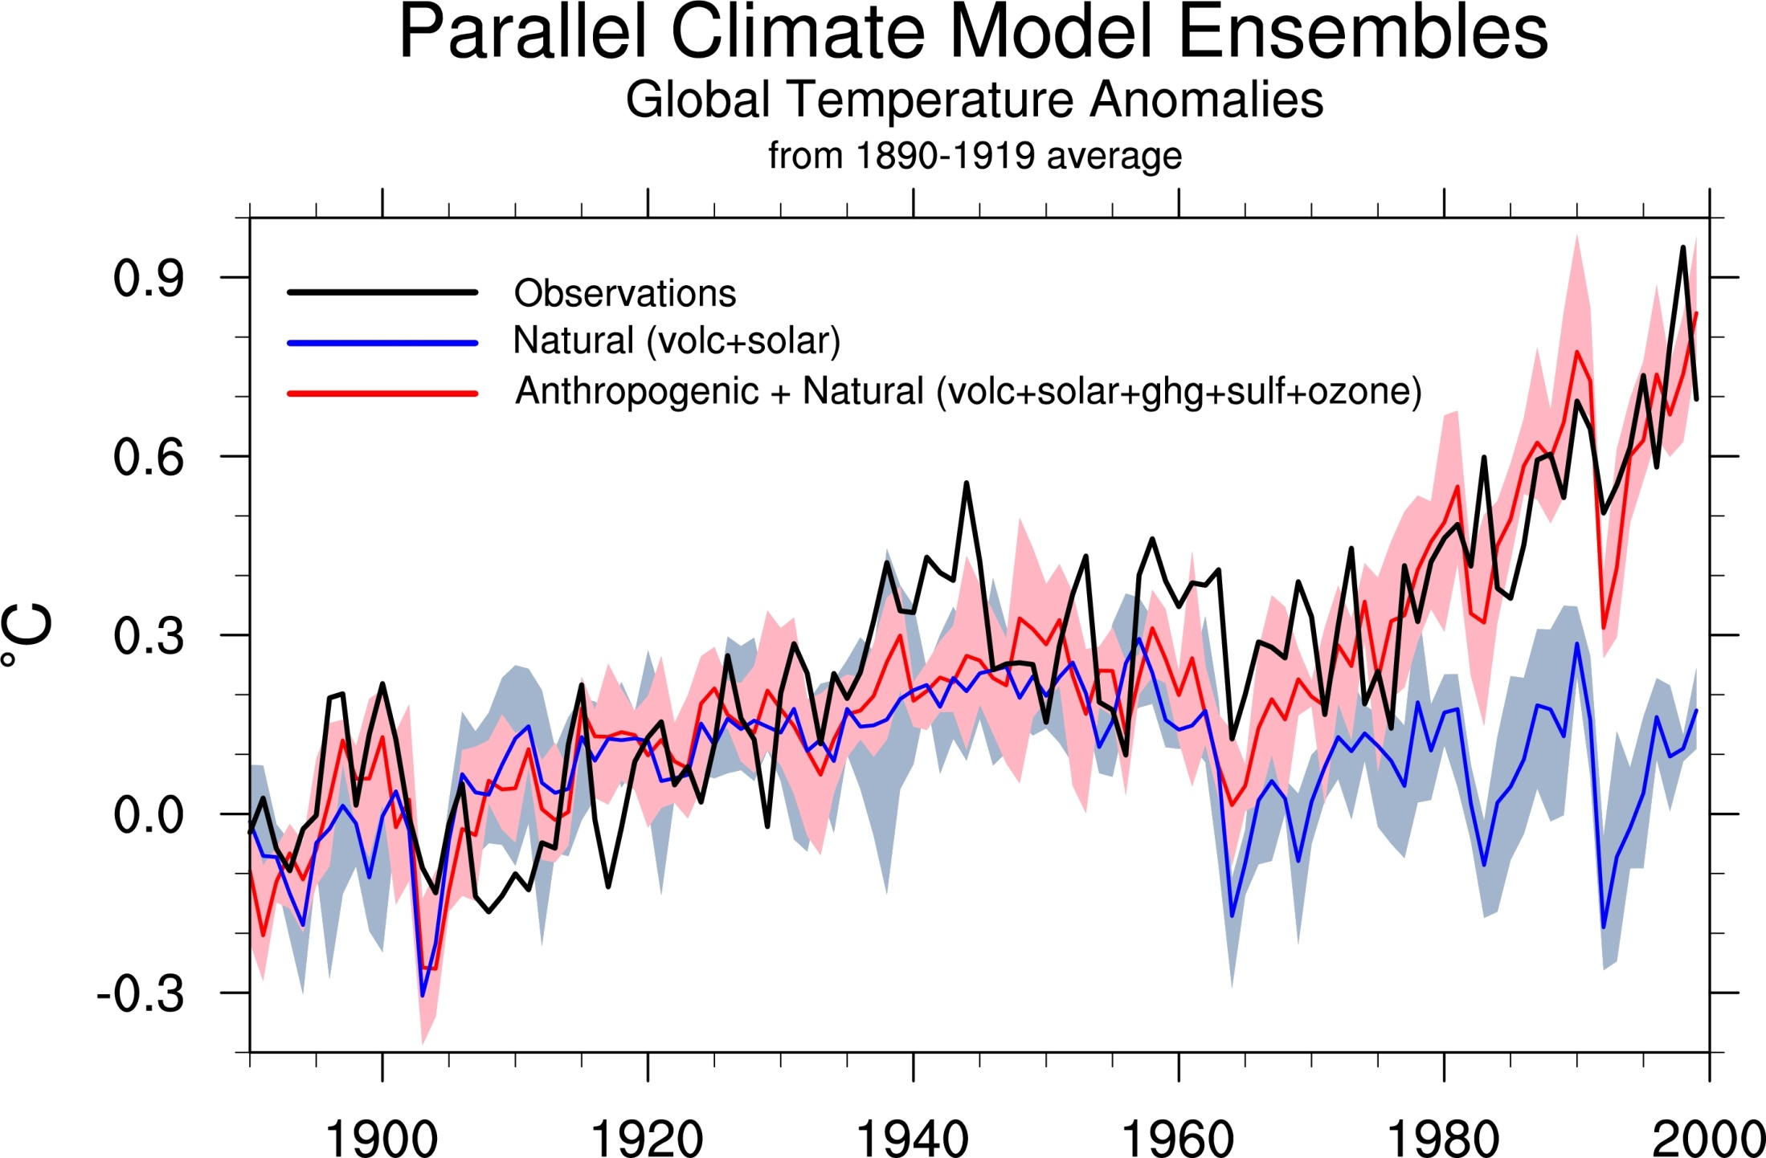
Climate models: Natural processes do not account for
observed 20th century warming after 1965

Slide 19
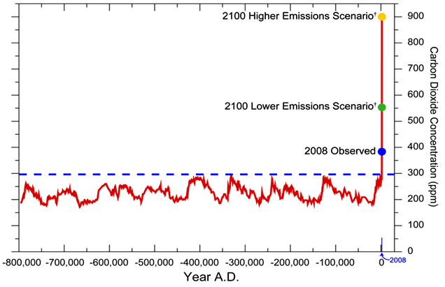
We have Moved Outside the Range of Historical Variation
800,000 Year Record of Carbon Dioxide Concentration
Don Wuebbles

Slide 20
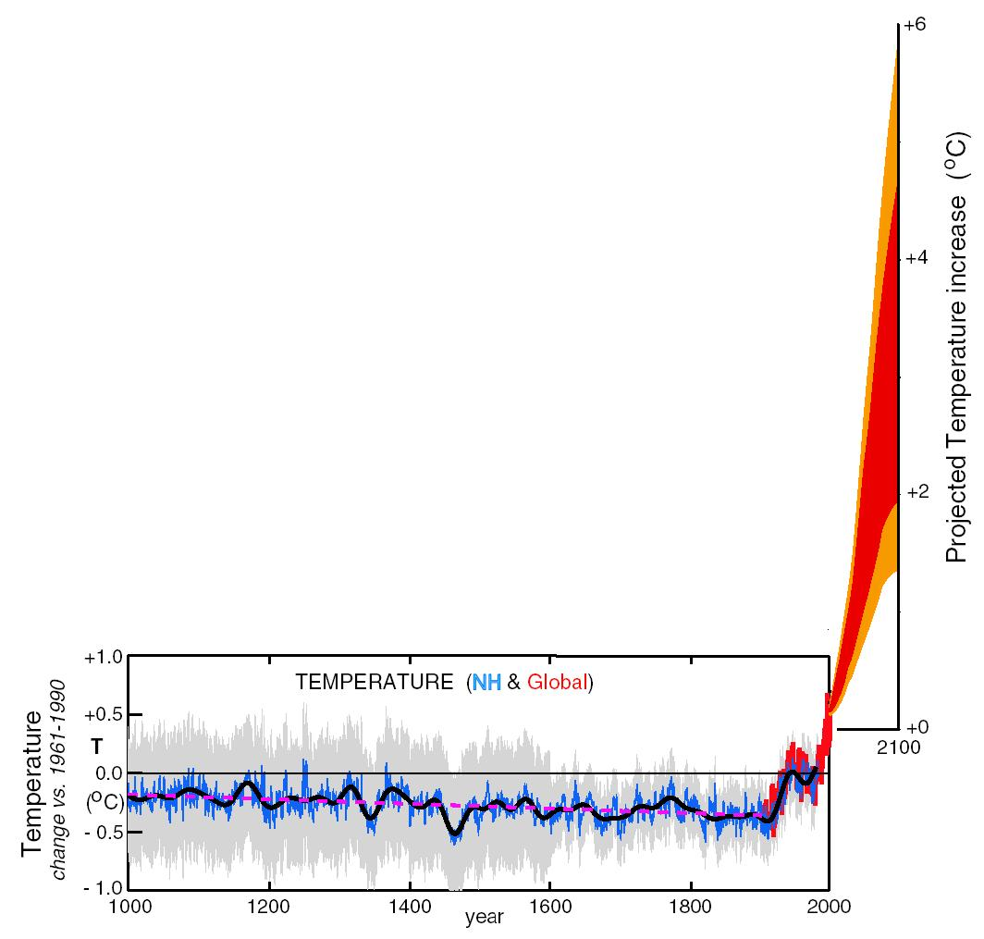
What can we expect in the future?
Don Wuebbles

Slide 21
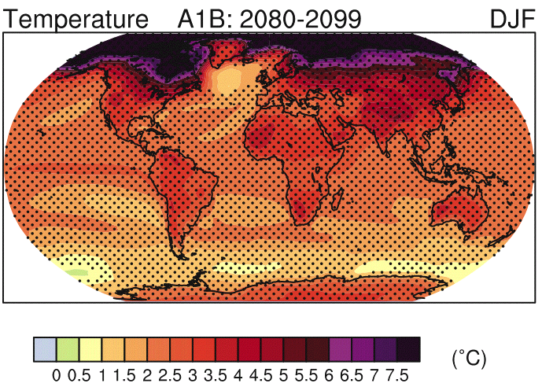
IPCC 2007

Slide 22
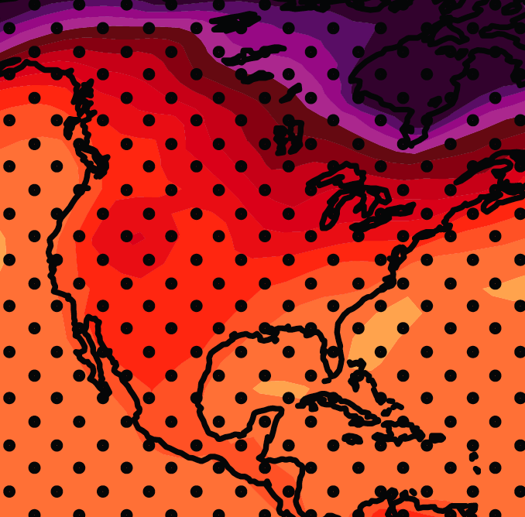
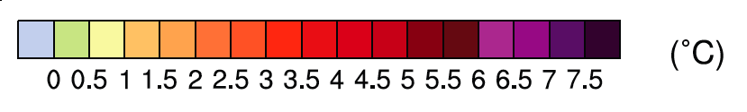
December-January-February Temperature Change
7.2ºF
6.3ºF
A1B Emission Scenario
2080-2099 minus1980-1999

Slide 23
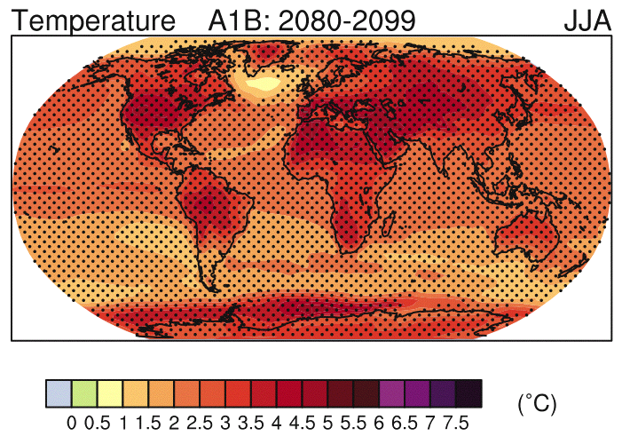
IPCC 2007

Slide 24
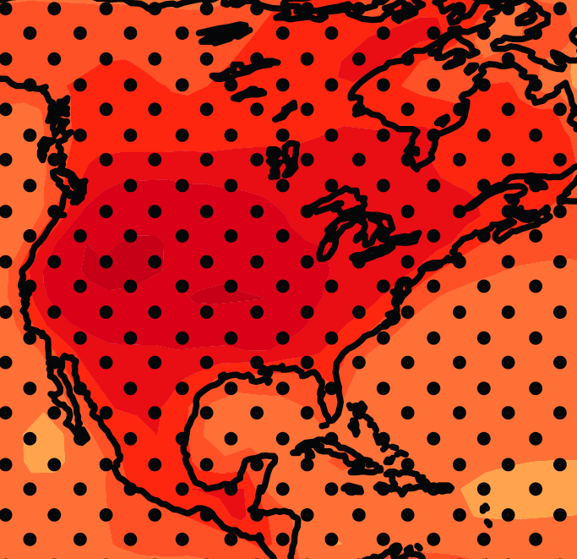
June-July-August Temperature Change
4.5ºF
5.4ºF
A1B Emission Scenario
2080-2099 minus1980-1999

Slide 25
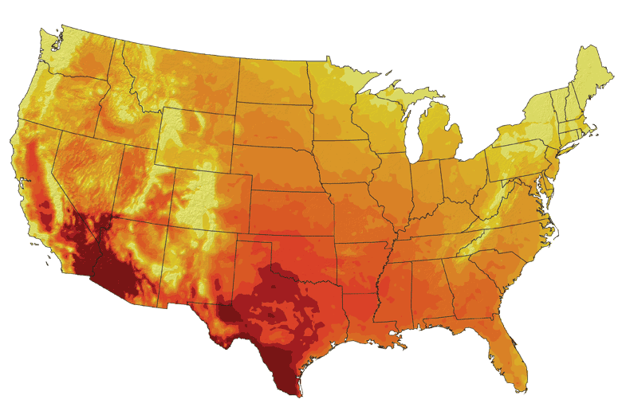
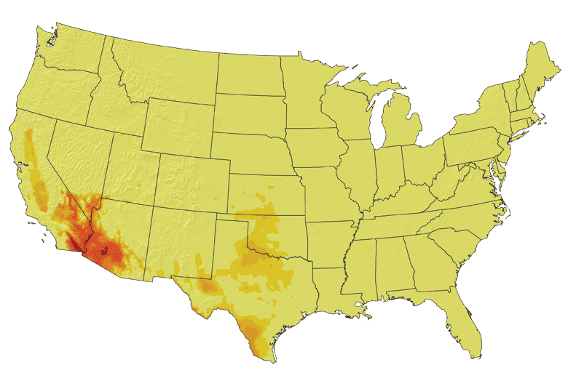
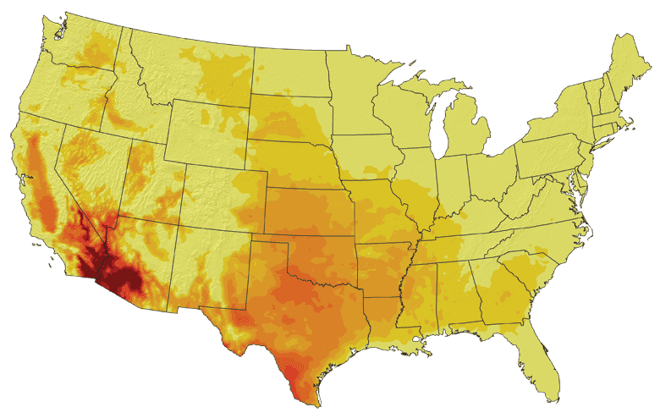
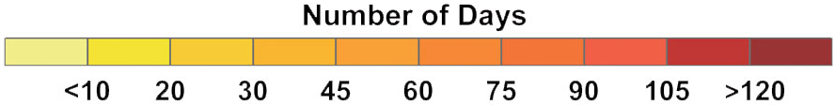
Increases in very high temperatures will have
wide-ranging effects
Higher Emissions Scenario, 2080-2099
Number of Days Over 100ºF
Recent Past, 1961-1979
Average:
30-60 days
Lower Emissions Scenario, 2080-2099
Average:
10-20 days
Don Wuebbles

Slide 26
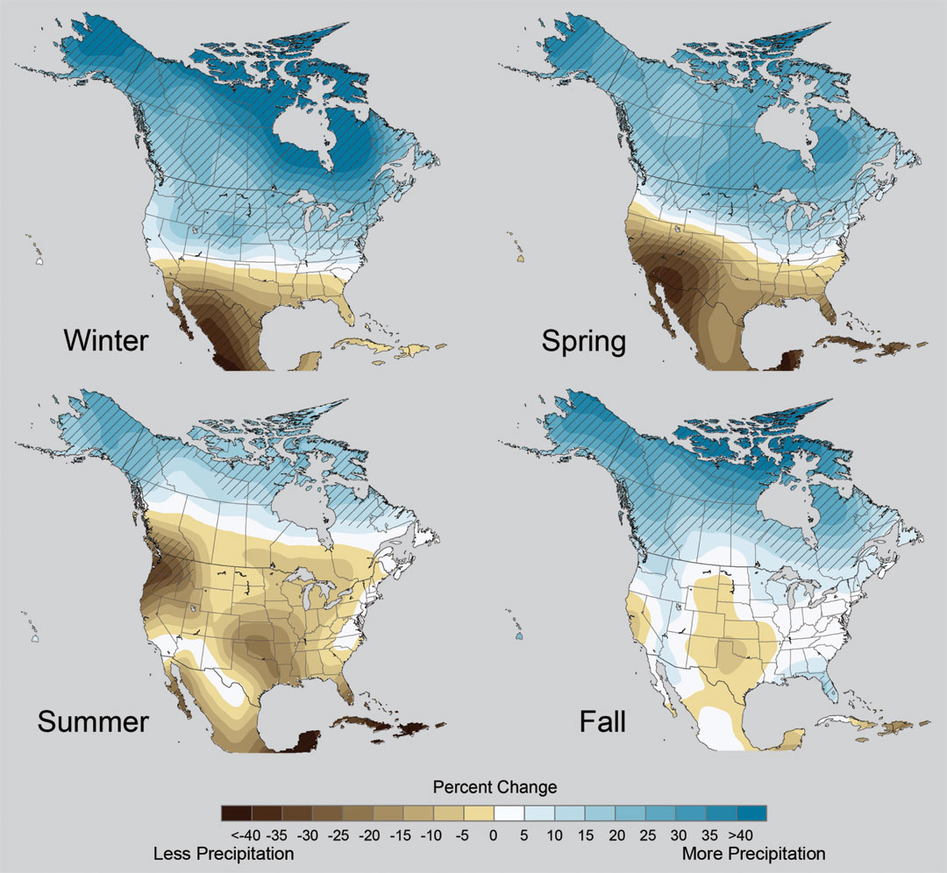
Projected Change in Precipitation: 2081-2099
Midwest: Increasing winter and spring precipitation, with drier summers
More frequent and intense periods of heavy rainfall
Unstippled regions indicate reduced confidence
Relative to 1960-1990
NOTE: Scale Reversed
Don Wuebbles

Slide 27
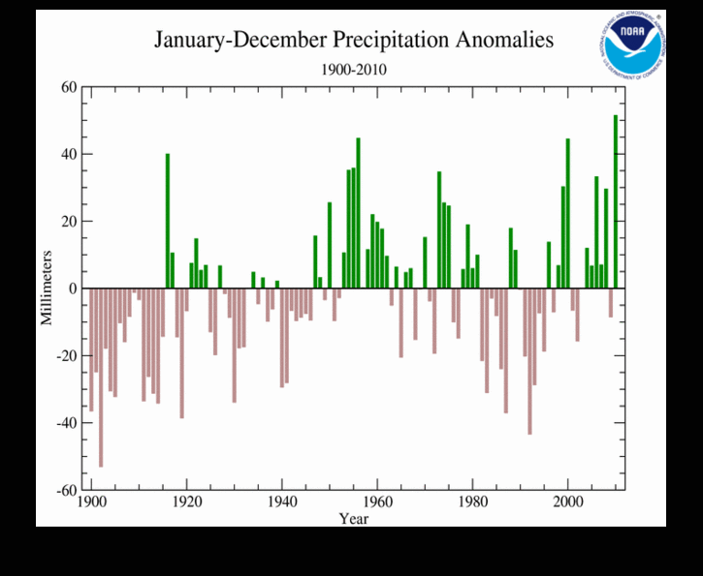
2010 had the highest global total precipitation in the 111 year record

Slide 28
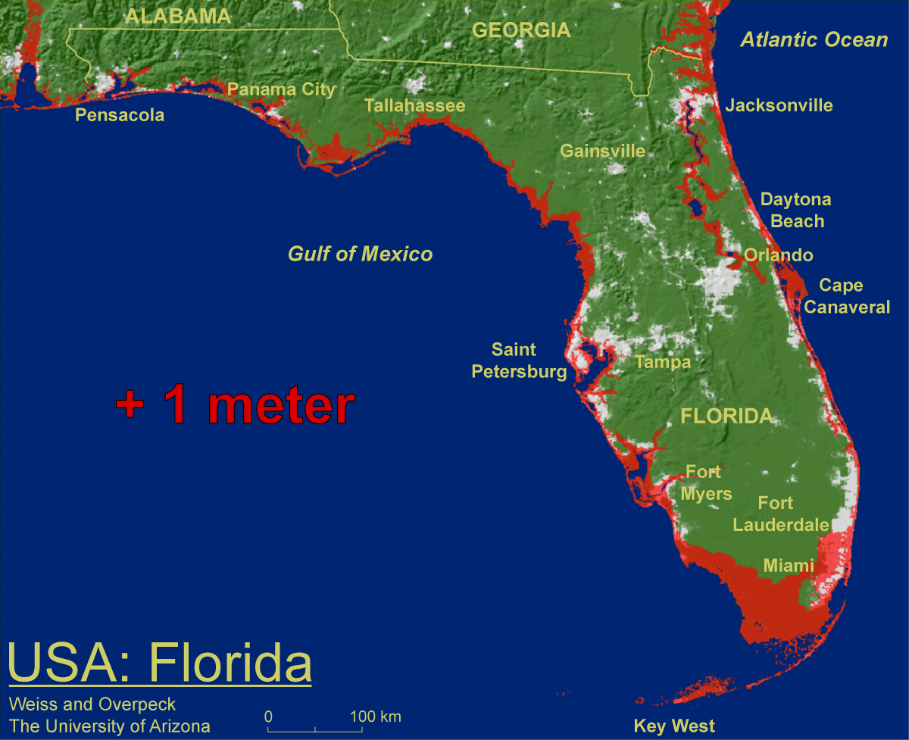
1 meter will be hard to avoid, possibly within this century, just from thermal expansion and small glacier melt.
Don Wuebbles

Slide 29

Widespread climate-related impacts are occurring now and are expected to increase
Water Resources
Energy Supply & Use
Transportation
Agriculture
Don Wuebbles
Ecosystems
Human Health
Society

Slide 30
Managing the Unavoidable:
Adapting to Climate Change

Slide 31
But Abstract Concepts of Global Changes and Models Projecting Future Conditions Do Not Inspire Urgency and Action
It takes nearby events in my backyard that are recurring and outside the range of recent memory to raise questions about whether something fundamental is changing.
Let’s forget about models of the future for a few minutes and look at the data
The Iowa Example…

Slide 32
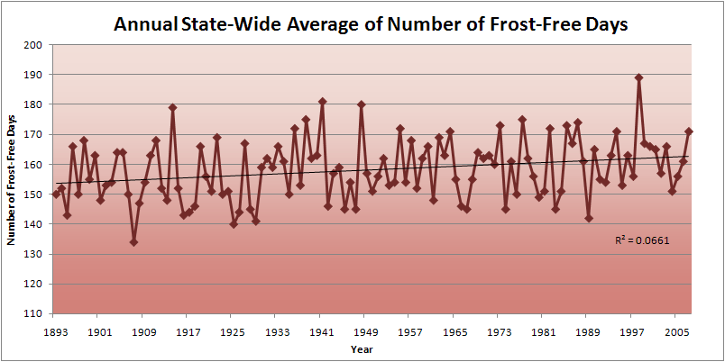
Iowa State-Wide Average Data

Slide 33
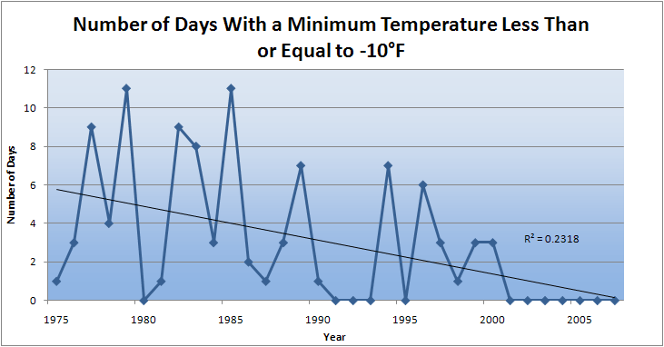
Des Moines Airport Data
Caution: Not corrected for urban heat island effects

Slide 34
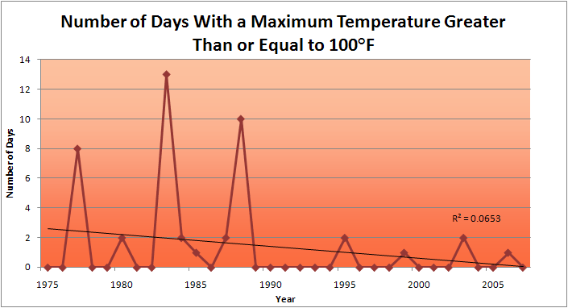
Des Moines Airport Data
1983: 13
1988: 10
1977: 8
2009: 0
2010: 0

Slide 35
Des Moines Airport Data
1983: 13
1988: 10
6 days ≥ 100ºF in the last 22 years
1977: 8
2009: 0
2010: 0

Slide 36
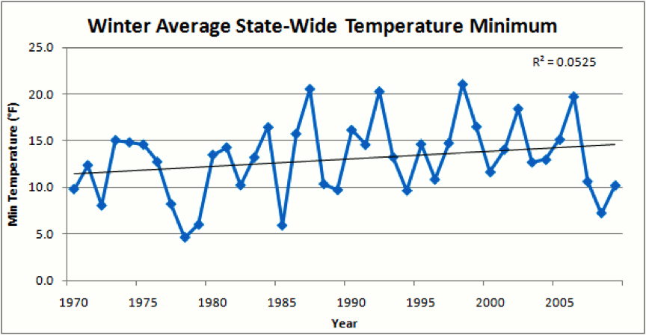
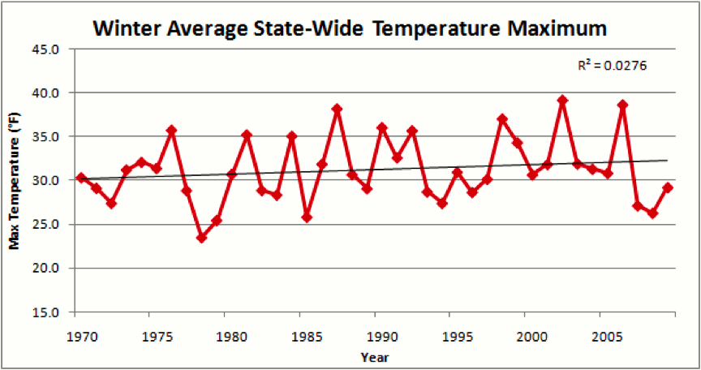
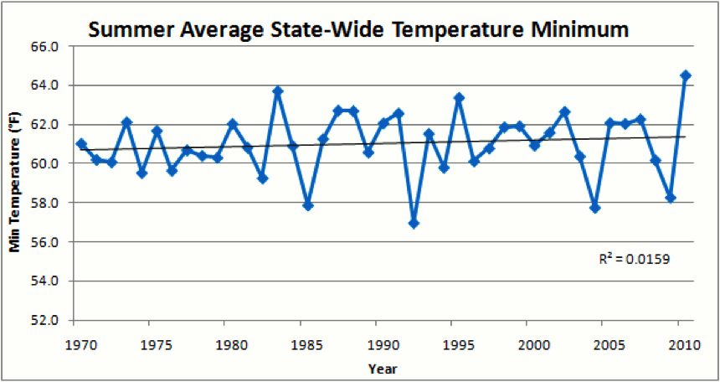
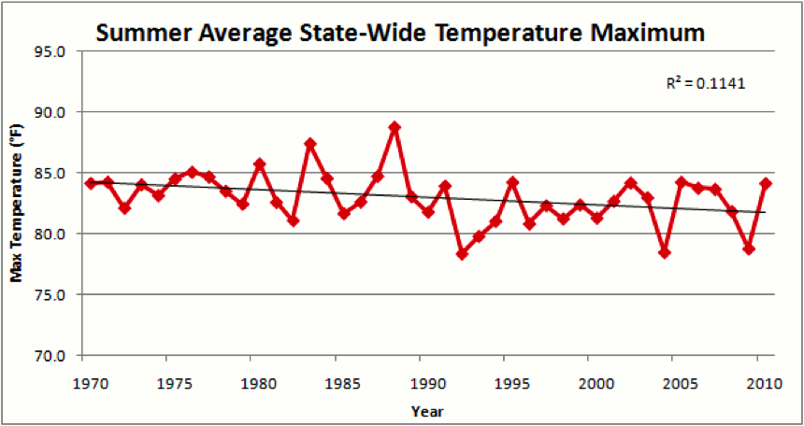

Slide 37
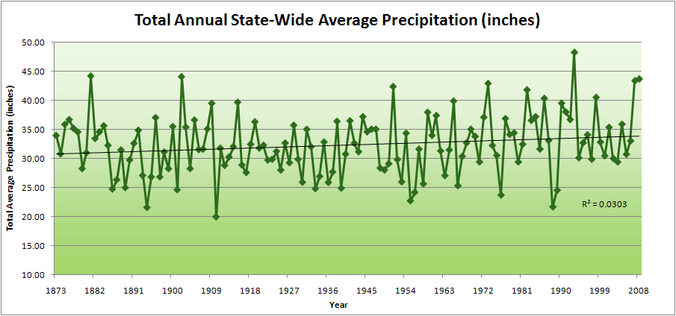
Iowa State-Wide Average Data

Slide 38
Iowa State-Wide Average Data
34.0”
10% increase
30.8”

Slide 39
Iowa State-Wide Average Data
Totals above 40”
2 years

Slide 40
Iowa State-Wide Average Data
Totals above 40”
8 years
2 years

Slide 41
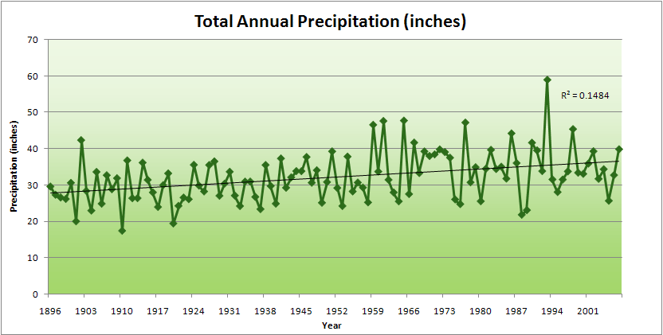
Cedar Rapids Data

Slide 42
Cedar Rapids Data
28.0”
32% increase
37.0”

Slide 43
Cedar Rapids Data
Years with more than 40 inches
11
1
28.0”
32% increase
37.0”

Slide 44
Years with more than 40 inches: 43% Increase
2010 so far

Slide 45
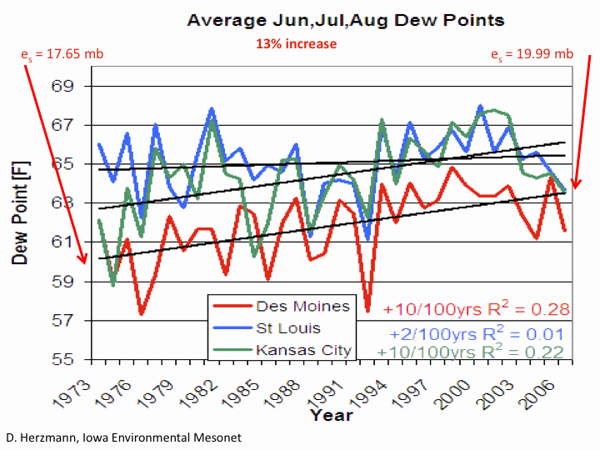

Slide 46
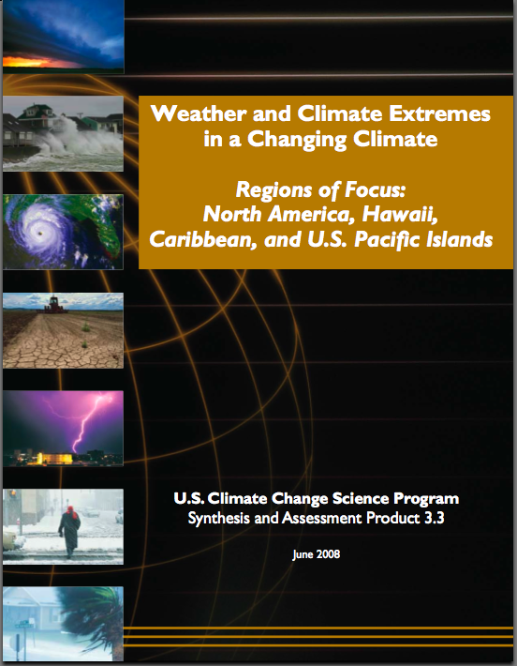
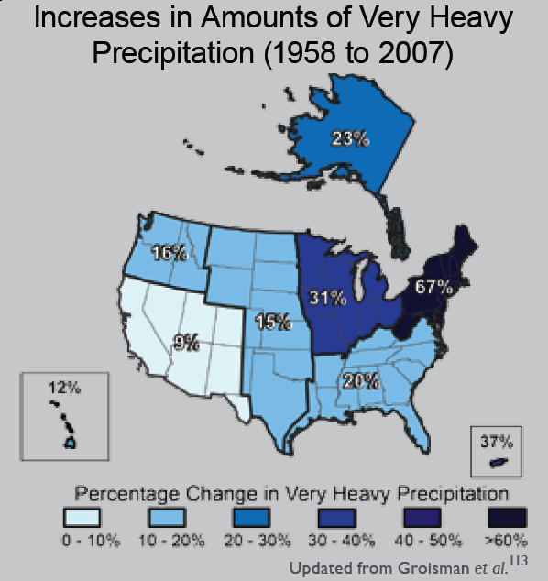
“One of the clearest trends in the United States observational record is an increasing frequency and intensity of heavy precipitation events… Over the last century there was a 50% increase in the frequency of days with precipitation over 101.6 mm (four inches) in the upper midwestern U.S.; this trend is statistically significant “
Karl, T. R., J. M. Melillo, and T. C. Peterson, (eds.), 2009: Global Climate Change Impacts in the United States. Cambridge University Press, 2009, 196pp.

Slide 47
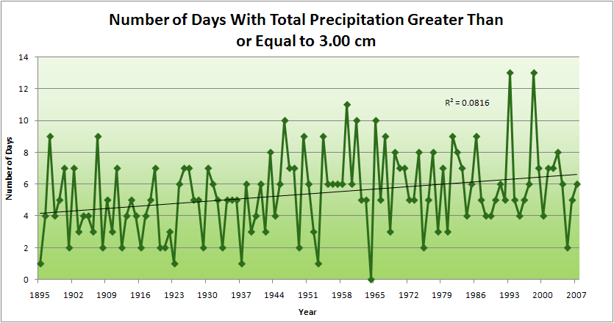
Cedar Rapids Data
1.25 inches
4.2 days
57% increase
6.6 days

Slide 48
Cedar Rapids Data
1.25 inches
Years having more than 8 days
13
2
4.2 days
57% increase
6.6 days

Slide 49
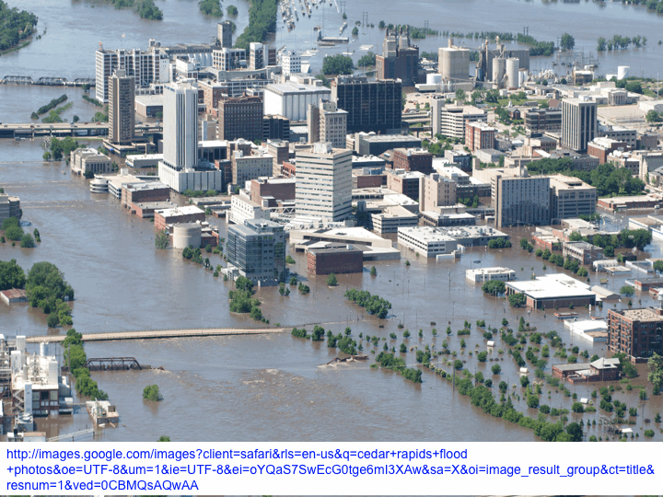
2008

Slide 50
2010 through Sept 27
3.7
41% Increase
5.2

Slide 51
Years having more than 8 days
2010 through Sept 27
7
350% Increase
2
3.7
41% Increase
5.2

Slide 52
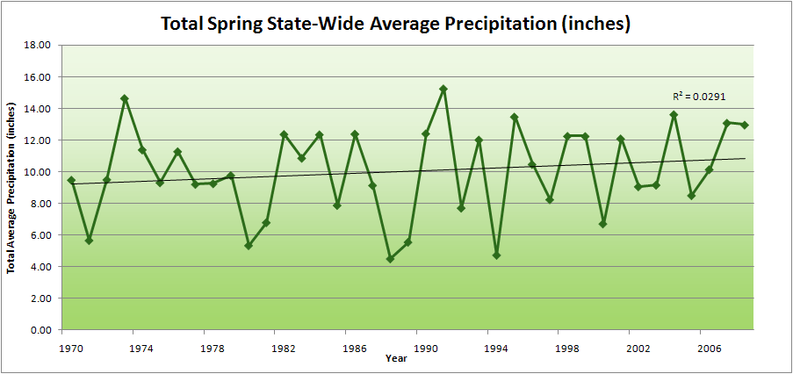
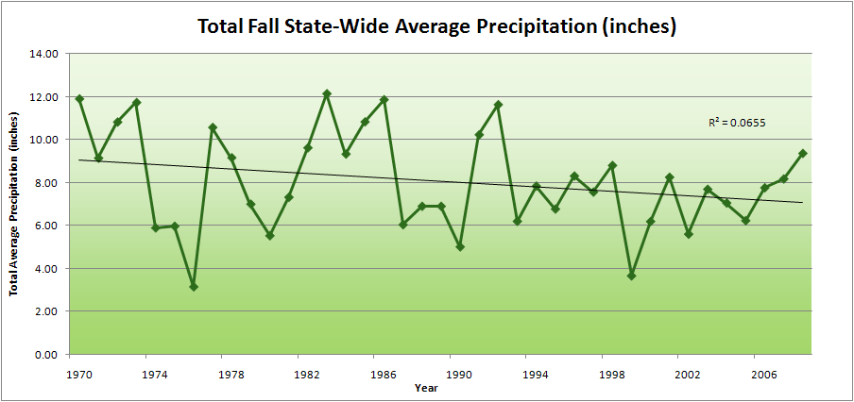
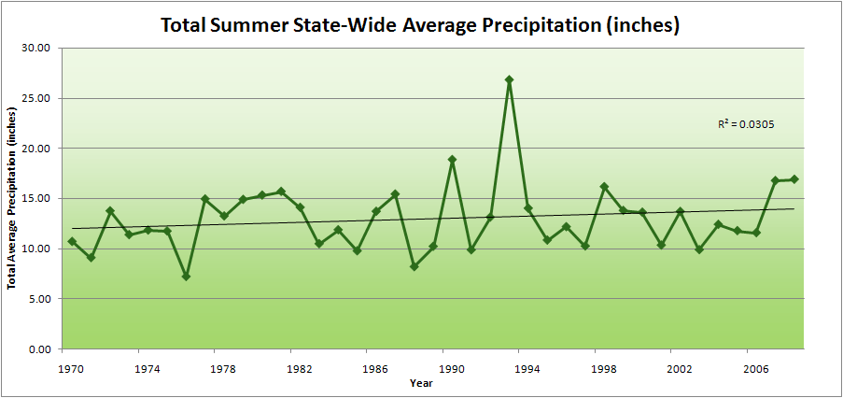
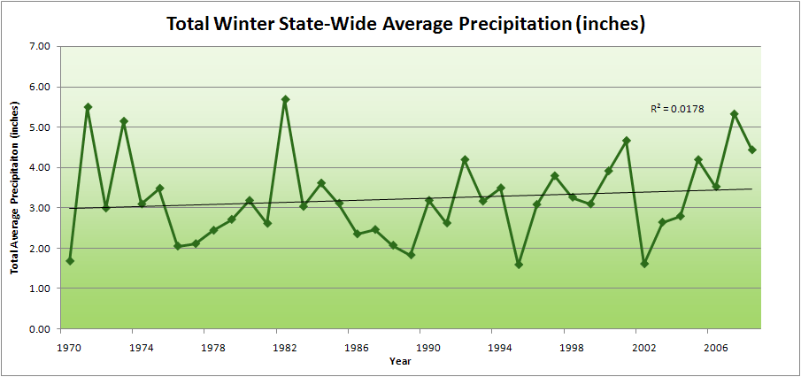
Amplification of the Seasonality of Precipitation
Spring
Fall
21.2 => 25.3 inches (19% increase)
12.1 => 10.5 inches (13% decrease)
Summer
Winter

Slide 53
Drainage basins
Storm tracks
Rivers
Mar-May
June
July
Aug-Sep

Slide 54
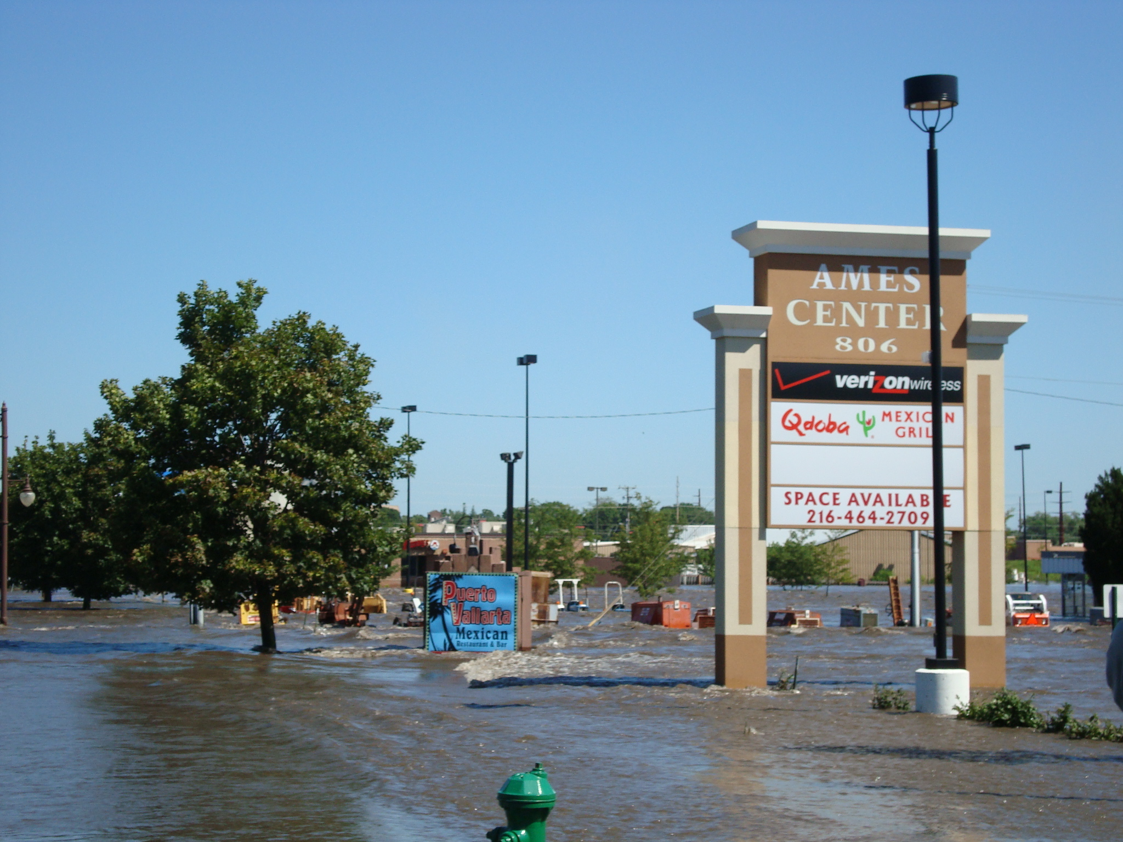
2010

Slide 55
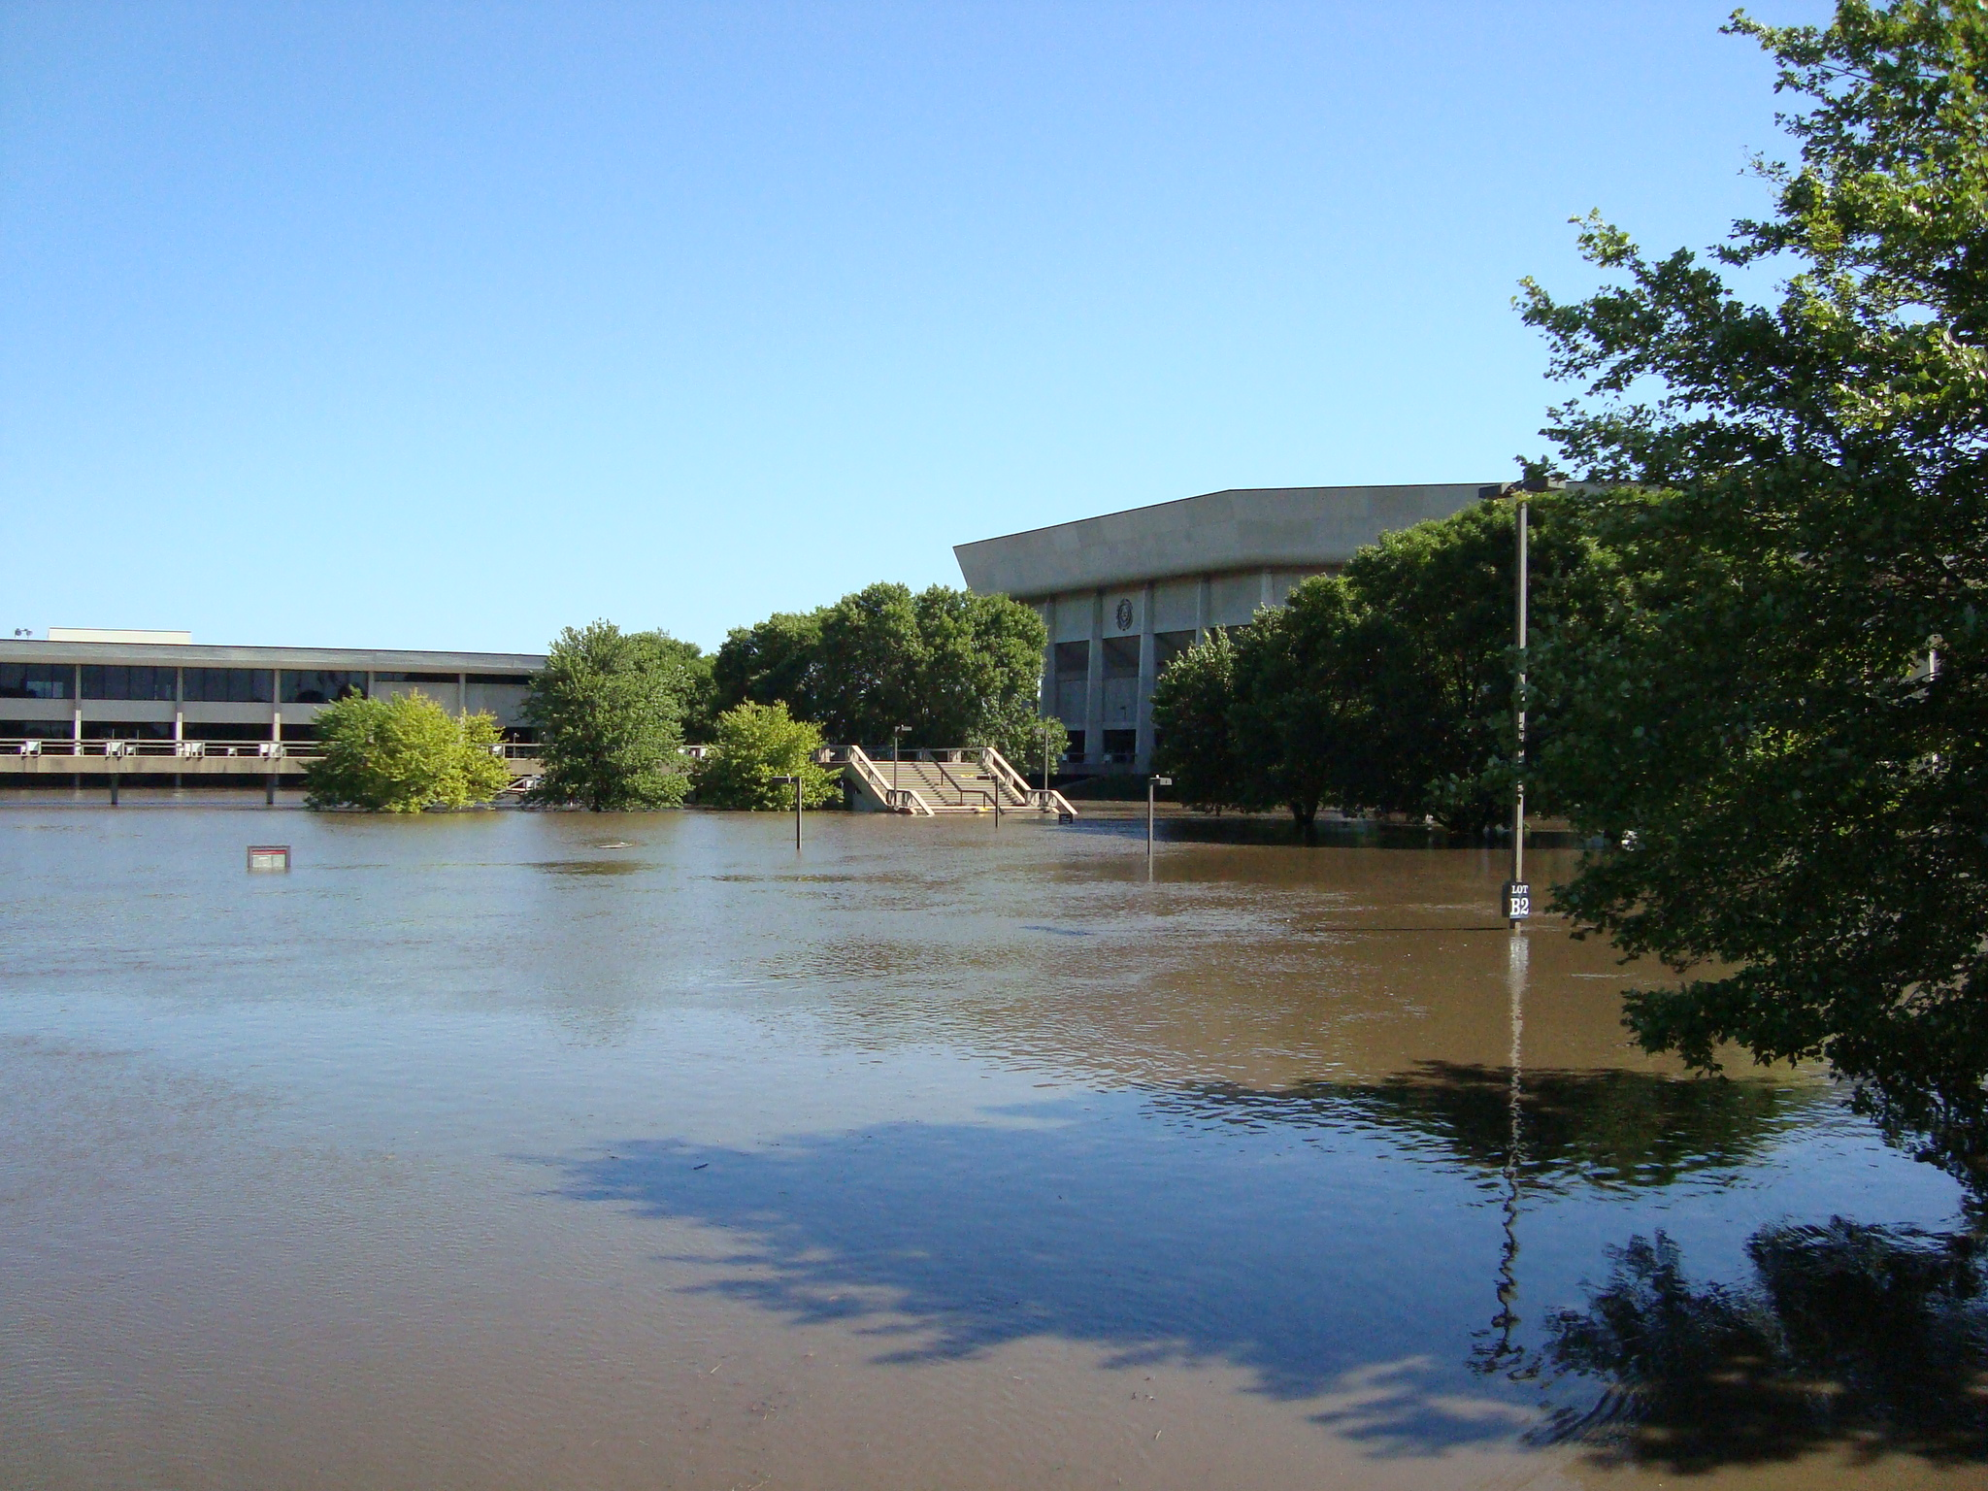

Slide 56
Why Small Changes in Rainfall Produce Much More Flooding
13% increase in atmospheric moisture in June-July-August
~8% increase in average precipitation in Iowa since 1970
~3 to 7-fold increase in high-precipitation events over the last century, mostly in June-July-August, that lead to runoff
Amplified seasonal cycle
Iowa rivers and watersheds are oriented NW-SE
Rainfall patterns turn from SW-NE in March-May to W-E or NW-SE in mid summer
AND: more subsurface drainage tile has been installed

Slide 57
Iowa Agricultural Producers are Managing the Unavoidable:
Longer growing season: plant earlier, plant longer season hybrids, harvest later
Wetter springs: larger machinery enables planting in smaller weather windows
More summer precipitation: higher planting densities for higher yields
Wetter springs and summers: more subsurface drainage tile is being installed, closer spacing, sloped surfaces
Fewer extreme heat events: higher planting densities, fewer pollination failures
Higher humidity: more spraying for pathogens favored by moist conditions. more problems with fall crop dry-down, wider bean heads for faster harvest due to shorter harvest period during the daytime.
Drier autumns: delay harvest to take advantage of natural dry-down conditions
HIGHER YIELDS!!
Is it genetics or climate? Likely some of each.

Slide 58
Avoiding the Unmanageable :
Mitigating Impacts of Global Climate Change

Slide 59

Rise in global mean temperature (ºC)

Slide 60

Rise in global mean temperature (ºC)

Slide 61

Energy intensive
Balanced fuel sources
More environmentally friendly
Limit to avoid “dangerous anthropogenic
Interference” with the climate system
2ºC limit
IPCC Fourth Assessment Report Summary for Policy Makers

Slide 62

Long-Term Stabilization Profiles
A2
B1
2008
2009
Nebojša Nakićenović IIASA, Vienna

Slide 63
Long-Term Stabilization Profiles
A2
Achieving this emission reduction scenario will provide a 50% chance of not exceeding the 2ºC guardrail
B1
2008
2009
Nebojša Nakićenović IIASA, Vienna

Slide 64
Long-Term Stabilization Profiles
A2
Achieving this emission reduction scenario will provide a 50% chance of not exceeding the 2ºC guardrail
B1
Carbon reductions needed will be 90 times as large
as the impact of the 2009 recession
2008
2009
Nebojša Nakićenović IIASA, Vienna

Slide 65

Food for a Week, Darfur Refugees, Chad
© 2005 PETER MENZEL PHOTOGRAPHY
Source: Menzel, 2005
Nebojša Nakićenović IIASA, Vienna

Slide 66

Food for a Week, Germany
© 2005 PETER MENZEL PHOTOGRAPHY
Source: Menzel, 2005
Nebojša Nakićenović IIASA, Vienna

Slide 67
Share of Carbon-Free Energy
4.5ºC
4.0ºC
3.0ºC
2.0ºC*
* maximum temperature change over the 21st century assuming 3ºC climate sensitivity
Nebojša Nakićenović IIASA, Vienna
Notes:
Add temperature numbers here as well!!

Slide 68
Summary
Global temperature trends of the 20C cannot be explained on the basis of natural variation alone
Only when the influences of greenhouse gases and sulfate aerosols are included can the trends be explained
Models that explain these trends, when projected into the future, indicate a 1.5-6.5ºC warming over the 21C
Iowa farmers and cities already are paying to cope with climate change
Substantial adverse consequences to food production, fresh-water supplies, and sustainability will occur for temperature increases above 2ºC
The major challenge to our global society is to figure out how to reduce our global dependence on carbon-emitting fuels

Slide 69
For More Information
Contact me directly:
gstakle@iastate.edu
Climate Science Program website:
http://climate.engineering.iastate.edu/
Current research on regional climate and climate change at the ISU Regional Climate Modeling Laboratory:
http://rcmlab.agron.iastate.edu/
North American Regional Climate Change Assessment Program:
http://www.narccap.ucar.edu/
Iowa precipitation analysis and simulation is a collaborative project under funding from the Iowa Flood Center (http://www.iowafloodcenter.org/)
Or just Google Eugene Takle

