Slide 1
Sustainability under Global Climate Change: Avoiding the Unmanageable, Managing the Unavoidable
Eugene S. Takle
Professor
Department of Agronomy
Department of Geological and Atmospheric Science
Director, Climate Science Program
Iowa State University
Ames, IA 50011
Technology and Social Change 220X
Iowa State University
8 February 2012

Slide 2
Outline
Observed global changes in carbon dioxide and temperature
Projected future changes in global and US temperatures and precipitation
Adaptation already is happening
Mitigation must be a priority

Slide 3
Climate change is one of the most important issues facing humanity
The scientific evidence clearly indicates that our climate is changing, and that human activities have been identified as a dominant contributing cause.
Notes:
No disagreement in peer reviewed literature
Powerful statements from every major professional science society and organization in the world
Powerful statements from the National Academies of Sciences (the leadership in science) for every major country
G8 + 5 other countries, May 2009: “The need for urgent action to address climate change is now indisputable.”

Slide 4
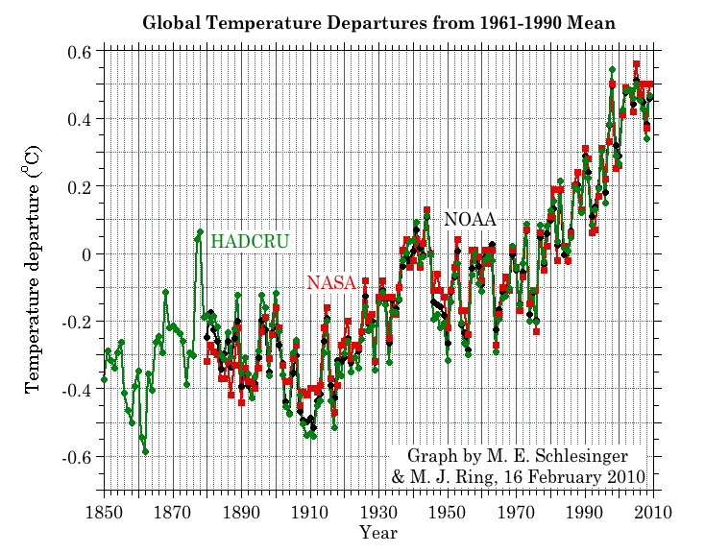
Three separate analyses of the temperature record – Trends are in close agreement
Don Wuebbles

Slide 5
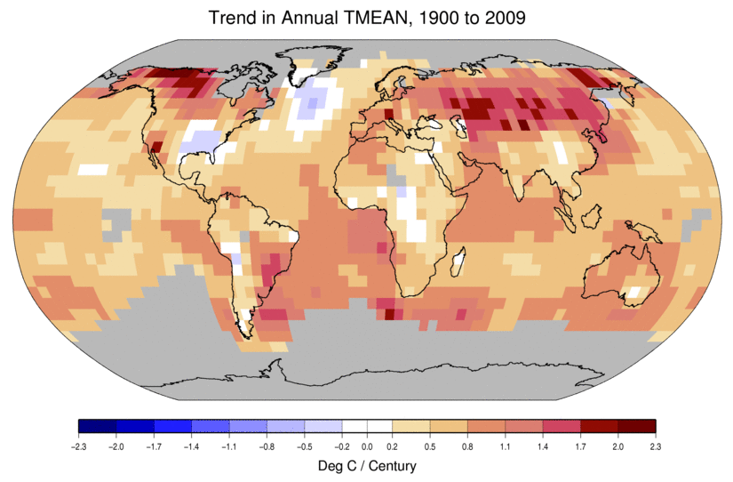
Temperature Changes are Not Uniform Around the Globe
From Tom Karl, NOAA NCDC

Slide 6
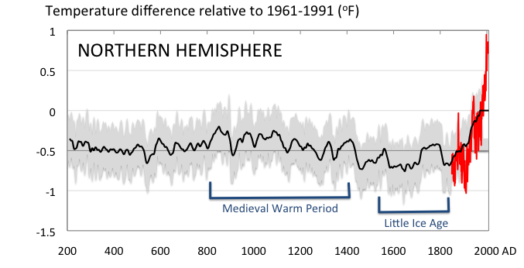
Conditions today are unusual in the context of the last 2,000 years …
Don Wuebbles

Slide 7
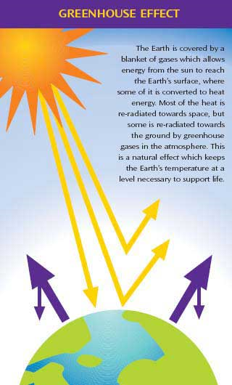
Why does the Earth warm? 1. Natural causes
THE GREENHOUSE EFFECT…
…is 100% natural.
Heat is trapped in the atmosphere.
…sustains life on Earth.
Keeps average temperatures at 12.8ºC (55ºF), instead of –29ºC (-20ºF).
Don Wuebbles

Slide 8
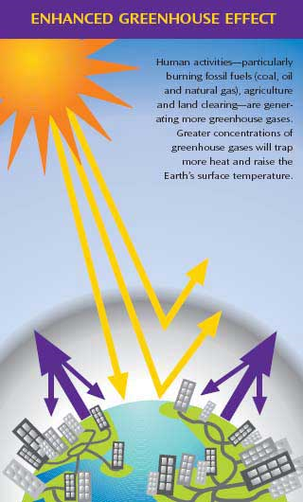
Why does the Earth warm? 2. Human causes
THE ENHANCED GREENHOUSE EFFECT
(or GLOBAL WARMING)
… is primarily human-induced: We’re increasing heat-trapping gases in the atmosphere.
… is like wrapping an extra blanket around the Earth.
Don Wuebbles

Slide 9
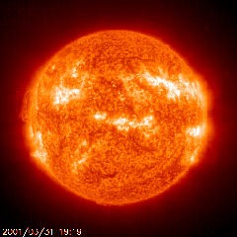
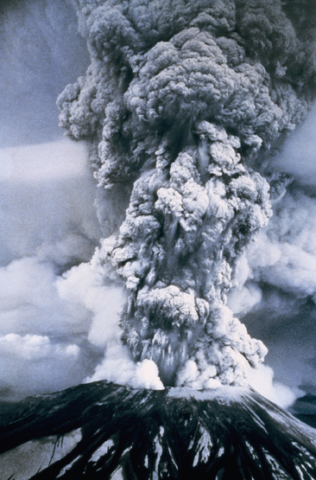
Natural factors affect climate
Variations in the energy
received from the sun
Variations in the Earth's orbit
(Milankovic effect)
Stratospheric
aerosols from
energetic
volcanic eruptions
Chaotic interactions in
the Earth's climate
(for example, El Nino, NAO)
Don Wuebbles

Slide 10
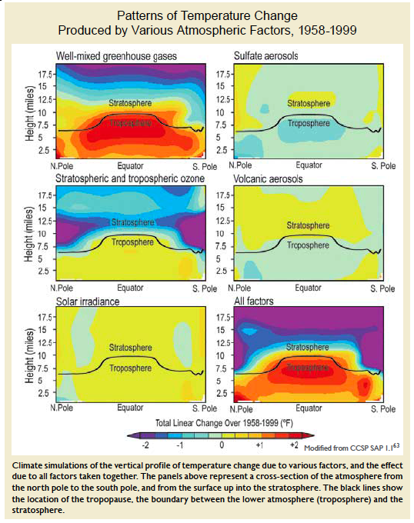
Warming of the Lower and Upper Atmosphere Produced by Natural and Human Causes
Karl, T. R., J. M. Melillo, and T. C. Peterson, (eds.), 2009: Global Climate Change Impacts in the United States. Cambridge University Press, 2009, 196pp.

Slide 11
Warming of the Lower and Upper Atmosphere Produced by Natural and Human Causes
Note that greenhouse gases have a unique temperature signature, with strong warming in the upper troposphere, cooling in the lower stratosphere and strong warming at the surface over the North Pole. No other warming factors have this signature.
Karl, T. R., J. M. Melillo, and T. C. Peterson, (eds.), 2009: Global Climate Change Impacts in the United States. Cambridge University Press, 2009, 196pp.

Slide 12
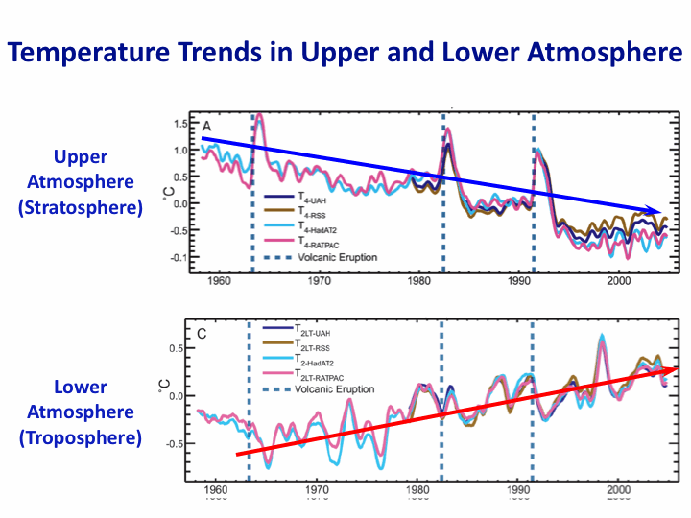
Warming of the Lower and Upper Atmosphere Produced by Natural and Human Causes
Note that greenhouse gases have a unique temperature signature, with strong warming in the upper troposphere, cooling in the lower stratosphere and strong warming at the surface over the North Pole. No other warming factors have this signature.
Karl, T. R., J. M. Melillo, and T. C. Peterson, (eds.), 2009: Global Climate Change Impacts in the United States. Cambridge University Press, 2009, 196pp.

Slide 13
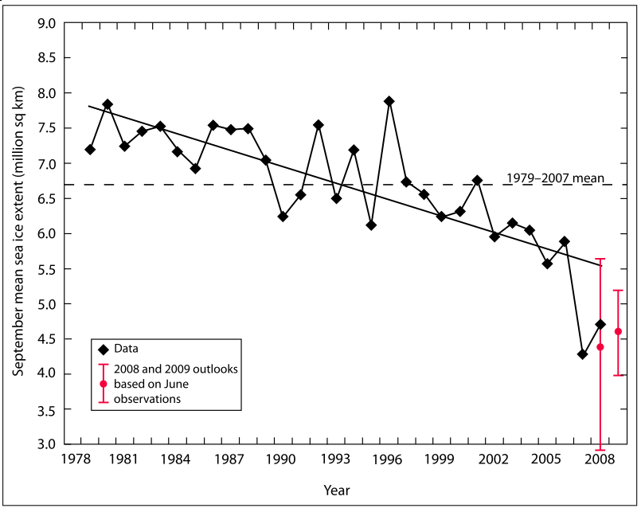
Warming of the Lower and Upper Atmosphere Produced by Natural and Human Causes
Note that greenhouse gases have a unique temperature signature, with strong warming in the upper troposphere, cooling in the lower stratosphere and strong warming at the surface over the North Pole. No other warming factors have this signature.

Slide 14
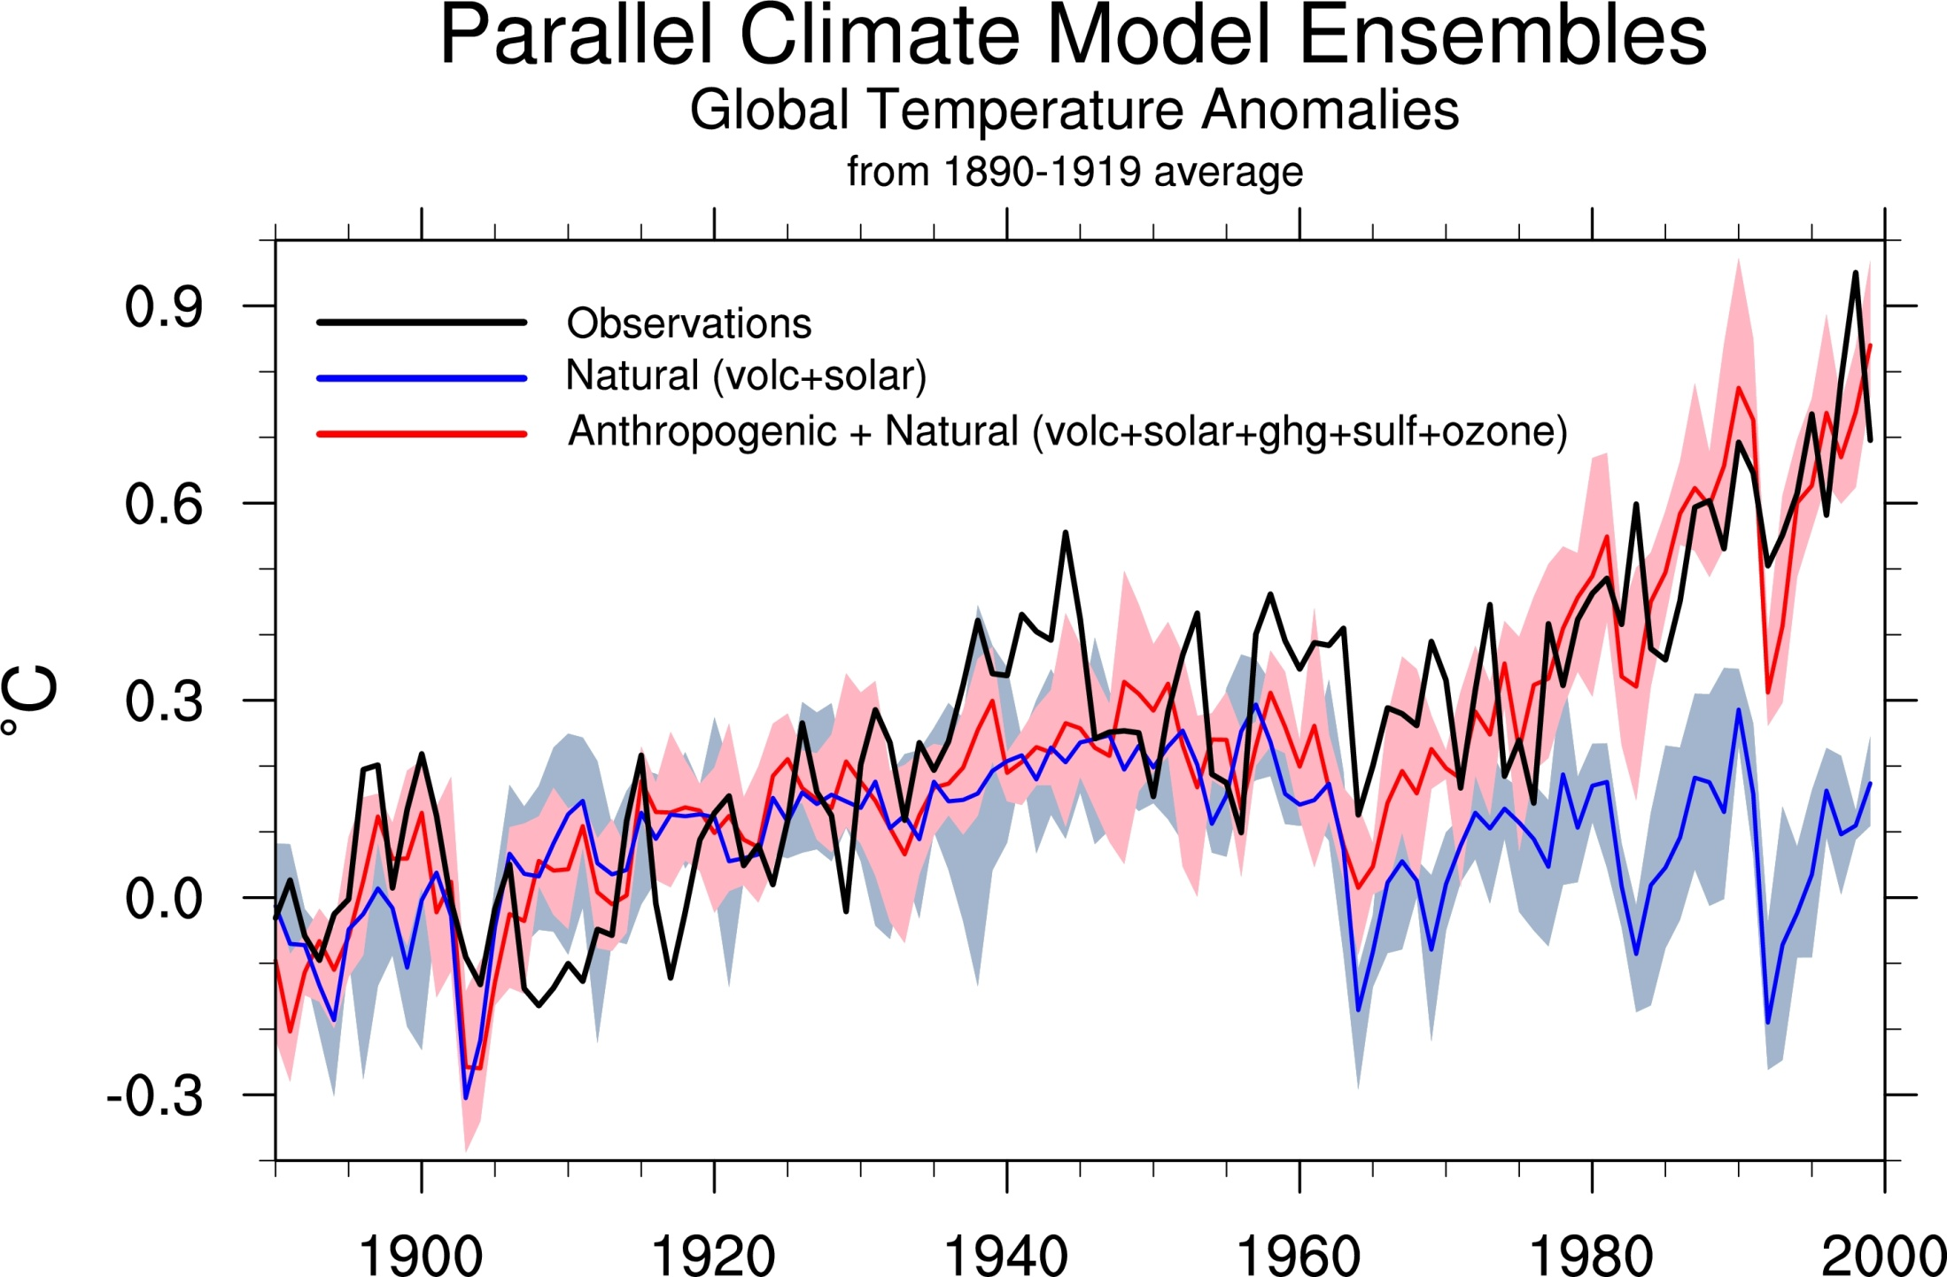
Climate models: Natural processes do not account for
observed 20th century warming after 1965
Jerry Meehl, National Center for Atmospheric Research

Slide 15
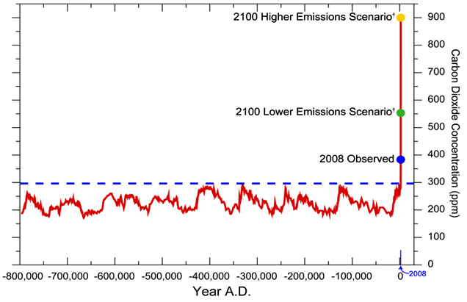
We have Moved Outside the Range of Historical Variation
800,000 Year Record of Carbon Dioxide Concentration
Don Wuebbles

Slide 16
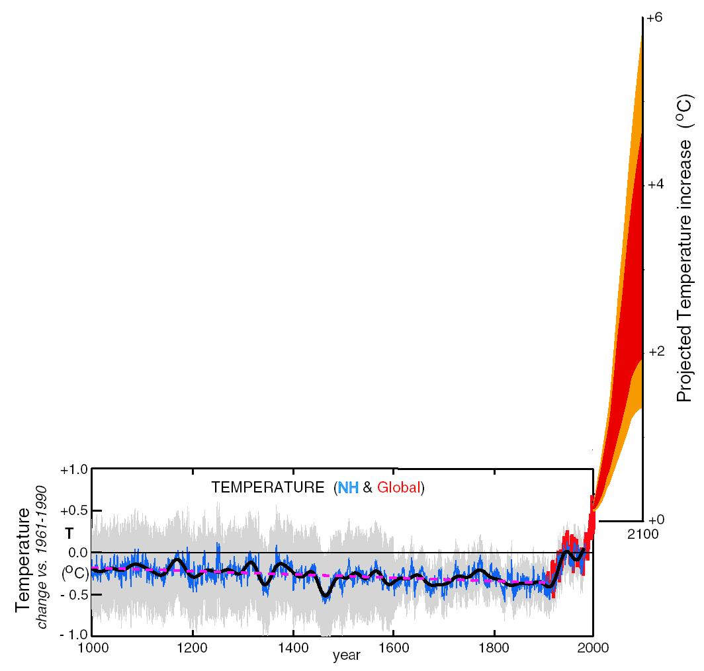
What can we expect in the future?
Don Wuebbles

Slide 17
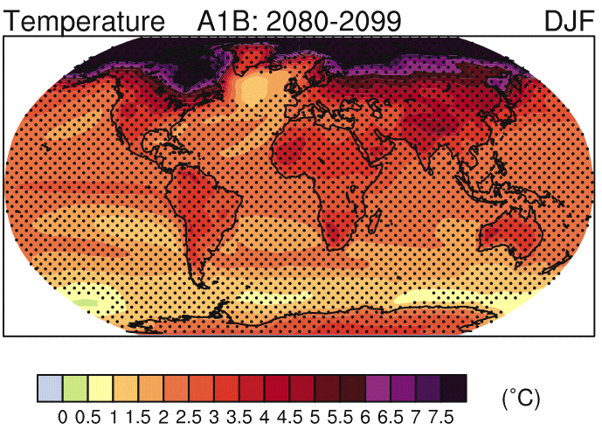
IPCC 2007

Slide 18
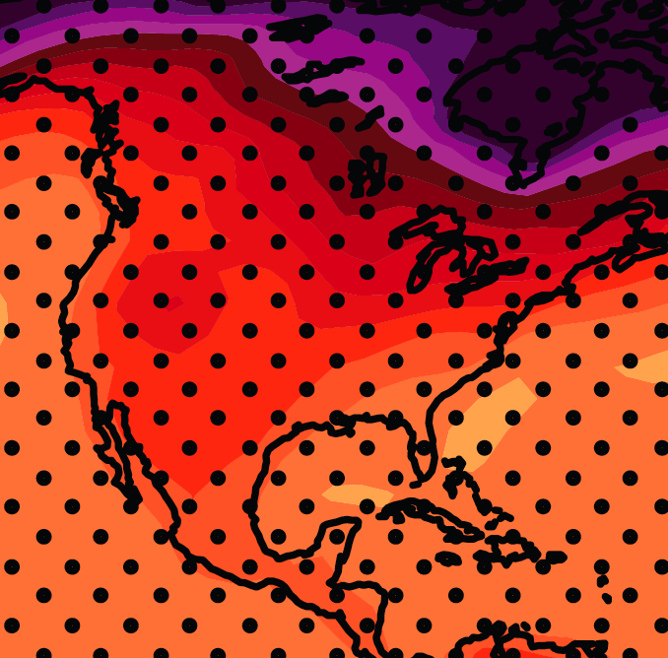
December-January-February Temperature Change
7.2ºF
6.3ºF
A1B Emission Scenario
2080-2099 minus1980-1999

Slide 19
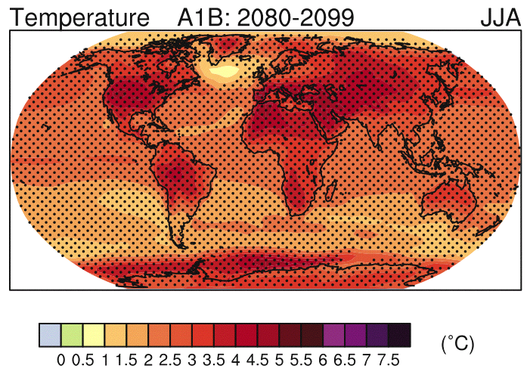
IPCC 2007

Slide 20
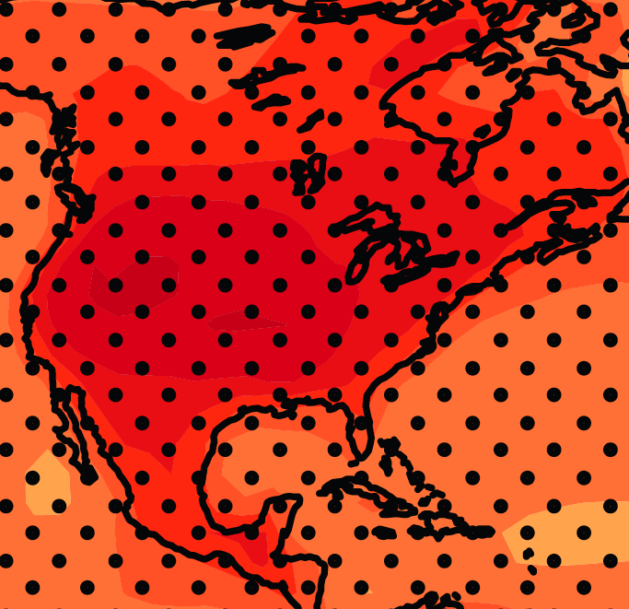
June-July-August Temperature Change
4.5ºF
5.4ºF
A1B Emission Scenario
2080-2099 minus1980-1999

Slide 21
June-July-August Temperature Change
4.5ºF
5.4ºF
A1B Emission Scenario
2080-2099 minus1980-1999

Slide 22
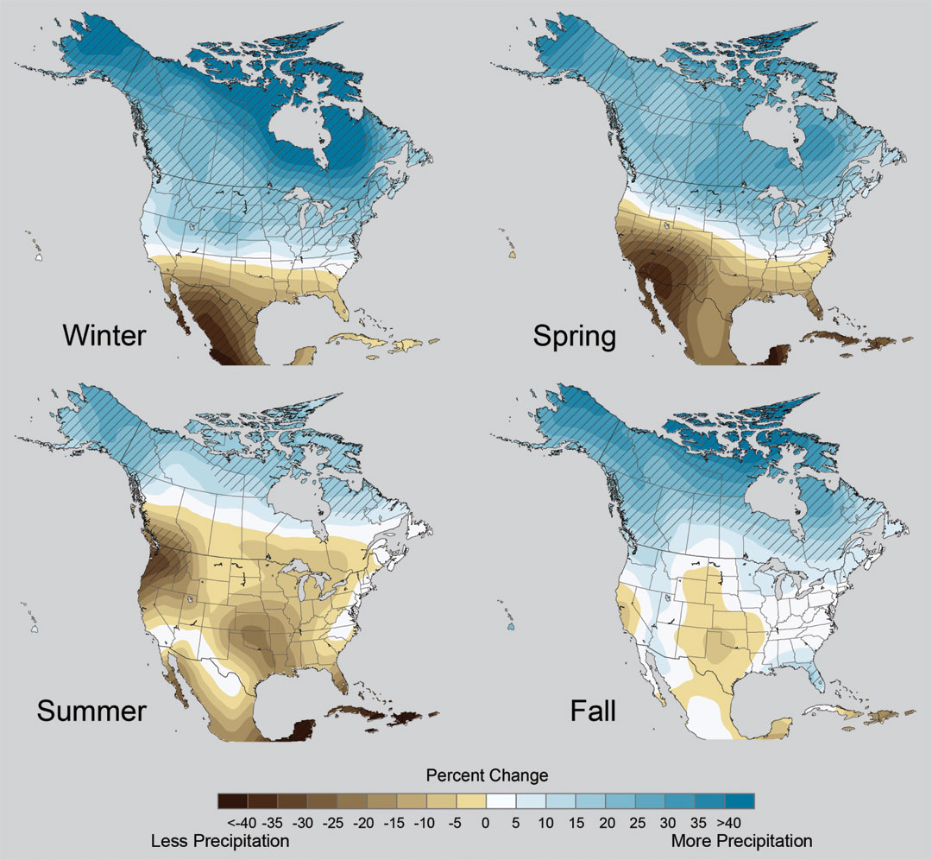
Projected Change in Precipitation: 2081-2099
Midwest: Increasing winter and spring precipitation, with drier summers
More frequent and intense periods of heavy rainfall
Unstippled regions indicate reduced confidence
Relative to 1960-1990
NOTE: Scale Reversed
Don Wuebbles

Slide 23
Managing the Unavoidable:
Adapting to Climate Change

Slide 24
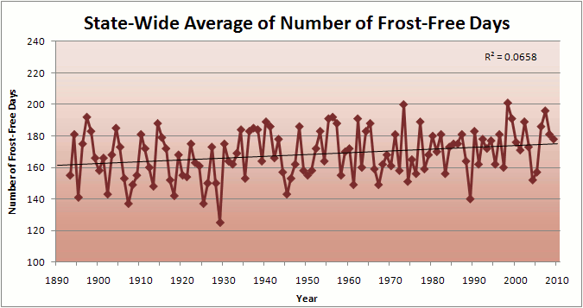
Iowa State-Wide Average Data

Slide 25
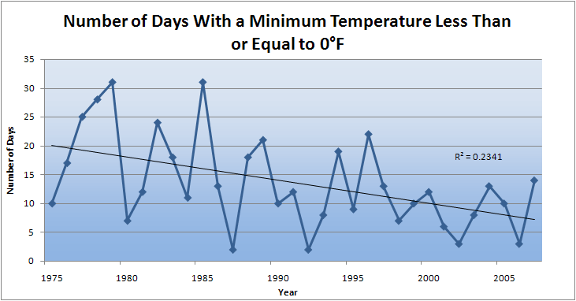
Des Moines Airport Data
Caution: Not corrected for urban heat island effects

Slide 26
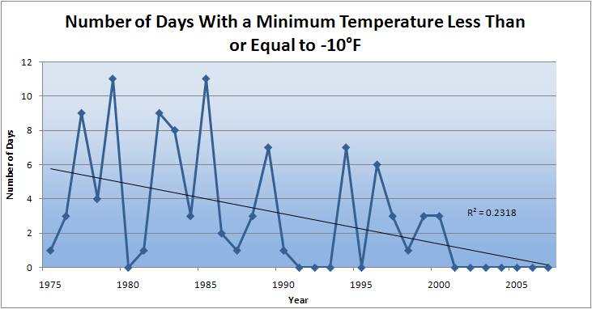
Des Moines Airport Data
Caution: Not corrected for urban heat island effects

Slide 27
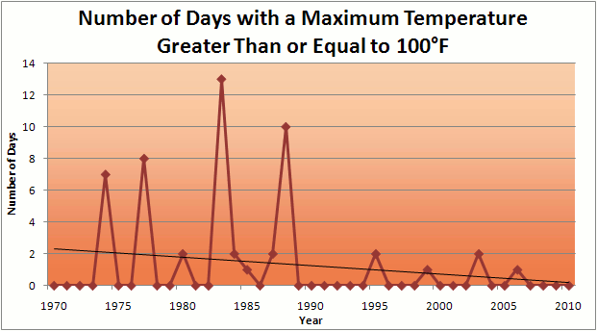
Des Moines Airport Data
1983: 13
1988: 10
1977: 8
1974: 7
2011: 0

Slide 28
Des Moines Airport Data
1983: 13
1988: 10
1977: 8
1974: 7
6 days ≥ 100ºF in the last 23 years
2011: 0

Slide 31
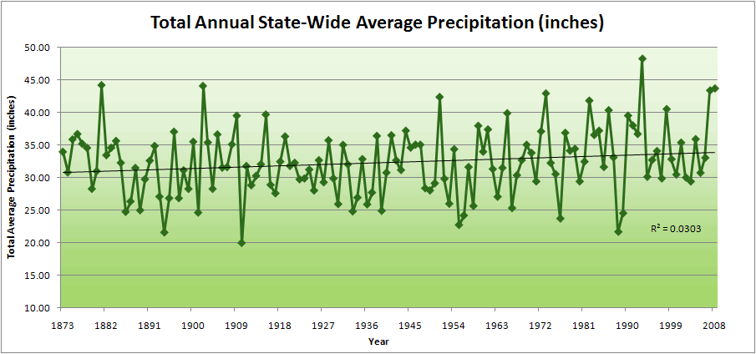
Iowa State-Wide Average Data

Slide 32
Iowa State-Wide Average Data
34.0”
10% increase
30.8”

Slide 33
Iowa State-Wide Average Data
Totals above 40”
2 years
34.0”
10% increase
30.8”

Slide 34
Iowa State-Wide Average Data
Totals above 40”
2 years
8 years
34.0”
10% increase
30.8”

Slide 35
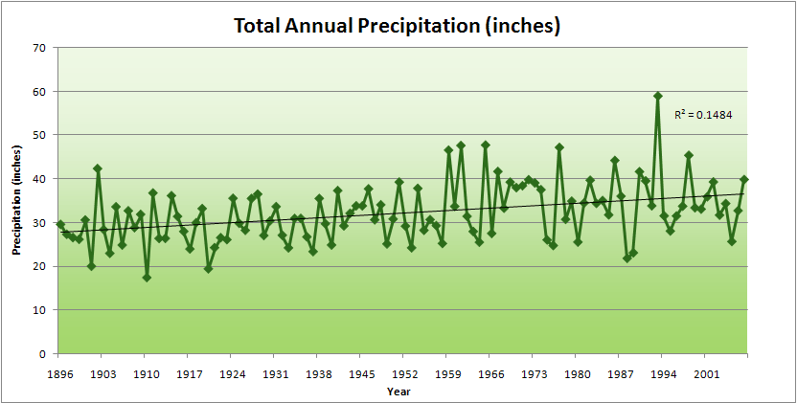
Cedar Rapids Data

Slide 36
Cedar Rapids Data
28.0”
32% increase
37.0”

Slide 37
Cedar Rapids Data
Years with more than 40 inches
11
1
28.0”
32% increase
37.0”

Slide 38
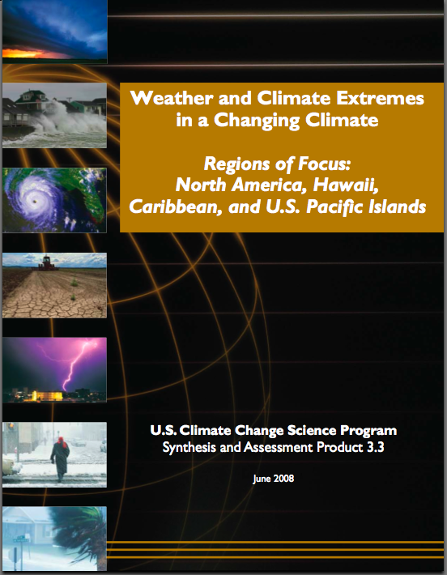
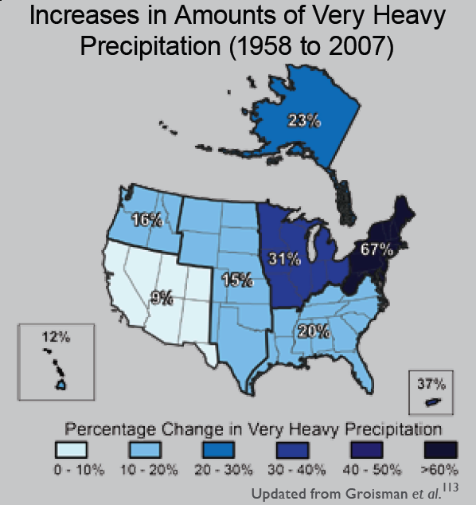
“One of the clearest trends in the United States observational record is an increasing frequency and intensity of heavy precipitation events… Over the last century there was a 50% increase in the frequency of days with precipitation over 101.6 mm (four inches) in the upper midwestern U.S.; this trend is statistically significant “
Karl, T. R., J. M. Melillo, and T. C. Peterson, (eds.), 2009: Global Climate Change Impacts in the United States. Cambridge University Press, 2009, 196pp.

Slide 39
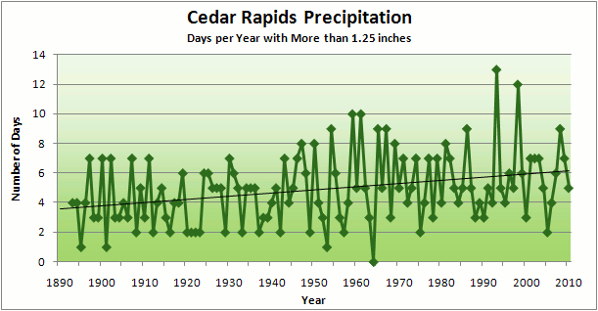
Cedar Rapids Data
3.6 days
67% increase
6.0 days

Slide 40
Cedar Rapids Data
Number of Years with More than 8 Occurrences
0
9
3.6 days
67% increase
6.0 days

Slide 41
Years with more than 40 inches: 43% Increase
2010 so far

Slide 42
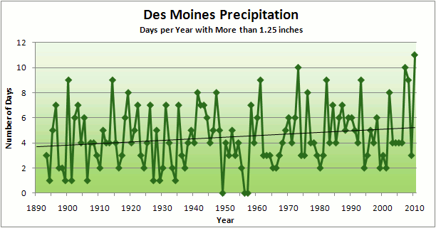
3.7
41% Increase
5.2

Slide 43
Number of Years with More than 8 Occurrences
2
7
3.7
41% Increase
5.2

Slide 44
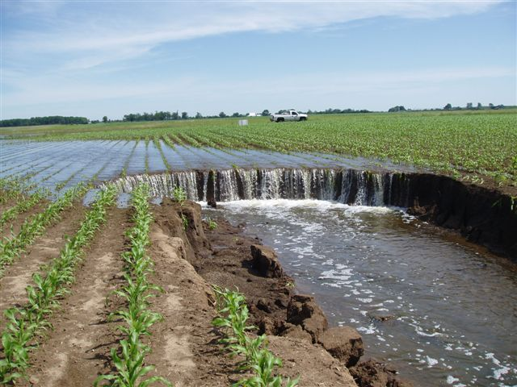
Photo courtesy of RM Cruse

Slide 45
2008

Slide 46
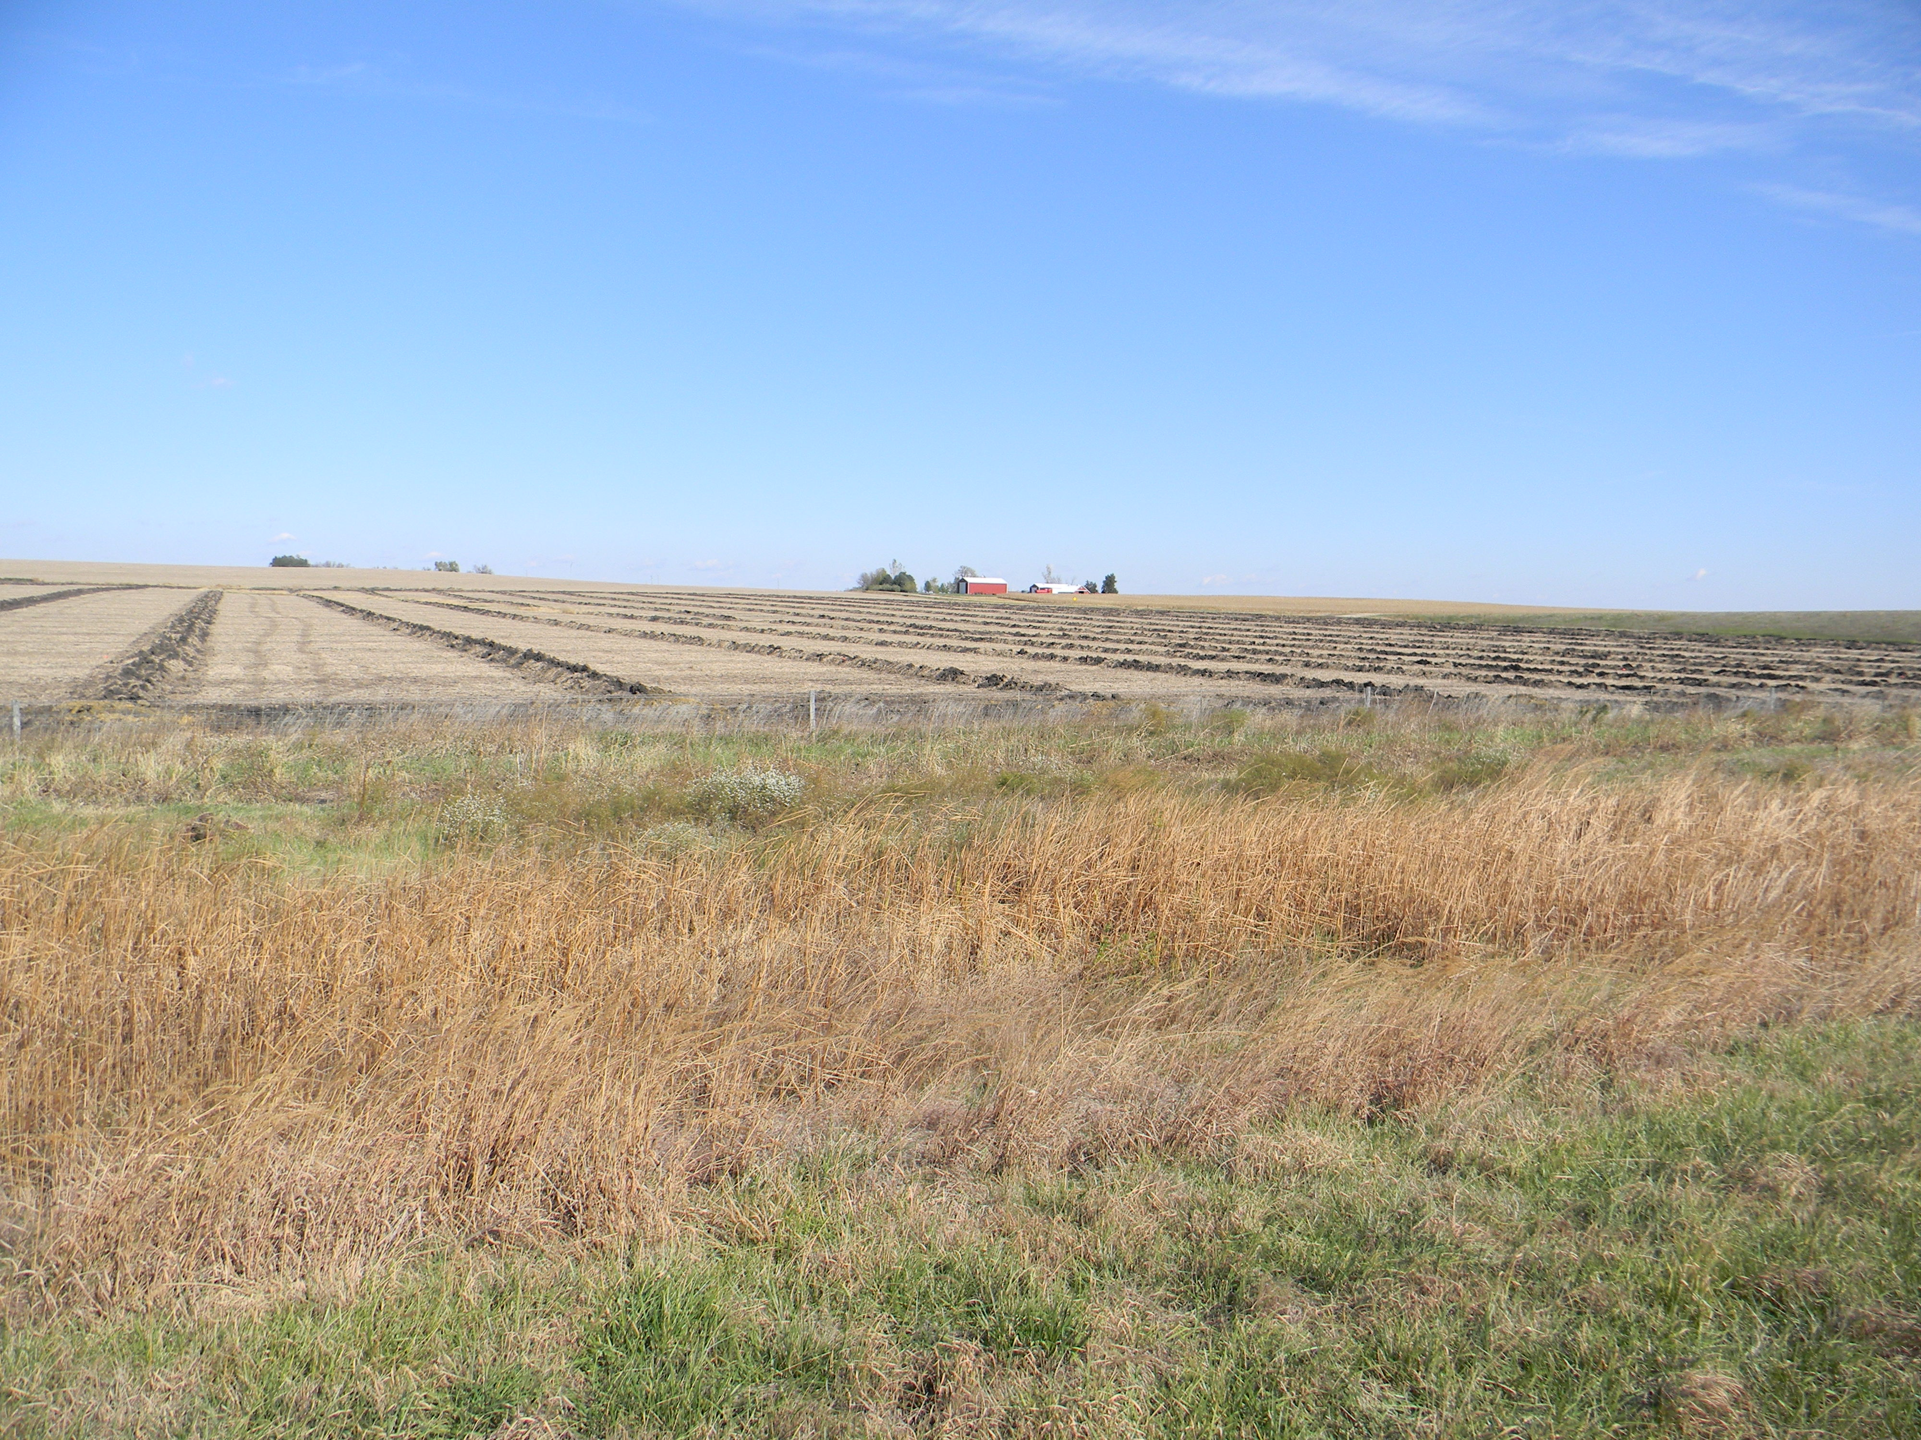

Slide 47
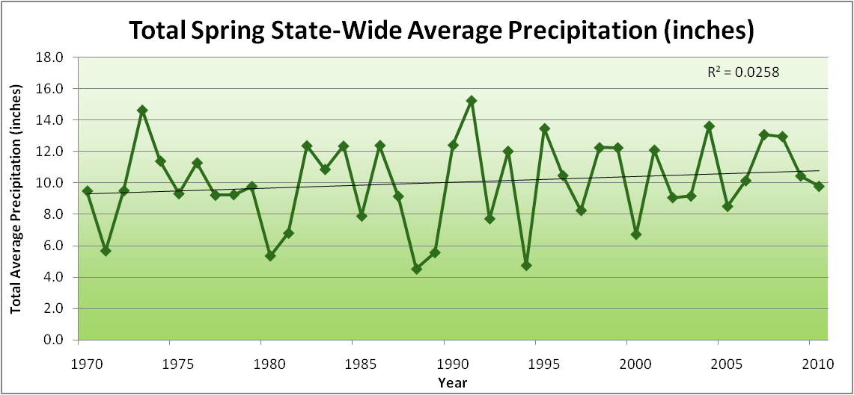
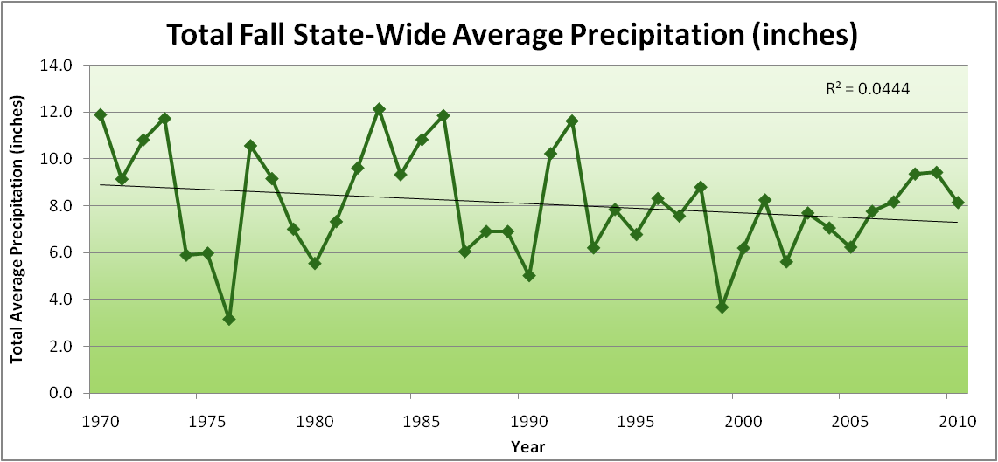
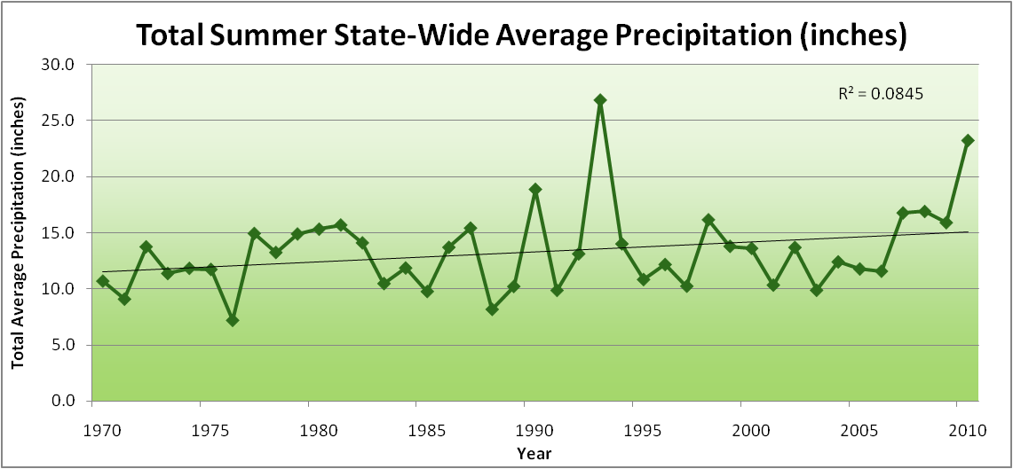
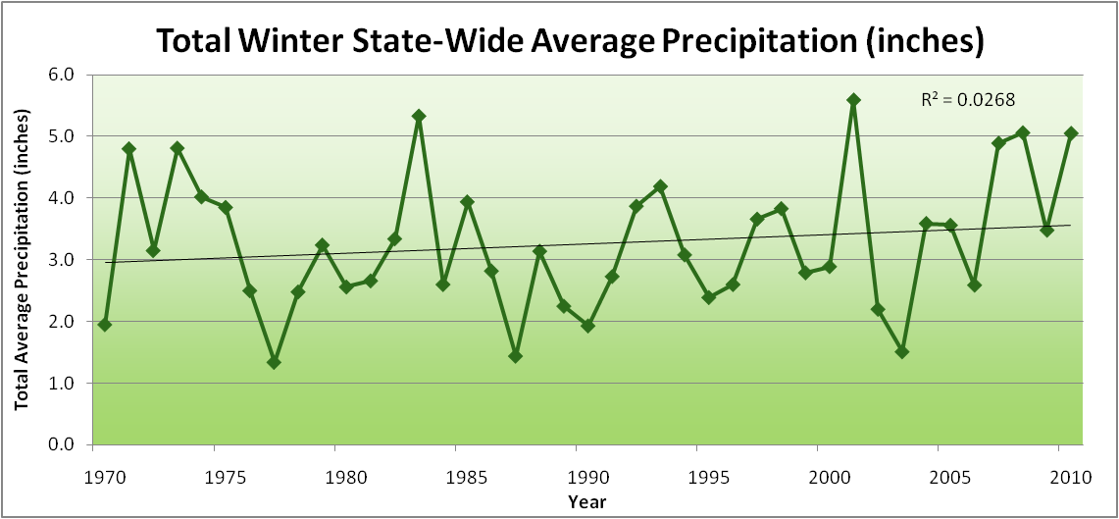
Amplification of the Seasonality of Precipitation
Spring
Fall
Summer
Winter

Slide 48
Amplification of the Seasonality of Precipitation
Spring
Fall
Summer
Winter

Slide 49
Amplification of the Seasonality of Precipitation
Spring
Fall
21.2 => 25.3 inches (22% increase)
12.1 => 10.5 inches (13% decrease)
Summer
Winter

Slide 50
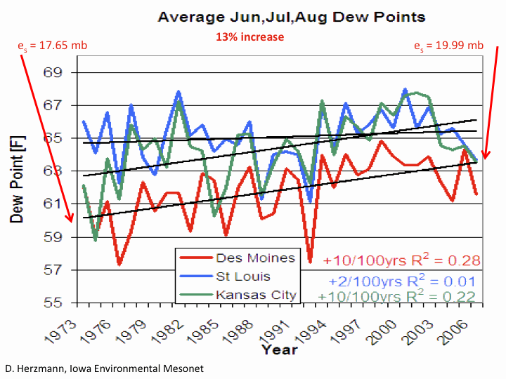

Slide 51
Iowa Agricultural Producers are Adapting to Climate Change:
Longer growing season: plant earlier, plant longer season hybrids, harvest later
Wetter springs: larger machinery enables planting in smaller weather windows
More summer precipitation: higher planting densities for higher yields
Wetter springs and summers: more subsurface drainage tile is being installed, closer spacing, sloped surfaces
Fewer extreme heat events: higher planting densities, fewer pollination failures
Higher humidity: more spraying for pathogens favored by moist conditions. more problems with fall crop dry-down, wider bean heads for faster harvest due to shorter harvest period during the daytime.
Drier autumns: delay harvest to take advantage of natural dry-down conditions, thereby reducing fuel costs
HIGHER YIELDS!!
Is it genetics or climate? Likely some of each.

Slide 52
Avoiding the Unmanageable :
Mitigating Impacts of Global Climate Change

Slide 53
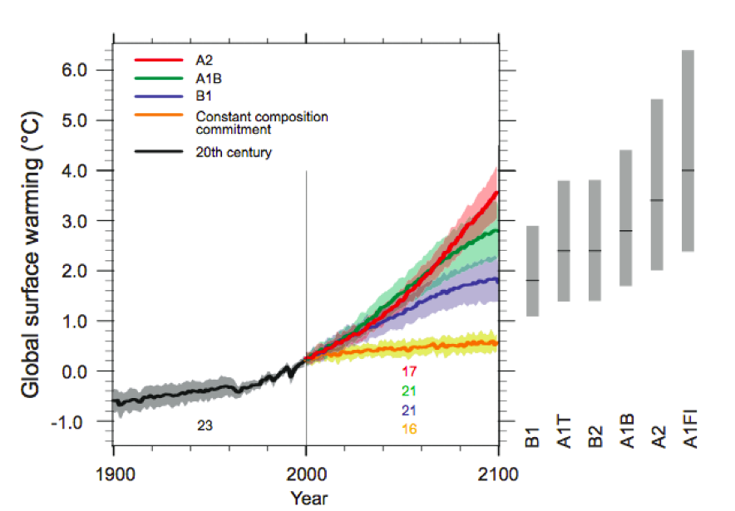
Energy intensive
Balanced fuel sources
More environmentally friendly
Limit to avoid “dangerous anthropogenic
Interference” with the climate system
2ºC limit
IPCC Fourth Assessment Report Summary for Policy Makers

Slide 54
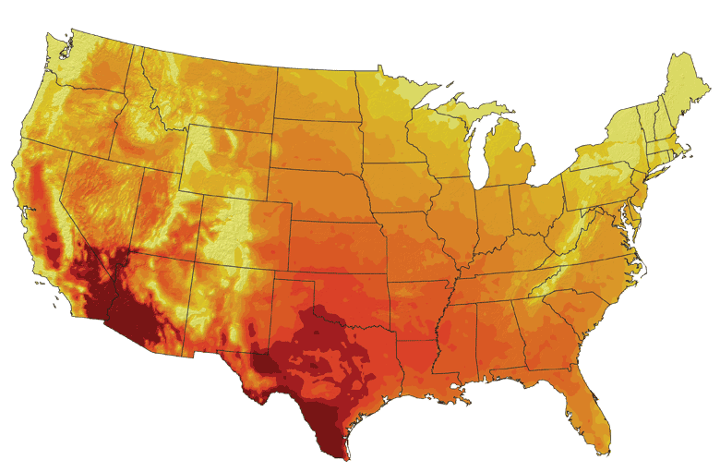
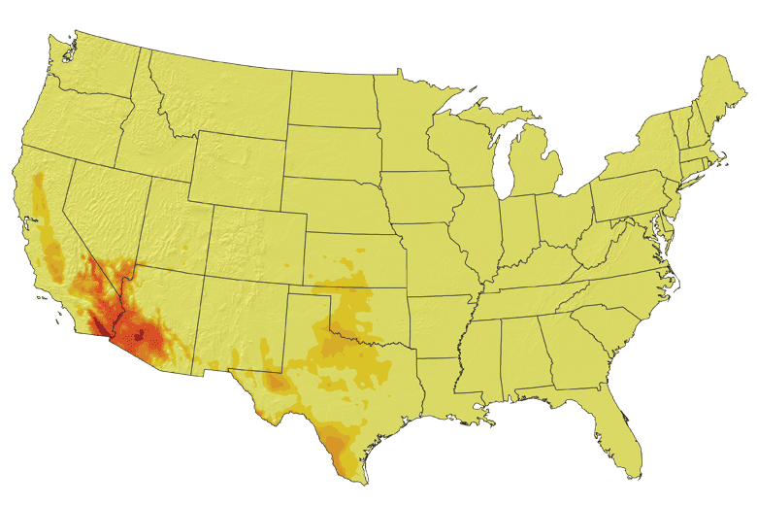
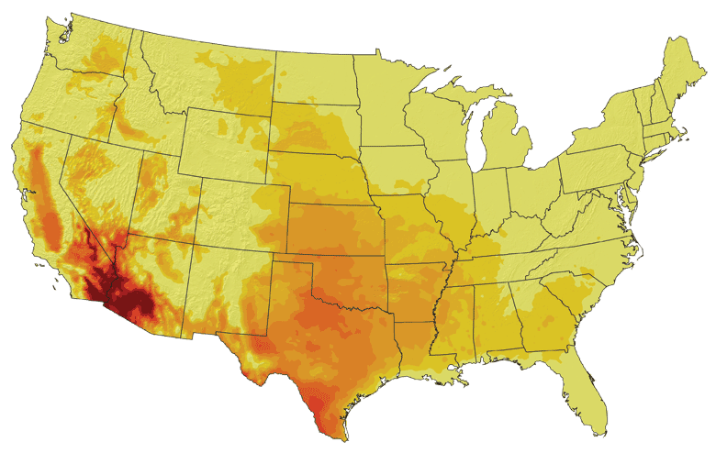
Increases in very high temperatures will have
wide-ranging effects
Higher Emissions Scenario, 2080-2099
Number of Days Over 100ºF
Recent Past, 1961-1979
Average:
30-60 days
Lower Emissions Scenario, 2080-2099
Average:
10-20 days
Don Wuebbles

Slide 55
Rise in global mean temperature (ºC)

Slide 56
Rise in global mean temperature (ºC)

Slide 57
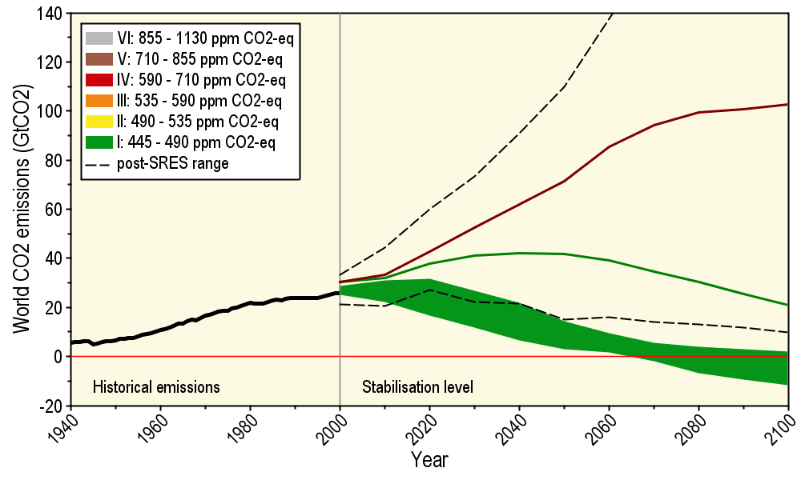
Long-Term Stabilization Profiles
A2
B1
Nebojša Nakićenović IIASA, Vienna

Slide 58
Long-Term Stabilization Profiles
A2
Achieving this emission reduction scenario will provide a 50% chance of not exceeding the 2ºC guardrail
B1
2008
2009
Nebojša Nakićenović IIASA, Vienna

Slide 59
Long-Term Stabilization Profiles
A2
Achieving this emission reduction scenario will provide a 50% chance of not exceeding the 2ºC guardrail
B1
Carbon reductions needed will be 90 times as large
as the impact of the 2009 recession
2008
2009
Nebojša Nakićenović IIASA, Vienna

Slide 60
Summary
Global temperature trends of the 20C cannot be explained on the basis of natural variation alone
Only when the influences of greenhouse gases and sulfate aerosols are included can the trends be explained
Models that explain these trends, when projected into the future, indicate a 1.5-6.5ºC warming over the 21C
Iowa farmers and cities already are paying to cope with climate change
Substantial adverse consequences to food production, fresh-water supplies, and sustainability will occur for temperature increases above 2ºC
The major challenge to our global society is to figure out how to reduce our global dependence on carbon-emitting fuels

Slide 61
For More Information:
Climate Science Program
Iowa State University
http://climate.engineering.iastate.edu/
gstakle@iastate.edu
Iowa Flood Center
University of Iowa
http://www.iowafloodcenter.org/
witold-krajewski@uiowa.edu

