Slide 1
Vulnerability of US Non-Irrigated Commodity Crops to Extremes of Weather and Climate
Eugene S. Takle
Professor
Department of Agronomy
Department of Geological and Atmospheric Science
Director, Climate Science Program
Iowa State University
Ames, IA 50011
US CLIVAR/NCAR ASP Researcher Colloquium
Statistical Assessment of Extreme Weather Phenomena under Climate Change
NCAR Foothills Lab, Boulder, Colorado, USA
June 13-17, 2011

Slide 2
Provocative thoughts
If it weren’t for farmers we would all be hunter-gatherers

Slide 3
Provocative thoughts
If it weren’t for farmers we would all be hunter-gatherers
Farmers allow the rest of us time to sit around and think about statistics and climate change

Slide 4
Provocative thoughts
If it weren’t for farmers we would all be hunter-gatherers
Farmers allow the rest of us time to sit around and think about statistics and climate change
Maybe we should help farmers do their job better (or at least as well as in the past)

Slide 5
Provocative thoughts cont’d
No civilization that depended on irrigation for its food supply has survived.

Slide 6
Provocative thoughts cont’d
No civilization that depended on irrigation for its food supply has survived.
It is our self-interest to assess the impact of climate extremes on rainfed agriculture

Slide 7
Overview
Rainfed agriculture; commodity crops of the Midwest
Production and impacts of technology and weather/climate on trends
Climate extremes
Climate conditions leading to changes from “expected yields”
Recent climate changes and farmer adaptations
Farmer weather-related decision calendar

Slide 8
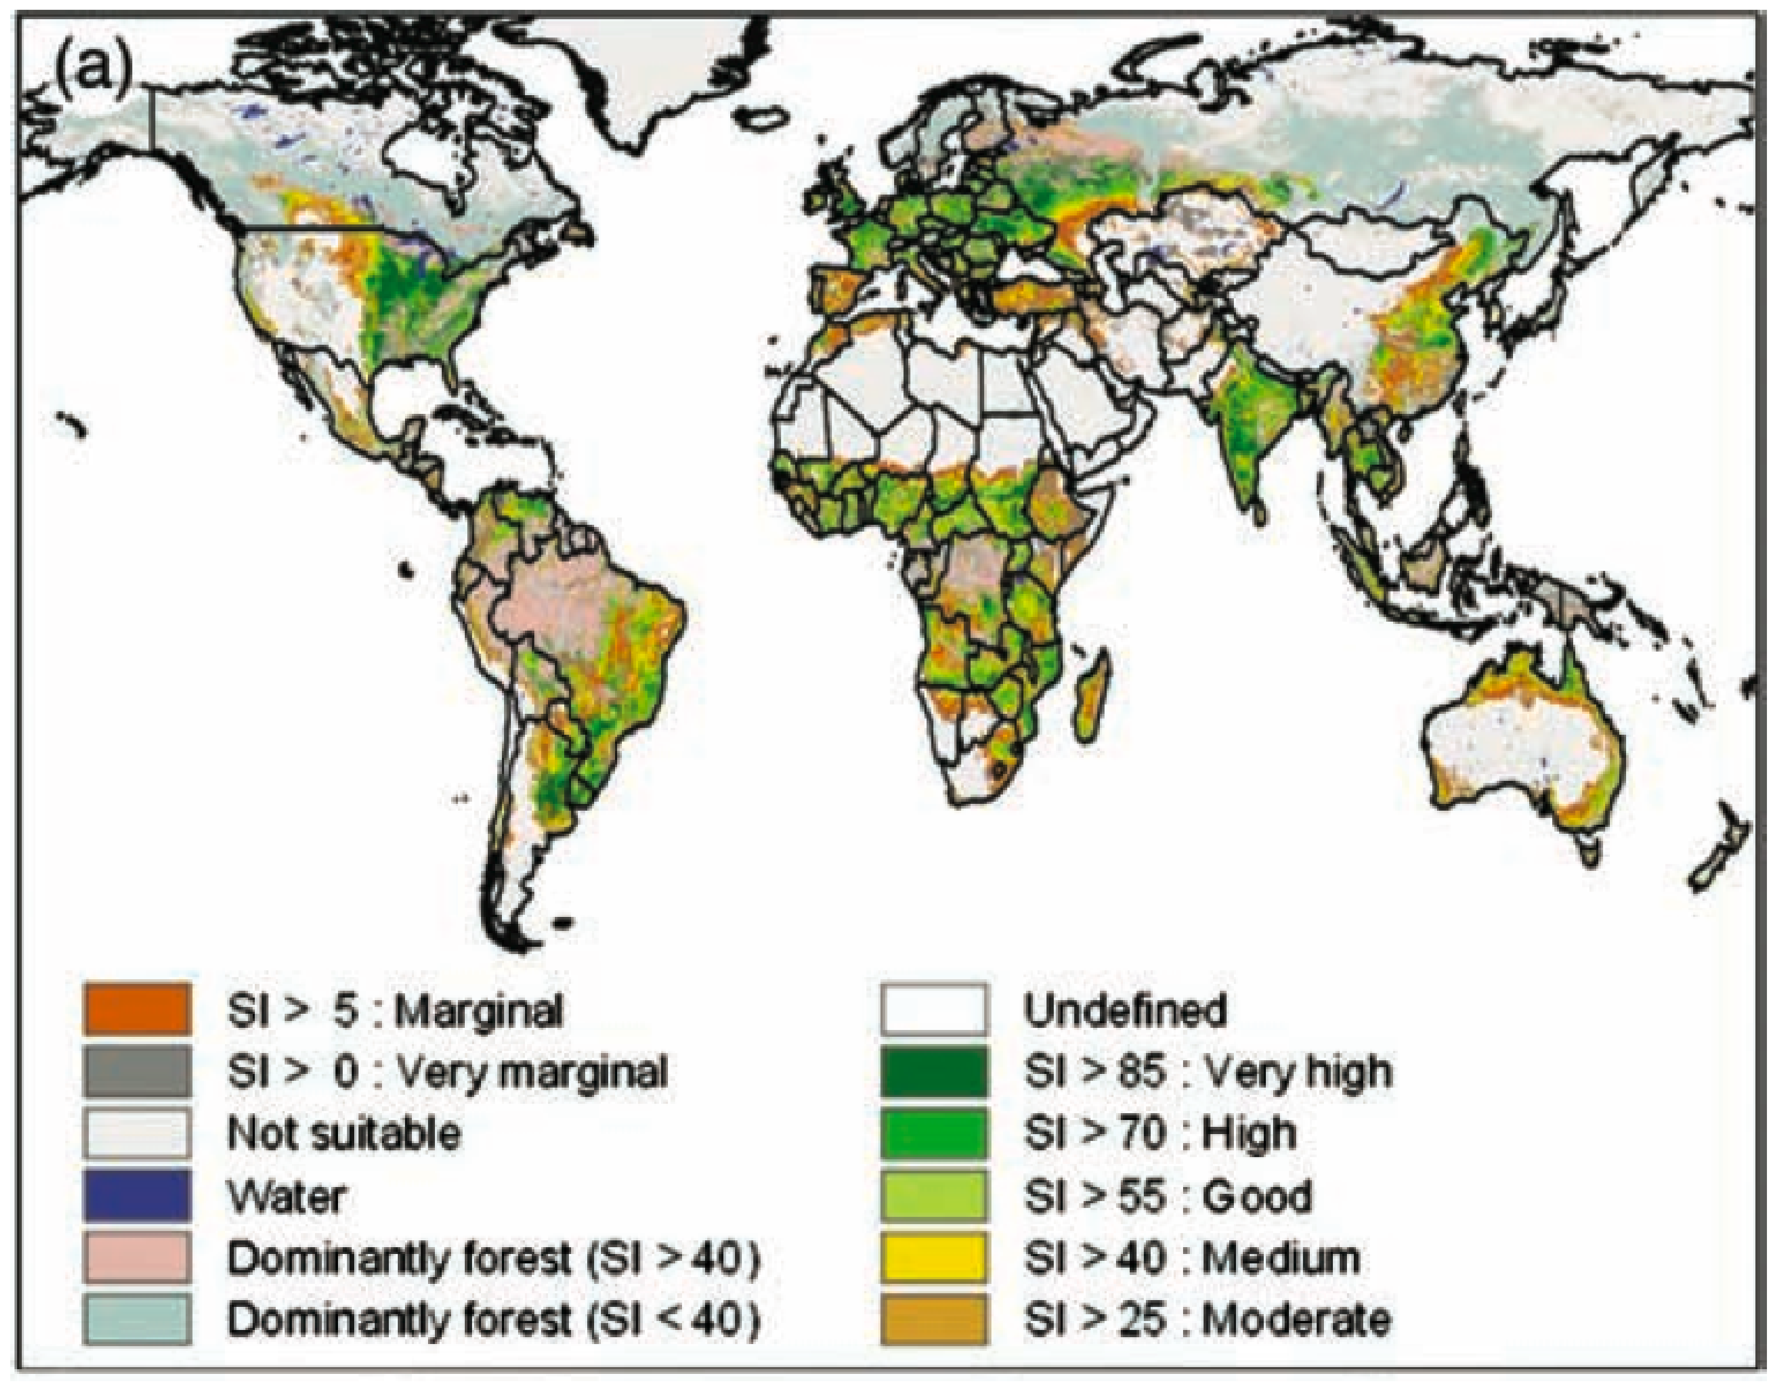
Suitability Index for Rainfed Agriculture
IPCC 2007

Slide 9
Suitability Index for Rainfed Agriculture
IPCC 2007

Slide 10
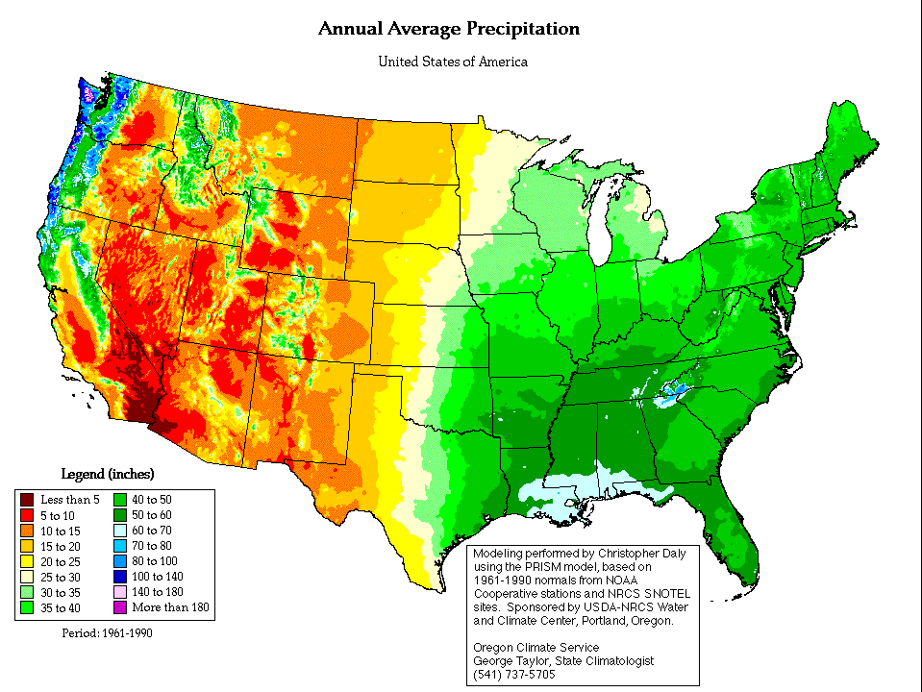
Wheat
Corn and Soybean
US Precipitation climatology

Slide 11
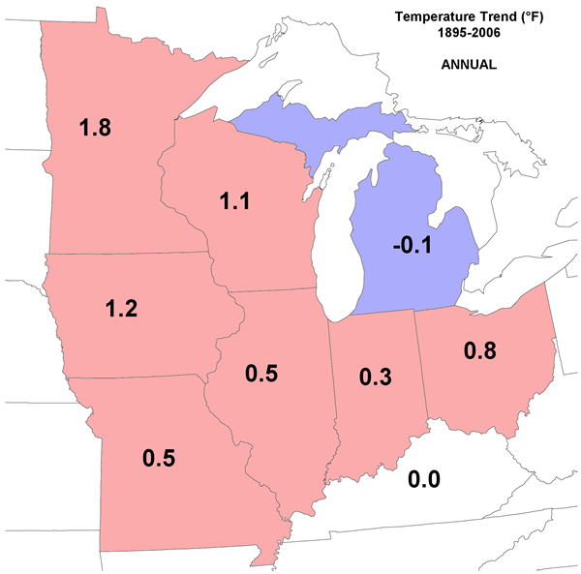
Midwest Regional Climate Center

Slide 12
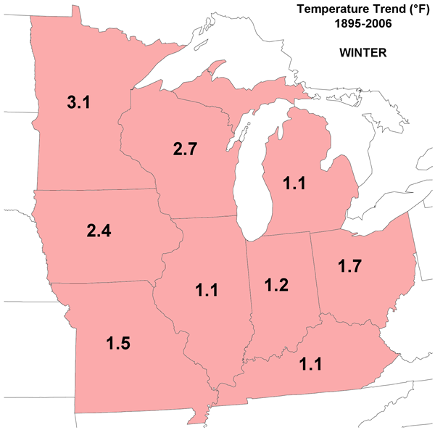
Midwest Regional Climate Center

Slide 13
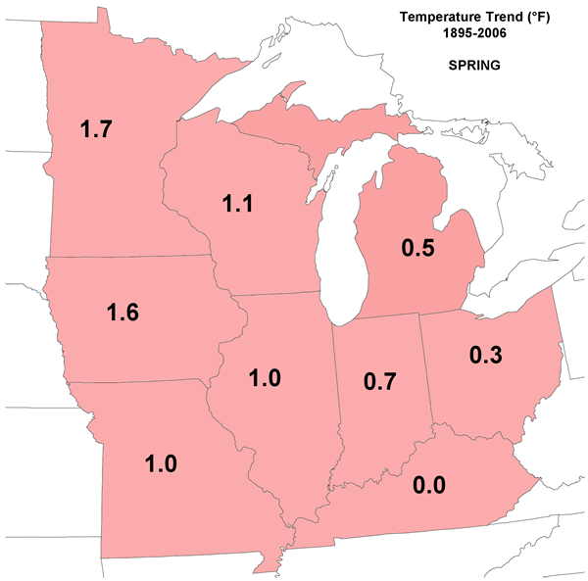
Midwest Regional Climate Center

Slide 14
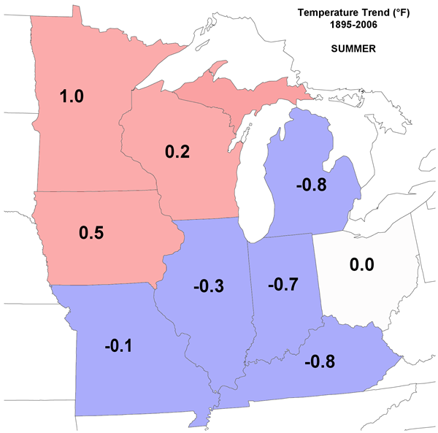
Midwest Regional Climate Center

Slide 15
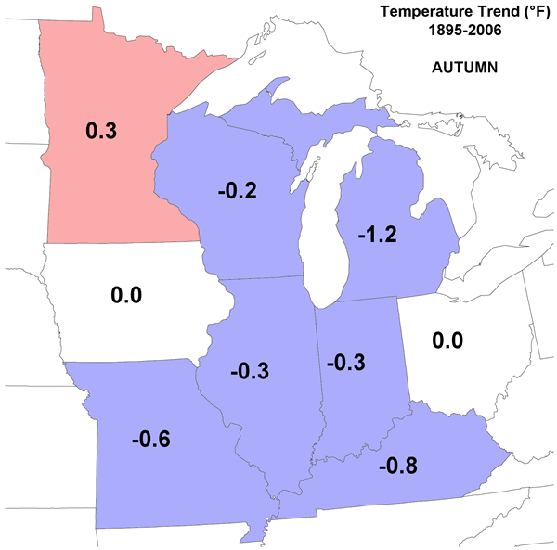
Midwest Regional Climate Center

Slide 16
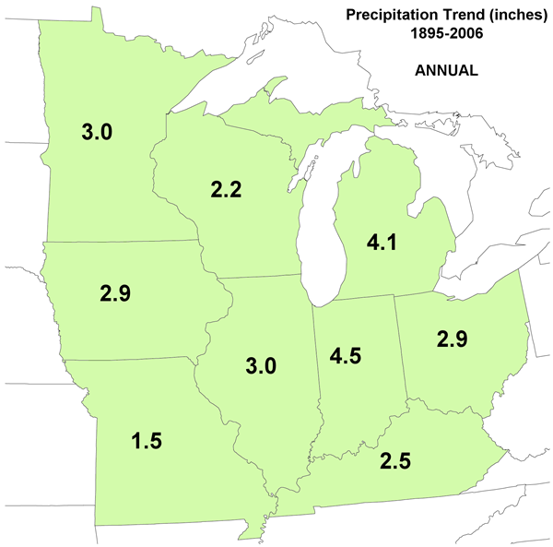
Midwest Regional Climate Center

Slide 17
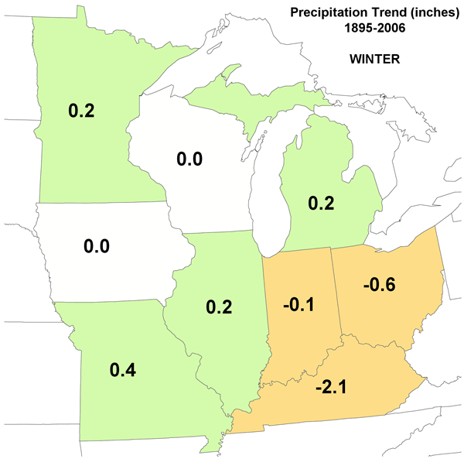
Midwest Regional Climate Center

Slide 18
Midwest Regional Climate Center

Slide 19
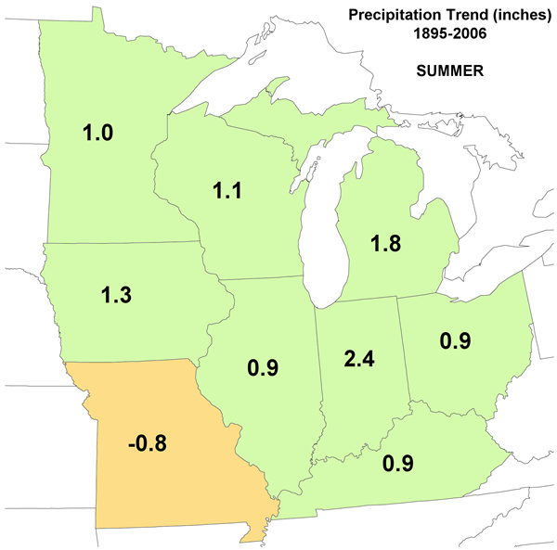
Midwest Regional Climate Center

Slide 20
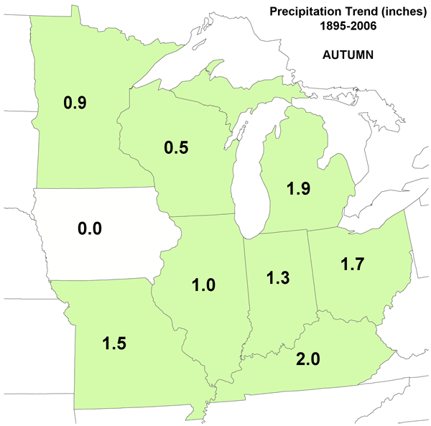
Midwest Regional Climate Center

Slide 21
Commodity Crops
Corn (maize)
Soybean
Wheat
Rice

Slide 23
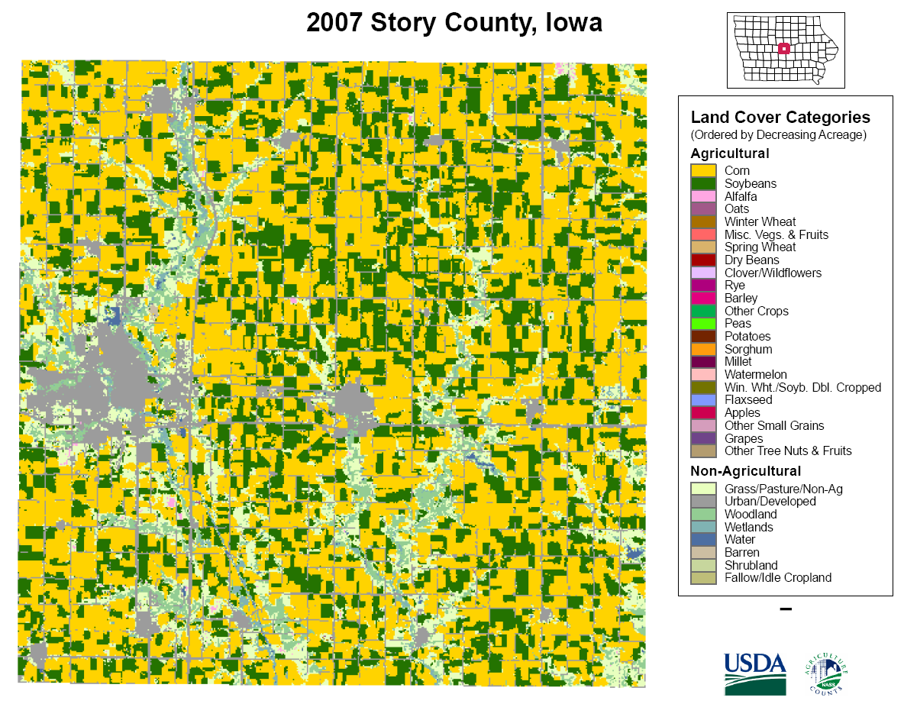

Slide 24
Yield, Bushels per Acre
KR Lamkey

Slide 25
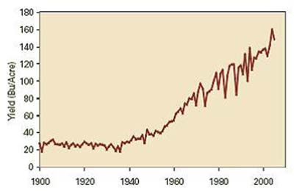
US Corn Yields (Bushels/Acre)
1 bu = 25.5 kg
1 acre = 0.405 ha
1 bu/ac= 63 kg/ha
1.96 bu/ac/y
KR Lamkey

Slide 26
US Annual Corn yields
Chad Hart

Slide 27
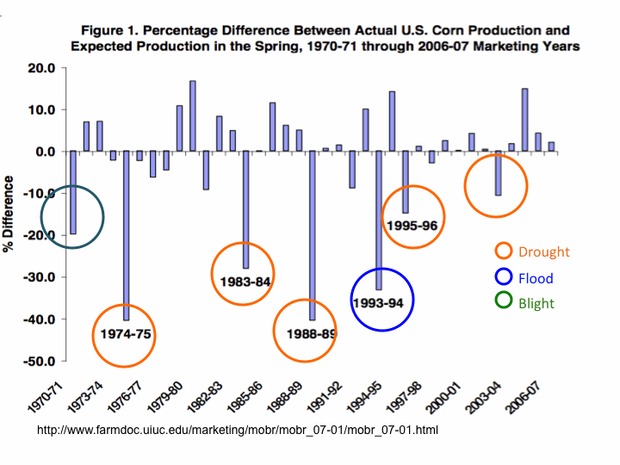
Excess water

Slide 28
Factor Percent
Cold Winter 0.9
Decline in Price 6.6
Drought 35.5
Excess Moist/Precip/Rain 38.4
Flood 2.6
Freeze 0.1
Hail 7.2
Heat 1.2
Hot Wind 0.0
Mycotoxin (Aflatoxin) 1.0
Plant Disease 0.3
Winds/Excess Win 5.0
Other 1.1
Total 100.0
Insured Crop Loss for Corn in Iowa*
*Milliman, Inc., based on 1995-2006 data from the Risk Management
Agency Website (http://www.rma.usda.gov/)

Slide 29
US Annual Wheat yields
Bushels per acre
Chad Hart

Slide 30
US Wheat Yield Deviation from Expected
Chad Hart

Slide 31
US Annual Soybean yields
Bushels per acre
Chad Hart

Slide 32
US Soybean Yield Deviation from Expected
Chad Hart

Slide 33
Insured Crop Loss for Soybeans in Iowa*
Factor Percent
Cold Winter 0.6
Decline in Price 4.8
Drought 56.8
Excess Moist/Precip/Rain 20.2
Flood 1.4
Freeze 0.1
Hail 13.0
Heat 0.9
Hot Wind 0.0
Mycotoxin (Aflatoxin) 0.0
Plant Disease 1.1
Winds/Excess Wind 0.2
Other 1.1
Total 100.0
*Milliman, Inc., based on 1995-2006 data from the Risk Management
Agency Website (http://www.rma.usda.gov/)

Slide 34
Much of the trend and part of reduced interannual variability is due to technology
But not all…

Slide 35
Yield, Bushels per Acre
KR Lamkey

Slide 36
KR Lamkey

Slide 37
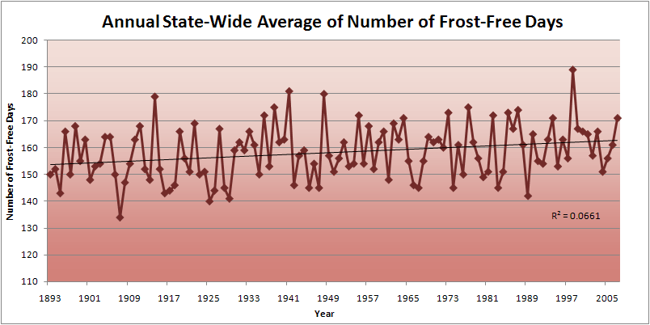
Iowa State-Wide Average Data

Slide 38
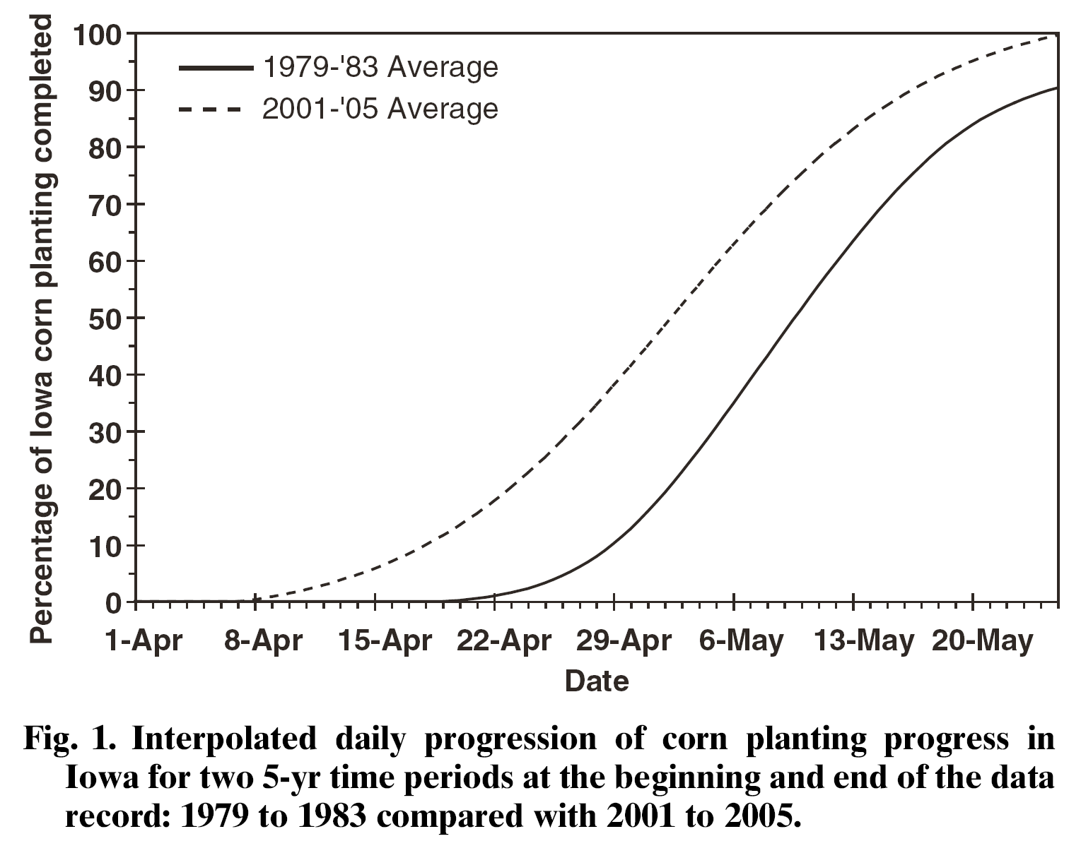
Ave planting date one week earlier
Kucharik. 2006. Agron. J. 98:1544
C Kucharik

Slide 39
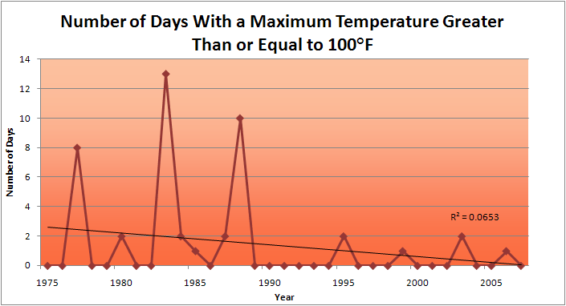
Des Moines Airport Data
1983: 13
1988: 10
1977: 8
2009: 0
2010: 0

Slide 40
Des Moines Airport Data
1983: 13
1988: 10
6 days ≥ 100ºF in the last 22 years
1977: 8
2009: 0
2010: 0

Slide 41
Observed Summer (JJA) Daily Maximum Temperature
Changes (K), 1976-2000
Adapted from Folland et al. [2001]

Slide 42
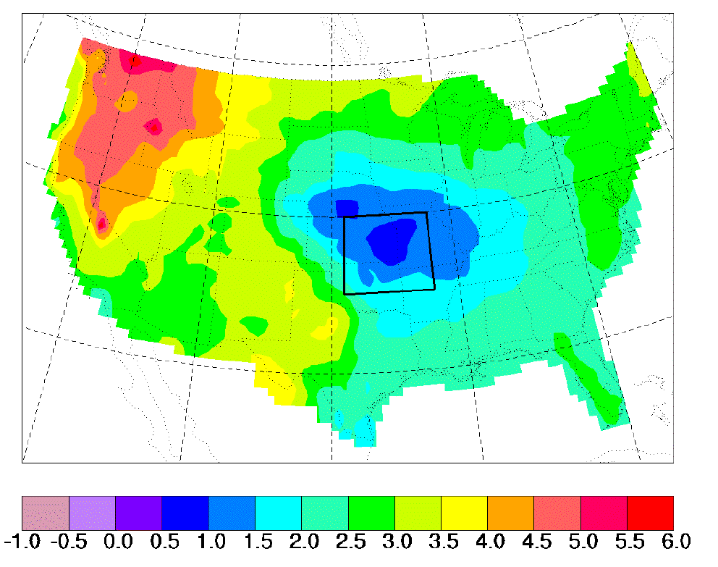
“Warming Hole”: Regional climate model simulations of changes in daily maximum summertime temperatures between 1990s and 2040s
ΔT_{max} (JJA)
˚C
Pan, Z., R. W. Arritt, E. S. Takle, W. J. Gutowski, Jr., C. J. Anderson, and M. Segal,2004: Altered hydrologic feedback in a warming climate introduces a “warming hole”. Geophys. Res. Lett.31, L17109, doi:10.1029/2004GL020528.
Notes:
A feature that corresponds to later 20th century trends. Not seen in GCMs. Linked to mesoscale circulation.

Slide 43
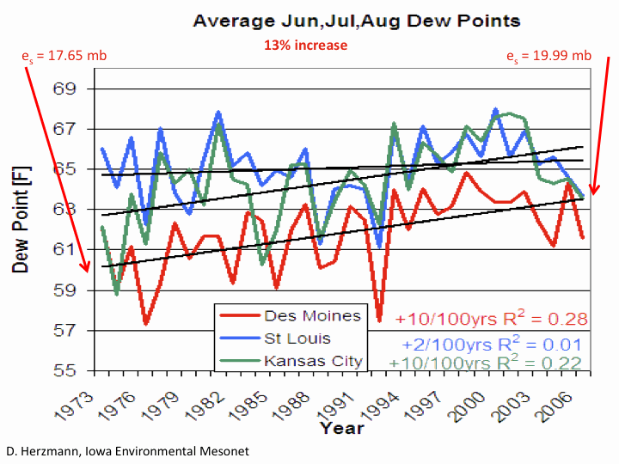

Slide 44
3.5ºF increase in Dew Point Temperature

Slide 46
Something is masking summer expression of the underlying warming

Slide 47
NASA GISS transient model from 1980’s projected little or no warming in summer (Takle and Zhong, 1991)

Slide 48
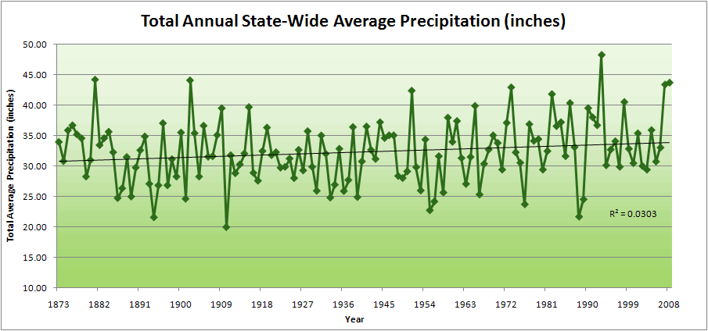
Iowa State-Wide Average Data
Totals above 40”
8 years
2 years
10% increase
30.8”
34.0”

Slide 49
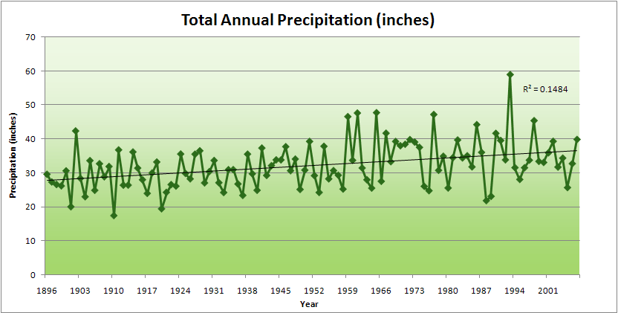
Cedar Rapids Data
Years with more than 40 inches
11
1
28.0”
32% increase
37.0”

Slide 50
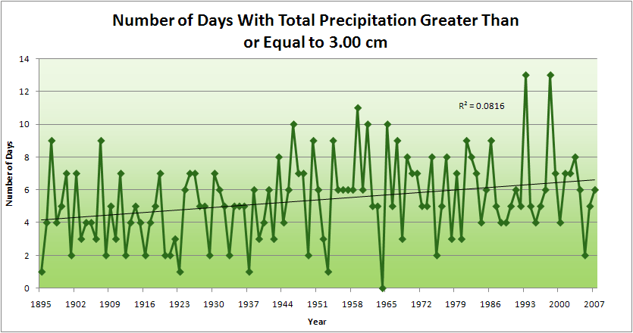
Cedar Rapids Data
1.25 inches
Years having more than 8 days
13
2
4.2 days
57% increase
6.6 days

Slide 51
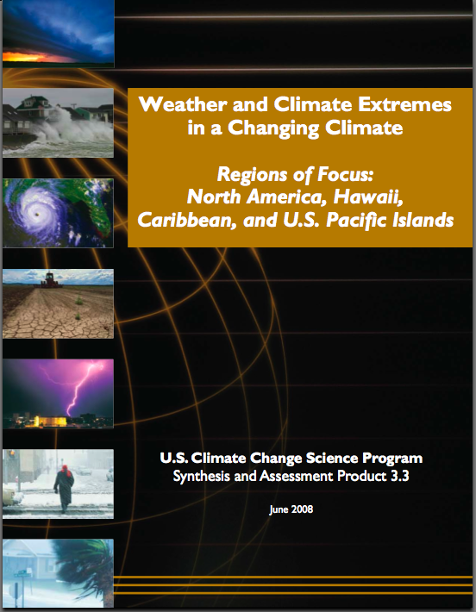
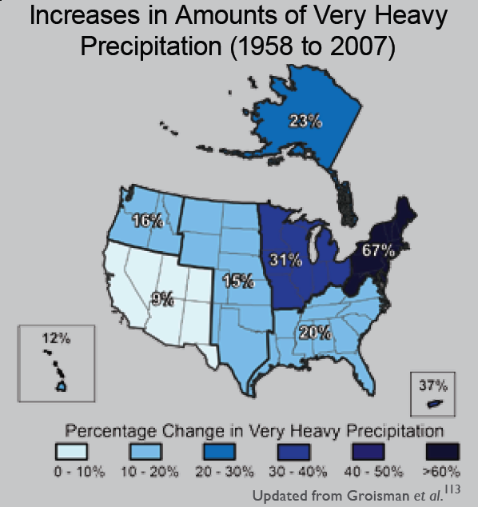
“One of the clearest trends in the United States observational record is an increasing frequency and intensity of heavy precipitation events… Over the last century there was a 50% increase in the frequency of days with precipitation over 101.6 mm (four inches) in the upper midwestern U.S.; this trend is statistically significant “
Karl, T. R., J. M. Melillo, and T. C. Peterson, (eds.), 2009: Global Climate Change Impacts in the United States. Cambridge University Press, 2009, 196pp.

Slide 52
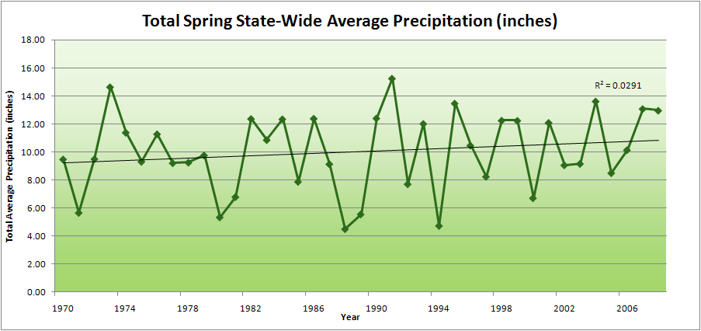
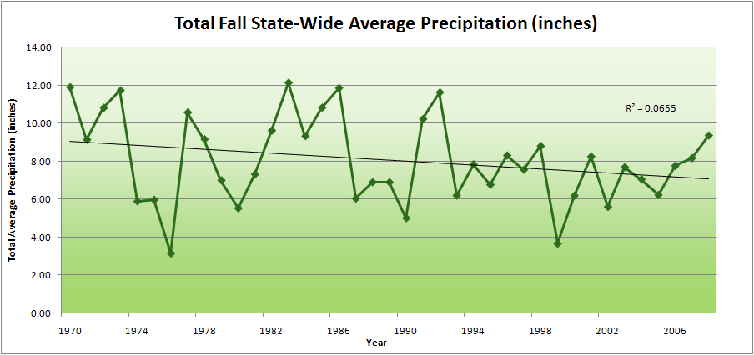
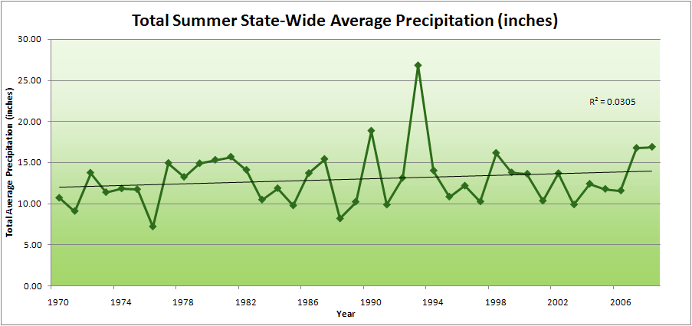
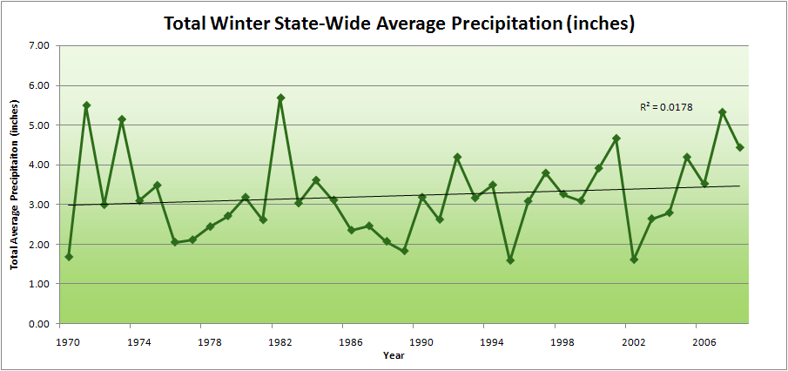
Amplification of the Seasonality of Precipitation
Spring
Fall
21.2 => 25.3 inches (19% increase)
12.1 => 10.5 inches (13% decrease)
Summer
Winter

Slide 53
Amplification of the Seasonality of Precipitation
Spring
Fall
21.2 => 25.3 inches (19% increase)
12.1 => 10.5 inches (13% decrease)
Summer
Winter
NASA GISS model from 1980’s projected little or no warming in summer (Takle and Zhong, 1991)

Slide 55
July Cloud Cover, Des Moines

Slide 56
JJA Cloud Cover, Des Moines

Slide 57
Iowa Agricultural Producers are Adapting to Climate Change:
Longer growing season: plant earlier, plant longer season hybrids, harvest later
Wetter springs: larger machinery enables planting in smaller weather windows
More summer precipitation: higher planting densities for higher yields
Wetter springs and summers: more subsurface drainage tile is being installed, closer spacing, sloped surfaces
Fewer extreme heat events: higher planting densities, fewer pollination failures
Higher humidity: more spraying for pathogens favored by moist conditions. more problems with fall crop dry-down, wider bean heads for faster harvest due to shorter harvest period during the daytime.
Drier autumns: delay harvest to take advantage of natural dry-down conditions
HIGHER YIELDS!!
Is it genetics or climate? Likely some of each.

Slide 58
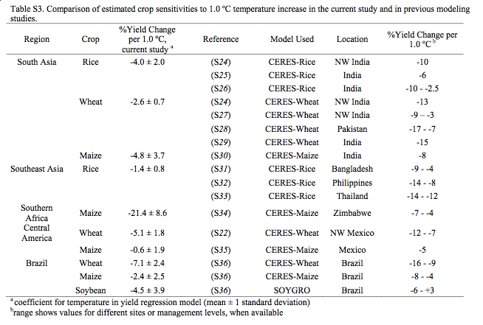
Lobell et al., Science 2008

Slide 59
Ninth Climate Prediction Applications Science Workshop draft report

Slide 60
Ninth Climate Prediction Applications Science Workshop draft report

Slide 61
Issue Met condition Lead time Decision
Soil compaction rain 4/25-5/15 1-2 days to do field work
Hail damage hail occurrence 2 mo ins
Fertilization winter soil T, summer rain 6-9 mo fall/spr appl, amt
Pest managemnt dew duration, multiple stress 6-9 mo chem purch
Field work days rain 4/15-5/15 3-6 mo corn=>soy, mkt
Pollination failure heat 7/15-7/30 6 mo corn=>soy, mkt
Drought extnde heat &no rain, Jun-Aug 6-9 mo corn=>soy, ins, mkt
Freeze T< 0ºC 3-6 mo ins, mkt
Growing deg days T > 10ºC 3-6 mo mkt
Nighttime temp T_{min} consistently > ~20ºC 3-6 mo mkt
Rental agreemnts favorable weather 12 mo change rates
Adaptive mngmnt local climate change 1-3 yr change machinery
Prices global weather 6-12 mo corn⬄soy, mkt
Prices global weather 1-3 yr machinery purchase
Prices global climate 1-3 yr land purchase
Soil erosion heavy precip 1-5 yr conserv. practices
Waterlogged soil increased precip 5-10 yr install subsoil drain tile

Slide 62
For More Information
Contact me directly:
gstakle@iastate.edu
Climate Science Program website:
http://climate.engineering.iastate.edu/
Current research on regional climate and climate change at the ISU Regional Climate Modeling Laboratory:
http://rcmlab.agron.iastate.edu/
North American Regional Climate Change Assessment Program:
http://www.narccap.ucar.edu/
Iowa precipitation analysis and simulation is a collaborative project under funding from the Iowa Flood Center (http://www.iowafloodcenter.org/)
Or just Google Eugene Takle

