Slide 1
CWEX-10/11:
Overview of Results from the First Two Crop/Wind Energy eXperiments
E. S. Takle¹
D. A. Rajewski¹, J. Prueger², Steven Oncley³, J. K. Lundquist⁴, Thomas W. Horst³,
Michael E. Rhodes⁴, Richard Pfeiffer², Jerry L. Hatfield², Kristopher K. Spoth¹, Russell K. Doorenbos¹
¹Iowa State University, ²National Laboratory for Agriculture and the Environment, ³National Center for Atmospheric Research, ⁴University of Colorado/NREL

Slide 2
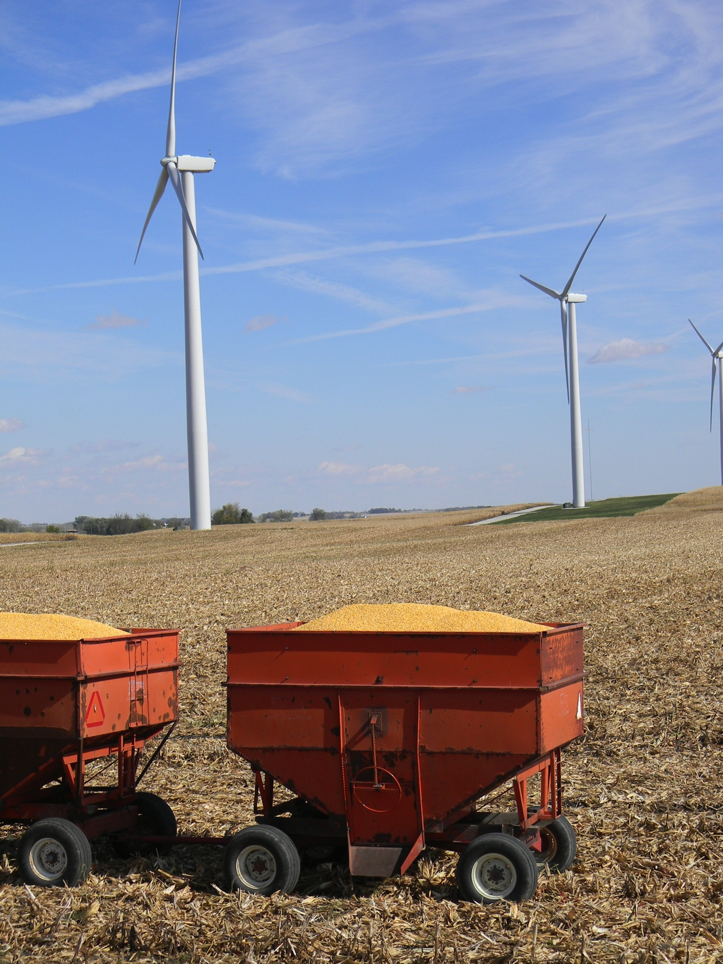
Outline
Conceptual framework for wind farm studies
Site description
Microclimate measurements in corn fields
Science and engineering research objectives
Future plans

Slide 3
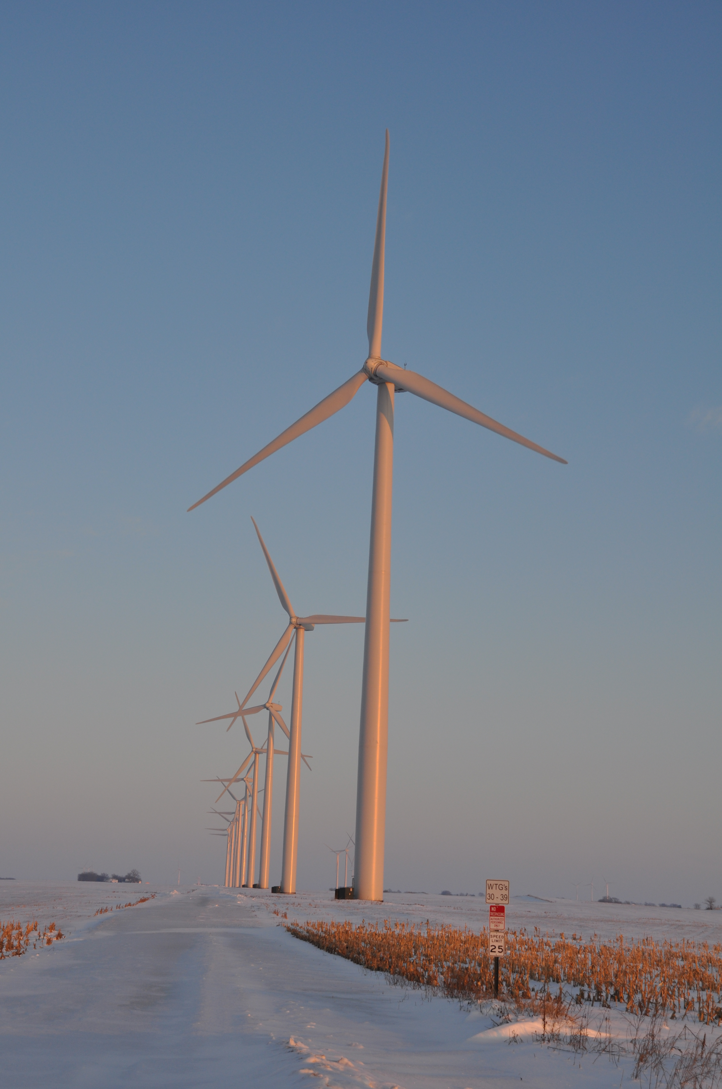
Turbine-Crop Interactions:
Overview
Do turbines create a measureable influence on the microclimate over crops?
If so, does this influence create measureable biophysical changes?
And if this is so, does this influence affect yield?
Agricultural shelterbelts have a positive effect on crop growth and yield.
Will wind turbines also have a positive effect?
Photo courtesy of Lisa H Brasche

Slide 4
Conceptual model of turbine-crop Interaction via mean wind, perturbation pressure, and turbulence fields
(based on shelterbelt studies of Wang and Takle, 1995: JAM, 34, 2206-2219 )
1995)
over-speeding zone
turbine wake
H
L
wind-ward
reduction zone
Heat
H₂O
CO₂
day
night
leeward ‘bleed’ through and speed up-zone
H
L
night
…….............................................................................................................................................
……..................
Site 1
Site 2
Site 3
Notes:
This is the most updated version of the schematic

Slide 5
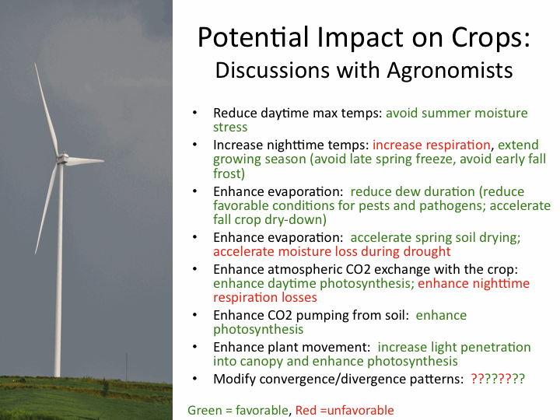
Photo courtesy of Lisa H Brasche

Slide 6
CWEX10 Field Experiment
Iowa utility-scale wind farm (200-turbines)
Southern edge of a wind farm
Corn-soybean cropping pattern (measurements made in corn)
26 June – 7 September 2010; turbines off 0700 LST 26 July – 2300 LST 5 Aug 2300
4 Eddy Covariance flux towers (NLAE)
NREL/CU Lidar (J. Lundquist) (28 June-9 July)

Slide 7
CWEX11 Field Experiment
Same location
Measure from June-August
Six measurement stations (instead of 4); four provided by National Center for Atmospheric Research
Two lidars (one upwind, one downwind of turbine line) provided by J. Lundquist, CU
Wind Energy Science, Engineering and Policy Research Experience for Undergraduates (REU) students involved

Slide 9
Prevailing Wind Directions:
South (SE-S-SW) in Summer; NW (WNW-NW-NNW) in Winter

Slide 10
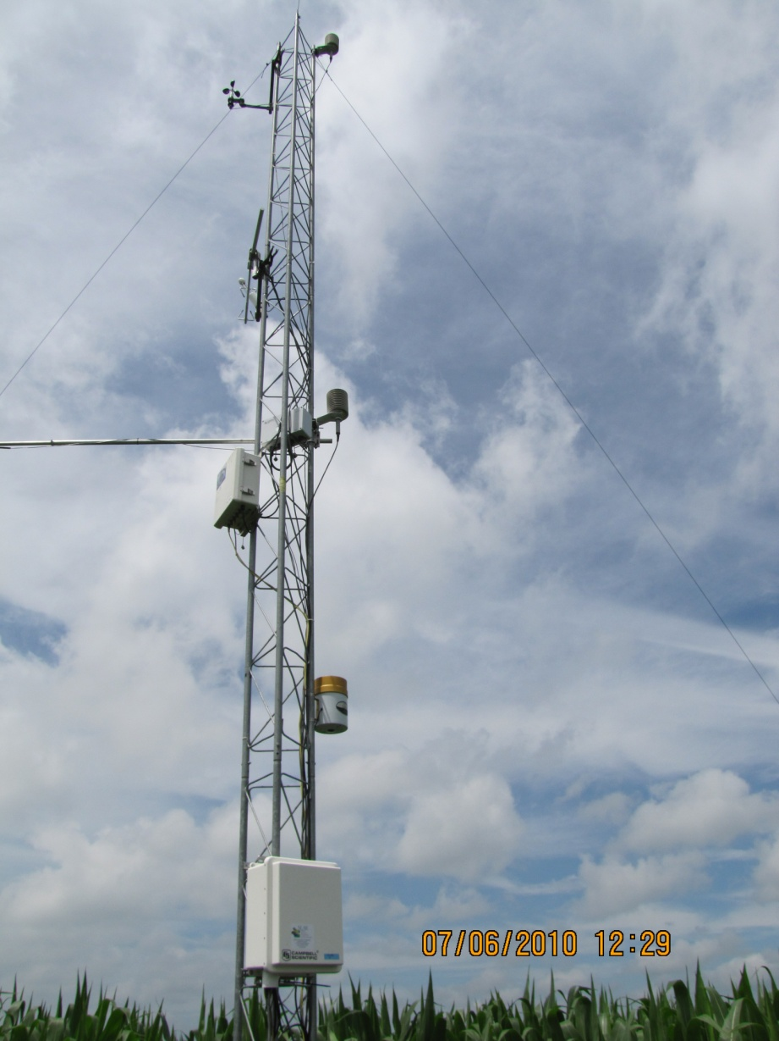
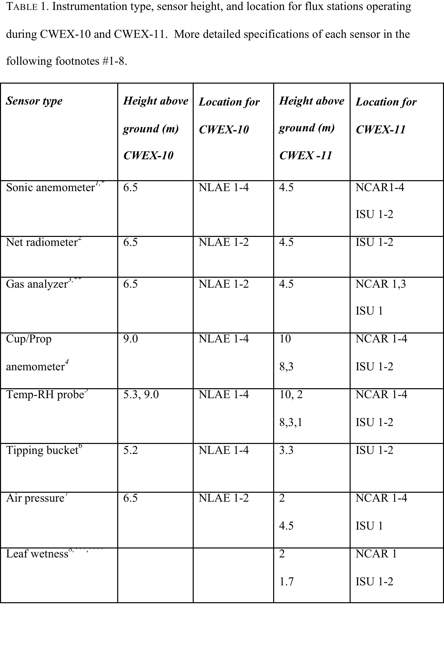

Slide 11
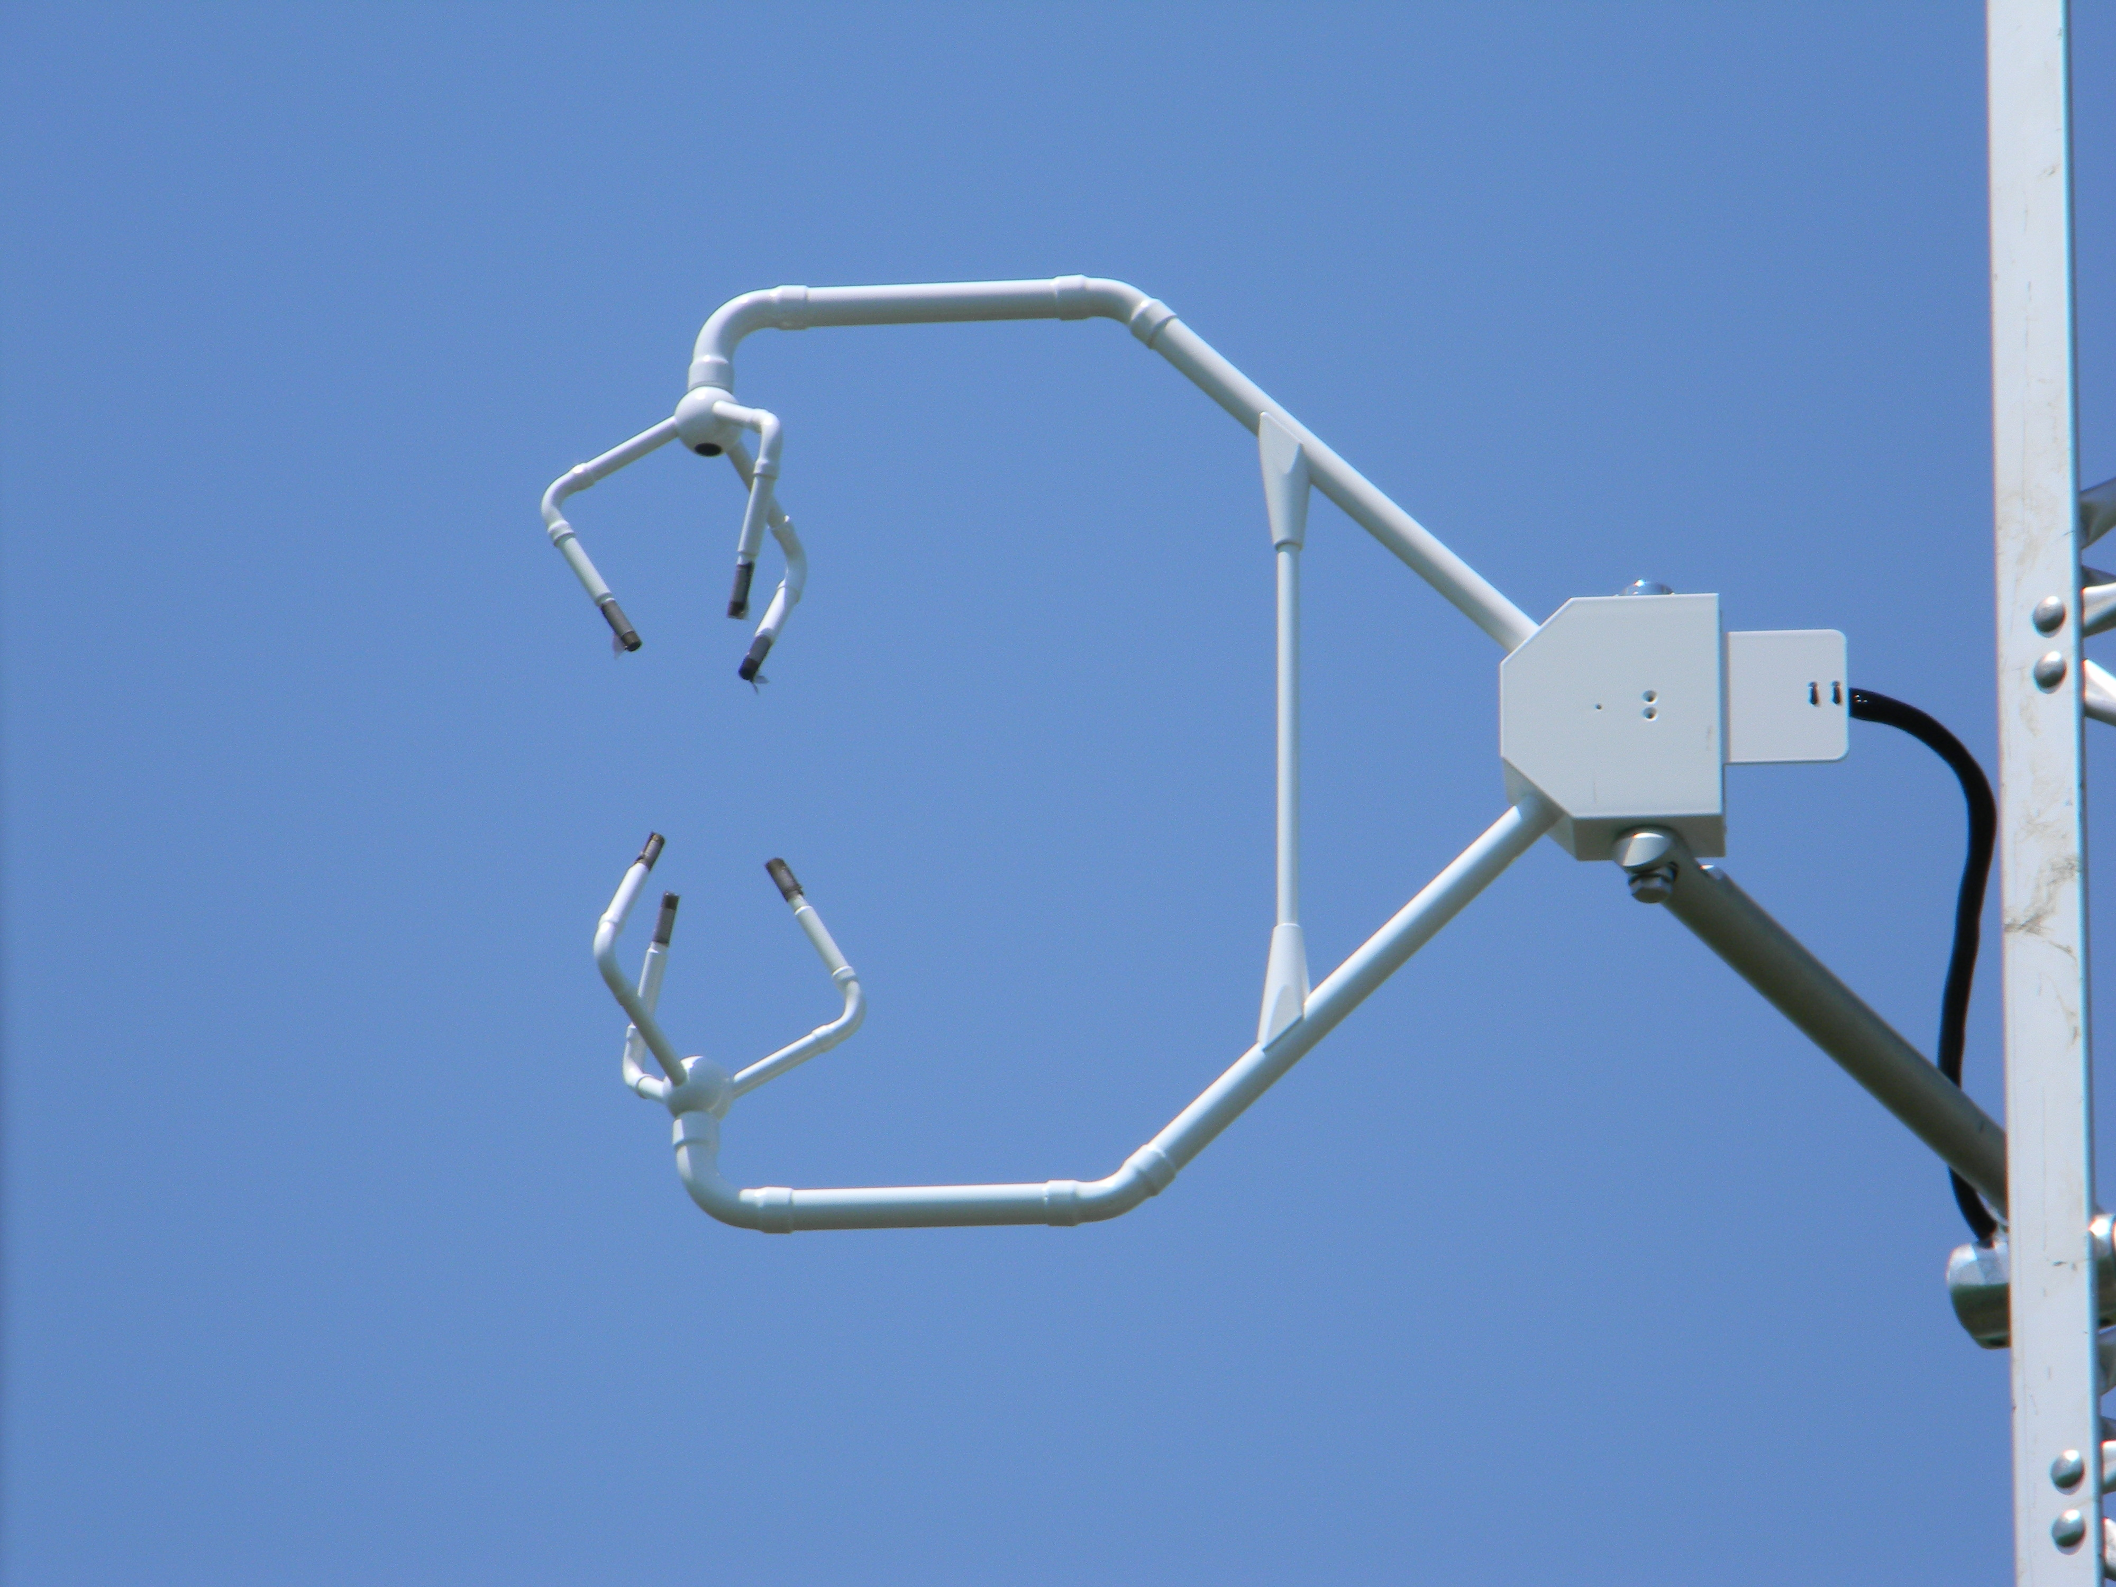

Slide 12
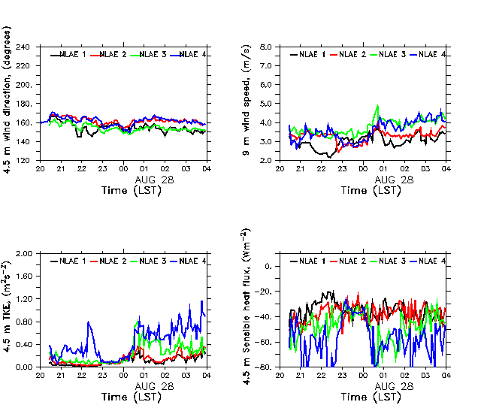
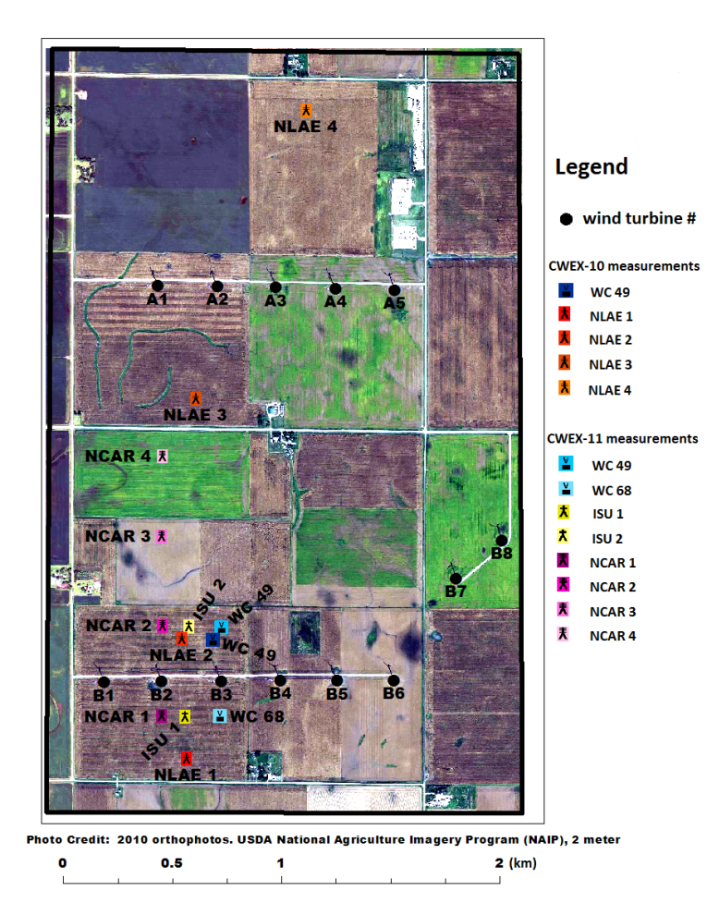
Turbines offline:
August 27, 2010 2300-0000 LST
Station north of two turbine lines has 2-3X ambient TKE and Heat flux before/after OFF period
80-m wind direction
vector
Return to reference flow
conditions during the shut
down

Slide 13
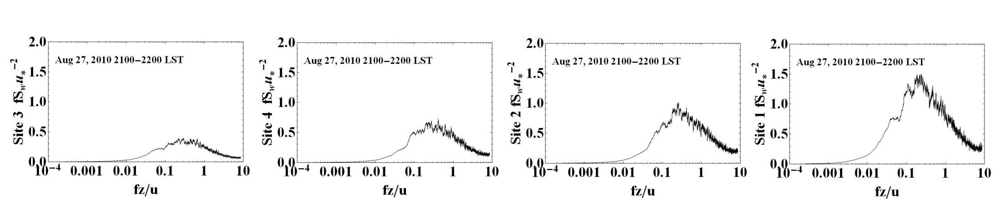
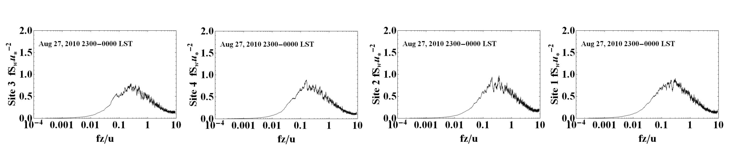
Spectral evidence before and during the shutdown period
W-power spectra
South → North
Turbines ON
NLAE 1
NLAE 2
NLAE 3
NLAE 4
South → North
Turbines OFF
NLAE 1
NLAE 2
NLAE 3
NLAE 4
ON: Increase in vertical velocity variance of: 2.0X downwind of first line of turbines
5.0X downwind of two lines of turbines
OFF: Similar intensity of variance for all flux stations south and north of two turbine lines

Slide 14
Nighttime Conditions Reveal Turbine Influences
Wind Speed
Turbulence Kinetic Energy
Temperature
Heat Flux

Slide 15
Conceptual model of turbine-crop Interaction via mean wind, perturbation pressure, and turbulence fields
(based on shelterbelt studies of Wang and Takle, 1995: JAM, 34, 2206-2219 )
1995)
over-speeding zone
turbine wake
H
L
wind-ward
reduction zone
Heat
H₂O
CO₂
day
night
leeward ‘bleed’ through and speed up-zone
H
L
night
…….............................................................................................................................................
……..................
Site 1
Site 2
Site 3
Notes:
This is the most updated version of the schematic

Slide 16
Turbine Influence on Surface Fluxes
2010 NLAE Instruments (6.45 m)
2011 NCAR Instruments (4.50 m)
Same maize field
Different maize fields
Daytime fluxes
  Sensible heat: <2%
  Latent heat: <2%
  CO₂ : -15% (higher uptake)
Nighttime fluxes
  Sensible heat: -2 to -4% (warms crop)
  Latent heat: +10-20% (less dew)
  CO₂: +10% (more respiration)
Net ecosystem exchange*
  +18-20% (increased uptake by crop)
Daytime fluxes
  Sensible heat: +5% (cools crop)
  Latent heat: +3 to +4% (dries crop)
  CO2: -5 to -10% (higher uptake)
Nighttime fluxes
  Sensible heat: -5-15% (warms crop)
  Latent heat: -20-30% (more dew)
  CO₂: +5 to -5% (indeterminate)
Net ecosystem exchange*
  +10% (increased uptake by crop)
* Soil respiration not included
Notes:
Same as what was shared at Nov 29 EPSCoR meeting

Slide 17
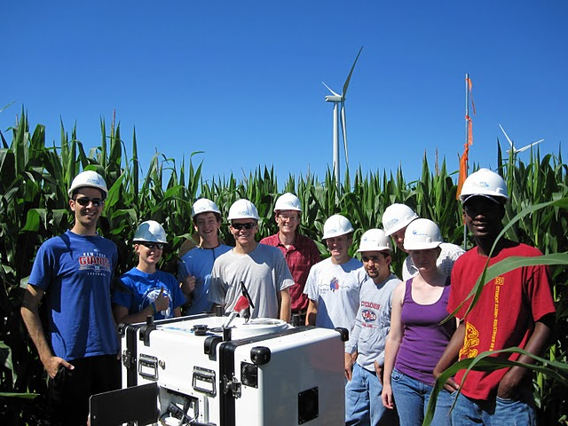

Slide 18
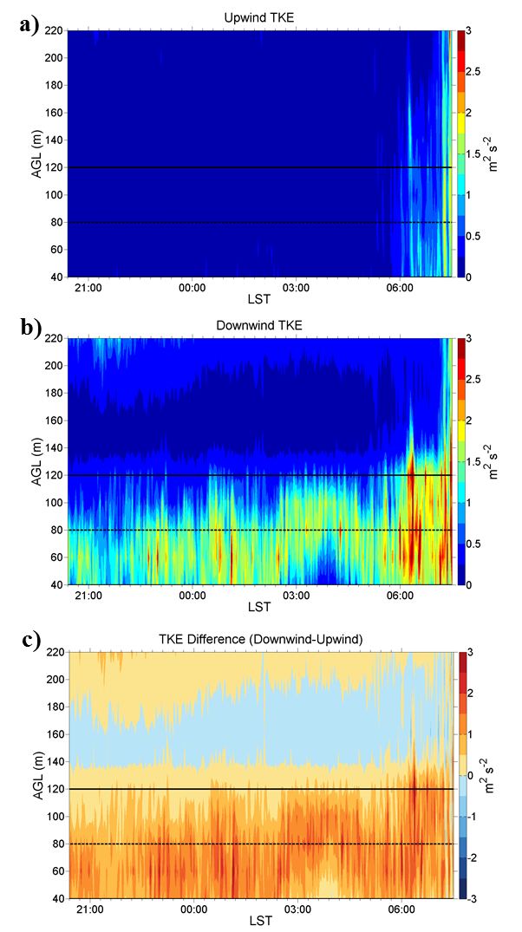
Vertically Pointing Lidar
Vertical profiles of turbulence kinetic energy (TKE)
16-17 July 2010
4.5 D South of B-turbines
Rotor Layer
2.0 D North of B-turbines
CU/NREL/ISU Lidar deployment team
TKE difference

Slide 19
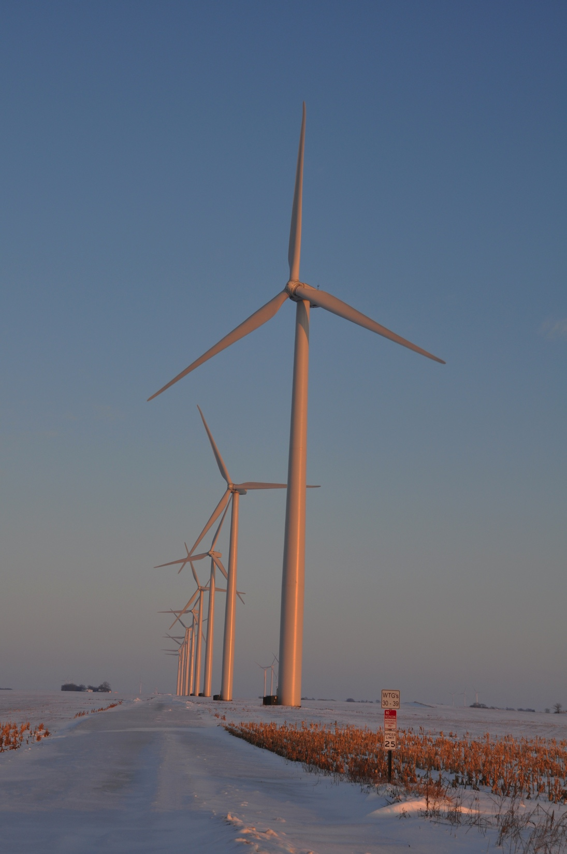
Projects in Progress
Aerodynamic characteristics of large wind farms
Wind Ramp Events at Turbine Height – Spatial Consistency and Causes at two Iowa Wind Farms (Walton, Gallus, Takle poster; Walton REU paper)
Influence of Wind Turbines on Atmospheric Stability and Dew Duration (Lauridsen senior thesis)
Balloon-borne measurements in a wind farm (Matson MS project in progress)
Comparison and Analysis of Wind Turbine Wake Interactions (Flowers summer SULI project)
Constructing low-dimensional stochastic wind models from meteorology data (Guo, Rajewski, Takle, Ganapathysubramanian, submitted to Wind Energy)

Slide 20
Measuring Wind Speed, Wind Direction, Temperature, and Turbulence with a Tethered Balloon

Slide 21
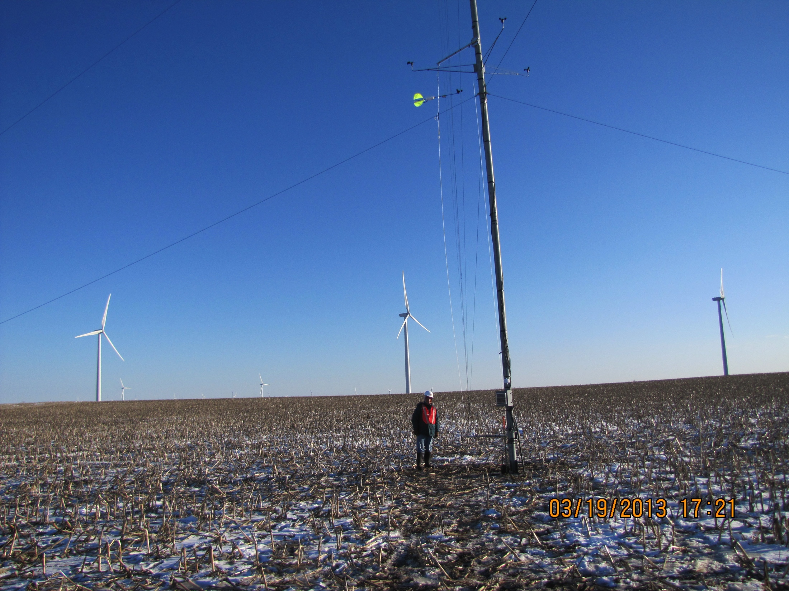

Slide 23
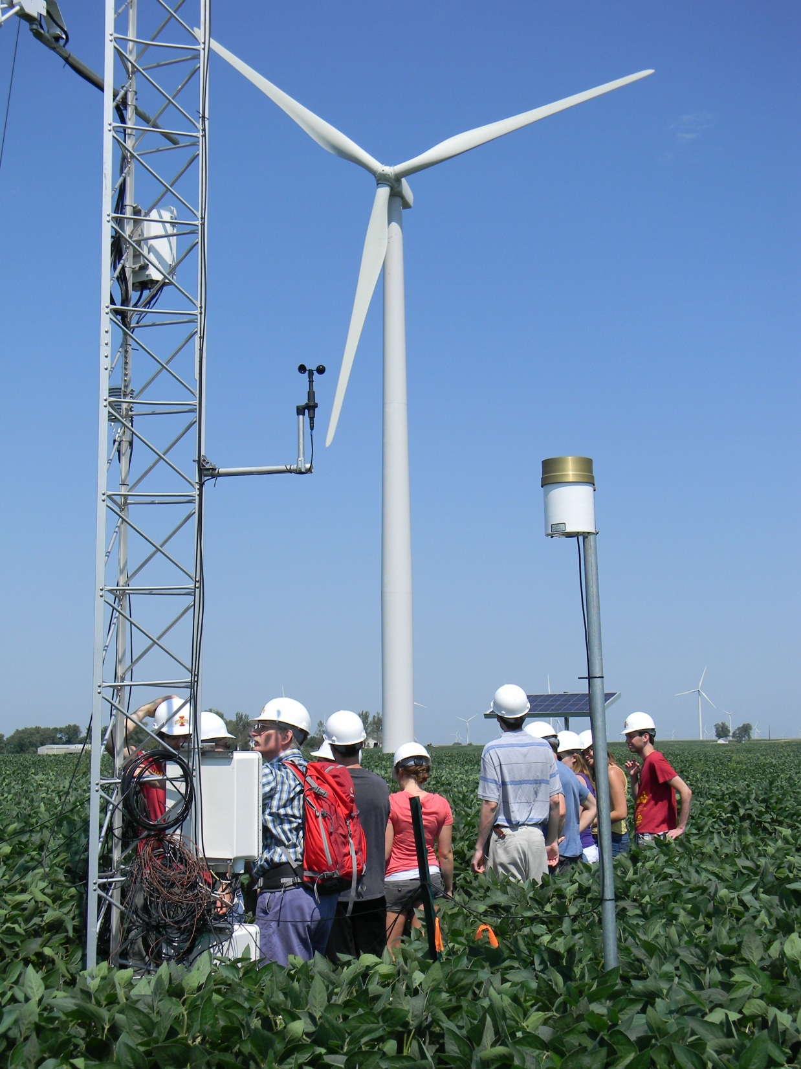
CWEX Supports Research, Education, Industry Engagement, and Outreach
Wind Energy Science Engineering and Policy IGERT (an NSF Integrative Graduate Education and Research Traineeship PhD program admits up to 10 PHD students per year for 5 years)
Wind Energy Science Engineering and Policy REU (an NSF Research Experiences for Undergraduate 10-week summer program for 10-15 undergraduate students)
Harnessing Energy Flows in the Biosphere (an NSF EPSCoR program for building research infrastructure in renewable energy, including multiple outdoor wind energy measurement venues)

Slide 24
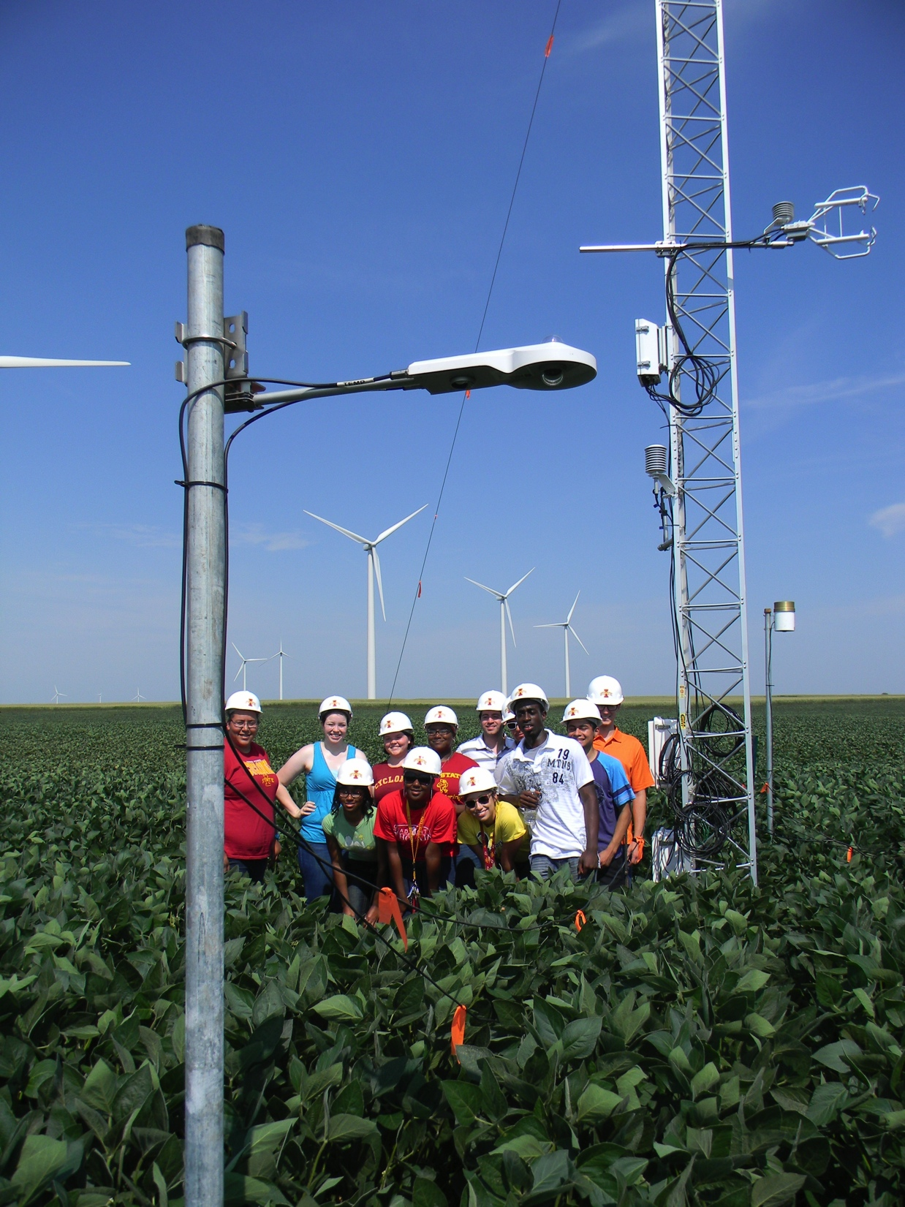
CWEX Science and Engineering Objectives
Turbine-crop interactions
Wind-farm internal aerodynamics (pressure forcing, vertical exchange processes, thermal stratification, anisotropic turbulence, vertical shear of speed and direction)
  Near-turbine flow field environment
  Individual turbine wakes (elevated, surface based)
  Multiple turbine wakes (rotor layer vs turbine layer)
Mesoscale interactions
  Surface convergence
  Wind-farm/boundary-layer interactions
  Vertical velocities
  Interaction with nocturnal low-level jet
  Downwind influence (lateral extent of wind farm footprint)
  Influence on cloud/fog formation

Slide 25
Measurements Needed
Additional surface flux measurements (middle of wind farm)
Surface pressure field across turbine line
Vertical profiles of horizontal velocity through the turbine layer (H)
Horizontal velocities across the wind farm (convergence?)
Turbulence in and above the turbine layer with the layer above (H-2H); also vertical velocity above the turbine layer
Diurnal changes of u, T, RH, turbulence in H-10H
Low-level jet characteristics

Slide 26
Analysis Needed
Surface flux anomalies
Wake structure – dependence on stability, speed and direction shear
Coupling of the turbine layer with the layer above (H-2H)
Horizontal convergence in the H layer
Diurnal changes in H-10H
Low-level jet characteristics

Slide 27
Modeling Needed
Diurnal changes of surface fluxes
Coupling of the turbine layer with the layer above (H-2H)
Horizontal convergence in the H layer
Diurnal changes in H-10H
Low-level jet characteristics
Turbine-turbine interactions (wake characteristics)
Shear and turbulence coupling to blade stresses

Slide 28
Current Status:
Instrumentation
Installation of two 120-m instrumented towers
Expanded network of surface stations
Nanobarometer network
Short-term exploratory studies with tethered balloon measurement platform, 50-m towers and sodars

Slide 29
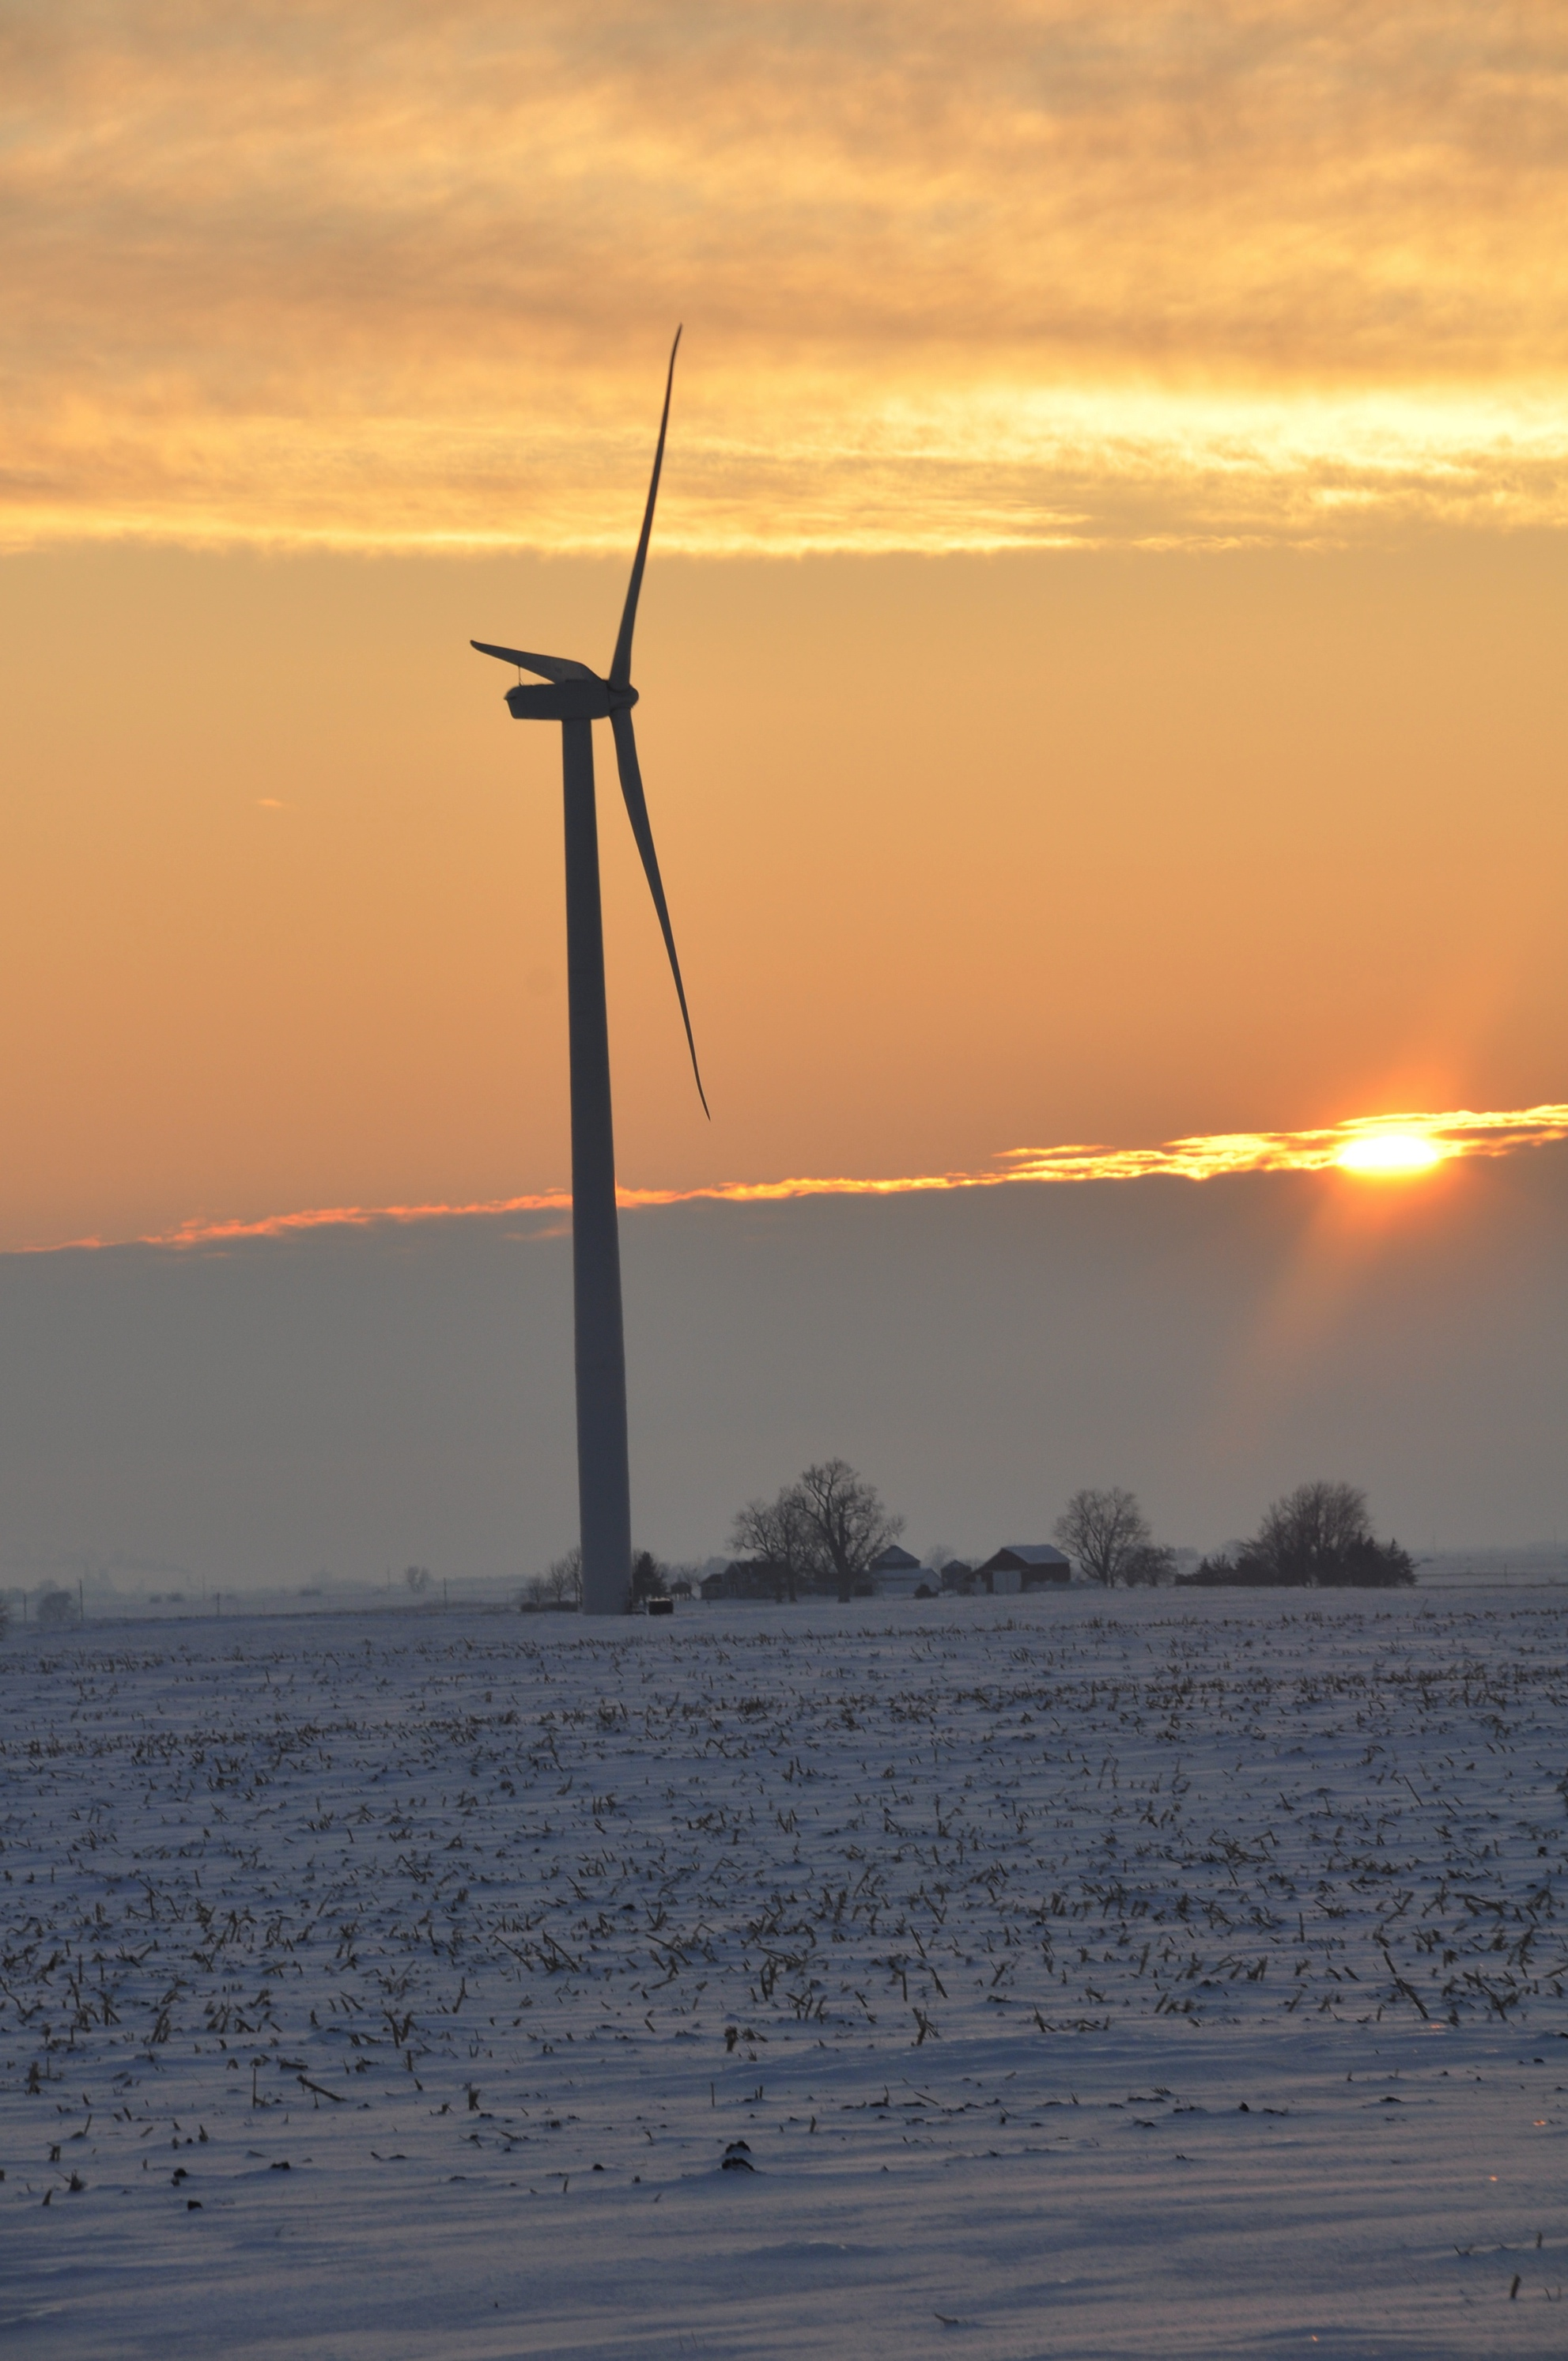
For More Information
Eugene S. Takle
gstakle@iastate.edu
http://www.meteor.iastate.edu/faculty/takle/
515-294-9871
This material is based on work supported in part by the National Science Foundation under Grant Number EPS-1101284.
Photo courtesy of Lisa H Brasche

